Slide 1
Five Forces
A2 Business

Slide 2
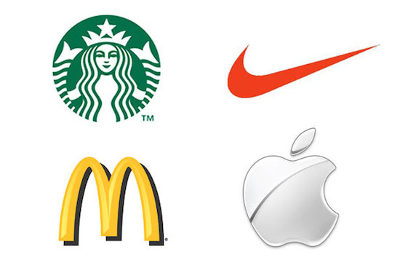
What type of Marketing Strategy have these adopted?

Slide 3
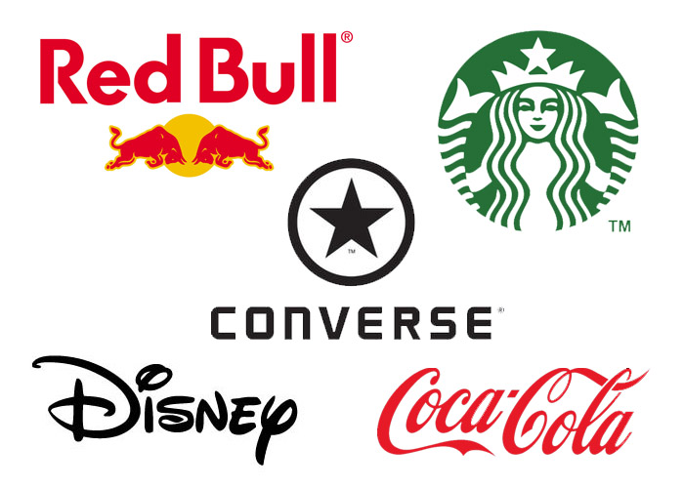
What type of Marketing Strategy have these adopted?

Slide 4
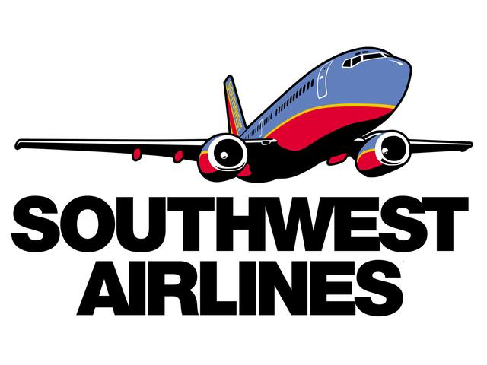
How about?

Slide 5
Lesson Objectives
All – know Porter’s Five Forces
All – explain the Five Forces Model
Most – Use examples to show understanding of the Five Forces Model

Slide 6
What is it?
The model is a framework for analysing the nature of competition within an industry.
Every market or industry is different.

Slide 7
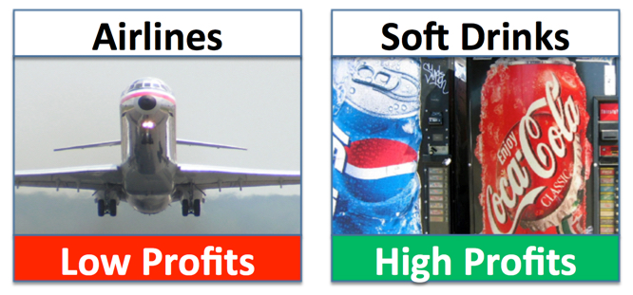
Examples

Slide 8
Why do airlines make so little profit (and such big losses)?
Very intensive competitor rivalry – mainly on price
Low barriers to entry – lots of new airlines who want to set up
Suppliers of aircraft & equipment are powerful – can charge high margins
Customers have lots of substitute options – e.g. rail, car
High fixed costs – airline losses rise significantly if revenues fall only slightly since it costs roughly the same to fly half-empty planes as full ones

Slide 9
Soft Drinks
why are profits so high in the soft drinks market?
Customers and suppliers have little power
There is high brand awareness & loyalty
High barriers to entry – how do you enter a market dominated by Coca-Cola and Pepsi?

Slide 10
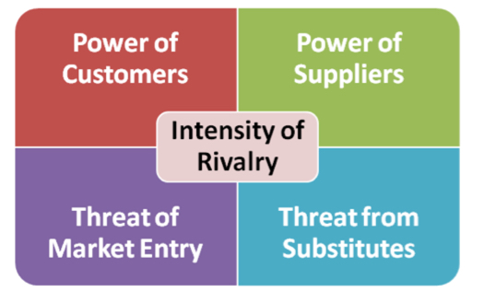

Slide 11
Porter identified five factors
Threat of new entrants to a market
Bargaining power of suppliers
Bargaining power of customers ("buyers")
Threat of substitute products
Degree of competitive rivalry

Slide 12
Activity
Porter’s Five Forces Worksheet

Slide 13
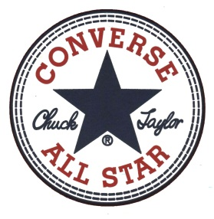
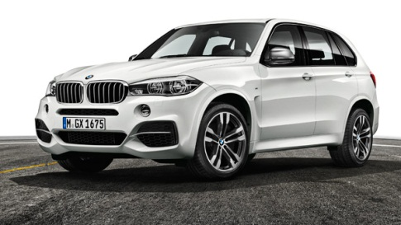
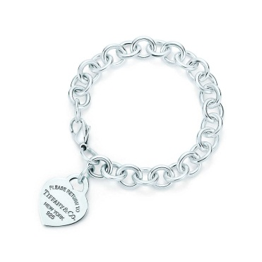
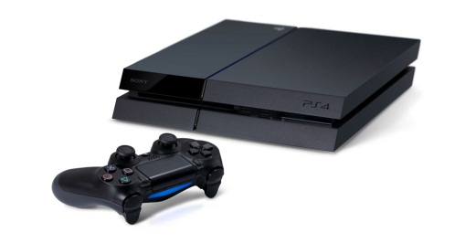
Products
Marriot Hotel
Converse Trainers
BMW X5
Tiffany Bracelet
Sony Playstation 4

Slide 14
Lesson Objectives
All – know Porter’s Five Forces
All – explain the Five Forces Model
Most – Use examples to show understanding of the Five Forces Model

