Slide 1
Preparing For A Maths Test
The next two slides gives you an example of how you could revise for a test.
This is followed by general advice on revision techniques.

Slide 2
Make sure you know what you need to revise
Date | Topics
28th and 29th June | Ordering numbers Displaying data including two-way tables, tally tables, barcharts and pie charts Calculating with decimals Finding fractions and percentages of numbers Order of operations Substituting into formula Writing algebraic expressions Calculations involving time and money Non-calculator calculations Scatter graphs Area of 2D shapes Angle rules including drawing and measuring Ratio Parts of a circle Finding averages Solving equations Simplifying algebraic expressions including expanding brackets Equation of a straight line Writing questionnaires Standard form and rounding Trigonometry

Slide 3
Choose a topic e.g. Standard Form
Start – Ask yourself do you know anything about the topic e.g. What is standard form? How do we write it?
Gather information - Video
Record what you have learnt - Notes/Revision Cards
Practice – Questions on sheet, exam questions, MyMaths

Slide 4
Preparing for September/General Revision
Long term Revision
Organising yourself
Revision tips

Slide 5
Why revise when you don’t have a test to prepare for?
The best way to help your brain remember something is to keep using the information over a long period of time – this is called retrieval practice.
Revise a small amount = less revision and stress
each week now before the final exams

Slide 6
Make sure you plan your space …
Have a desk or table you work at.
It needs to be in a quiet place preferably with somewhere nearby you can leave books/equipment until you need them.
You need to avoid wasting time looking for equipment and books before you start your revision.

Slide 7
Make sure you plan time …
Timings can be flexible but the commitment to the amount of work isn’t.
Write a revision timetable – example …

Slide 8
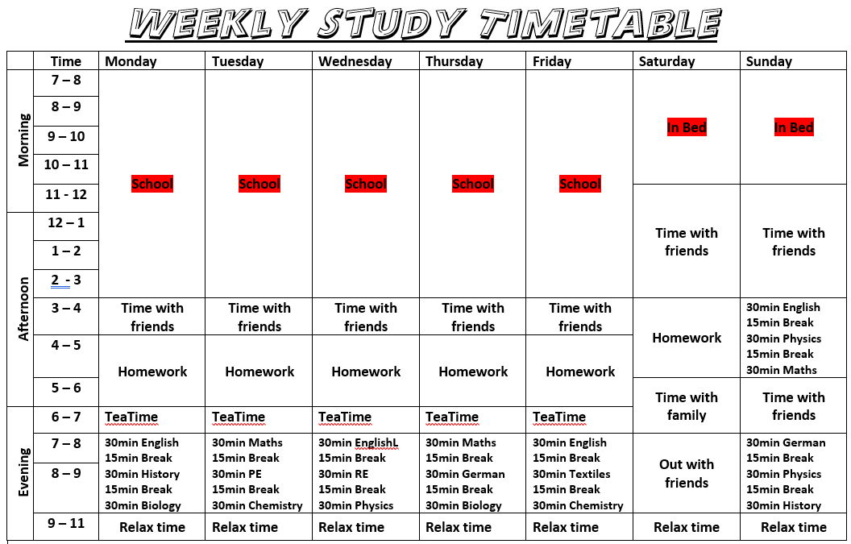

Slide 9
Make sure you plan the content …
Check with teachers what you have covered or where you can find the information.
Break the content down into smaller chunks and plan when you will revise it, for example …

Slide 10
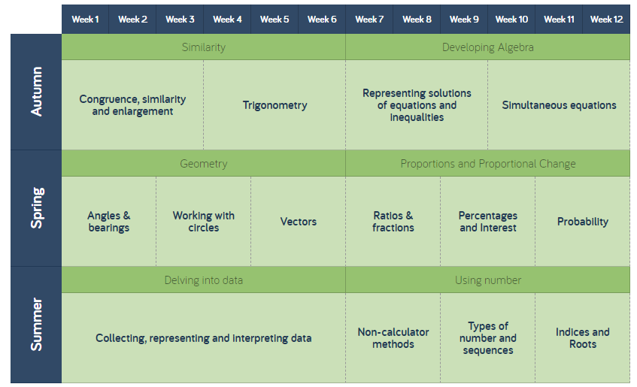
WB 5th July and 12th July
WB 19th July

Slide 11
Make sure you plan how you will revise …
In a 30 minute slot you could …
20 minutes reading through a topic and creating revision cards.
10 minutes revisiting cards you have prepared on another topic.
OR
10 minute exam question on a topic revised previously.
10 minutes creating Cornell notes.
10 minutes testing yourself on Cornell notes previously created.

Slide 12
REMEMBER – The Spacing Effect

Slide 14
Other Effective revision activities

Slide 15
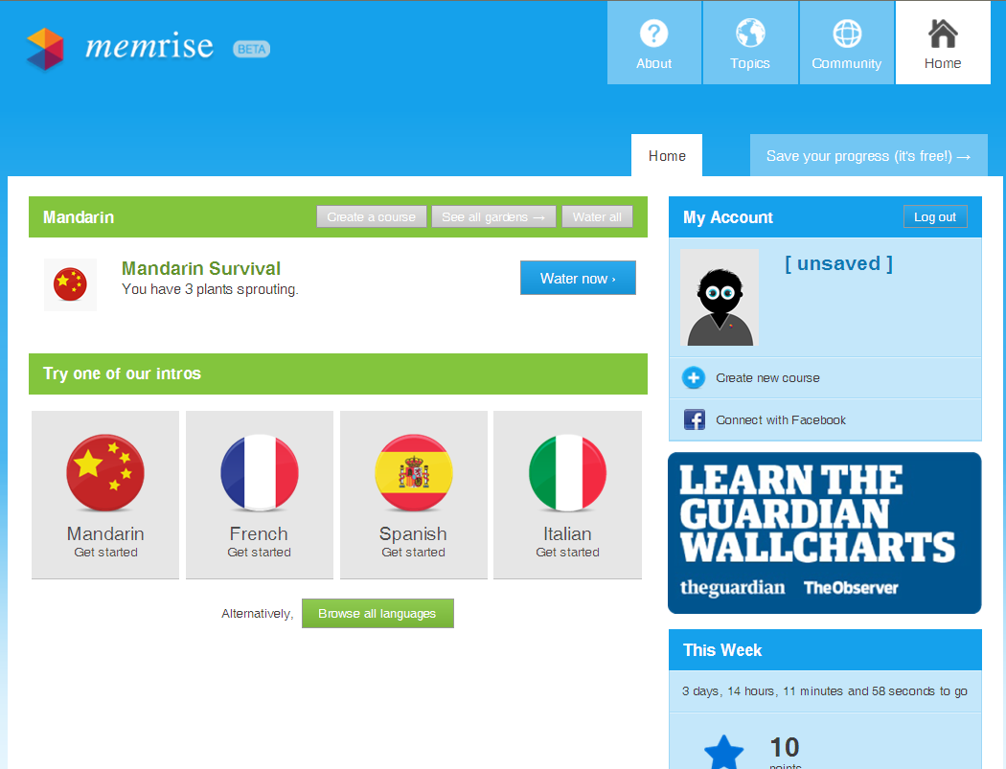
Quizzing

Slide 16
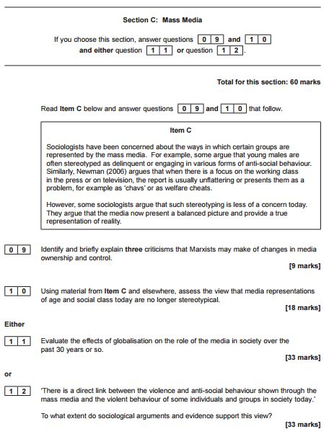
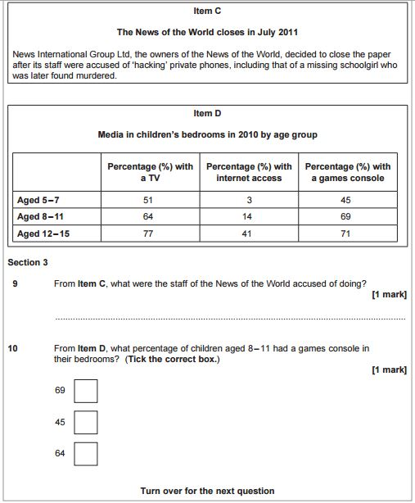
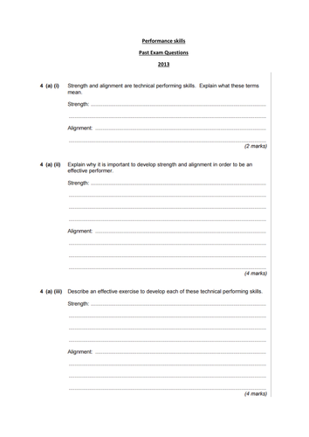
Past Exam Questions

Slide 19
Note Making – Cornell Notes

Slide 20
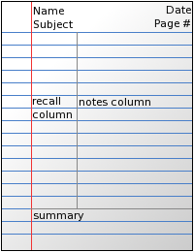

Slide 21
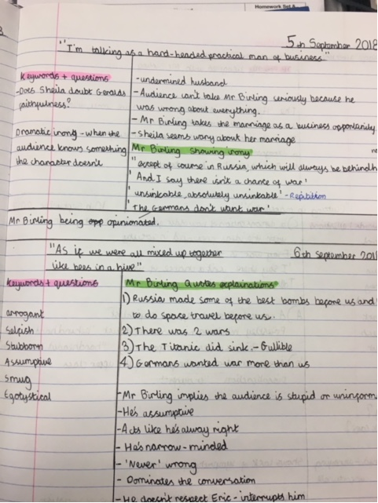
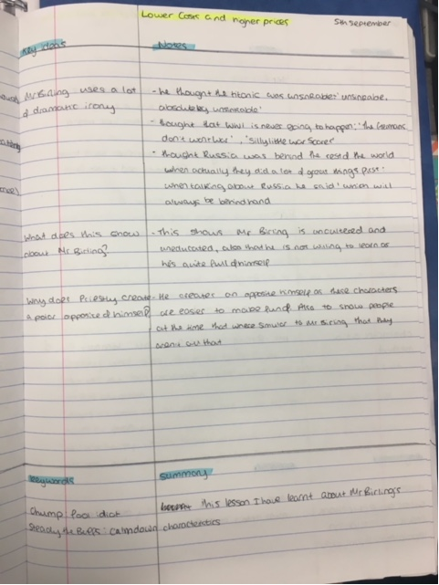
Cornell Notes.
An Inspector calls

Slide 23
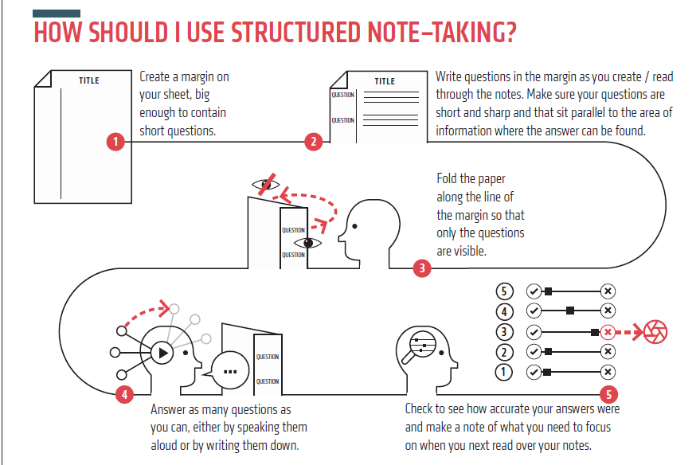

Slide 25
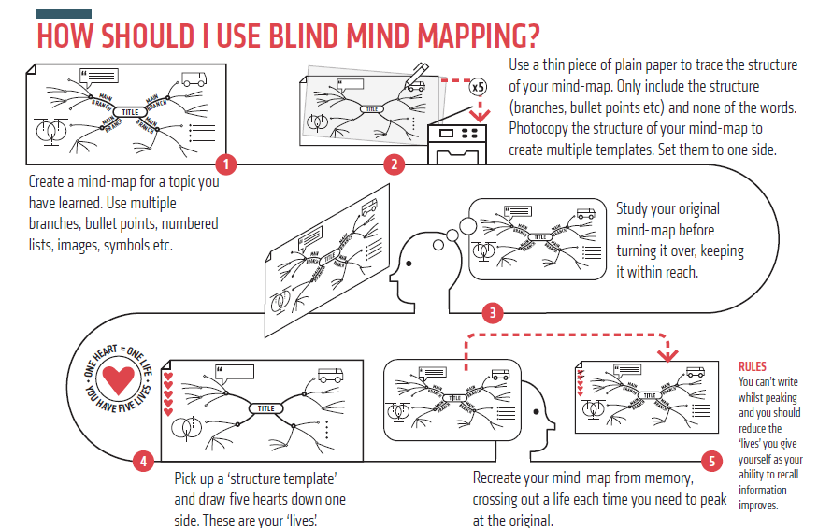
Or cover sections you would need to recreate with post its or flaps.

