Slide 1
1.1.3. Market positioning
a) Market mapping
b) Competitive advantage of a product or service
c) The purpose of product differentiation
d) Adding value to products/services

Slide 2
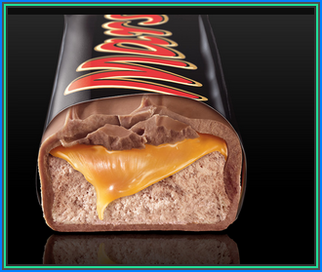
Starter
Mars Bar, come up with as many new product ideas as you can in 3 minutes

Slide 3
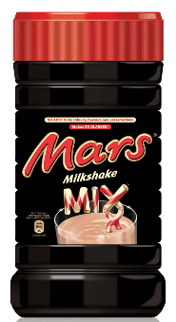
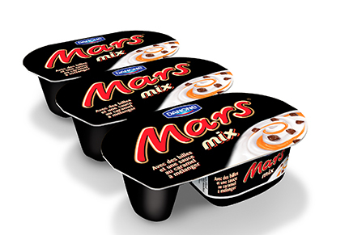
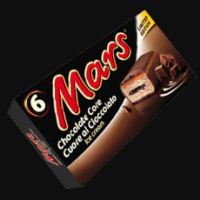
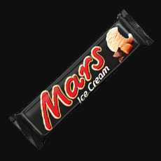
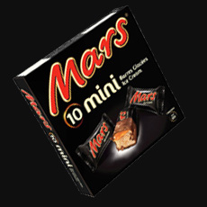
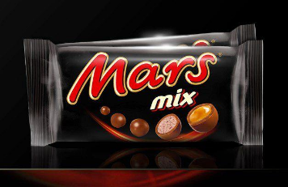
How did MARS identify gaps in the market?
How did MARS decide what new products to produce?
Notes:
This should lead you nicely into market mapping

Slide 4
Market Positioning

Slide 5
Market mapping

Slide 6
Market Mapping
When launching a new product or service, companies need to decide exactly where they want to position the brand in relation to customer perceptions and the positioning of competitors. This is largely achieved by market mapping.

Slide 7
Definition: Market Mapping
Market mapping is the process of finding the variables which differentiate brands in a market and then plotting them on a map – to identify a gap in the market

Slide 8
Market mapping example
A market map plots existing brands or companies on two axes, variables are chosen depending on the industry
Examples of variables:
Modern ------- traditional
Mass ----------- niche
Functional -----luxury
High Quality ---low quality
Luxury ---------- economy
Premium --------budget
Premium
Functional
Luxury
Budget
Suggest some other variables

Slide 9
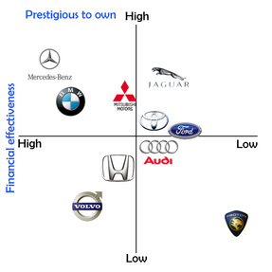

Slide 10
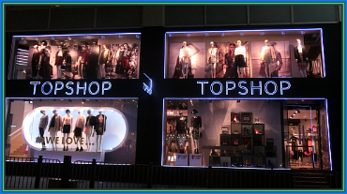
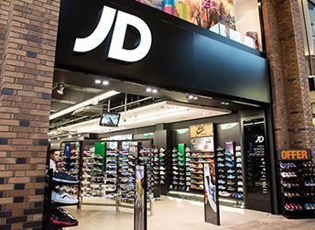
Suggested activity: Create a market map
Create a market map for these clothes shops (add others that you know)
High price – Low price
High quality – Low quality
George (at ASDA) Dorothy Perkins
Peacocks JD Sports
Sports Direct Marks & Spencer
Next H&M
Topshop Matalan
Primark Debenhams
Superdry
Dior

Slide 11
Suggested answer to activity
Possible gap in the market here
Dior
High Price
Debenhams
Marks and Spencer's
Next
Dorothy Perkins
Top Shop
Low Quality
High Quality
George
Possible gap in the market here
Matalan
Peacocks
Sports Direct
Primark
Low Price
Why are there gaps in the market?
What problems may occur if a business tried to occupy these gaps?
Suggest ways these difficulties could be overcome.
Notes:
These are just suggestions

Slide 12
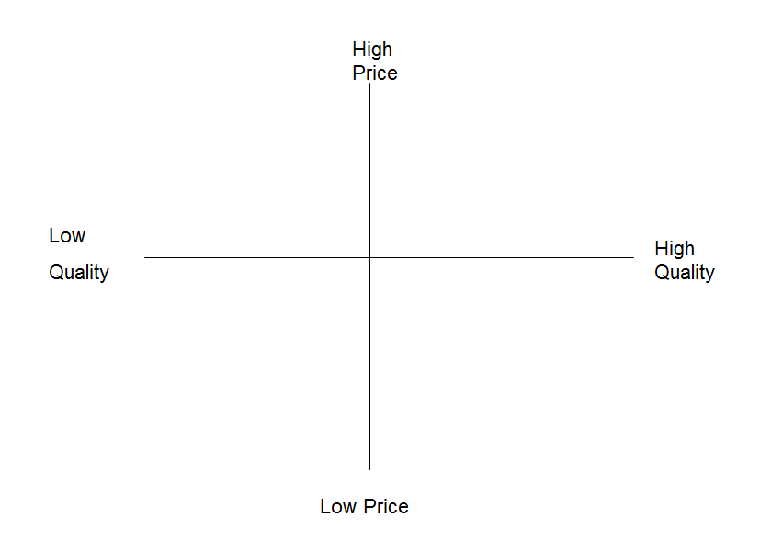
You are going to create a market map for the chocolate market
Create a list of all the chocolate that you can think of
Come up with the dimensions that you will use to map it against, remember, it doesn't have to be the ones we have looked at
Map this onto your sheet
Are there any gaps? What does this tell you about the market?

Slide 13
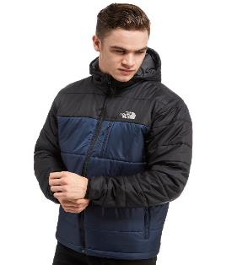
Uses of market mapping
Market mapping could be used to identify a gap in the market
It could also be used by a start-up to identify which products to produce or which services to provide – so they are market orientated (not product orientated)
It could also be used by a traditional brand to reposition itself in the market
North Face has moved away from the traditional mountaineer image to a younger market

Slide 14
Competitive advantage of a product or service

Slide 15
Definition of competitive advantage
An advantage a business has over its competitors, allowing it to generate larger than average turnover for the industry, either in low cost leadership or on price leadership
The concept of competitive advantage was first thought of by Michael Porter in his book called “Competitive Advantage” which was published in the 1980’s (A2 topic)
The main idea is that a business can win by being cheaper or by being different

Slide 16
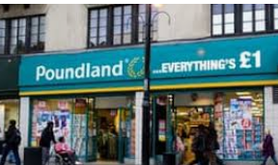
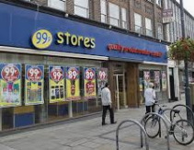
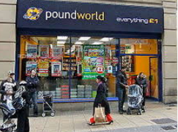
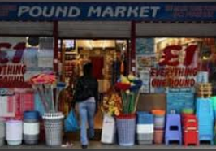
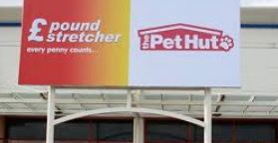
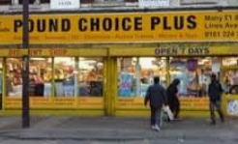
Ways that a business can achieve competitive advantage: Price
Some businesses choose to use a very low cost model and compete on price
This can be found in many industries including retail and the holiday market
How do these types of businesses keep their costs low enough to compete on price?
Notes:
Low staff levels, cheaper goods, with Ryannair they use new planes which require less maintenance, you could build up a list of ways

Slide 17
Question
What processes or ingredients can you add to fish to add value to the product and make it more appealing to consumers?

Slide 18
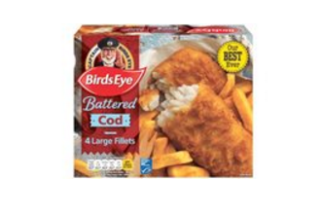
Ways that a business can achieve competitive advantage: Added Value
Added value can be achieved through a process
Birds Eye takes Cod and Pollock and adds value to the fish and produces a range of fish products
What 3 processes do you think are applied to the fish to produce the product at the bottom?
Which of these two types of product is more appealing?
Notes:
Battered, fried, frozen

Slide 19
Question
What is the difference between invention an innovation?
Notes:
Invention – is the new product or service idea
Innovation is that new idea ready for market

Slide 20
Ways that a business can achieve competitive advantage: Innovation
“Like everyone we get frustrated by products that don’t work properly. As design engineers we do something about it. We’re all about invention and improvement.” James Dyson
In 1978 James Dyson created 5127 prototypes and took 5 years to create the first bagless vacuum cleaner
What other products does Dyson produce, and how are they innovative?
Notes:
Hair dryer and fan at time of writing

Slide 21
Question
Can you guess at the brand name of the most and the least reliable car?

Slide 22
Ways that a business can achieve competitive advantage: Reliability
Lexus NX voted UK’s most reliable car by Auto Express
Why is reliability important in the car market?
What other products would reliability be one of the most important factors and selling features e.g. parachute?
What do you think was the least reliable car?
Press esc for the answer
Notes:
http://www.autoexpress.co.uk/best-cars/driver-power/64280/most-reliable-cars-to-buy-now
Answer: Nissan Qashqai

Slide 23
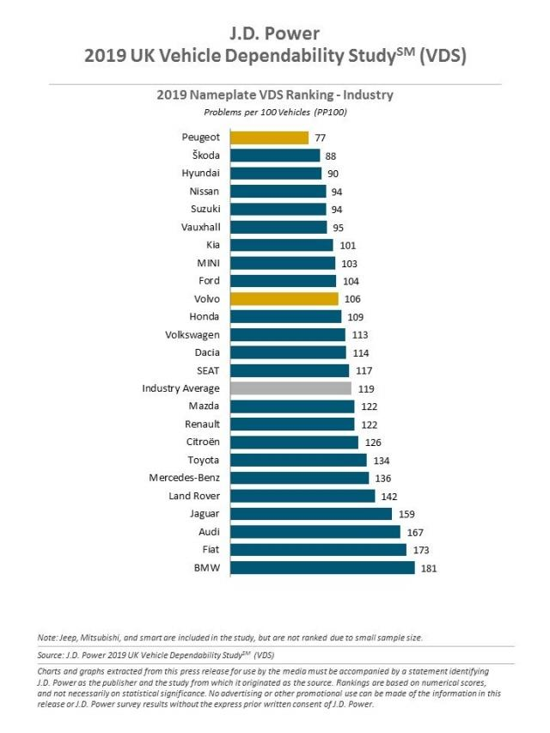

Slide 24
Question
Can you explain what a Vileda product is or what kinds of products they make?
Notes:
See next slide for the answer

Slide 25
Ways that a business can achieve competitive advantage: Quality
Vileda makes cleaning products and over the last 60 years the family-run business has put together a broad product portfolio and established itself as a market leader in the mechanical cleaning products sector.
Their focus has consistently remained on the highest quality standards as well as consumer and customer satisfaction.
Alongside the consumer benefit, particular importance is placed on stability and durability of the products, all of which are designed and manufactured using the latest technologies.

Slide 26
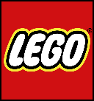
Question
Can you guess which of these 4 companies is British?
Notes:
Answer RR

Slide 27
Ways that a business can achieve competitive advantage: Reputation
The LEGO Group is a privately held, family-owned company with headquarters in Denmark
Founded in 1932 by Ole Kirk Kristiansen, and based on the iconic LEGO® brick, it is one of the world's leading manufacturers of play materials
Guided by the company spirit: "Only the best is good enough”, the company is committed to the development of children and aims to inspire and develop the builders of tomorrow through creative play and learning
Answer is Rolls Royce is a British company
Notes:
Answer - Rolls Royce
Source: http://www.managementtoday.co.uk/companies-best-reputation-uk/article/1364161

Slide 28
Ways that a business can achieve competitive advantage: Advertising
A business can advertise to raise awareness of the brand, remind customers or inform them of product features
McVitie's is a British snack food brand owned by United Biscuits. Their advert on the left was voted the most popular advert of 2016 try these and vote on which one you like the best
Notes:
http://www.campaignlive.co.uk/article/uks-favourite-ads-2016/1417979

Slide 29
Question
Which country is the Superdry clothing brand from?
Japan
Taiwan
South Korea
China
America
UK

Slide 30
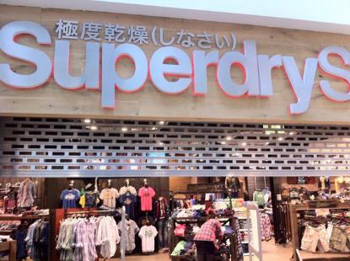
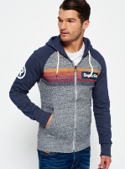
Ways that a business can achieve competitive advantage: Branding
Superdry is an exciting contemporary brand which focuses on high-quality products
They are characterised by quality fabrics, authentic vintage washes, unique detailing, world leading hand-drawn graphics and tailored fits with diverse styling
Such distinctiveness has gained the brand exclusive appeal as well as an international celebrity following
Notes:
British

Slide 31
Question
Why do you think that small independent businesses, like butchers and bakers, would protest when a Tesco Express tries to open near them?
Can you use the term stakeholders in your answer?
Press esc for a suggested answer
Notes:
Small local shops can’t compete on price because Tesco has economies of scale and buying power, small independents
go out of business as a result…the independents are a stakeholder of the business. There is a trade off here between ethics (what is right) and profit. Low trade forcing local businesses into closing might be regarded as unethical.

Slide 32
Ways that a business can achieve competitive advantage: Convenience
Tesco is the fourth largest retailer in the world measured by revenues and the second largest measured by profits.
The chain was founded by Jack Cohen in 1919. The brand first appeared after Cohen bought a shipment of tea from T.E. Stockwell and he used those initials and added the first two letters of his own surname. The first Tesco store was opened in 1929 in Burnt Oak, Edgware, Middlesex.
Originally a UK-focused retailer specialising in food and drink, it has diversified both geographically and by product, into areas such as clothing, electronics, financial services, telecoms, home, health, car and dental insurance, retailing and renting DVDs, CDs, music downloads, Internet services and software.
What other businesses trade on convenience?

Slide 33
Question
Can you guess the top 5 companies for good customer services (that trade in the UK)

Slide 34
Ways that a business can achieve competitive advantage: Customer Service
Customer service can provide a business with competitive advantage
Consumers want a business to get things right first time and dealing with their complaints faster and more efficiently.
Amazon for example their vision/mission statement states: “to be earth’s most customer-centric company.”
Notes:
https://www.yorkshirepost.co.uk/read-this/uk-companies-best-customer-service/

Slide 35
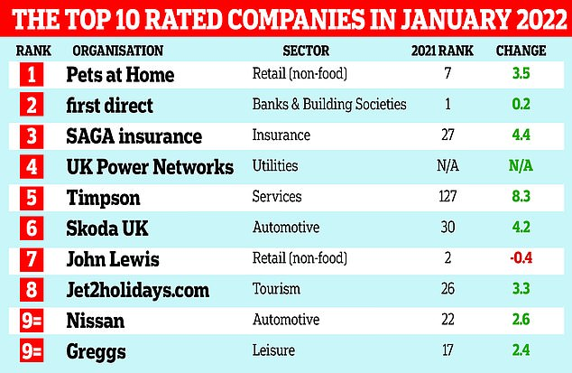
Ways that a business can achieve competitive advantage: Customer Service

Slide 36
How do Waitrose gain their competitive advantage?
​How does this benefit them? What does this lead to?
Why may this be so important for them?

Slide 37
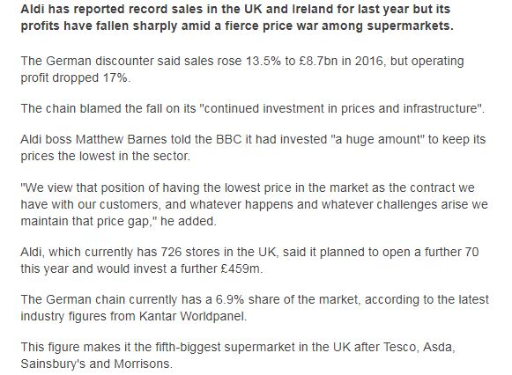
How has competitive advantage been achieved?
How does this benefit Aldi?
What would be Tesco's competitive advantage?

Slide 38
c) The purpose of product differentiation

Slide 39
Product Differentiation - Definition
The ways in which a company gains competitive advantage e.g. strong product branding, price, marketing and customer service Consumers must be able to perceive that your brand is different from its competitors and may be willing to pay a higher price

Slide 40
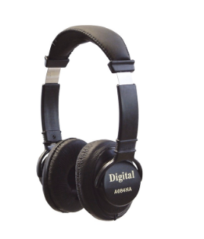
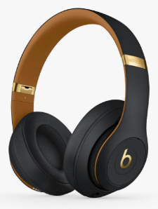
Product differentiation
Where a product is different from the competition in some way
Consumers must be able to perceive this difference and may be willing to pay a premium price for the product
Look at the headphones, why are customers prepared to pay £299.99 for one type of headphones when they could buy a pair of headphones for £6?
Soundlab headphones RRP £6.00 HERE
Beats by Dr Dre – RRP £299
HERE

Slide 41
Methods of differentiation
Through reputation (hair salon, restaurant)
Through customer service or after sales service (Marks and Spencer)
Through value for money (ASDA, Lidl, Aldi, Primark)
Through product features (Cars, mobile phones)
Notes:
Link is to trip advisor – what is best restaurant in town> Then put town in and see what Trip advisor suggests. Would customers go based on a resturant being high on the list – probably.

Slide 42
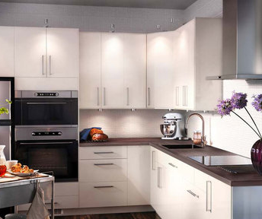
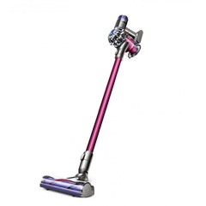
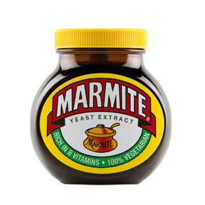
Ways in which actual product differentiation can be created:
A unique design (something that is aesthetically pleasing to the eye e.g. Scandinavian furniture from IKEA)
A unique product function (e.g. mobile phone with unique feature)
A unique taste (Dr pepper, marmite)
Ergonomic features (easier to use than competitors)
Superior performance (e.g. Dyson vacuum cleaner)

Slide 43
d) Adding value to products/services

Slide 44
Definition: Added value
Added value is the difference between the price that is charged to the customer and the cost of inputs required to create the product or service
This can be achieved through the product itself or the way that consumers perceive the product

Slide 45
How can a business add value?
Building a brand – a reputation for quality, value etc that customers are prepared to pay for. Nike trainers sell for much more than Hi-tec, even though the production costs per pair are probably pretty similar!
Delivering excellent service – high quality, attentive personal service can make the difference between achieving a high price or a medium one
Product features and benefits – for example, additional functionality in different versions of software can enable a software seller to charge higher prices; different models of motor vehicles are designed to achieve the same effect.
Offering convenience – customers will often pay a little more for a product that they can have straightaway, or which saves them time.

Slide 46
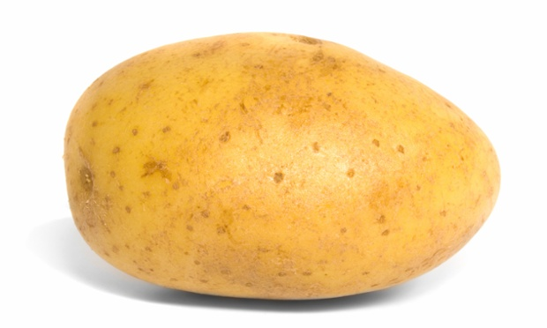
Suggested activity: Adding value
How many ways can you think of adding value to this potato?

Slide 47
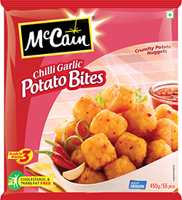
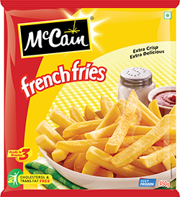
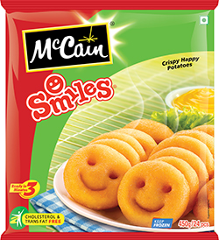
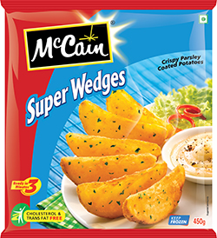
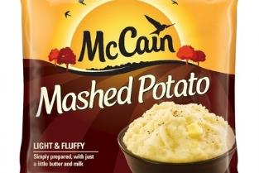
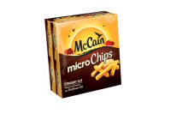
Potato products

Slide 48
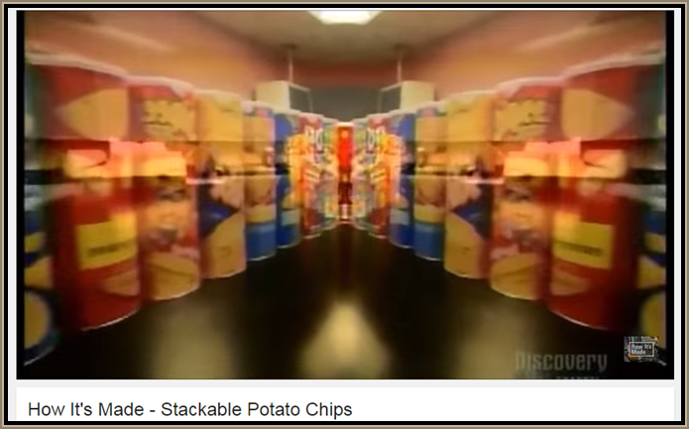
Adding value - video
Watch the video and make notes on how value is added to a potato when making stackable potato chips.
Notes:
Cost of a potato is pence but a tube of Pringles can cost £1 - £2

Slide 49
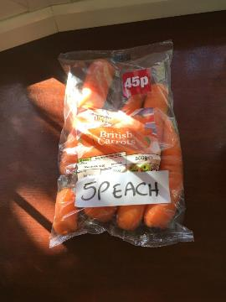
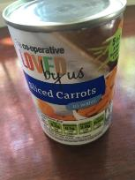
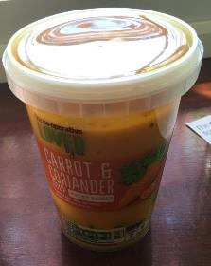
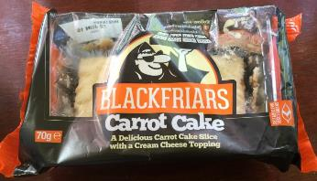
How value can be added
Process e.g. cooking, slicing, canning
Additional ingredients e.g. cake mix
Convenience e.g. In supermarket
Packaging e.g. Handy cake slice in plastic
Finished goods
Raw materials

Slide 50
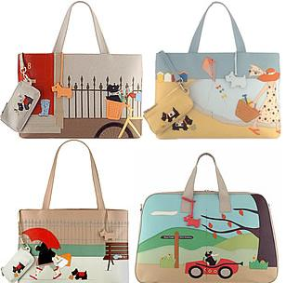
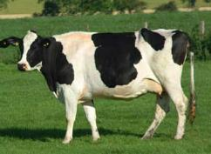
Benefits of adding value
The more value that is added, the higher the price that can be charged, which means higher profit margins
Protection against competitors offering lower prices which means competitive advantage
Customer loyalty which means repeat business
Radley have added value to leather, these bags cost £300
Notes:
50

Slide 51
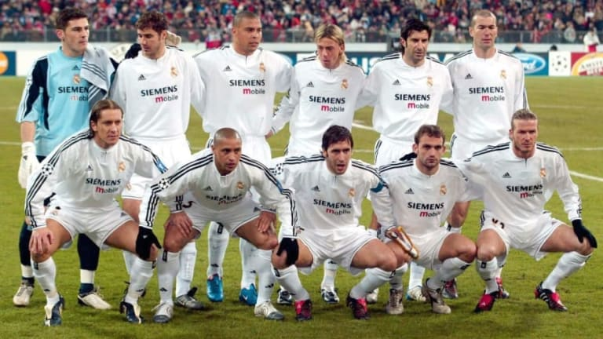
Market positioning - Evaluation
How have these 3 footballs clubs differentiated themselves in the last decade?
In recent years Real Madrid have tried to position themselves as the most glamorous football club in the world, Have they achieved this?
Bayern Munich have been the most successful and Barcelona play the best football but Real Madrid's point of differentiation is glamor.

Slide 52
Key message:
- Choose a position that customers find acceptable while company finds it profitable - Work out how to secure it - Advertising, packaging and other forms of promotion must focus on making customers believe in the market position

Slide 53
Review questions
(30 marks; 30 minutes)
1 Identify three markets where age is a crucial factor in drawing up a market map. (3)
2 The UK population is growing older, with a rising proportion of over 60s. Outline two business opportunities that may arise as the population gets older. (4)
3 Give three possible sources of competitive advantage for an independent clothes shop. (3)
4 Why might it be difficult to differentiate a mass market brand? (4)
5 What would you say is the USP of each of the following: (6)
a) Maltesers
b) the latest iPhone
c) Marmite?
6 Suggest four ways in which value could be added to a plank of wood. (4)
7 Explain how your school or college differentiates itself. (6)

Slide 54
Sample Edexcel A2 questions

Slide 55
Case study for question 1

Slide 56
Sample question 1
Knowledge 2
Application 2
Analysis
4
Evaluation
4

Slide 57
Glossary
Market mapping; The process of finding the variables which differentiate brands in a market and then plotting them on a map – to identify a gap in the market
Competitive advantage; An advantage a business has over its competitors, allowing it to generate larger than average turnover for the industry
Differentiation; This is the extent to which consumers perceive one product as being different from the others in the market, highly differentiated products have no substitutes
Adding value; The process by which a business adds to the price that a consumer is willing to pay for a product e.g. frying potatoes to make chips

