Slide 1
From Edexcel
a) The effects on businesses of:
consumer protection
employee protection
environmental protection
competition policy
health and safety

Slide 2
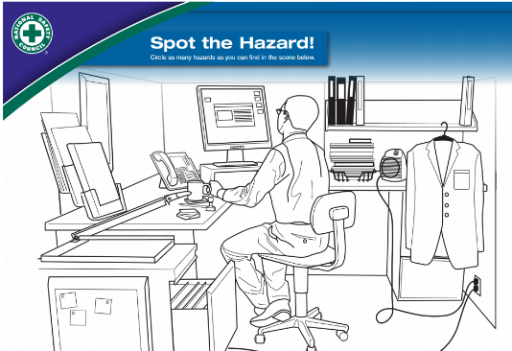
#5 Health and Safety at Work Act: workplace hazard
In general, health and safety laws apply to all businesses
As an employer, or a self-employed person, they are responsible for health and safety in the business
Health and safety laws are there to protect the owners, the employees and the public from workplace dangers
Spot the workplace hazard, click on the graphic to download a PDF with several examples and answers

Slide 3
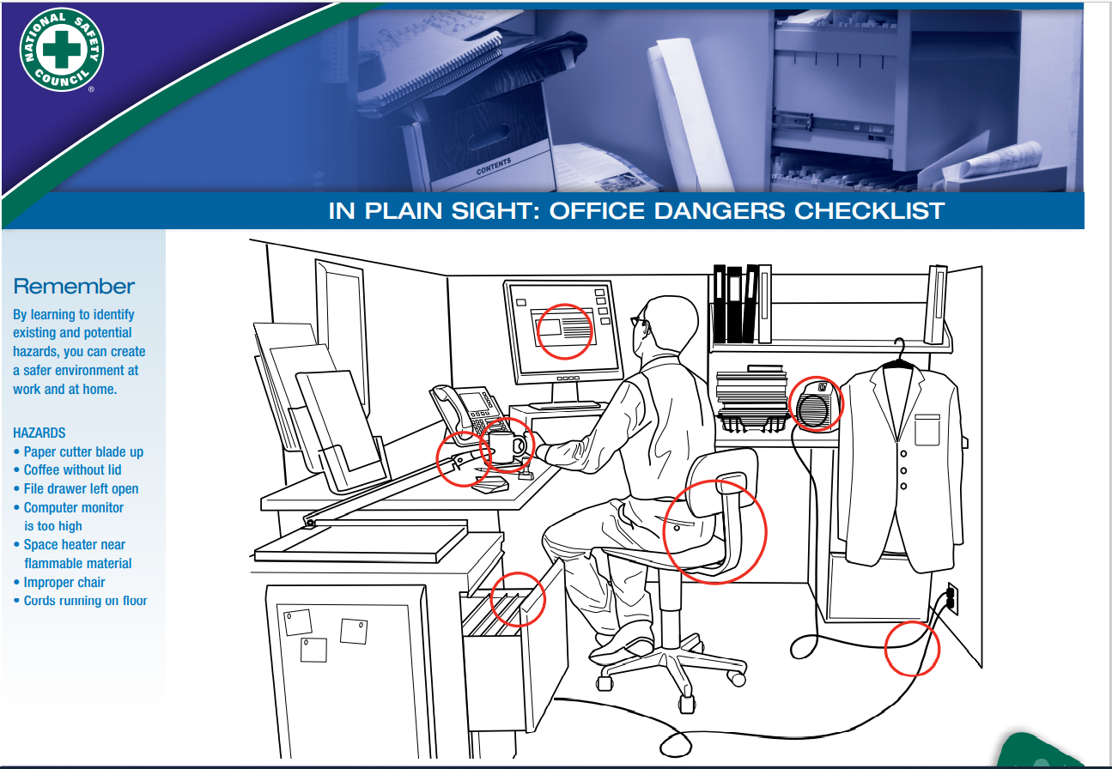

Slide 4
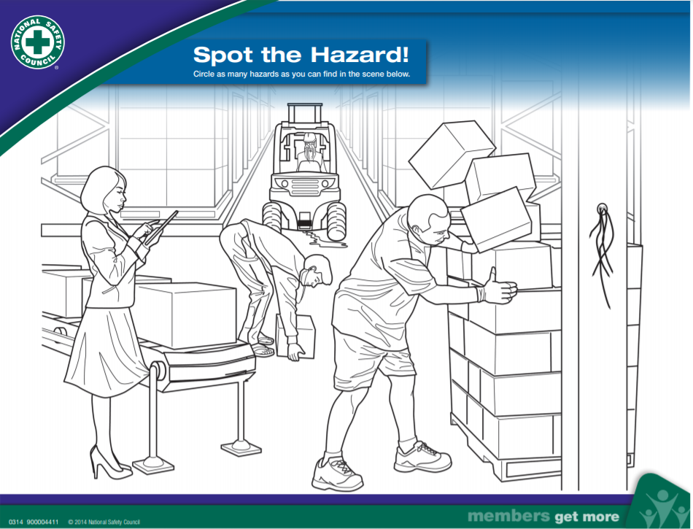

Slide 5
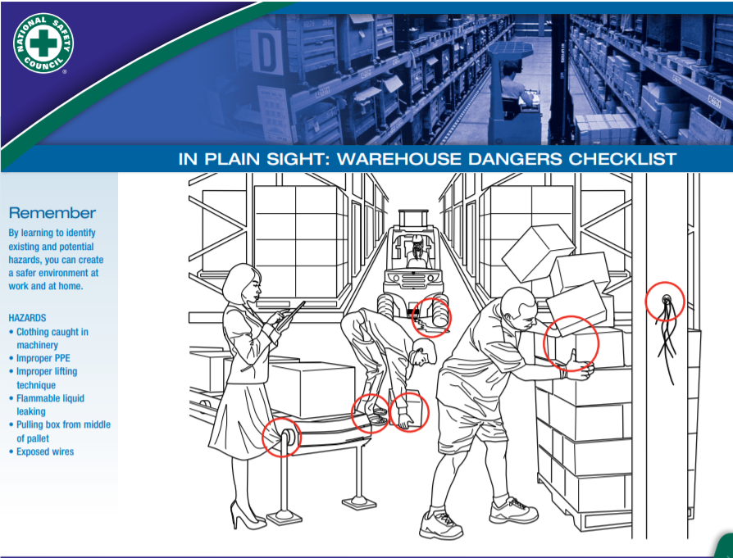

Slide 6
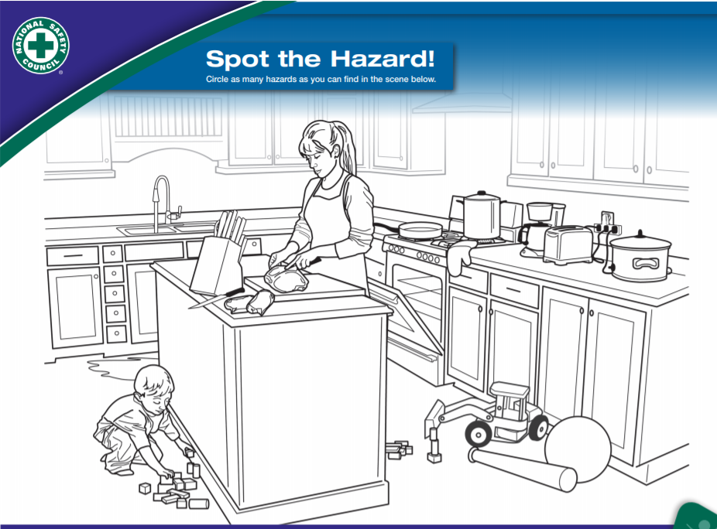

Slide 8
HSE
https://www.hse.gov.uk/aboutus/index.htm

Slide 9
Latest press releases
https://press.hse.gov.uk/?_ga=2.145082292.184497846.1609953664-1995484486.1609953663
Visit this link and feedback a summary on a recent case:
What breach of HSE legislation occurred
Judgement
Consequence

Slide 10
#5 Health and Safety at Work Act: employer duties
Prevent accidents and cases of work-related ill health by managing the health and safety risks in the workplace
Provide clear instructions and information, and adequate training, to ensure employees are competent to do their work
Engage and consult with employees on day-to-day health and safety conditions Implement emergency procedures – evacuation in case of fire or other significant incident.
Maintain safe and healthy working conditions, provide and maintain plant, equipment and machinery, and ensure safe storage / use of substances

Slide 11
#5 Health and Safety at Work Act
All workers have a right to work in places where risks to their health and safety are properly controlled.
Health and safety is about stopping you getting hurt at work or ill through work.
The employer is responsible for health and safety, but the employees must help.
Watch the video, can you explain the impact that Health and Safety might have on a business
Notes:
Costs would rise

Slide 12
Impact of legislation on business cost
A business will have to meet all of the consumer, employment and recruitment laws
This may mean additional costs
Training staff
Protection equipment for staff e.g. hairnets or googles
Cost of paying NMW
How will higher costs have a an impact on the business?
Notes:
Impact on profit margins

Slide 13
Impact of legislation on business training needs
Businesses will need to make sure that all their employees are trained and that the training is up-to-date
This will make sure that the business is legally compliant
This way the owners of the business will not face fines or prison
Have you ever had any training?
Notes:
Some students may have jobs that include H&S training like working at height or lifting

Slide 14
Impact of legislation on business recruitment
Race, sex, age or disability discrimination is illegal in UK business, so businesses must be careful to recruit within the equality law
They must offer equal pay and promotion opportunities for women and ethnic minorities

Slide 15
Sample Edexcel A2 questions

Slide 16
Case study for question 1

Slide 17
Sample question 1
Knowledge 2
Application 2
Analysis
3
Evaluation
3

Slide 18
Glossary
consumer protection; legislation put in place to make sure that consumers are protected when buying products or services in the UK
employee protection; legislation put in place to protect the rights of employees in UK businesses
environmental protection; legislation put in place to ensure that business recycles and managers their waste effectively
competition policy; legislation put in place to promote competition for benefit of consumers, prevent abuse of monopoly power, prevent collusion and prosecute cartels
health and safety; legislation put in place to ensure the health and safety of every worker in a UK business regardless of their trade

