Slide 1
STARTER ACTIVTIY
Using only 3 illustrations demonstrate what you think the word ‘economy’ means.

Slide 2
Left or Right – QUIZ
Answer the 15 questions truthfully.
The answers will then be revealed and each answer either +1 or -1 from your score.
Then compare your score of the spectrum.

Slide 4
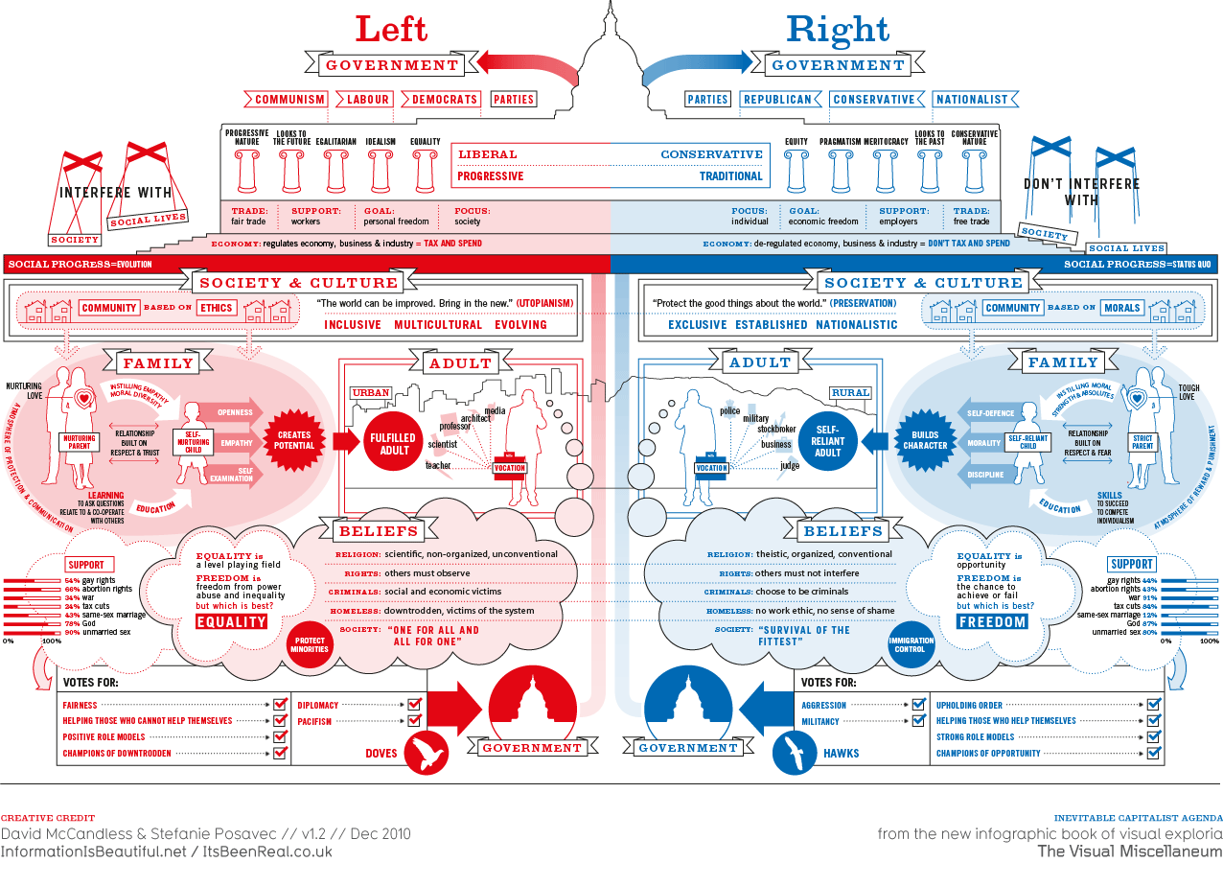

Slide 5
The basic economic problem… infinite wants and finite resources.
WHAT goods and services should be produced?
HOW should these goods and services be produced?
FOR WHOM should these goods and services be produced?
Depending upon WHO answers these questions (government or society) depends upon the type of economic system

Slide 6
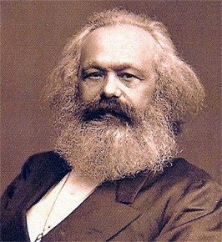
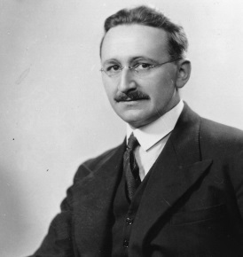
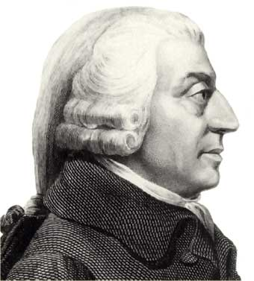
Market Systems – the spectrum
Combination of both, some left to free market and government intervene when necessary (UK)
Command economy
Free market
Mixed economy
Socialist
Capitalist
An economy in which the factors of production (land, labour and capital) are owned and determined centrally by a government
An economy where markets are determined by the forces of demand and supply, no government involvement
Fairness and equality
Opportunity for all

Slide 7
STRUCTURE OF ECONOMIES
Market economy: An economy in which market forces (price mechanism) are allowed to guide the allocation of resources. Factors of production are privately owned (capitalism).
Command economy: An economy in which decisions regarding resource allocation are guided by the state. Factors of production are owned by the government (socialism).
Mixed economy: An economy in which resources are allocated partly through price signals and partly on the basis of intervention by the state. FoP are owned by privately and government.

Slide 8
https://twitter.com/SkyNewsPolitics/status/1047102041313763335
Boris Johnson free market

Slide 9
SCALE ACTIVITY.
The UK is a free-market economy, with elements of a command economy.
Place the following UK markets on the scale.
Remember, government intervention can include any act where the government tries to manipulate or alter the invisible hand.
Education
Food
Housing
Banking
Healthcare
Furniture
Cars
Emergency Services
Streetlamps
Waste Disposal
Railways
Alcohol

Slide 10
What can we deduce about the following economies?

Slide 11
LEARNING OBJECTIVES
Lo1: Explain the differences between a capitalist and command economy.
Lo2: Outline the theories of Smith, Marx and Hayek.
Lo3: Evaluate the advantages and disadvantages of each economic system.
Notes:
6, 7, 13, 14, 15, 18, 19, 21,

Slide 12
Market Systems – the spectrum
Combination of both, some left to free market and government intervene when necessary (UK)
Free market
Command economy
Socialist
Capitalist
Mixed economy

Slide 13
ECONOMIC THINKERS…
The specification (topic 1.1.6) requires you to know the distinction between free market, mixed and command economies: with reference to Adam Smith, Karl Marx
and Friedrich Hayek

Slide 14
Specification
1.1.6 Free market economies, mixed economy and command economy
a) The distinction between free market, mixed and command economies: reference to Adam Smith, Friedrich Hayek and Karl Marx
b) The advantages and disadvantages of a free market economy and a command economy
c) The role of the state in a mixed economy
Students should have an awareness of the perspective of Smith, Hayek and Marx. There is no requirement for detailed consideration of the work of each economist.

Slide 15
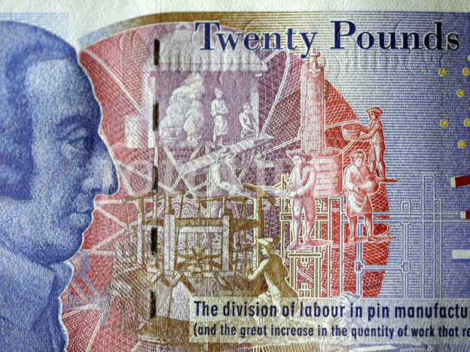
ADAM SMITH
Key advocate of the market economy.
By pursuing their own self-interest, individuals would be led ‘as by an invisible hand’, with resources allocated in such a way that is in the best interests of society – price mechanism.
Smith believed that competition in markets ensures that firms, whose main objective is to maximise profits, produce their goods at the lowest possible cost (productive efficiency).

Slide 16
THE INVISIBLE HAND
https://www.youtube.com/watch?v=ulyVXa-u4wE

Slide 17
“It is not from the benevolence [kindness] of the butcher, the brewer, or the baker that we expect our dinner, but from their regard to their own interest.” – Chapter 2, page 19.

Slide 18
FRIEDRICH HAYEK
Friedrich Hayek was a key supporter of the free market and deeply critical of socialism (state planning).
He believed that governments should not intervene in resource allocation decisions, except in the provision of some goods.
If government officials made decisions on how resources should be allocated, this would not be successful since these officials lack sufficient information about markets to be able to make informed decisions.
Hayek’s ideas were not as popular as other economists (namely John Maynard Keynes) amongst politicians. Hayek’s advice was to step back and do nothing, something which would not be popular amongst voters.

Slide 19
KARL MARX
Marx believe that all economies are in transition, heading towards communism.
This video explains why capitalism, according to Marx, is inherently unstable and will lead to crisis after crisis.
The next stage is socialism (all factors of production are owned by the government).
Then ultimately communism (the state ‘withers’ away and all output is shared equally amongst society)
www.bbc.co.uk/programmes/p00z0yb2

Slide 20
Why capitalism is doomed!!
↓Supply of workers
↑Wages… ↑costs for firms and ↓profits
Number of firms decreases, as they go bankrupt.
↑Unemployment as firms lay-off workers (∴↑supply of workers)
↓wages again and firms go back to ‘exploiting’ workers.
↑Supply of workers
↓wages (industrial reserve army of the unemployed)
↓Consumption falls (as workers/consumers earn less)
↓Sales and profits of firms
Number of firms decreases, as they go bankrupt. ↑Unemployment
Either way, Marx claims that capitalism is doomed and will make a transition to socialism.
Can you spot any potential flaws in the ↓Supply of workers
argument?

Slide 21
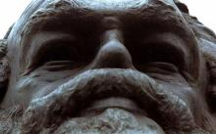
KARL MARX
Read the article relating to Karl Marx and answer the questions.
1) Who controls the factors of production in: a) socialist b) communism c) capitalism.
2) Explain what Marx meant by the labour theory of value and how it creates inequality.
3) What did Marx believe a capitalist society would evolve into? Mention monopolies in your answer.
4) The end of the 20th century saw the general collapse of communism. Identify the reasons why communism in practice had major weaknesses as an economic system.

Slide 22
ECONOMIC SYSTEMS QUESTIONS
Complete the questions relating to Hayek, Smith and Marx.
“The curious task of economics is to demonstrate to people how little they really know, about what they imagine they can design.” – Friedrich Hayek

Slide 23
ESSAY QUESTION…
Answer the following question…
‘Command economies will always be inferior to free market economies as economic systems’. To what extent is this statement true? Refer to Hayek, Marx and Smith in your answer. (10)
Notes:
Go through exam technique.

Slide 24
10-mark ESSAY QUESTION…
KAA - Command economy is inferior
6 Marks (1 or 2 Points excluding definition)
Define command economy
Points analysed/explained which support the notion that command economy is inferior.
Must apply to Marx, Hayek and Smith at least once somewhere in answer (KAA/EV) for App marks.
EV - Command economy is not inferior/critique KAA argument
4 Marks (1 or 2 Points)
Points analysed/explained which support the notion that command economy isn’t inferior.
Could be in form of command being better/free-market weaknesses
Question/critique any of KAA points.
Start each paragraph with “however”, “on the other hand”
Conclusion – overall, is command economy inferior? Why? Don’t repeat points!
Notes:
Go through exam technique.

Slide 26
COMMAND vs. FREE MARKET – YOUTUBE ACTIVITY
Why did the state-controlled industries suffer from a lack of investment?
What are the three main problems with a command economy?
Explain the importance of competition.
Why is Hayek’s view that the state “lacks the relevant information” relevant?
How does the free market deal with the problem of a shortage?

Slide 27
Opportunity Cost 3 (12:44)
Command economies and free market economies Discusses disadvantages and advantages of command and free market
Portsmouth Professor
https://www.youtube.com/watch?v=4SfjyqNVh9c

Slide 28
Price Set Too High
Price
S1
When the state lacks information to set a price where demand=supply, then a disequilibrium will occur.
P1
When the diagram is read, at the price P1, the quantity demand is Qd and the quantity willing to be supplied by producers is Qs.
At this price level, the producers are willing to supply more than the consumers will demand.
The resultant is a surplus, which represents a misallocation of resources (allocative inefficiency). This is a waste of scare resources and the producer ends up with unpurchased stock.
Surplus
D1
Qd
Qs
Quantity
Notes:
In a movement along the demand curve, people's demand preferences haven't changed. The price has changed, and therefore the quantity of goods that people demand has changed as well. In a shift in the demand curve, something has changed in people's demand preferences. At the same price, they demand a different amount than they did previously. The second case is a little more complicated to understand. Maybe the job market is improving, so people are less concerned with saving, and therefore they are ready to spend more on goods right away. Maybe the reverse is true. Whatever the cause, the quantity of goods that people will buy at the same price has changed.

Slide 29
Price Set Too Low
Price
S1
When the state lacks information to set a price where demand=supply, then a disequilibrium will occur.
When the diagram is read, at the price P1, the quantity demand is Qd and the quantity willing to be supplied by producers is Qs.
At this price level, the producers are not incentivised to supply enough to meet demand, where as the consumers would demand too much at this low price.
P1
The resultant is a shortage, which represents a misallocation of resources (allocative inefficiency). Demand is not satisfied, as there is too much, and there is not enough profit to incentivise enough supply to establish an equilibrium.
Shortage
D1
Qs
Qd
Quantity
Notes:
In a movement along the demand curve, people's demand preferences haven't changed. The price has changed, and therefore the quantity of goods that people demand has changed as well. In a shift in the demand curve, something has changed in people's demand preferences. At the same price, they demand a different amount than they did previously. The second case is a little more complicated to understand. Maybe the job market is improving, so people are less concerned with saving, and therefore they are ready to spend more on goods right away. Maybe the reverse is true. Whatever the cause, the quantity of goods that people will buy at the same price has changed.

Slide 31
LEARNING OBJECTIVES
Lo1: Explain the differences between a capitalist and command economy.
Lo2: Outline the theories of Smith, Marx and Hayek.
Lo3: Evaluate the advantages and disadvantages of each economic system.

Slide 32
https://www.youtube.com/watch?v=QwqnRYPcrl0&feature=youtu.be
Free market v socialist RAP 2019
10 minutes… good pros and cons of each,

Slide 33
WHO SAID IT…?
KAHOOT: https://create.kahoot.it/l/#quiz/61e41ad9-5b87-4f8f-9966-5e2e8844faec

Slide 34
1. Private property has made us so stupid and partial that an object is only ours when we have it, when it exists for us as capital … Thus all the physical and intellectual senses have been replaced by … the sense of having.
Notes:
Go through exam technique.

Slide 35
2.It is not from the benevolence of the butcher, the brewer, or the baker that we expect our dinner, but from their regard to their own interest.

Slide 36
3. The more the state "plans" the more difficult planning becomes for the individual.

Slide 37
4. The worker's existence is thus brought under the same condition as the existence of every other commodity. The worker has become a commodity, and it is a bit of luck for him if he can find a buyer, And the demand on which the life of the worker depends, depends on the whim of the rich and the capitalists.

Slide 38
5. Whenever the legislature attempts to regulate the differences between masters and their workmen, it is always to the benefit of the masters. When the regulation, therefore, is in favour of the workmen, it is always just and equitable; but it is sometimes otherwise when in favor of the masters.

Slide 39
6. Communism is for us not a state of affairs which is to be established, an ideal to which reality [will] have to adjust itself. We call communism the real movement which abolishes the present state of things.

Slide 40
7. It was from Hayek that I began.

Slide 41
8. Consumption is the sole end and purpose of all production

Slide 42
9. We address ourselves, not to their humanity, but to their self-love, and never talk to them of our own necessities, but of their advantages.

Slide 43
10. The theory of Communism may be summed up in the single sentence: Abolition of private property.

Slide 44
11. I am totally against dictatorships. But a dictatorship may be a necessary system for a transitional period. At times it is necessary for a country to have, for a time, some form or other of dictatorial power. As you will understand, it is possible for a dictator to govern in a liberal way

Slide 45
12. Money is therefore not only the object but also the fountainhead of greed.

Slide 46
13. It is unjust that the whole of society should contribute towards an expense of which the benefit is confined to a part of the society.

Slide 47
14. "If that is Marxism, then I am not a Marxist.”
Notes:
Go through exam technique.

Slide 48
WHO SAID IT…?
ANSWERS

Slide 49
1. Private property has made us so stupid and partial that an object is only ours when we have it, when it exists for us as capital … Thus all the physical and intellectual senses have been replaced by … the sense of having.
Notes:
Go through exam technique.

Slide 50
2.It is not from the benevolence of the butcher, the brewer, or the baker that we expect our dinner, but from their regard to their own interest.

Slide 51
3. The more the state "plans" the more difficult planning becomes for the individual.

Slide 52
4. The worker's existence is thus brought under the same condition as the existence of every other commodity. The worker has become a commodity, and it is a bit of luck for him if he can find a buyer, And the demand on which the life of the worker depends, depends on the whim of the rich and the capitalists.

Slide 53
5. Whenever the legislature attempts to regulate the differences between masters and their workmen, it is always to the benefit of the masters. When the regulation, therefore, is in favour of the workmen, it is always just and equitable; but it is sometimes otherwise when in favor of the masters.

Slide 54
6. Communism is for us not a state of affairs which is to be established, an ideal to which reality [will] have to adjust itself. We call communism the real movement which abolishes the present state of things.

Slide 55
7. It was from Hayek that I began.

Slide 56
8. Consumption is the sole end and purpose of all production

Slide 57
9. We address ourselves, not to their humanity, but to their self-love, and never talk to them of our own necessities, but of their advantages.

Slide 58
10. The theory of Communism may be summed up in the single sentence: Abolition of private property.

Slide 59
11. I am totally against dictatorships. But a dictatorship may be a necessary system for a transitional period. At times it is necessary for a country to have, for a time, some form or other of dictatorial power. As you will understand, it is possible for a dictator to govern in a liberal way

Slide 60
12. Money is therefore not only the object but also the fountainhead of greed.

Slide 61
13. It is unjust that the whole of society should contribute towards an expense of which the benefit is confined to a part of the society.

Slide 62
14. "If that is Marxism, then I am not a Marxist.”
Notes:
Go through exam technique.

Slide 64
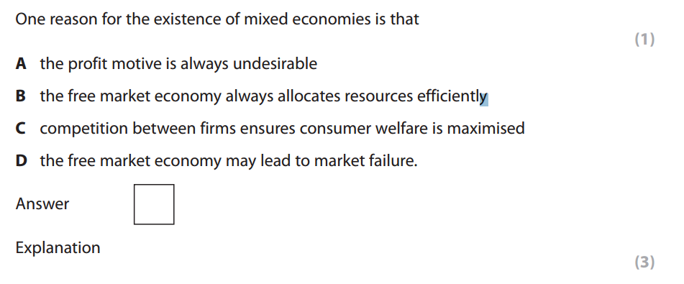

Slide 65
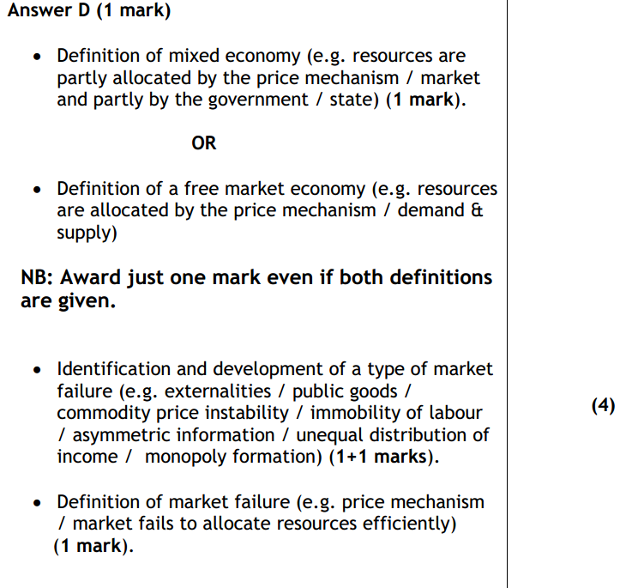

Slide 66
Preview
NEXT TOPIC…
Free markets tend to result in ‘market failure’ of some kind, there are several examples of market failure.
This is the next topic.
Consequently, the government intervenes in order to eliminate and/or reduce these market failures.
Which is why we have mixed economies.

Slide 67
MASTERS OF MONEY…
Two excellent BBC documentaries about Hayek and Marx
HAYEK
https://www.youtube.com/watch?v=PZgw3WEKHmw
MARX
https://www.youtube.com/watch?v=1Nj26cHCWoI

