Slide 1
Edexcel A2 Business
4.4.1 The impact of MNCs
Revisionstation

Slide 2
Worksheet

Slide 3
From Edexcel
a) Impact of MNCs on the local economy:
local labour, wages, working conditions and job creation
local businesses
the local community and environment
b) Impact of MNCs on the national economy:
FDI flows
balance of payments
technology and skills transfer
consumers
business culture
tax revenues and transfer pricing

Slide 4
Starter
From what you know about MNCs would you agree or disagree with this statement:
MNCs are good for the developing nations that they trade or manufacture in

Slide 5
Possible answers to starter
MNCs are good for the developing nations that they set up in
Yes I agree | No I disagree
MNcs bring FDI | MNCs send all their profits back to their home nation
MNCs create jobs for the host nations | MNCs only give the menial or temporary jobs to the host nationals, all the management jobs go to those from the home country
MNCs pay taxes to host nations | Lots of examples of MNCs who don’t pay what they should e.g. Starbucks
MNCs help to increase competition in the host nations | MNCs destroy fledgling businesses who cannot compete as they don’t have the EOS of the MNCs

Slide 6
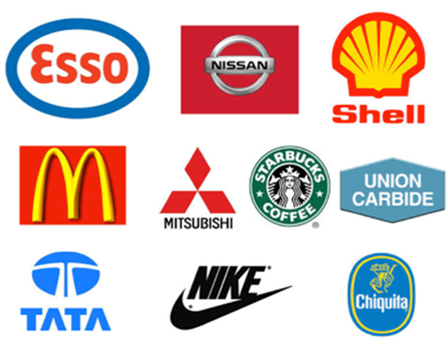
MNC Defined
A MNC is a multinational corporation, a business which operates in more than one country. For example Coca Cola produces in over 200 countries.
Note you may also see this type of business called MNEs or transnational corporations, but they all mean the same thing

Slide 7
Impact of MNCs on local economy

Slide 8
Positive effects of MNCs

Slide 9
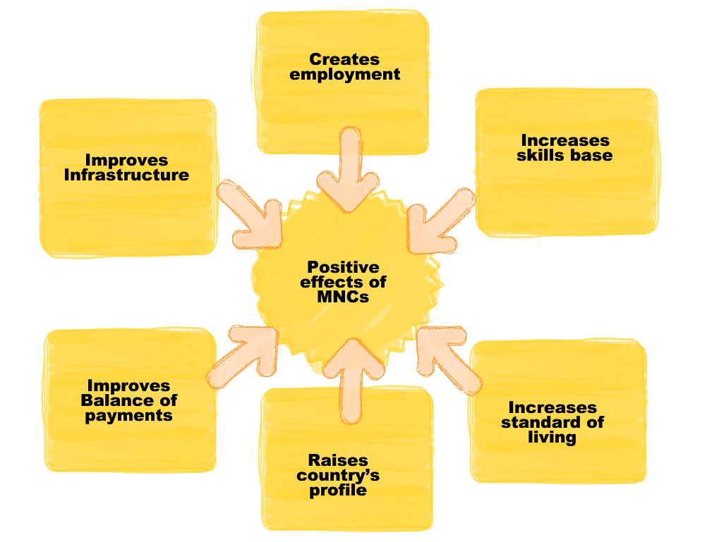
Positive effects of MNCs

Slide 10
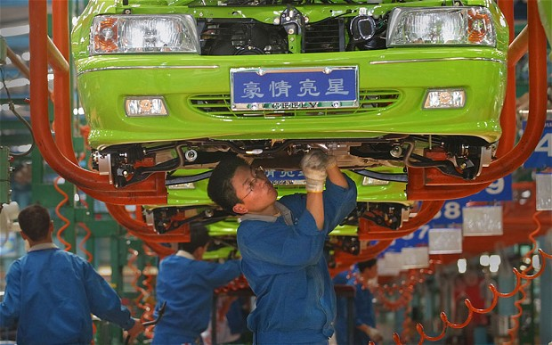
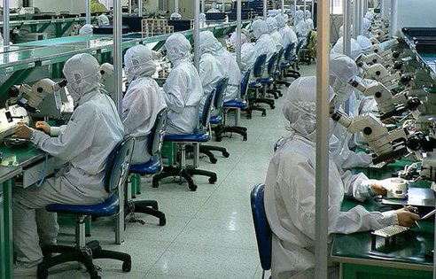
Positive impacts 1
Creates employment
There are jobs available for local people, thus reducing numbers of unemployed and the resultant drain on local resources
Increases skills base
Many MNCs operate training schemes for local people to learn how to use machinery. Such skills also attract other firms to the country
Increased standard of living
An increase in earnings increases taxes paid within the country and gives more money to spend on services

Slide 11
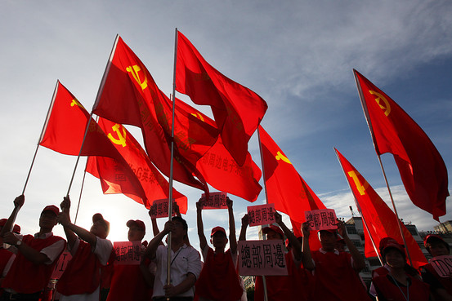
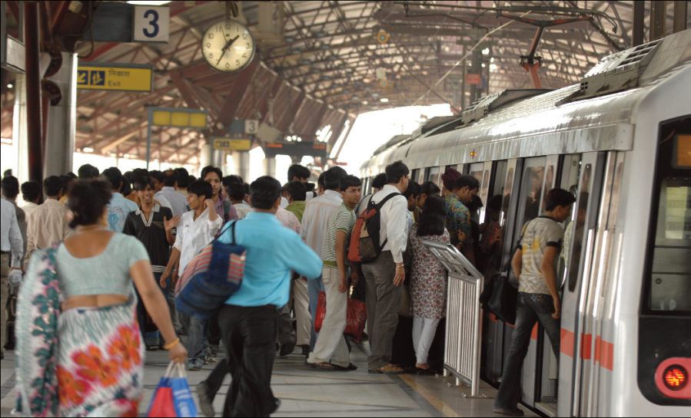
Positive impacts 2
Raises country’s profile
MNCs plan their moves carefully. This is known worldwide and the movement into a particular country is a statement about its pro-business environment and political stability.
Improves balance of payments
Many goods made by MNCs are exported to other nearby countries. This increases amount of money earned by the country.
Improves infrastructure
MNCs often improve communication links within a country, e.g. road, rail and port facilities are updated and expanded. This benefits the country.

Slide 12
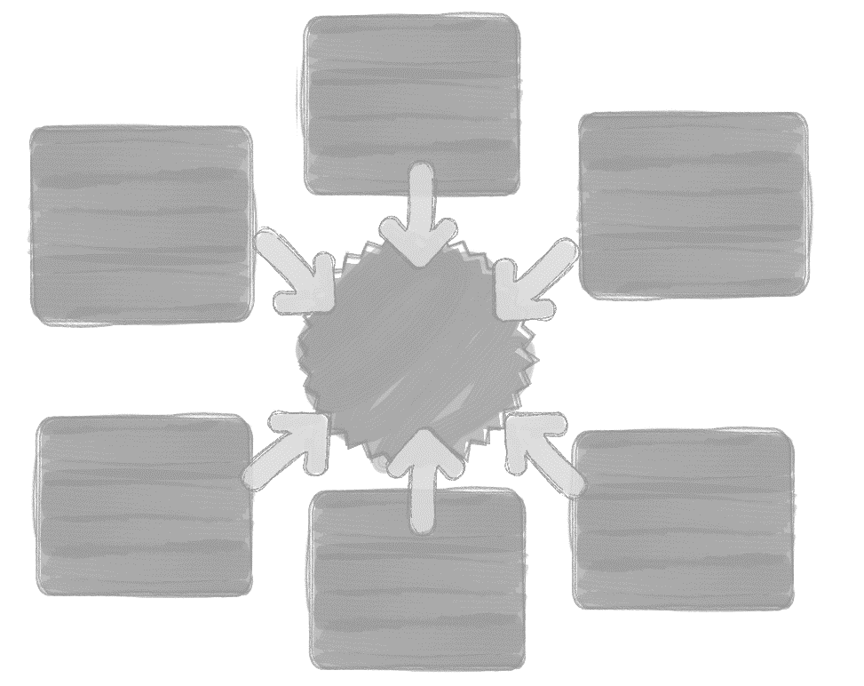
Negative effects of MNCs

Slide 13
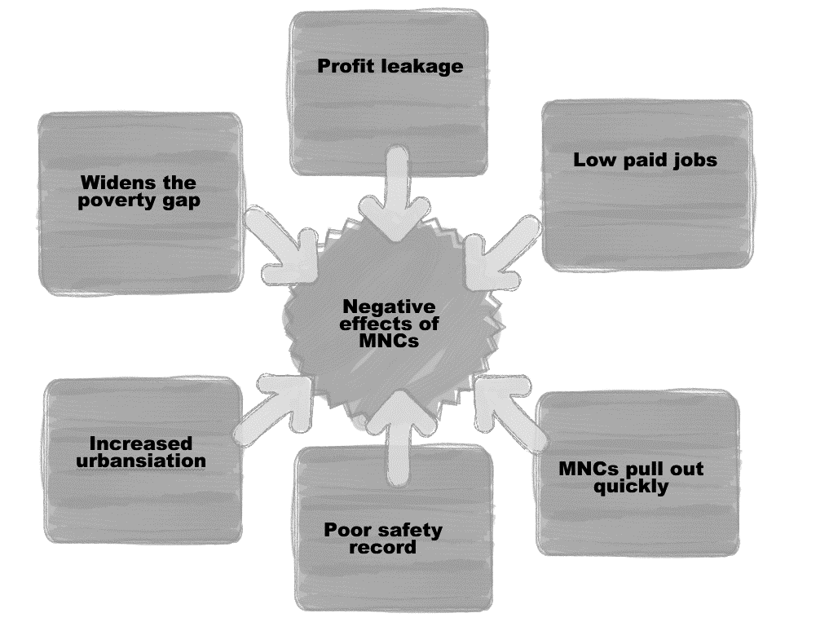
Negative effects of MNCs

Slide 14
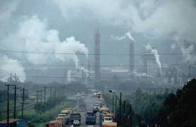
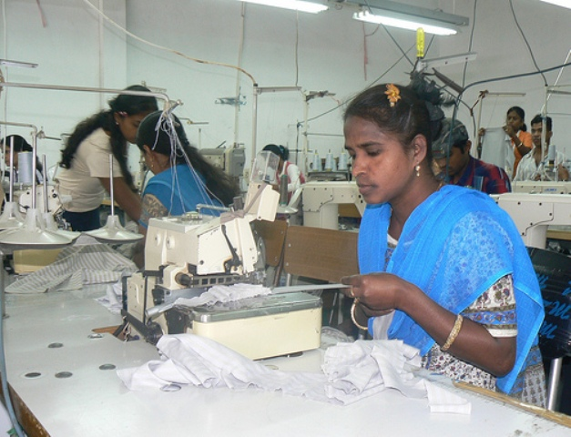
Negative impacts 1
Profit leakage; Profits from factories or hotels run by the MNC go to the country in which the head office of the company is found.
Low paid jobs; Mainly low paid jobs are provided for local people. Higher paid managerial jobs go to workers brought in from the head office country.
Pull out quickly; In times of recession/low sales, jobs of workers in the head office country are protected for longer than in other factories.

Slide 15
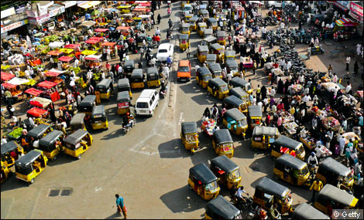
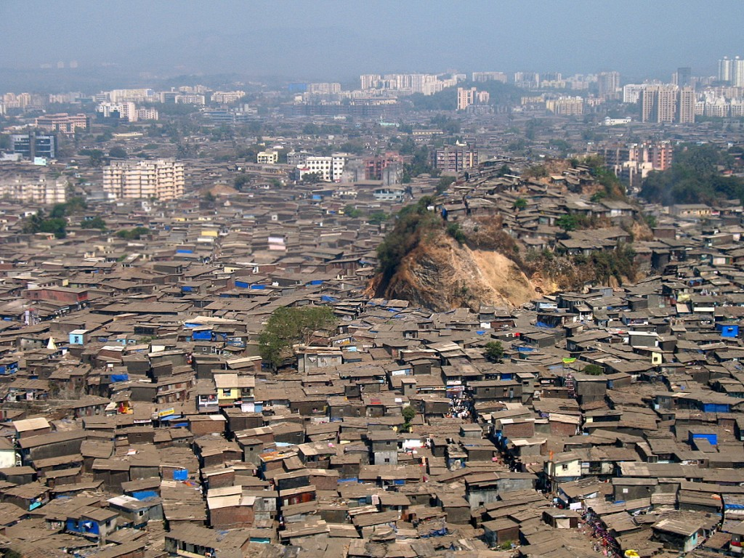
Negative impacts continued
Negative impacts 2
Poor safety record; Poorer countries often have poorer safety standards, and governments are willing to turn a blind eye to breaking the standards that exist.
Increases urbanisation; Most jobs created by MNCs are usually found in or close to urban areas. Hope of securing these jobs attracts more people from rural areas to cities.
Widens poverty gap; Although wages are low in factories, they are higher than elsewhere. This increases the cost of living for all, as prices of goods rise.

Slide 16
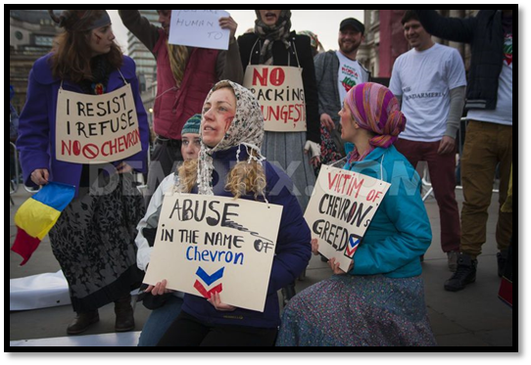
Impact on the local community / environment
The Unocal Corporation, which recently became a subsidiary of Chevron, is an oil and gas company based in California with operations around the world.
In December 2004, the company settled a lawsuit filed by 15 Burmese villagers, in which the villagers alleged Unocal's complicity in a range of human rights violations in Burma, including execution, torture, forced labour and forced migration.

Slide 17
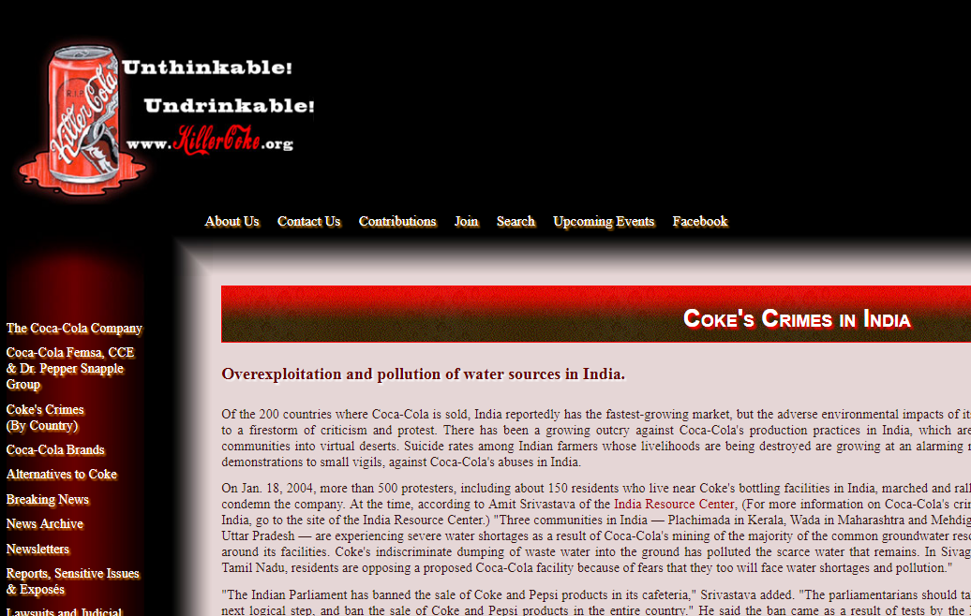
Impact on the local community / environment
In India, Coca-Cola extracted 1.5 million litres of deep well water, which they bottled and sold under the names Dasani and BonAqua.
The groundwater was severely depleted, affecting thousands of communities with water shortages and destroying agricultural activity.
As a result, the remaining water became contaminated with high chloride and bacteria levels, leading to scabs, eye problems, and stomach aches in the local population.
There is a website dedicated to this called Killer Coke – click the graphic above

Slide 18
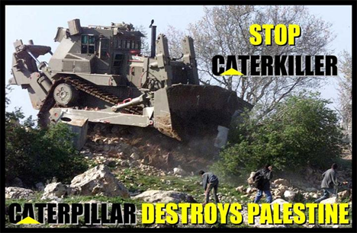
Impact on the local community / environment
For years, the Caterpillar Company has provided Israel with the bulldozers used to destroy Palestinian homes.
Despite worldwide condemnation, Caterpillar has refused to end its corporate participation house demolition by cutting off sales of specially modified D9 and D10 bulldozers to the Israeli military.

Slide 19
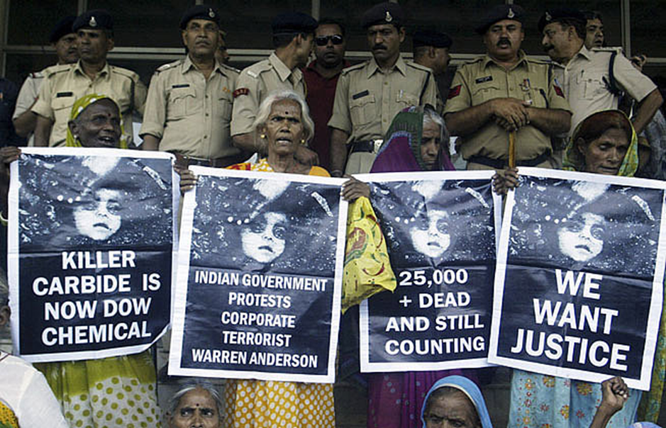
Impact on the local community / environment
Dow Chemical's impact is felt globally because it has been producing chlorinated chemicals and burning and burying its waste including chemicals that make up Agent Orange.
In New Plymouth, 500,000 gallons of Agent Orange were produced and thousands of tons of dioxin-laced waste was dumped in agricultural fields.

Slide 20
Impact of MNCs on national economy

Slide 21
MNCs and FDI flows
FDI is foreign direct investment
When a multinational invests in a host country, the scale of the investment (given the size of the firms) is likely to be significant.
Governments will often offer incentives to firms in the form of grants, subsidies and tax breaks to attract investment into their countries.
India has had $300billion of FDI to date

Slide 22
MNCs and the balance of payments
Inward investment will help a country's balance of payments.
The investment will be a direct flow of capital into the country and the investment is also likely to result in import substitution and export promotion.
Export promotion comes due to the multinational using their production facility as a basis for exporting, while import substitution means that products previously imported may now be bought domestically.

Slide 23
MNCs and technology and skills transfer
MNCs will bring with them technology and production methods that are probably new to the host country and a lot can therefore be learnt from these techniques.
Workers will be trained to use the new technology and production techniques and domestic firms will see the benefits of the new technology. This process is known as technology transfer.

Slide 24
MNCs and impact on consumers
If the multinational manufactures for domestic markets as well as for export, then the local population will gain from a wider choice of goods and services and at a price possibly lower than imported substitutes.
Consumers get the benefit of new products and services from the more industrialised nations

Slide 25
MNCs and the impact on business culture
Cultural and social impact - large numbers of foreign businesses can dilute local customs and traditional cultures.
George Ritzer coined the term McDonaldization to describe the process by which more and more sectors of American society as well as of the rest of the world take on the characteristics of a fast-food restaurant, such as increasing standardisation and the movement away from traditional business approaches.

Slide 26
MNCs and the impact on tax revenues and transfer pricing
The phrase “transfer pricing” as shorthand for multinational corporations shifting profits to tax havens to avoid tax in developed countries
Multinationals report vast profits in tax havens like the Cayman Islands, Luxembourg, Switzerland and Ireland where there is little or no production going on
Christian Aid estimates that developing countries lose $160 billion of tax revenue annually to transfer pricing
Also PDF from Christina aid here – report on MNC tax avoidance

Slide 27
Revision Video

Slide 28
Sample Edexcel A2 questions

Slide 29
Sample question 1
[6]
Knowledge 2
Application 2
Analysis
2
Notes:
Legacy question – no case study either

Slide 30
Answer sample question 1

Slide 31
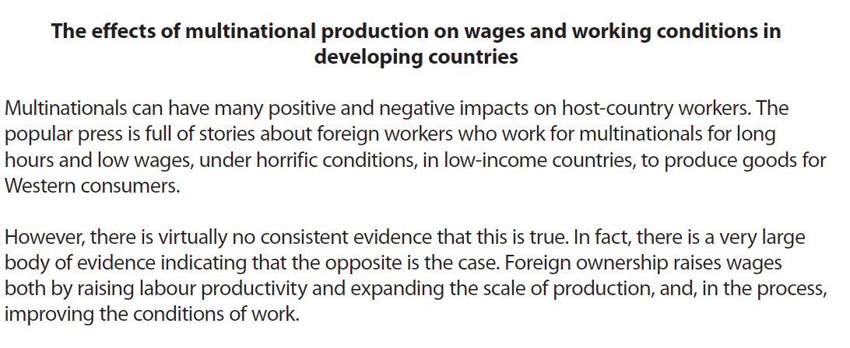
Case study for question 2

Slide 32
Sample question 2
Knowledge Level 1
1-2
Application Level 2
3
Analysis
Level 3
4-7
Evaluation
level 4
8-15

Slide 33
Answer sample question 2
e.g. defines multinationals or identifies aspects of economic development such as living standards
e.g. any specific examples illustrating the points made such as BP and the Gulf of Mexico, or Microsoft and Egypt
e.g. FDI, job creation, technology transfer, multiplier effects, raising productivity and wages OR negative aspects such as environmental damage etc.
Contrast the positive and negative effects of multinational activity, e.g. wages higher than local employers yet cause further inequality of incomes.
e.g. weighs relative significance of points raised such as employment and incomes are often more important to the unemployed than some externalities

Slide 34
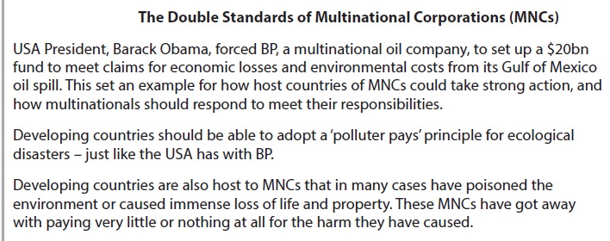
Case study for question 3

Slide 36
Sample question 3
[8]
Knowledge 2
Application 2
Analysis
4

Slide 37
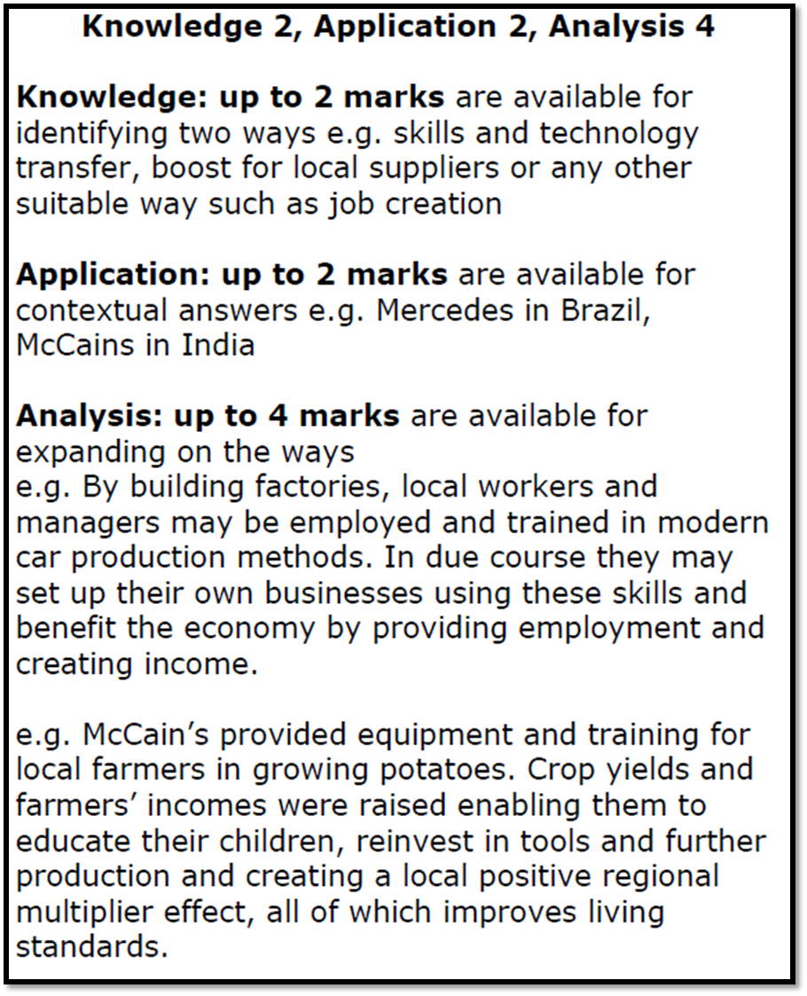
Answer sample question 3

Slide 38
Glossary
FDI; is a controlling ownership in a business enterprise in one country by an entity based in another country.
Balance of payments; the difference in total value between payments into and out of a country over a period.

