Slide 1
Edexcel A2 Business
1.2.4 Price Elasticity of Demand
Revisionstation

Slide 2
Worksheet

Slide 3
Calculators will be needed for this topic

Slide 4
From Edexcel
a) Calculation of price elasticity of demand
b) Interpretation of numerical values of price elasticity of demand
c) The factors influencing price elasticity of demand
d) The significance of price elasticity of demand to businesses in terms of implications for pricing
e) Calculation and interpretation of the relationship between price elasticity of demand and total revenue

Slide 5
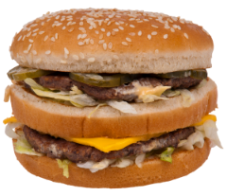
Starter
If the price of a Big Mac goes up to £10 would you still buy one?
Notes:
This is a good introduction to demand in action and should keep the discussion going about Bic Macs vs other favourites from McDs.

Slide 6
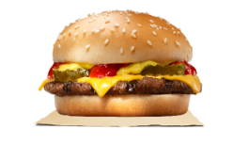
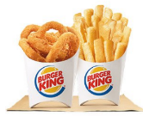
The link between demand and price
When prices go up, customers demand less. That statement makes logical sense and all businesses know this, so they try to avoid putting prices up.
If the business costs rise they try and absorb the costs so that the customers do not have to pay more, because this will affect demand for their product.
For example if McDs put up the price of a Big Mac to £10 customer demand will decrease, sales revenue for that product will decrease and profits will decrease.
There is another argument that customers may switch to an available substitute, and it may be McDs Chicken Nuggets OR the customer may switch to Burger King.
Business Vocab Note: we would prefer you to use increase and decrease rather than rise and fall.

Slide 7
Definition: PED
PED stands for price elasticity of demand
PED measures the responsiveness of demand to a change in price
PED can be either elastic or inelastic
PED values can be calculated so that you can work out if a product or service has elastic or inelastic demand
PED values are always a minus

Slide 8
Calculation of price elasticity of demand

Slide 9
PED formula
To calculate the price elasticity of demand (PED) we use a formula:
% change in Quantity demanded
__________________________________
% change in Price
This is not as simple as it first appears, we need to make a another calculation to find the % change in price or % change in quantity demanded – see next slide

Slide 10
% change in price formula
Price new – Price old
Price old x 100
Example: A price changes from £5 to £7. You could say that it has increased by £2, but you need to calculate the % change increase
Apply the formula: New is £7, Old is £5
What is the % change, show your answer to two decimal places
You can now use this answer in your PED formula
Notes:
5-7 = 2/5 = 0.4
0.4*100 = 40% change in price

Slide 11
Example calculations % change
 | Product A | Product B | Product C | Product D
Old Price | £300 | £55 | £70 | £60
New price | £290 | £29 | £77 | £65
% Change
Price new – Price old
Price old x 100

Slide 12
Example calculations % change - answers
 | Product A | Product B | Product C | Product D
Old Price | £300 | £55 | £70 | £60
New price | £290 | £29 | £77 | £65
% Change | 3.33% | 29.09% | 10% | 8.33%
Price new – Price old
Price old x 100

Slide 13
Example PED Calculation
Work through this walkthrough example
Sam owns a sunglasses business. She wants to know how elastic the demand for some of her products is. This will help her to decide if she should put her prices up or not.
If she puts up her prices from £35 to £55 then she sells 45% less.
Calculate PED and comment on the elasticity of demand.

Slide 14
Example PED calculation steps
Step 1 – Find the % change in price
55-35 / 35 *100 = -57.14% (a minus because the price has decreased)
Step 2 – Take the % change in quantity and divide it by the % change in price
45% / 57.14% = PED -0.79

Slide 15
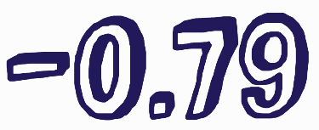
What does a PED value of mean?
When you calculate PED you get a numerical result (-0.79 for example) this will tell you if the product has:
Elastic demand (Demand for the product is sensitive to a change in price)
Value will be more than 1 e.g. 1.7, 2.4 etc
Inelastic demand (Very little change in demand with a change in price)
Values will be between 0 and 1 e.g. 0.2, 0.66 etc.
In the example is -0.79 elastic or inelastic?
Notes:
Inelastic

Slide 16
Interpretation of numerical values of price elasticity of demand

Slide 17
Elastic Demand
Can you explain why burgers and fast food have elastic demand?
Products and services that have elastic demand are responsive to a change in price
This means if the business puts prices up, then demand will decrease
If prices decrease then demand will increase. It stands to reason that if you make a product cheaper that more customers will want to buy it.
What happens if prices rise too high?
Notes:
Burgers have elastic demand because there are lots of substitutes if prices rise too high customers will go elsewhere.

Slide 18
Elastic Demand and calculations
If your PED calculation is more than 1 then this will mean that the product or service has elastic demand
For the business this means that they need to be careful when setting prices, too high and they will lose their customers, too low and they may not have enough supply to meet demand
Generally products with lots of substitutes have elastic demand
Examples -1.27, -1.4, -6,

Slide 19
Inelastic Demand
Inelastic demand is for goods where if the price is changed the demand stays the same
With inelastic demand there are few substitutes (e.g. insulin, petrol)
Generally addictive products have inelastic demand – can you explain why?
Notes:
Addictive products – customers will buy them no matter what the price.

Slide 20
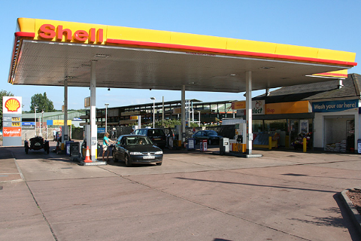
Inelastic demand explained
You are in your car, you are running very low on petrol – but at last you see a garage and pull in
Questions
What choice of products do you have?
Are there any substitutes for petrol that you could put in your car?
Can you drive away if you are unhappy with the price of the petrol?
Can you explain why demand remains unchanged even when the price of petrol increases?
Notes:
1) Petrol / diesel /
2) No
3) No you can’t drive away as you don’t have any petrol
Explanation – there are NO substitutes so demand will remain almost constant

Slide 21
Inelastic demand and calculations
When you calculate PED using the formula: If the result is between 0 and -1 this means that demand is inelastic
Examples
-0.2 = inelastic demand
-0.45 = inelastic demand
-0.006 = inelastic demand

Slide 22
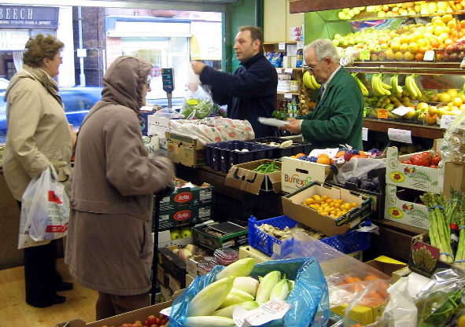
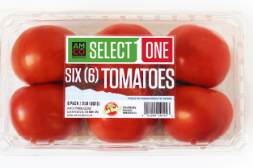
Example 1
John runs a greengrocers in a high street. He decides to increase the price of a pack of tomatoes from £1.50 to £1.75 and he knows that demand will fall 25% - calculate and comment on the PED value of the tomatoes
Notes:
Change in P = 0.25/1.50 *100 = 16.67% (rounded up)
Change in Q = -25%
-25/ 16.67 = -1.50 (rounded up)
PED value is above -1 therefore demand for his tomatoes is elastic, if he puts prices up too high, customers may buy from the supermarket instead

Slide 23
Example 1 - answer
% change in price = 0.25/1.50 *100 = 16.67% (rounded up)
% change in quantity demanded was given in the question = -25%
-25/ 16.67 = -1.50 (rounded up)
Comment:
The PED value of the tomatoes is -1.50 which is above -1 therefore demand is elastic
If John puts prices up too high, customers may buy from the supermarket instead because there are lots of substitutes for this product and for John’s greengrocers shop.

Slide 24
Example 2
Kathryn makes scarves, they are not selling very well, there is lots of competition in the high street.
She has decided to reduce the price of her scarves from £15 each to £8 each. She expects to see a rise in demand of 80%.
Calculate the PED value of the scarves and comment on her decision

Slide 25
Example 2 - answer
% Change in Price = -7/15 *100 = 46.67% (rounded up)
% Change in Quantity demanded, which you are given in the question = 80%
PED calculation is therefore
80/-46.67 = -1.71
Comment:
The PED value is -1.71 which is above -1, this means the scarves are elastic products, therefore if she reduces the prices of her scarves then demand will increase

Slide 26
Example 3
Gurpal owns a sandwich bar, he sells soups and sandwiches. They are selling well, but he would like to make more revenue, but he is worried if he puts his prices up that his customers will go elsewhere.
So, he thinks he might increase the price from £5 to £9 for a soup and sandwich combo meal and he estimates that demand may decrease by just 10%
Calculate the PED value of one of his combo meals and comment on his decision

Slide 27
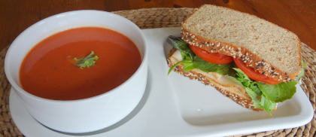
Example 3
% Change in Price 4/5 *100 = 80%
% Change in Quantity Demanded which is given in the question
= -10%
PED value -10/80 = -0.13 rounded up
Comment:
The PED value of the soup and sandwich combo meal is -0.13 which is below -1 which suggests that Gurpal’s customers are loyal and demand will not change if he puts his prices up

Slide 28
The factors influencing price elasticity of demand

Slide 29
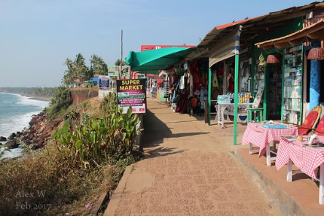
Availability of substitutes
Example
PED
-1.82
When a market has a large number of available substitutes, then the more sensitive demand will be to price
Lots of substitutes
Means
Demand for products is more sensitive to price
Means
Product is more price elastic
Example, beach shops often all sell the same goods

Slide 30
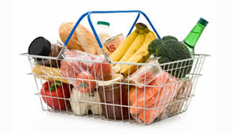
Frequency of purchase
Example
PED
-3.4
Products that are bought frequently by consumers tend to be very elastic (sensitive to price)
Frequent purchase
Means
Consumers sensitive to changes in price
Means
Products are price elastic

Slide 31
Necessities (staple goods)
Example
PED
-0.021
Necessities have lower price elasticises as consumers must purchase the product despite price changes
Petrol is a necessity
Means
Consumers need to keep buying petrol even if price increases
Means
Product is very price inelastic
Notes:
The more necessary a good is, the lower the price elasticity of demand

Slide 32
Luxury goods
Example
PED
- 1.96
Luxury goods tend to be very expensive, these are a very large percentage of consumer’s incomes
The high cost will cause consumers to pay attention to the price
Luxury goods
Means
Large investment so consumers very sensitive to price change
Means
Product is price elastic
Notes:
The higher the percentage of a consumer's income used to pay for the product, the higher the elasticity tends to be.

Slide 33
The significance of price elasticity of demand to businesses in terms of implications for pricing

Slide 34
Competitive pricing
Some products or services are priced very similar to close competitors
This is used by a business which sells products that have very close substitutes
This means that customers will may have to judge a product or service on “non-price” methods such as; quality of service, speed, extras etc.
Have you tried searching for car insurance on price comparison sites? Do you get similar prices?

Slide 35
Skimming pricing
Products that are unique or first to market can have a high price can charged at introduction or launch
This is so that the business can maximise revenue and profits before substitutes appear on the market
High demand when product first launched at it will have a Unique Selling Point (USP)
The business will need to set high prices to recoup research and development (R&D) costs

Slide 36
Calculation and interpretation of the relationship between price elasticity of demand and total revenue

Slide 37
PED and total revenue
There is a relationship between PED and Total Revenue
Total revenue is calculated by: TR = Quantity x Price
Total revenue is a measure of how much can be made from selling products / services (before costs have been taken off)
A business will have an objective of maximising profits, to do this it will need to increase total revenue
Total revenue can be increased by increasing price
This is why business managers will need to know PED – they need to know how sensitive their customers are to a change in price

Slide 38
Revision Video
Notes:
https://www.youtube.com/watch?v=fL0SlEnWSw4

Slide 39
Sample Edexcel A2 questions

Slide 40
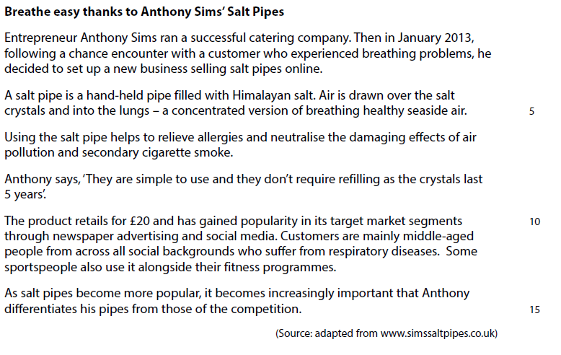
Case Study for sample question 1

Slide 41
Sample question 1
Knowledge 1
Application 3

Slide 42
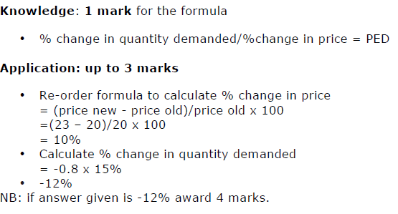
Final answer to sample question 1

Slide 43
Case study for question 2

Slide 44
Sample question 2
Knowledge 2
Application 2
Analysis
4
Evaluation
4

Slide 45
Answer question 2 paper 1/2

Slide 46
Answer question 2 paper 1/2

Slide 47
Formula round up – two to remember
PED:
% change in Quantity demanded
__________________________________
% change in Price
% Change in price
Price new – Price old
Price old x 100

