Slide 1
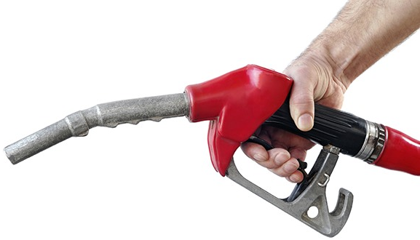
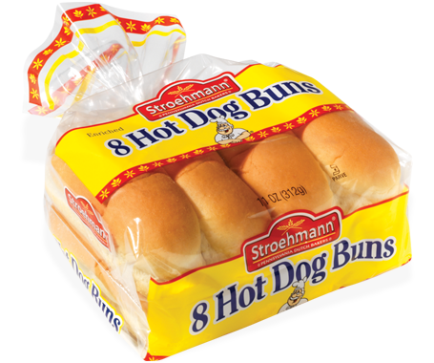
How could this be useful/important to the government and firms?
STARTER – DEFINE PED
RECAP: What is PED?

Slide 2
How could these be useful/important to government and firms?
STARTER – DEFINE PED, YED & XED
RECAP: What is PED?

Slide 3
Complete the results trees for YED and XED…
STARTER
RECAP: What is PED?

Slide 4
Is the XED positive or negative?
Positive
Negative
ZERO
Substitute
Complementary
Unrelated
Inelastic
Elastic
Inelastic
Elastic
Weak Substitute
Strong Substitute
Weak Complement
Strong Complement

Slide 5
Is the YED positive or negative?
Positive
Negative
NORMAL GOOD
INFERIOR GOOD
We don’t need to analyse any further than this for inferior goods.
Greater than 1
Less than 1
LUXURY GOOD
NECESSITY

Slide 6
LEARNING OBJECTIVES
Lo1: State factors which influence the PED of goods/services.
Lo2: Explain the relationship between PED and revenue, whilst identifying varying PED along a demand curve.
Lo3: Apply uses for XED, YED and PED in the real world.

Slide 7
Specification
1.2.3 Price, income and cross elasticities of demand e) The significance of elasticities of demand to firms and government in terms of: changes in real income changes in the prices of substitute and complementary goods f) The relationship between price elasticity of demand and total revenue (including calculation) Students should be able to understand the diagram that links total revenue (TR) with price changes along a demand curve (in slides). This diagram is revisited in more detail during Year 13.

Slide 8
GROUP ACTIVITY
In small groups.
Each group will be given a factor that influences PED, along with a question.
You will be given 10 MINUTES to consider the statement and answer the question(s).
Afterwards each group will have 2 MINUTES to present their findings back to the class, who will then fill in a table for each factor.

Slide 9
PED AND REVENUE
Complete the PED and Revenue worksheet.
Use the information in the table to draw the total revenue curve.
Follow the instructions very careful – if you are unsure, ask before drawing!

Slide 10
25
Revenue
24
24
Answers
16
16
Demand curves have two sections along the curve.
These sections are an elastic section and an inelastic section.
13
This can help a firm establish what impact a price change will have upon revenue.
Total Revenue (TR)
Here revenue is maximised when the price is £5 and Qd 5
Quantity
Elastic section: between £10 and up to £5
Price
10
Revenue rises as the price falls (vice versa)
8
Elastic
Inelastic section: from £5 to £0
Unit Elastic
6
Revenue falls as the price falls (vice versa)
5
Inelastic
4
2
Demand
2
4
6
8
10
Quantity

Slide 11
PED AND REVENUE - Website
The higher part of the demand curve (where lowering the price increases revenue) is described as the ‘elastic section’.
The lower part of the demand curve (where lowering the price decreases revenue) is described as the ‘inelastic section’.
The point where these two sections meet would be the ‘unitary point’ and at this price/quantity the revenue is maximised.
http://web.mit.edu/11.203/www/econ/index.php%3Fid=5.html
This interactive website shows how the elasticity varies along a demand curve.

Slide 12
Revenue PED Answer
A hotel has 75 rooms; it finds that when it charges £130 per night it fills 50 rooms. It calculates that the price elasticity of demand is – 1.5. What will be the change in total revenue if it lowers the price for each room by 20 per cent?
??????
50 rooms (Qd) x £130 = £6,500 is the original revenue
_________________
= -1.5
P -20%
£130 reduced by 20% = £104
-20 x -1.5 = +30 (price change)
50 Qd increased by 30% = 65
Qd +30%
65 rooms (Qd) x £104 = £6,760 is the new revenue
_________________
= -1.5
P -20%
Revenue has changed by +£260

Slide 13
Demonstrating Revenue on a Demand Curve
Price
P1
. PED = 1
Drawing a total revenue curve is not the only way to show revenue.
P2
Revenue can be demonstrated by the area of QxP at any given price.
P3
If P2 is where on the unit elastic part of the demand curve, then the blue box will have the largest area (revenue).
Demand
If the price falls to P3, then the area of this final box will be smaller than the blue box.
Q1
Q2
Q3
Quantity

Slide 14
NOTE!
This topic can become overly complicated.
Stick to only what is on the activity, slides, notes and that is as far as you need to go for the A-Level.

Slide 16
Specification
1.2.3 Price, income and cross elasticities of demand e) The significance of elasticities of demand to firms and government in terms of: changes in real income changes in the prices of substitute and complementary goods f) The relationship between price elasticity of demand and total revenue (including calculation) Students should be able to understand the diagram that links total revenue (TR) with price changes along a demand curve (in slides). This diagram is revisited in more detail during Year 13.

Slide 17
GOVERNMENTAL USE OF XED/PED – 5 minutes
Look at the following images…
How are RBC using XED/PED?
In which markets do you think price elasticity of demand is being impacted upon?
Is the market becoming more inelastic/elastic – why?
Notes:
…relationship between bikes and cars, reducing congestion.

Slide 18
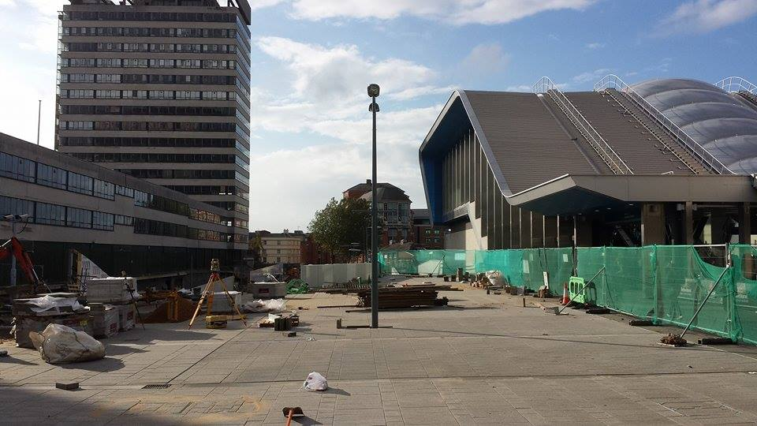

Slide 21
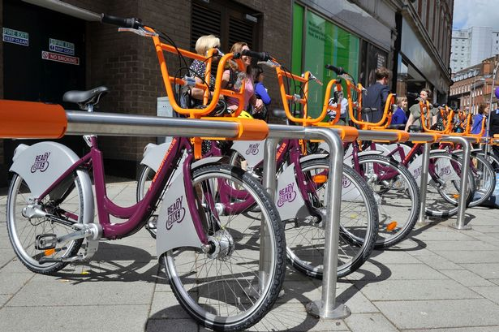

Slide 22
GOVERNMENTAL USE OF PED/XED – 5 minutes
How are RBC using PED?
In which markets do you think price elasticity of demand is being impacted upon?
Is the market becoming more inelastic/elastic – why?
Notes:
…relationship between bikes and cars, reducing congestion.

Slide 23
Notes:
Price of unleaded fuel. What is happening to the price of fuel? Why?

Slide 24
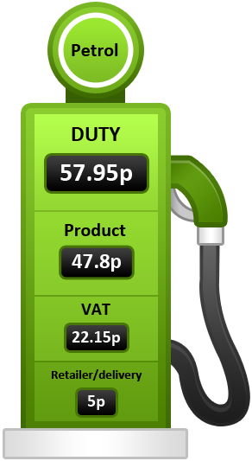
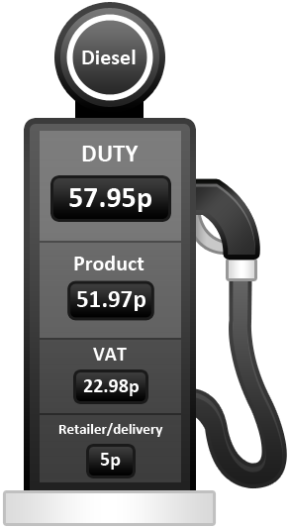
GOVERNMENT USING PED
The average price of a litre of unleaded petrol is 129.7p per litre.
How much of this do you think is tax?
Unleaded: 80.1p tax
Diesel: 80.93p tax
https://youtu.be/p9cJtUKEbyM
VIDEO - http://www.bbc.co.uk/news/business-12250225

Slide 25
15 mins – PED and Petrol
Complete the worksheet relating to PED and Petrol
Continue onto the: Cause and effects of PED.

Slide 26
MINI-WHITEBOARD PLENARY
On your mini-whiteboards!
Answer the following multi-choice questions, which all relate to the learning objectives for today’s lesson.
BE AWARE: There may be more than one answer! …or even none that all!

Slide 27
LEARNING OBJECTIVES
Revisited!
Lo1: State factors which influence the PED of goods/services.
Lo2: Explain why particular goods/services are targeted by the government for taxation
Lo3: Analyse and comment upon the factors which influence the PED of goods and services.

Slide 28
LEARNING OBJECTIVE 1
Question 1: Which of these is not a factor that impacts upon the PED of a good/service
A: Number of substitutes
B: Necessity
C: Availability of raw materials
D: Breadth of definition
E: Opportunity cost of production

Slide 29
LEARNING OBJECTIVE 1
Question 2: Which of these is not a factor that impacts upon the PED of a good/service
A: Habit
B: Switching Costs
C: Income
D: Short/Long-run
E: Peak and off-peak effects
F: None of the above
THEY ARE ALL FACTORS WHICH INFLUENCE PED!

Slide 30
LEARNING OBJECTIVE 2
Question 3: Why would the government generally choose not to put a tax on bath salts?
A: Because bath salts are relatively inelastic
B: Because bath salts are relatively elastic
C: A price rise would cause a proportionately larger decrease in quantity demanded.
D: A price rise would cause a proportionately smaller decrease in quantity demanded.

Slide 31
LEARNING OBJECTIVE 2
Question 4: Which of the following goods is the government most likely to tax?
A: Esso Petrol
B: Healthcare
C: Baby clothes
D: Diamonds

Slide 32
LEARNING OBJECTIVE 2
Question 5: If a good has a PED of 2.5, would you advice the government to put a tax on this good?
A: Yes, the PED is elastic and demand will fall a lot.
B: No, the PED in inelastic and demand won’t fall much.
C: No, the PED is elastic and demand will fall a lot.
D: Yes, the PED is inelastic and demand will fall a lot.

Slide 33
LEARNING OBJECTIVE 3
Question 6: Airline flights during the summer holidays are most likely to be…
A: Inelastic because there is only a fixed amount of aeroplanes.
B: Elastic because the price of flights will rise.
C: Inelastic because children are on holiday from school.
D: Elastic because jet fuel will be in short supply.

Slide 34
LEARNING OBJECTIVE 3
Question 7: The breadth of definition of a good or service is important when considering PED because…
A: Branded goods have less substitutes.
B: Individually branded goods will be more elastic.
C: The reaction of supply may not be prompt.
D: Referring to a good ‘in general terms’ makes it more inelastic e.g. petrol.

Slide 36
USING XED
Why does a firm want to know XED?
Knowing the XED of its own and other related products enables the firm to map out its market.
Mapping allows a firm to calculate how many rivals it has, and how close they are. It also allows the firm to measure how important its complementary products are to its own products.
This knowledge allows the firm to develop strategies to reduce its exposure to the risks associated with price changes by other firms, such as a rise in the price of a complement or a fall in the price of a substitute.

Slide 37
FIRMS USE OF XED –
15 minutes
Identify all of the examples of Cross Elasticity of Demand that are mentioned.
What kind of association do these goods/services have with each other, are they complements/substitutes?
How are the businesses involved utilising this knowledge of XED to make a profit?
Notes:
…relationship between bikes and cars, reducing congestion.

Slide 38
USING YED - UKIP WAG TAX ARTICLE
Give examples of the kinds of goods/services that Ukip may have targeted with the ‘WAG tax’.
What would the YED value be with these goods?
Draw the demand curve for such goods.
Who are Ukip trying to target with this tax and, considering the YED nature of luxury goods, how could this impact upon inequality?

