Slide 1
Welcome to BJ6 RS A Level
What we do in A level RS lessons:
Work really hard (sometimes anyway)!
Chat (Discuss lots of issues related to the subject - and not!)
Drink coffee/tea/hot chocolate (occasionally, if someone is prepared to wash up!)
Have a great time (current year 12s will tell you they really enjoy the subject)!

Slide 2
Introduction to RS A Level
The course has 3 elements:
Philosophy the study of the fundamental nature of knowledge, reality, and existence, especially when considered as an academic discipline.
Ethics (or Moral Philosophy) is concerned with questions of how people ought to act, and the search for a definition of right conduct (identified as the one causing the greatest good) and the good life (in the sense of a life worth living or a life that is satisfying or happy).
Buddhism a widespread Asian, non-theistic religion or philosophy, founded by Siddartha Gautama in NE India in the 5th century BC. A path of spiritual development leading to Insight into the true nature of reality.

Slide 3
Introduction to RS A Level
http://www.philosophyexperiments.com/fatman/Default.aspx
How good are your ethics? Would you kill the fat man?
What is the purpose of the preliminary questions?
Are you surprised at the statistics on the graphs after the preliminary questions?
Were you surprised at your responses to the questions?
After completing the scenario questions, what were your inconsistencies?
What is this exercise telling us about morality?

Slide 4
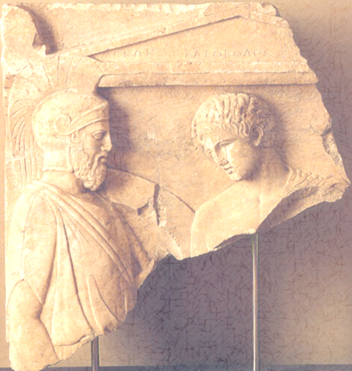
Introduction to RS A Level
What is philosophy all about?
Split into two groups. Each group will be given a piece of paper with a question on.
Only the first person is to read the question.
On the line below write a response to the question (it cannot be a yes/no/don’t know answer). Fold over the question so only your answer can be seen – not the question.
Pass the paper on to the next person in the group. This person is to write a response to what the previous person has written. Fold over the paper so just your response can be seen. Repeat until everyone has written a response. Pass the sheet, still folded, back to the teacher.
What were the questions?

Slide 5
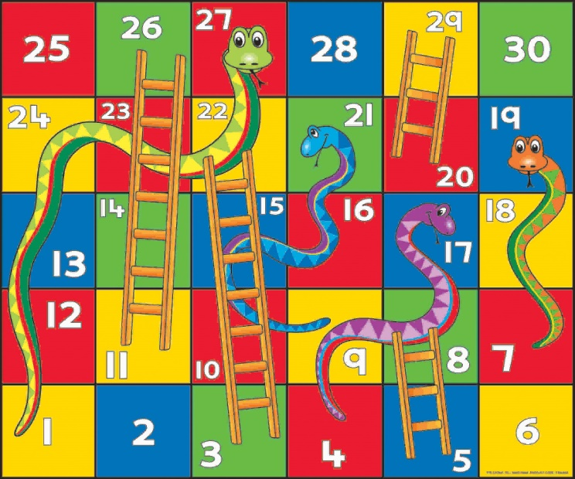
Introduction to RS A Level
How do Buddhist beliefs affect how a Buddhist lives?
Play Snakes and Ladders!
What did you learn about the Buddhist way of life from the game?

Slide 6
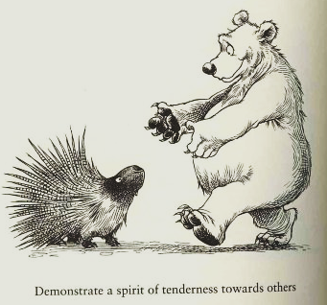
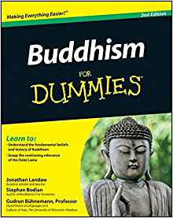
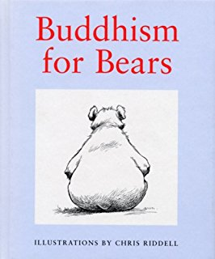
Introduction to RS A Level
Independent Learning…
Between now and when you start the course in September – read!
A very easily accessible novel that is an excellent introduction to philosophy is Sophie’s World.
Also Read about the basics of Buddhism.

