Slide 1
Edexcel A2 Business
4.4.3 Controlling MNCs
Revisionstation

Slide 2
Worksheet

Slide 3
From Edexcel
a) Factors to consider:
political influence
legal control
pressure groups
social media

Slide 4
Starter
True or false?
Walmart is larger in terms of income than Austria, South Africa and Qatar.
Six British multinationals 'did not pay any UK corporation tax in 2014'
Notes:
1 true
2 true

Slide 5
Control of MNCs
The activities of MNCs can be controlled (to some extent). This depends on; the MNC in question, the activities of the MNC and the country where this is all taking place.
There are lots of methods, but the main four that your exam board would like you to know about are:
political influence
legal control
pressure groups
social media
You need to know about these methods, some examples and benefits and drawbacks of each method. Some good sample questions at the end to help you practice this.

Slide 6
Political influence

Slide 7
Political influence to control MNC activity
Governments can apply pressure to attempt to change the behaviour of MNCs
For example MNCs have been avoiding paying tax in the UK
Starbucks
Google
Amazon
Since 2012, when the UK Chancellor at the time, put tax avoidance on the G20 agenda, the UK has helped reform international tax rules and led the way with action to prevent corporations from paying little or no taxes

Slide 8
Benefits of the use of political influence to control MNC activity
MNCs may wish to get political approval from the governments of the host nations, this may help trade and setting up in a new country
If the MNC gains political approval they may find trading smoother and less troublesome

Slide 9
Drawbacks of the use of political influence to control MNC activity
Politicians can be bribed, not such an issue in the UK but quite common in other countries
Some MNCs bring so much wealth and employment to an economy that a weaker government might ignore unethical activities, for example:
Brazil
Nigeria
Mali

Slide 10
Legal control

Slide 11
Legal controls to control MNC activity
If a country introduces laws to reduce pollution or protect children from child labour then this will all cost the MNC money to improve their practices
Quite often the MNC may ignore or flout these regulations
Prime example is the Deepwater Horizon where the US government legally made BP pay compensation to Mexicans affected by the disaster (see video at end of PowerPoint)

Slide 12
Benefits of the use of legal controls to control MNC activity
Laws can be passed at any point to control the actions of a MNC which are already established in a country
Laws mean that consumers have some rights against the MNC as in the McLibel case – see next slide
However even if laws are introduced they may still be broken by the MNCs – see Apple Foxconn video

Slide 13
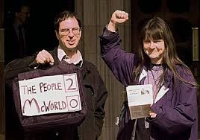
McLibel
Video (over 1 hour but great)
McDonald's Corporation v Steel & Morris [1997] known as "the McLibel case" was an English lawsuit for libel filed by McDonald's against environment activists Helen Steel and David Morris, the original case lasted ten years, making it the longest-running case in English history

Slide 14
Drawbacks of the use of legal controls to control MNC activity
The MNC may simply move production to a country where there are less laws and restrictions
The host nation does not want to lose the economic input of the MNC so this deters laws being passed
MNCs can afford expensive legal defence of any challenge

Slide 15
Pressure groups

Slide 16
Research task – 1 lesson – fact sheet
Pressure groups
1) What is a pressure group?
2) Overview of your chosen pressure group e.g. methods and history
3)Any current actions e.g. War on Want McD campaign
4) Any evidence to support pressure groups controlling the actions of MNCs?
Greenpeace
War on Want
Friends of the Earth
Amnesty International
Oxfam

Slide 17
Pressure groups to control MNC activity
Pressure groups are organisations which campaign for changes in the law or new legislation in specific areas.
Pressure groups can have a strong influence on public opinion and behaviour of MNC, if they want to avoid a PR disaster
Pressure groups such as
Greenpeace
WWF
Friends of the Earth
War on Want

Slide 18
Benefits of the use of pressure groups to control MNC activity
Pressure groups can raise public awareness of MNCs activities in host countries
Pressure groups can create PR problems for MNCs peacefully, which can lead to a change in their behaviour

Slide 19
Pressure groups examples

Slide 20
Drawbacks of the use of pressure groups to control MNC activity
The pressure group needs to be large and organised if it is to have any impact on changing the activities of the MNCs
The size and wealth of the largest MNCs mean they can easily counter or quieten pressure group activity

Slide 21
Social media

Slide 22
Social media to control MNC activity
Tools such as Twitter can see the swift mobilisation of public opinion and hence pressure on MNCs to change their behaviour
Social media can turn a product scare into a national crisis within hours
Social media networks can be used to orchestrate a boycott which will affect the sales and reputation of the MNC

Slide 23
Benefits of the use of social media to control MNC activity
Social media can be a very powerful way to change the behaviour of MNCs
For example twitter can put pressure on large corporations
Trip Advisor has become a very powerful way for customers to alter policy, activity and services of large hotel chains

Slide 24
Drawbacks of the use of social media to control MNC activity
Social media can only effect short-term change the Internet is a dynamic medium, fickle customers become bored easily and move on to the next scandal
A MNC can just dust itself down and carry on with very little impact on their activities

Slide 25
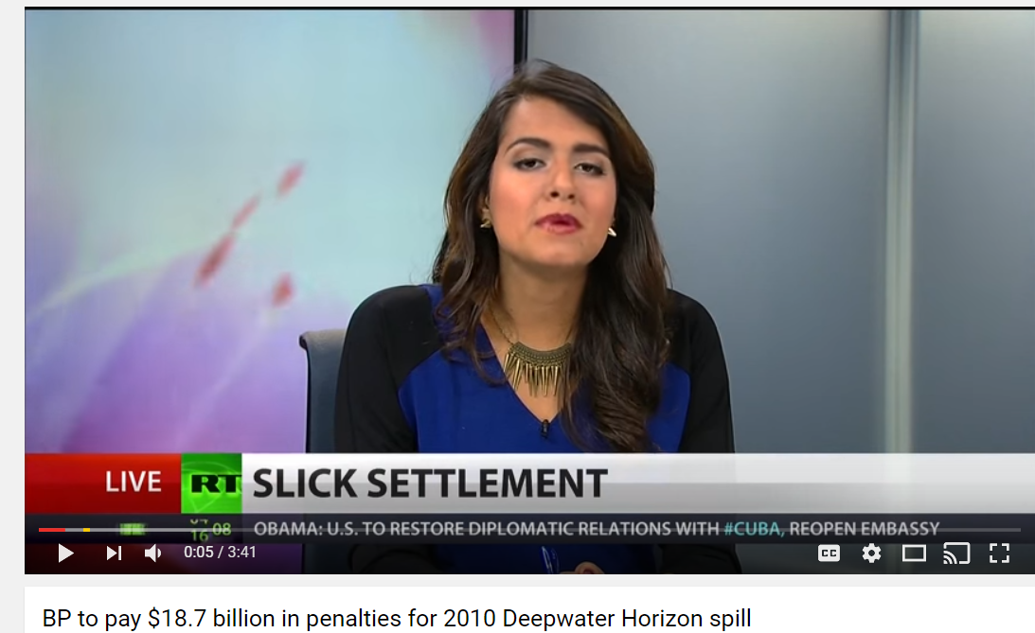
Revision Video

Slide 26
Sample Edexcel A2 questions

Slide 27
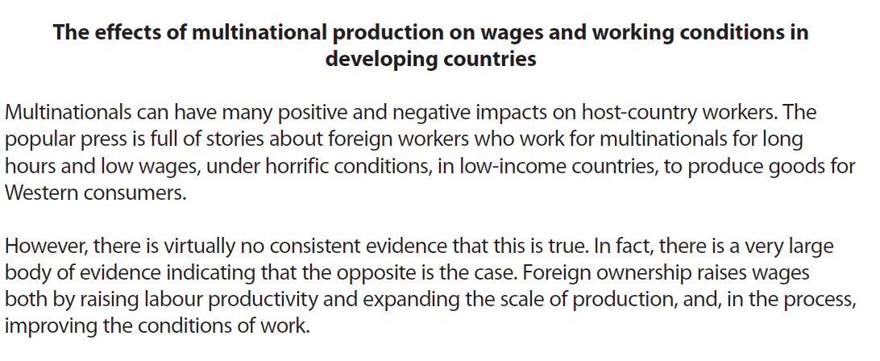
Case study for question 1

Slide 28
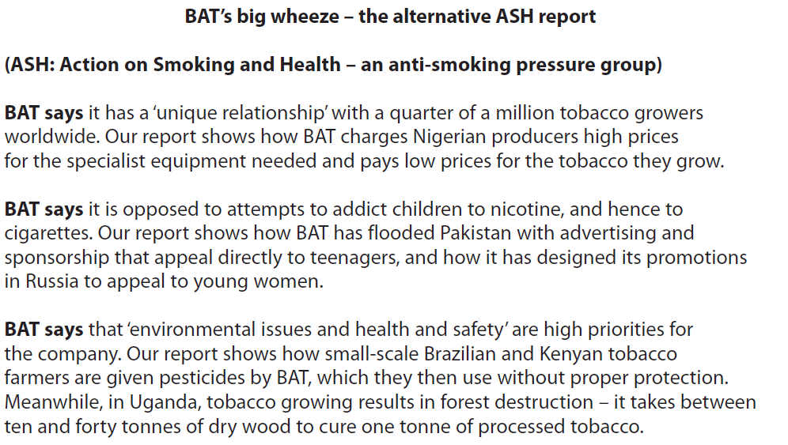

Slide 29
Sample question 1
[10]
Knowledge 2
Application 2
Analysis
3
Evaluation
3

Slide 30
Answer sample question 1
e.g. pressure groups, legislation
e.g. the work of ASH is referred to or any other specific example from the evidence or their own knowledge that is relevant.
e.g. government legislation, pressure group activity, public pressure, media influence could impact on sales and lead to multinationals changing their operations
e.g. Some countries may actually benefit so much from multinationals that little is actually done to attempt to control them

Slide 31
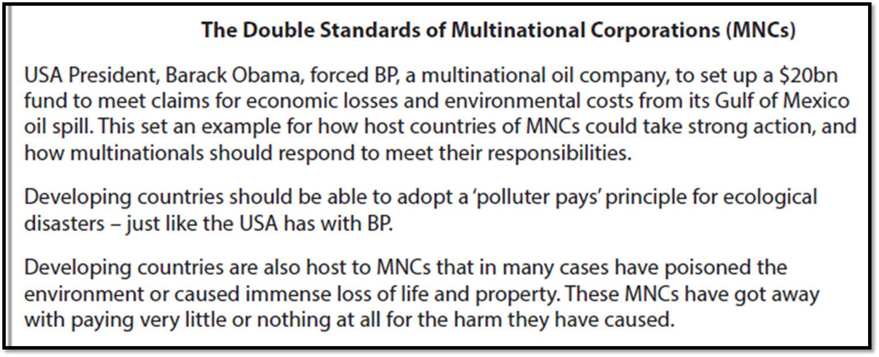
Case study for question 2

Slide 32
Sample question 2
[12]
Knowledge 3
Application 3
Analysis
3
Evaluation
3

Slide 33
Answer sample question 2
e.g. a MNC is a business that operates in more than one country. e.g. MNCs can be controlled by laws e.g. that BP is being made to pay compensation by the US government. Or uses another example from their own knowledge e.g. Starbucks and paying tax after public pressure
The actions of MNCs can be controlled by:
e.g. legal challenges/rulings/court cases brought by governments to force MNCs to change behaviour. e.g. campaigns by pressure groups forcing compliance. e.g. public opinion and boycotts which impact on sales and bring pressure to bear. e.g. pressure groups that launch a campaign against the actions of a MNC to change behaviour. e.g. adverse media coverage that mobilises public opinion against the MNC. e.g. use of social networks to orchestrate a boycott that could hit sales.
Begins to discuss the other side of the arguments which look at the extent to which these tactics will actually be effective in controlling the actions of MNCs:
e.g. MNCs can employ effective legal backing to overthrow legal challenges. e.g. overriding economic considerations can persuade governments not to be too harsh on MNC behaviour. e.g. an awareness that it depends on the strength of the government - the USA and China are likely to be more effective at controlling MNCs than Nigeria or Malawi. e.g. the effectiveness of consumer pressure will depend on whether the MNC sells to the public and has a positive image to protect such as Disney, in which case it is more likely to change its behaviour, or whether it has little or no direct public involvement such as a mining company like Freeport

Slide 34
Case study for question 3

Slide 35
Sample question 3
[9]
Knowledge 2
Application 2
Analysis
2
Evaluation
3

Slide 36
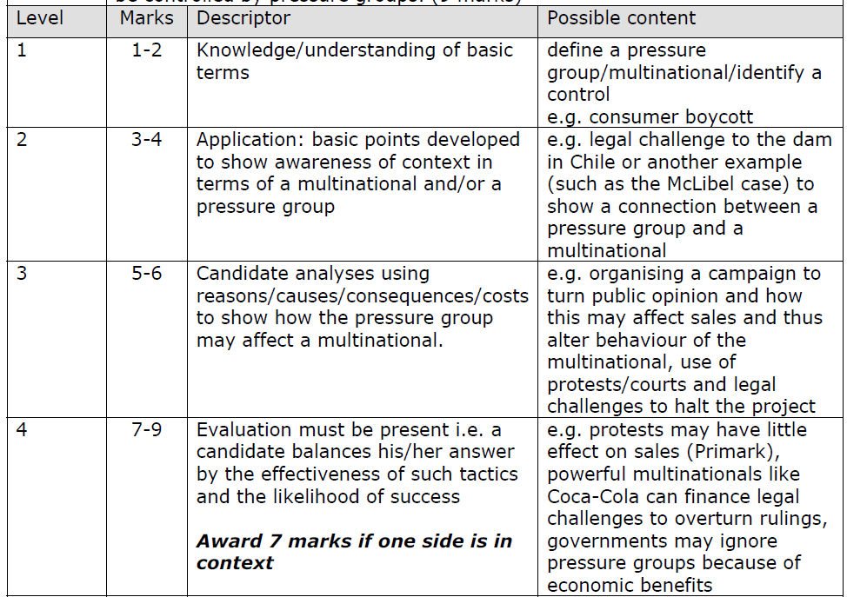
Answer sample question 1

Slide 37
Glossary
MNC; multi national corporation, a large business that trades in more than one country for example McDonald's, Nike and Coca-Cola
Pressure group; A group that wants to influence government or organisations to make them change a policy or behaviour
Social media; are computer-mediated tools that allow people to create, share or exchange information, ideas, and pictures/videos in virtual communities and networks

