Slide 1
Edexcel A2 Business
2.3.3 Business Failure
Revisionstation

Slide 2
Worksheet

Slide 3
From Edexcel
a) Internal and external causes of business failure:
financial factors
non-financial factors

Slide 4
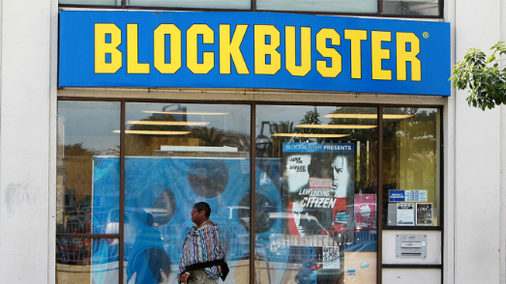
Starter
Question: Why do you think Blockbuster no longer trades?
Watch the clip and then try and answer the question again.

Slide 5
Definition: Business Failure
Business failure is when a business ceases to trade or when a business does not trade in a profitable way or when a business makes a terrible decision

Slide 6
Internal and external causes of business failure

Slide 7
Internal causes of business failure
Business failure can be down to factors inside the business, there are many of these such factors, but the ones your exam board would like you to be able to discuss are:
Poor efficiency
Poor marketing
Failure to innovate
Bad management of working capital

Slide 8
#1 Poor efficiency
Modelzone was started by David Mordecai in 1987 in Brighton
In 2013 Modelzone closed leaving £9million of debt unpaid to Lloyds bank
47 stores closed and 387 workers lost their jobs
This was due to an aggressive and disastrous expansion plan
The store opened 15 new shops between 2010 and 2012 but did not have the sales to sustain it, as online trade was taking the business
Reason for failure: Unrealistic sales forecasts which lead to over expansion

Slide 9
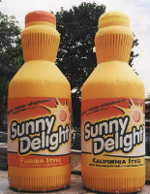
#2 Poor marketing
Sunny delight originally marketed as a heathy drink for kids, it was placed next to orange juice but was a totally artificial product
The ad agency called it “an own goal”, watch the advert HERE

Slide 10
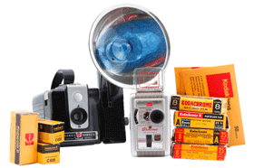
#3 Failure to innovate
Kodak the camera film producers knew that digital was coming, they even marketed that they were going digital
Kodak failed to move fast enough into the digital world and didn’t recognise it as a disruptive technology
Those who wanted to innovate were too low down the hierarchy and were not listened to
With 90% of the roll film market Kodak had become a complacent monopolist

Slide 11
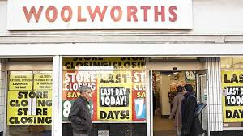
#4 Poor management of working capital
Management of working capital is critical if a business is to survive
Working capital performance is a measure of efficiency that compares a businesses’ assets to its liabilities
Inability to manage cashflow is the most common reason businesses fail. Many profitable and seemingly successful businesses have gone ‘belly-up’ because they haven’t had enough cash to pay their bills on demand.

Slide 12
External causes of business failure
Business failure can also be down to external factors beyond the control of the business, these are the two your exam board wish you to be able to discuss;
Economic recession
Strong pound – reduced export demand

Slide 13
#1 Economic recession
As a country enters economic recession, customers start to save rather than buy
They put off decisions to purchase large expensive items and they also switch to buying more inferior goods
These buying decisions means that some businesses fail in a recession – whereas others might prosper

Slide 14
#2 Strong pound
Strong pound means that manufacturing businesses who heavily export will be affected
It means their goods and products that they manufacture will cost their customers more
Some businesses shift production overseas to counter this effect but not all can afford to do this

Slide 15
Sample questions
There are no specific sample questions for this topic
However it is one of those topics that you will need to know about for the exams, as it could be useful as part of a question on paper 2 or paper 3
Try the business failure challenges on the next few slides

Slide 16
#1 Challenge
Carry out some research into Patisserie Valerie
1) What kind of business was this?
2) What was the business failure? What went wrong?
3) Was anyone to blame?
4) Does Patisserie Valerie still trade anywhere?
5) What is the status of the company now
Good place to start is this clip

Slide 17
#2 Challenge
Carry out some research into Jamie’s Italian restaurants
1) What kind of business was this?
2) What was the business failure? What went wrong?
3) Was anyone to blame?
4) Does Jamie Oliver still have restaurants anywhere?
5) What is the status of the company now?
Good place to start is this clip

Slide 18
#3 Challenge
Carry out some research into BHS
1) What kind of business was this?
2) What was the business failure? What went wrong?
3) Was anyone to blame?
4) Does BHS still trade anywhere?
5) What is the status of the company now?
Good place to start is this clip

Slide 19
#4 Challenge
Carry out some research into Toys R US
1) What kind of business was this?
2) What was the business failure? What went wrong?
3) Was anyone to blame?
4) Does Toys R US still trade anywhere?
5) What is the status of the company now?
Good place to start is this clip

Slide 20
#5 Challenge
Carry out some research into Poundworld
1) What kind of business was this?
2) What was the business failure? What went wrong?
3) Was anyone to blame?
4) Does Poundworld still trade anywhere?
5) What is the status of the company now?
Good place to start is this clip

Slide 21
Glossary
Business failure; The end of trading for a business
Financial failure; The end of trading due to mismanagement of the business finances
Non-financial failure; The end of trading due to a factor beyond the finances of the business

