Slide 1
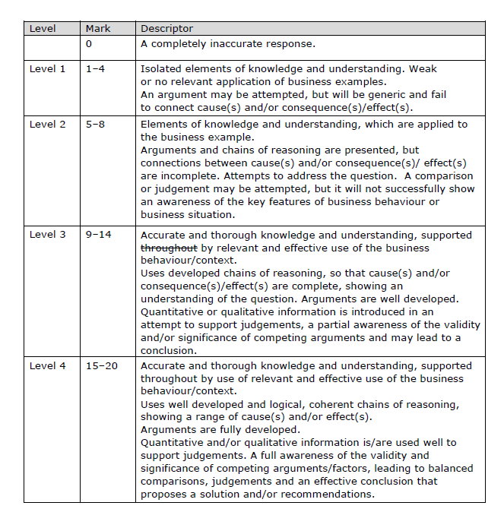
How to level sample question 1

Slide 2
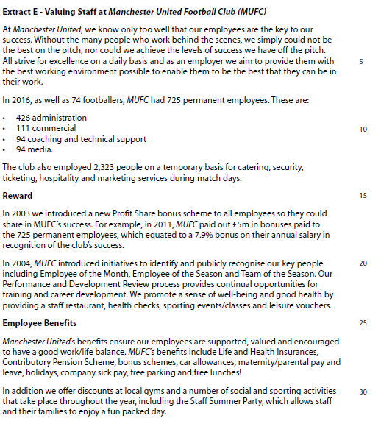
Case study for question 2

Slide 3
Sample question 2
Level 1
1-4
Level 2
5-8
Level 3
9-14
Level 4
15-20

