Slide 1
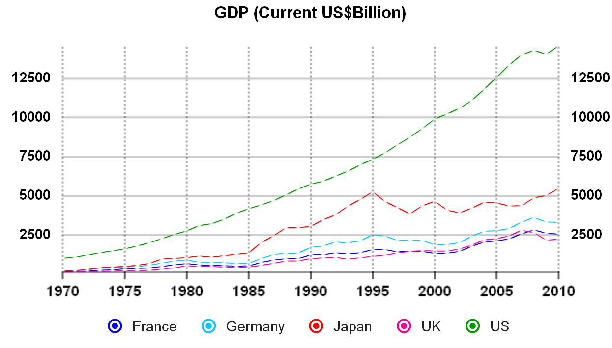
The Key Players
Traditionally the key single economies have been:
But things are changing!
Data Source: The World Bank

Slide 2
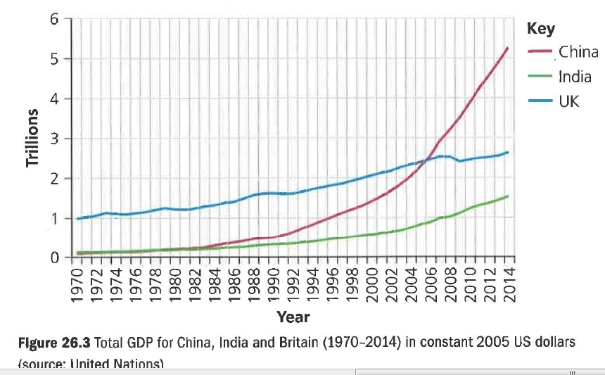
Growth Rates

Slide 3
The Emerging Economies
There are 4 emerging economic powers…
That are deemed to be at a similar stage of advanced development
That are predicted to be wealthier that the current major economic powers by 2050
The economies in question are:
Commonly referred to as the BRIC economies
Brazil
Russia
India
China

Slide 4
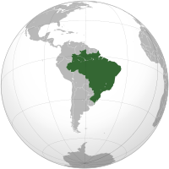
Brazil’s Profile
Brazil
BRAZIL: BASIC INDICATORS
Population (thousands, 2010) | 194 946 | Rank in world trade (2010) |  | Exports | Imports
GDP (million current US$, 2010) | 2 087 890 | Merchandise |  | 22 | 20
GDP (million current PPP US$, 2010) | 2 169 180 | excluding intra-EU trade |  | 16 | 14
Current account balance (million US$, 2010) | - 47 365 | Commercial services |  | 31 | 17
Trade per capita (US$, 2008-2010) | 2 189 | excluding intra-EU trade |  | 18 | 10
Trade to GDP ratio (2008-2010) | 23.8
 |  |  | Annual percentage change
 |  | 2010 | 2005-2010 | 2009 | 2010
Real GDP (2005=100) |  | 124 | 4 | -1 | 7
Exports of goods and services (volume, 2005=100) |  | 109 | 2 | -10 | 9
Imports of goods and services (volume, 2005=100) |  | 184 | 13 | -11 | 27
Source: www.wto.org

Slide 5
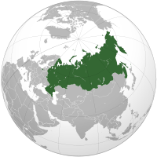
Russia’s Profile
Russia
BRAZIL: BASIC INDICATORS
Population (thousands, 2010) | 141 750 | Rank in world trade (2010) |  | Exports | Imports
GDP (million current US$, 2010) | 1 479 819 | Merchandise |  | 12 | 18
GDP (million current PPP US$, 2010) | 2 812 383 | excluding intra-EU trade |  | 7 | 12
Current account balance (million US$, 2010) | 71 129 | Commercial services |  | 23 | 16
Trade per capita (US$, 2008-2010) | 5 279 | excluding intra-EU trade |  | 12 | 9
Trade to GDP ratio (2008-2010) | 51.5
 |  |  | Annual percentage change
 |  | 2010 | 2005-2010 | 2009 | 2010
Real GDP (2005=100) |  | 118 | 3 | -8 | 4
Exports of goods and services (volume, 2005=100) |  | 114 | 3 | -5 | 5
Imports of goods and services (volume, 2005=100) |  | 144 | 8 | -30 | 18
Source: www.wto.org

Slide 6
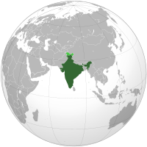
India’s Profile
India
INDIA: BASIC INDICATORS
Population (thousands, 2010) | 1 170 938 | Rank in world trade (2010) |  | Exports | Imports
GDP (million current US$, 2010) | 1 729 010 | Merchandise |  | 20 | 13
GDP (million current PPP US$, 2010) | 4 198 609 | excluding intra-EU trade |  | 14 | 8
Current account balance (million US$, 2010) | - 51 781 | Commercial services |  | 7 | 7
Trade per capita (US$, 2008-2010) | 595 | excluding intra-EU trade |  | 5 | 5
Trade to GDP ratio (2008-2010) | 47.7
 |  |  | Annual percentage change
 |  | 2010 | 2005-2010 | 2009 | 2010
Real GDP (2005=100) |  | 151 | 9 | 9 | 10
Exports of goods and services (volume, 2005=100) |  | 149 | 8 | -7 | 4
Imports of goods and services (volume, 2005=100) |  | 174 | 12 | -7 | 14
Source: www.wto.org

Slide 7
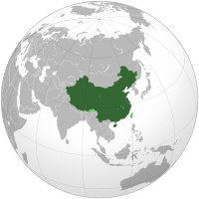
China’s Profile
China
CHINA: BASIC INDICATORS
Population (thousands, 2010) | 1 338 300 | Rank in world trade (2010) |  | Exports | Imports
GDP (million current US$, 2010) | 5 878 629 | Merchandise |  | 1 | 2
GDP (million current PPP US$, 2010) | 10 084 764 | excluding intra-EU trade |  | 2 | 3
Current account balance (million US$, 2010) | 305 370 | Commercial services |  | 4 | 3
Trade per capita (US$, 2008-2010) | 2 135 | excluding intra-EU trade |  | 3 | 3
Trade to GDP ratio (2008-2010) | 55.4
 |  |  | Annual percentage change
 |  | 2010 | 2005-2010 | 2009 | 2010
Real GDP (2005=100) |  | 170 | 11 | 9 | 10
Exports of goods and services (volume, 2005=100) |  | 180 | 12 | -10 | 25
Imports of goods and services (volume, 2005=100) |  | 168 | 11 | 4 | 17
Source: www.wto.org

Slide 8
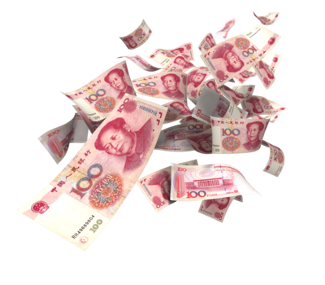
Emerging Economies & Purchasing Power
Purchasing Power
China
India
China’s rapid economic growth over the last 30 years has meant that those living in the main cities have experienced increased purchasing power, creating demand for more luxury goods.
However much of the rural areas remain poor.
India is the 4th largest global economy in terms of purchasing power parity. As such there is a strong and growing middle class.
This has led to a growing market for luxury items in urban areas, though poverty is a major
issue in rural areas.

Slide 9
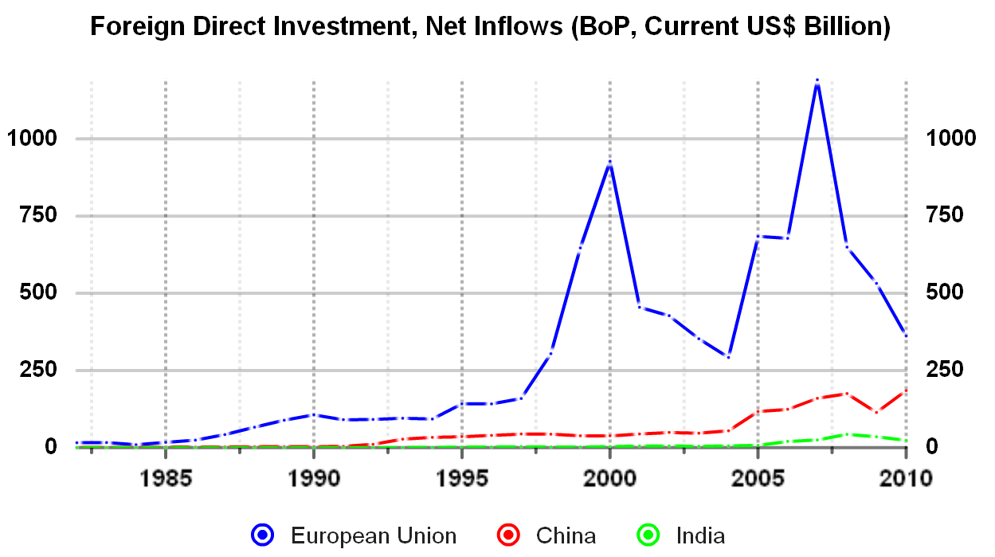
Emerging Economies FDI
FDI
The graph shows that both China and India have experienced a gradual increase in FDI, as manufacturers have invested due to cheaper labour costs

Slide 10
Opportunities For UK Firms
Opportunities
China
India
The emergence of China as an economic power has had positive impacts on the UK:
The change in India’s economy has also presented a number of opportunities for UK firms:
China’s move towards a market economy has required a concerted effort to build relationships with other countries
This has brought new opportunities to UK businesses
China’s manufacturing base means that it is a cheap and reliable supplier of components to UK firms
Indian based multinationals have increased their presence in the UK
Well known UK brands Jaguar, Land Rover and Tetley are all owned by the Indian company Tata
As with China, increased purchasing power means more opportunities for UK firms to sell in India

Slide 11
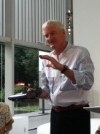
Threats For UK Firms
Threats
India
UK firms also face a number of threats from India:
China
China also presents a number of threats for UK firms:
Cheaper salaries and property costs meant many UK firms relocated elements of their business to India
This trend has started to be reversed, as costs in India rise. E.g Santander moved it’s call centres back to the UK in 2011
Laws, regulations and rules are often changed, and are tougher for foreign firms
This can make it challenging to operate in India
Although the Chinese economy is moving towards being market-based many business remain state-owned
This means that it is difficult to penetrate the market – even for firms such as Tesco
Copyright laws are not properly enforced in China
Sir James Dyson openly criticised the Chinese government about this issue in December 2011

Slide 12
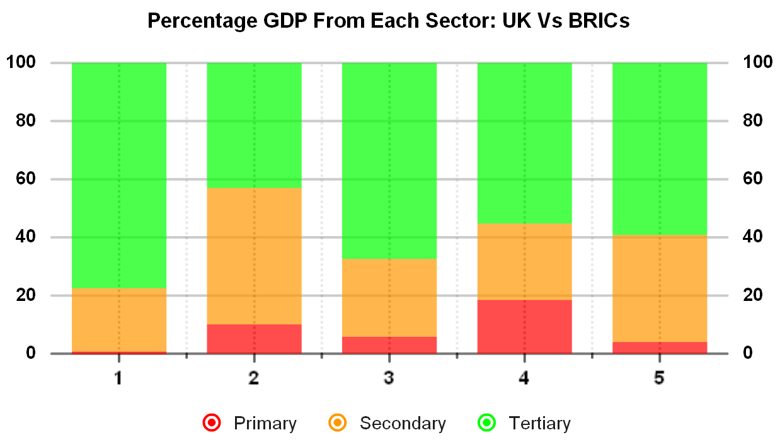
The Structure of the BRIC Economies
The structure of these BRIC economies is very different to the structure of the UK:
UK
China
Brazil
India
Russia
Data Source: CIA World Factbook

Slide 13
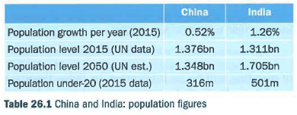
Growth comparison- China and India

Slide 14
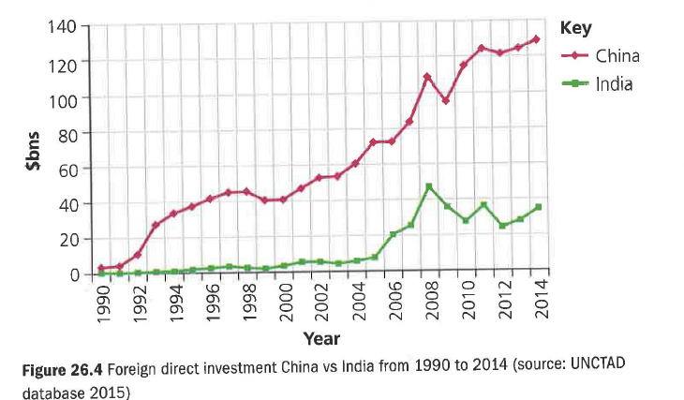
FDI comparison

Slide 15
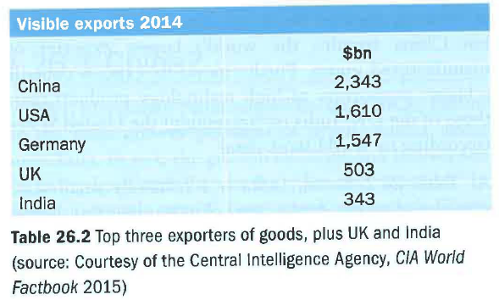
Visible Exports - comparison

Slide 16
Five why and a how

Slide 17
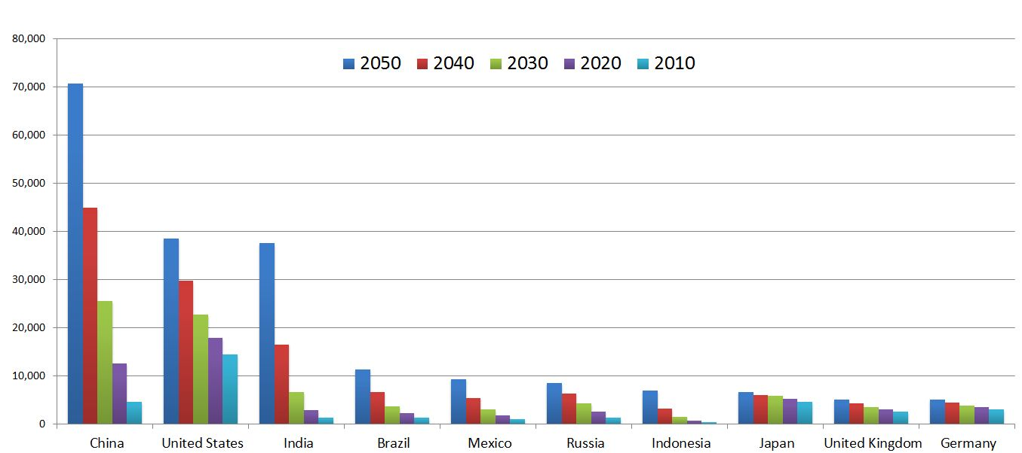
The Future
The importance of the BRIC economies is expected to grow:
Predicted Changes in the Size of Various Economies 2010-2050
Source: http://en.wikipedia.org/

Slide 18
Key terms
Balance of payments deficit: imports outweigh exports; if it continues indefinitely, it means ever greater build-up of foreign currency debt.
Fixed capital formation: an economist's way of saying investment in long-term assets, such as roads or buildings.
Invisible export: the sale of a service to an overseas customer,

