Slide 1
Edexcel A2 Business
2.1.1 Internal Finance
Revisionstation

Slide 2
Worksheet

Slide 3
From Edexcel
a) Owner’s capital: personal savings
b) Retained profit
c) Sale of assets

Slide 4
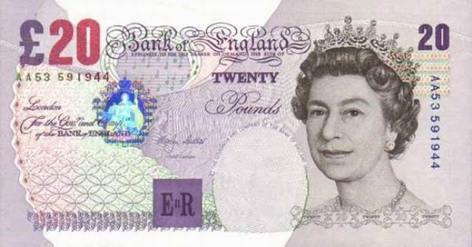
Starter
What do you own? Do you have any savings? Are you good with money? If I gave you £20 right now would you save it or spend it?
Notes:
This should reveal that it is hard to save money and some people are gifted with money, others are not.

Slide 5
Definition: Finance
Finance means the management of the investment needed to; open, run and grow a business
There are internal finance methods (investment that comes from within a business) and external finance methods (investment that comes from outside the business)
This topic is just about internal finance, 212 is about external finance

Slide 6
Reasons for raising finance
To pay debts, this is likely to be a consolidation loan which may pay off suppliers
To help a business over a slow trading period - overdraft
To expand: a business may apply for long term finance such as a loan
To start-up a business may apply for a loan with a business plan or ask friends and family to invest
To buy stock: a business would ask a supplier for trade credit, typically 30, 60, 90 days

Slide 7
Owner’s capital: personal savings

Slide 8
Owners capital
This is also sometimes called owners equity
It shows the stake the owner has in the business
This represents the net assets of the company – if all the debts of the business were paid off how much would be owed to the owner
The owner may have used savings or a redundancy pay out to start up the business, this is in theory still owed back to the owner, although they may never take it back out in the lifetime of the business

Slide 9
When is owner’s capital appropriate?
Sole traders and partnerships would be the two business forms which would mostly use owner’s capital to expand and to grow

Slide 10
Retained profit

Slide 11
Retained profits
After a year or more of trading a business may have some profits that they are able to re-invest into the business to help it grow.
The advantage of retained profits is there is no interest to pay
The disadvantage is once retained profit is used it has gone and cannot be used elsewhere in the business
Kath Kidston, she started her empire from a small shop in London in 1993 HERE

Slide 12
When is retained profit appropriate?
If a business is in its first year of trading it will NOT have any retained profits – as it will not have made any to retain
Also, if a business has not been profitable then there will NOT be any retained profit to spend
Are there any other circumstances when retained profit would not be an appropriate source of finance?

Slide 13
Sale of assets

Slide 14
Sale of assets
A business can raise finance by selling items that they already own, these are called assets
This could be:
Machinery
Land
Premises
Vehicles
The business that sells the asset will no longer have the benefit of that asset and it will not appear on the balance sheet of the company – meaning the business will look less attractive to investors

Slide 15
When is the sale of assets appropriate?
All types of business can sell their assets
When a business is growing it may need to raise cash fast to be able to continue to trade
Assets (like a van) can be sold quickly (same day) for cash
What other assets might a business have?

Slide 16
Advantages of selling assets
In a larger business which has a portfolio of products, then the sale of assets can improve efficiency and increase capacity utilisation
Assets from one brand can be sold off to raise finance to invest in another
Can you link this to the Boston Box and product lifecycle theories?

Slide 17
Disadvantages of selling assets
This may not raise enough money for growth or expansion
Selling assets may draw into question just how well run the business is, if it needs to sell its assets to pay bills or to continue to trade
A new start-up would be in a lot of trouble if they needed to sell their assets. E.g. a café that has just opened could sell their coffee machine

Slide 18
Internal sources of finance pros and cons
Internal source of finance | Advantage | Disadvantage
Retained profit
Sale of assets
Owners equity

Slide 19
Internal source of finance | Advantage | Disadvantage
Retained profit | No interest payments to be made on loans Easy access to finance, if it is in a bank account it could be accessed the same day, this is in comparison to a loan which could take longer with all the paperwork Owners keep control | Loss of interest payments on savings should the retained profits be left in a savings account instead Opportunity cost of not being able to use the retained profits elsewhere in the business
Sale of assets | No interest payments to be made on loans Straightforward sale can take place on a number of platforms e.g. eBay | Once the business has sold the asset they lose the benefit of it e.g. a van they cannot make deliveries with
Owners Capital | No interest payments to be made on loans Easy access the owner may have the funds sitting in a bank or savings account No complex paperwork and no security needed | Owner may not have the capital to put into the business and may still need to borrow, some businesses may have a term debt to gain a long-term profit

Slide 20
Revision Video

Slide 21
Sample Edexcel A2 questions

Slide 22
Case study for question 1

Slide 23
Sample question 1
Knowledge 2
Application 2
Analysis
3
Evaluation
3

Slide 24
Answer sample question 1

Slide 25
Answer sample question 1

Slide 26
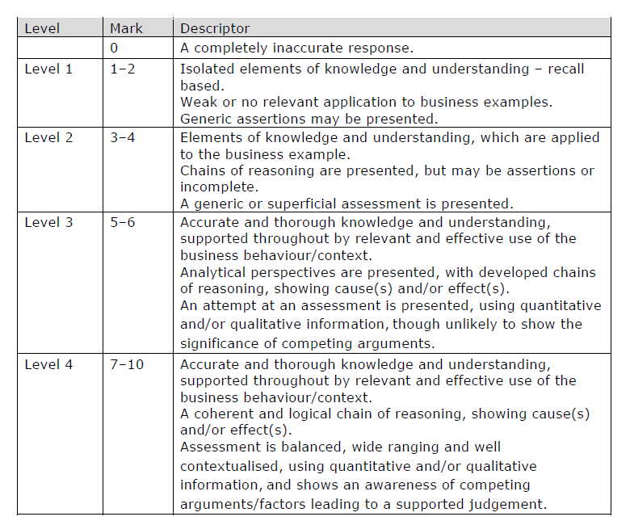
How to level sample question 1

Slide 27
Case study for question 2

Slide 28
Sample question 2
Knowledge 1
Application 2
Analysis
1

Slide 29
Answer sample question 2

Slide 30
Glossary
Owners capital; this is the money invested by the owner in the business, this may have come from their own personal savings
Retained profit; this is profit from a previous year that is saved and could be used to reinvest into the business
Asset; this is an item that the business owns that could be sold to raise cash e.g. a van, a machine

