Slide 1
Edexcel A2 Business
4.3.3 Social and cultural factors
Revisionstation

Slide 2
Worksheet

Slide 3
From Edexcel
a) Considerations for businesses:
cultural differences
different tastes
language
unintended meanings
inappropriate/inaccurate translations
inappropriate branding and promotion

Slide 4
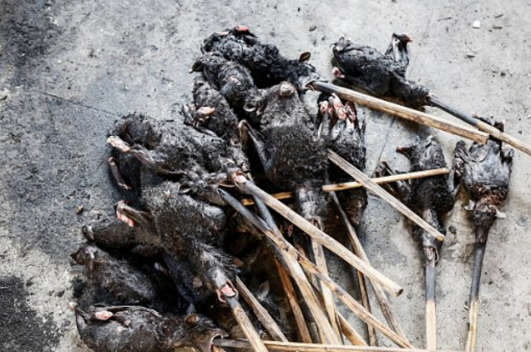
Starter
What animal would you NOT eat?
For example would you eat bat on stick?
Notes:
Good way to kick off cultural diversity is in a discussion of what we would not eat and what is normal in other cultures
Full article is here : http://www.dailymail.co.uk/news/article-2720671/Bat-wings-snake-meat-roasted-rats-Inside-Indonesian-market-packed-gruesome-local-delicacies.html

Slide 5
Cultural and social factors defined
Cultural factors include; Beliefs, moral values, traditions, language, laws held by a country
Social factors include; lifestyle, religion(s), economic wealth, family structures, education, and political systems held by a country

Slide 6
Cultural differences

Slide 7
Cultural differences
When doing business abroad a business needs to keep in mind the culture of the nation
Have a look at some of the photo montages of the following slides and discuss if they would be easy or hard to trade with, if they would have lots of cultural differences and what the challenges might be.

Slide 8
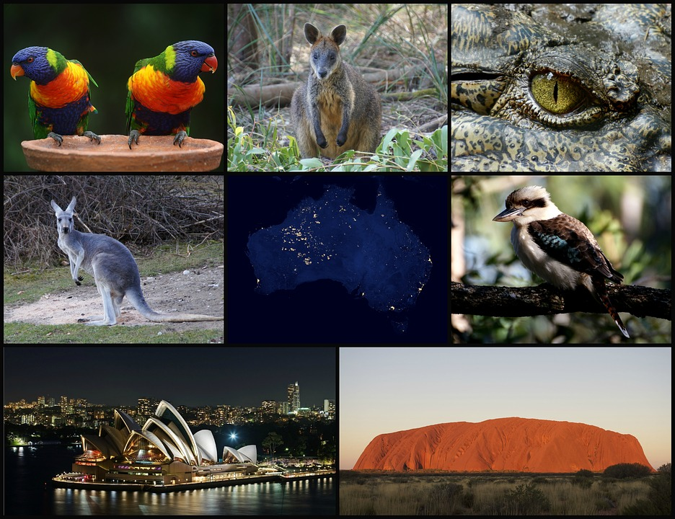
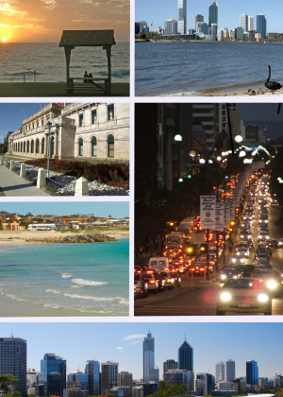
Australia

Slide 9
Myanmar

Slide 10
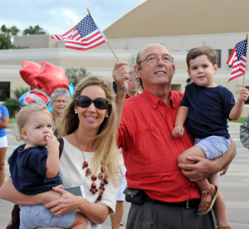
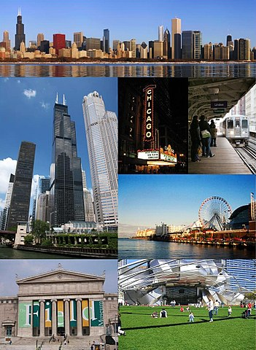
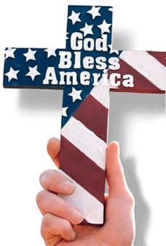
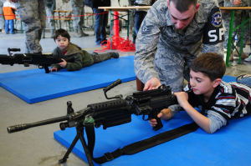
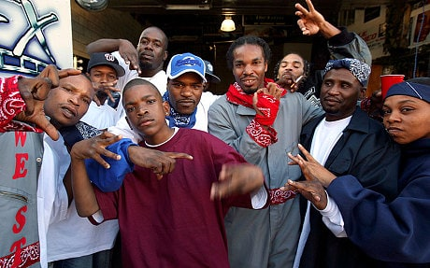
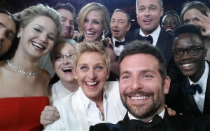
USA

Slide 11
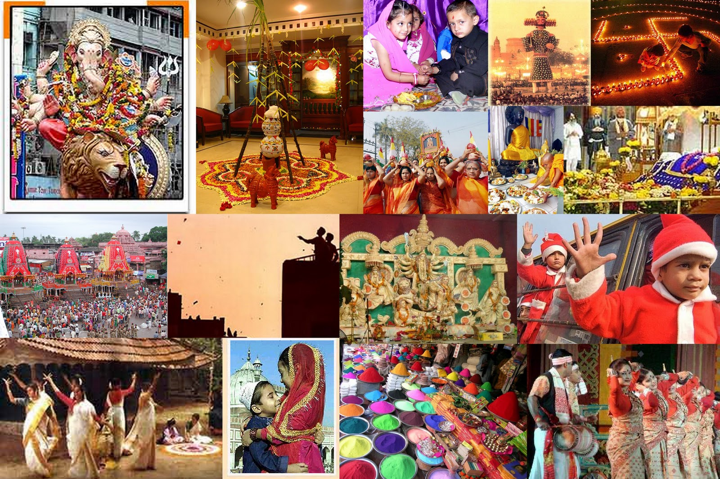
India

Slide 12
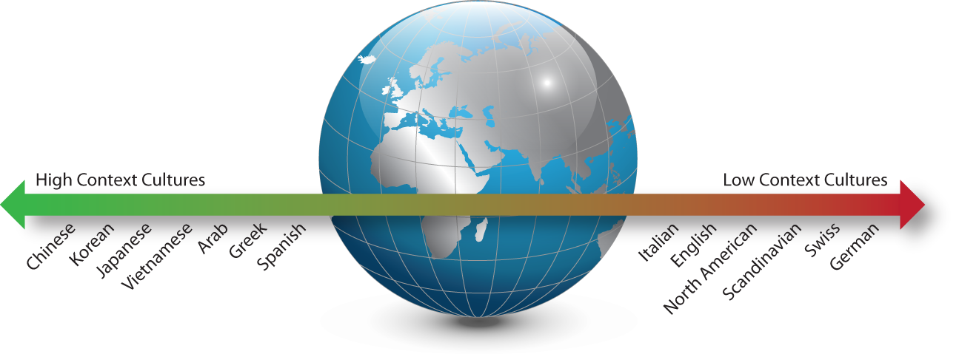
High Context/Low Context countries
High Context Communication Needs:
Establish social trust first
Value personal relations and good will
Agreement by general trust
Negotiations slow and ritualistic
Low Context Communication Needs:
Get down to business first
Value expertise and performance
Agreement by specific, legalistic contract
Negotiations efficient as possible
Notes:
See if students can role play a business meeting in the different cultures

Slide 13
Which of these images would be OK on a promotional ad in Dubai? Left, right or both?
Notes:
The ad on the right is OK as it doesn’t show too much flesh, but an odd dress for a beach?

Slide 14
Different tastes

Slide 15
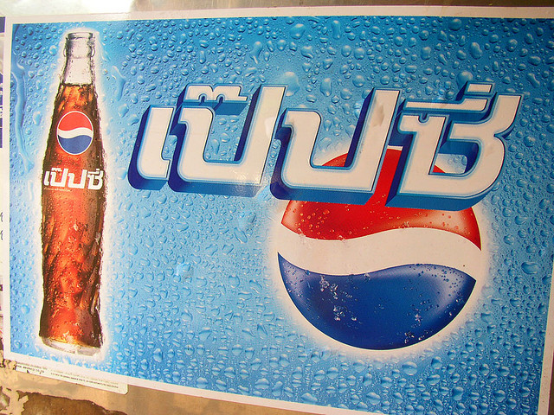
Understanding your market
Pepsi lost market share in Southeast Asia when it changed its vending machines from deep blue to light blue.
Light blue is a symbol of death and mourning in Southeast Asia.

Slide 16
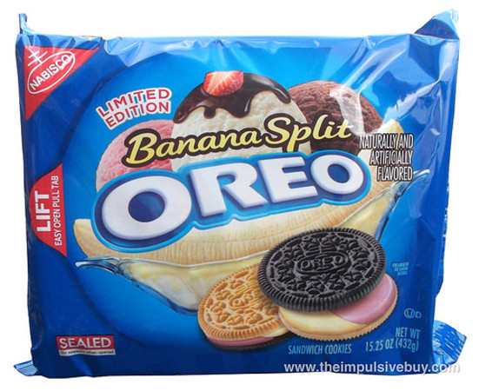
OREO – different products for different markets
OREO has lots of different types of their cookie for their various different markets
For example Caramel and apple is sold in the USA but not in Australia or the UK
Another example is the cinnamon bun flavour is sold in the USA but not Canada VIDEO

Slide 17
Kitkats – different products for different countries
If you think KitKat made by Nestle is just a wafer bar then think again
There have been more than 300 limited-edition seasonal and regional flavours of Kit Kats produced in Japan since 2000
Highlights include; Miso soup, soy and red potato see list HERE

Slide 18
Language

Slide 19
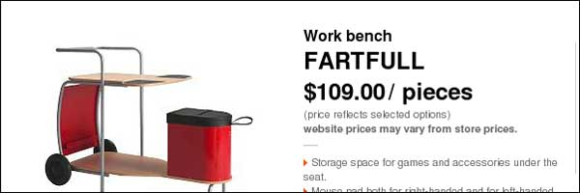
One of many examples from the Swedish company - Ikea
Ikea has a workbench called Fartfull
Click graphic for video

Slide 20
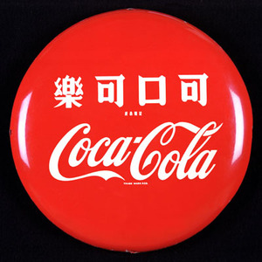
Coca cola in China
Coca-Cola's attempt to render its name in Chinese characters, which came off as "Bite the Wax Tadpole."

Slide 21
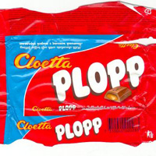
Careful how you say it

Slide 22
Video on bad product names
In Romania they produce a tea which is called Urinal, In Poland they have a chocolate bar called Fart
Product names may seem perfectly OK in the home country but may mean something totally different in other countries.
Please check video before showing….
Notes:
Warning! Content of video may not be suitable for your group – please check first

Slide 23
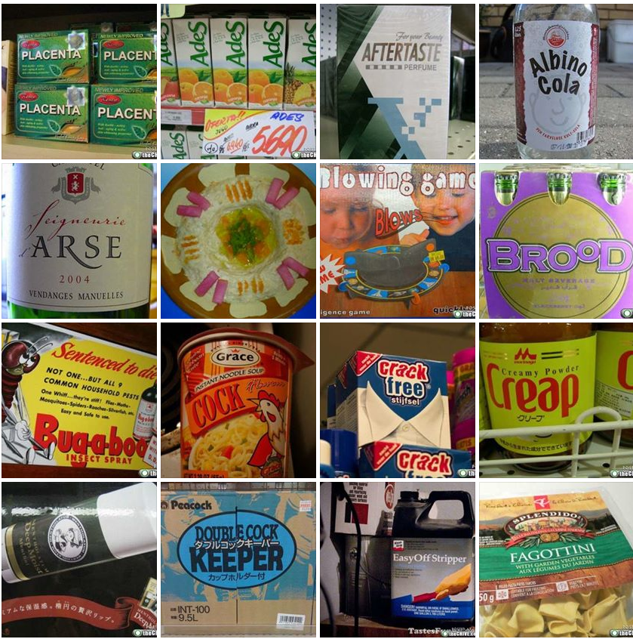

Slide 24
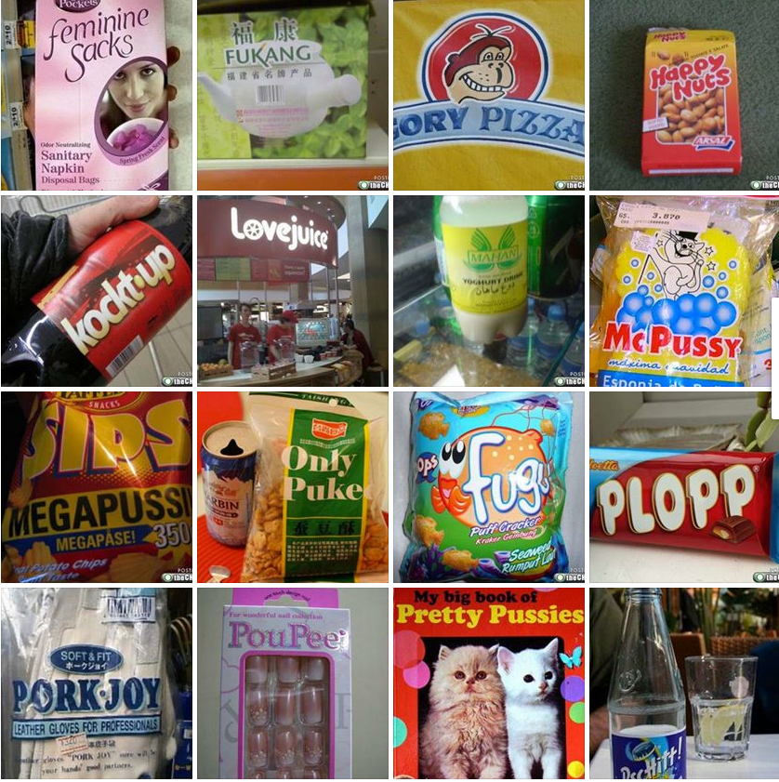

Slide 25
Unintended meanings

Slide 26
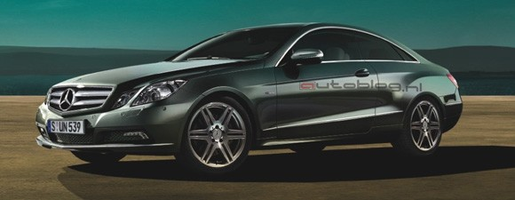
GST is not liked in Canada – why?
Mercedes-Benz shortened the name of its Grand Sports Tourer, which launched in 2005
In Canada GST is the acronym for the widely loathed goods and services tax (like our VAT) is also known as the "gouge and screw tax” or GST for short

Slide 27
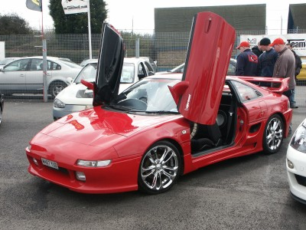
MR2 is called the MR in France – why?
Toyota MR2 did not sell well in France, its all down to how you say it…
"M-R-deux"--which, when spoken with a breezy French accent, sounds a lot like ????

Slide 28
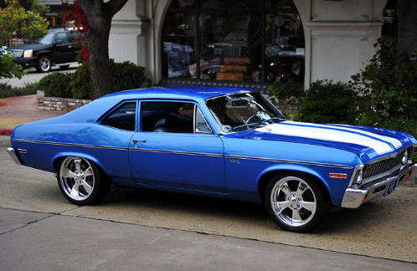
Chevy Nova? Sounds OK?
The Chevy Nova's flop in Latin America because "no va" means "won't go”, not a great name for a car!

Slide 29
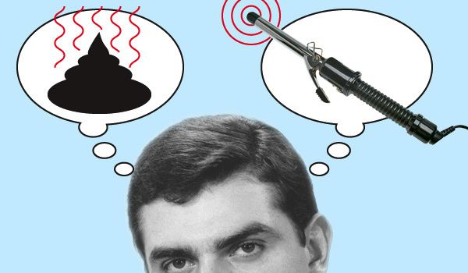
Massive company Clairol gets it wrong
Clairol launched a curling wand called “Mist Stick” in Germany.
Mist in German is slang for manure. It turns out manure sticks aren’t very popular in Germany.

Slide 30
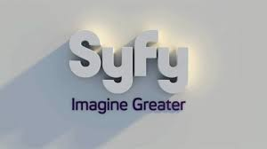
Sci-fi channel
Even if you’re aiming your brand at a domestic audience, you may find that you are talking a completely different language to your target customers. After realising that it couldn’t trademark the term “sci fi”, the SciFi Channel decided to use the next best thing and come up with a groovy new spelling — “Syfy”.
However syfy is a fairly common slang term for syphilis.
Notes:
http://www.crikey.com.au/2012/05/18/five-business-rebrands-that-got-lost-in-translation/?wpmp_switcher=mobile

Slide 31
Kraft foods gets it wrong
The name that Kraft Foods Inc. chose for its global snack spinoff — Mondelez International in Russia the word has a different meaning
Kraft says it chose the mashup to suggest worldwide deliciousness. (Monde means "world" in French, and delez, with a long E in the final syllable, is a play on "delish.")
But pronounced "mohn-dah-LEEZ," the name means something else to Russian speakers…

Slide 32
General Motors gets it wrong
General Motors had to change the name of its Buick LaCrosse sedan in Canada after it found that the word LaCrosse is slang for masturbation in Quebec.

Slide 33
Inappropriate/inaccurate translations

Slide 34
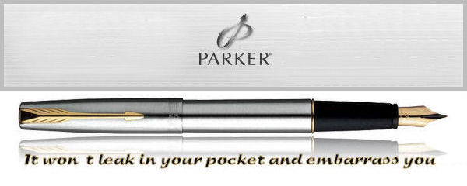
Parker Pen in Mexico wanted its advertisements to say “It won’t leak in your pocket and embarrass you.”
Instead, the company thought that the word “embarazar” (to impregnate) meant to embarrass, so the ad read: “It won’t leak in your pocket and make you pregnant.” I guess it all depends on what you want out of a pen.

Slide 35
Inaccurate translations

Slide 36
Google translate
Some businesses may decide to cut costs and use an online translation tool such as google translate
This can result in significant problems for the business – see the video and a funny video HERE again check content first

Slide 37
Even large MNCs get it wrong
Pepsi in China translated their slogan, “Pepsi Brings You Back to Life.” The slogan in Chinese literally means, “Pepsi Brings Your Ancestors Back from the Dead.”

Slide 38
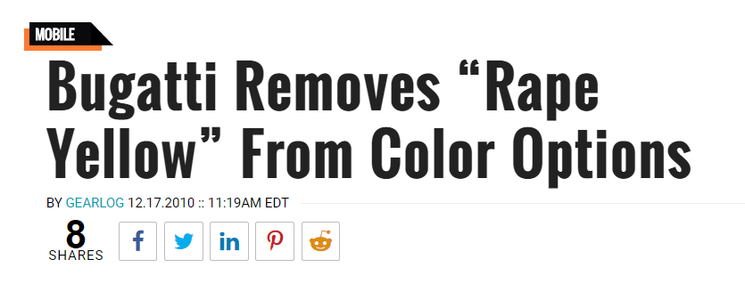
Bugatti translation fail
If you visited luxury car company Bugatti’s website in December 2010, you would have found a car available in “rape yellow,” the result of French to English translation error of “rapeseed plant.”

Slide 39
Inappropriate branding and promotions

Slide 40
Panasonic marketing fail
In the mid-1990s, people everywhere were still discovering the joy of home computers.
Japanese engineers at Panasonic were way ahead of the curve, and in 1996 they developed a touch screen PC for the home market. They decided to market the product aggressively in the US using a mascot called Woody. The marketing encouraged consumers to “touch woody”

Slide 41
Fiat car marketing blunder
FIAT released an ad in Italy in which actor Richard Gere drives a Lancia Delta from Hollywood to Tibet.
Gere is hated in China for being an outspoken supporter of the Dalai Lama – there was a huge on-line uproar on Chinese message boards commenting that they would never buy a FIAT car.

Slide 42
KFC slogan problem
In Chinese, the Kentucky Fried Chicken slogan “finger-lickin’ good” came out as “Eat your fingers off”.

Slide 43
Revision Video

Slide 44
Sample Edexcel A2 questions

Slide 45
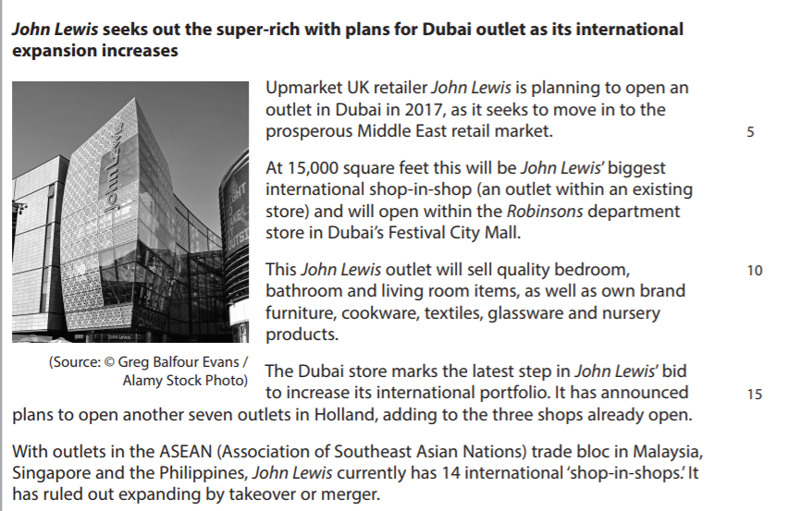
Case study for question 1

Slide 46
Sample question 1
[6]
Knowledge
2
Application
2
Analysis
2

Slide 47
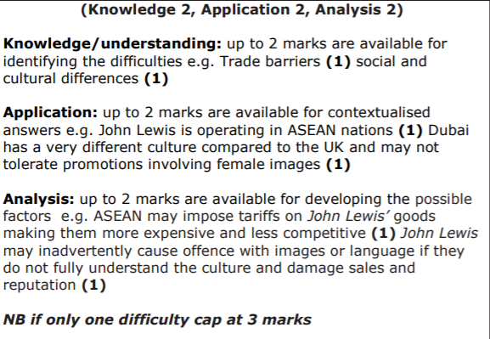
Answer sample question 1

Slide 48
Case study for question 2

Slide 49
Sample question 2
[8]
Knowledge 2
Application 2
Analysis
2
Evaluation
2

Slide 50
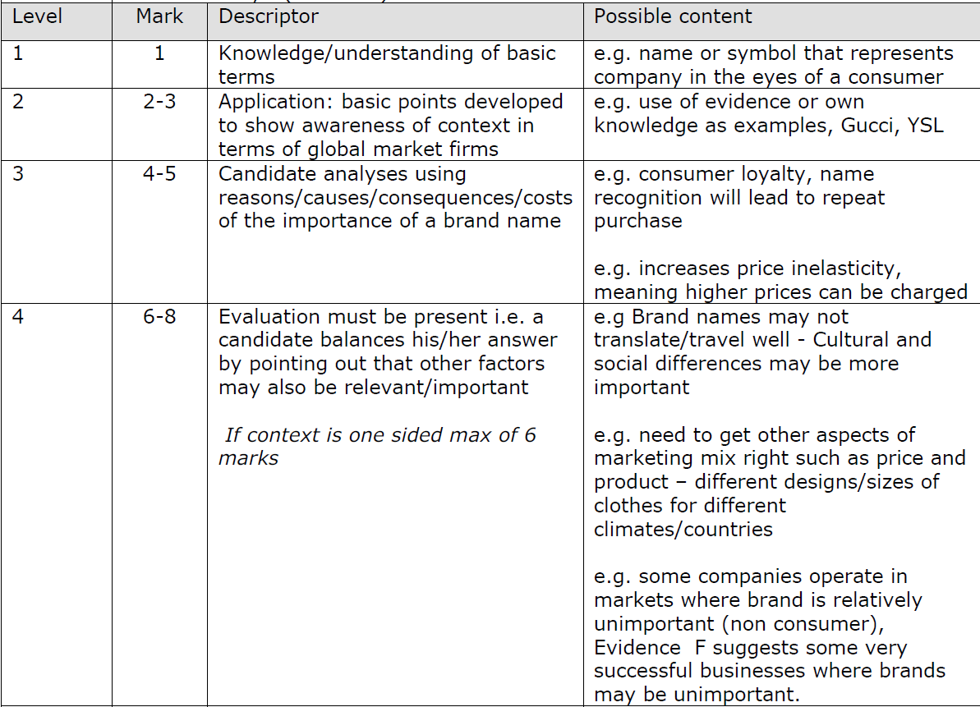
Answer sample question 2

Slide 51
Glossary
Cultural; A term which relates to the ideas, customs, traditions and beliefs of a society
Social; A term which means relating to society as a collective community based group
Brand; A name or symbol which represents the company in the eyes of the consumer
Promotion; the publicising of a product, company or service to increase sales or public awareness

