Slide 1
Edexcel A2 Business
1.5.1 Role of an Entrepreneur
Revisionstation

Slide 2
Worksheet

Slide 3
From Edexcel
a) Creating and setting up a business
b) Running and expanding/developing a business
c) Innovation within a business (intrapreneurship)
d) Barriers to entrepreneurship
e) Anticipating risk and uncertainty in the business environment

Slide 4
Starter
If you were going to start a business – what would be your product or service?
Notes:
This should promote a lively discussion about what kind of business students would like to have. Shoes? Games? Phones? Cakes? There may be some interesting ideas, every year I always get one or two who surprise me. One year two students decided to sell salt for gritting paths with. They went to the local salt mine bagged it up bought some shovels from costco, doubled the price of everything and drove round every evening with their mum delivering salt and shovels. They called it Ready N Salted!

Slide 5
Definition: Entrepreneur
An entrepreneur is a person who sets up a business and takes risks in the hope of a profit or reward

Slide 6
Creating and setting up a business

Slide 7
Suggested activity – why do people want to start their own businesses?
Watch the video – why did Catherine Cunningham want to start her own business?
What other reasons might there be to start a business?
Compile a long list and decide which is the most popular reason in the UK.
Notes:
She wanted to do something that she loved

Slide 8
Setting up a business
A small business just needs a good idea and an entrepreneur who wants to make it work. Here are the simplified steps:
Step 1: market research, find out what customers want
Step 2: start small at a market stall or similar context if possible
Step 3: draw up a business plan
Step 4: grow the business
Watch the video – why did Claire Hamilton start her own business?
Was this one of the reasons you gave from the previous activity?
Notes:
She had a brain injury and needed to work from home

Slide 9
Setting up an online only business
A business can be set up online only and be very successful – Amazon
Sites like eBay and Etsy mean that entrepreneurs don’t even need to have their own website they can sell through a third party
Sites like Alibaba can provide suppliers of materials, so the whole business from start to finish can be online
Watch the video – why did Chris want to start his own business?
Notes:
He wanted to work from home

Slide 10
Setting up a business with Etsy
In an Etsy Economy, creative entrepreneurs can find meaningful work selling their goods in both global and local markets, where thoughtful consumers can discover those goods and build relationships with the people who make and sell them.
Watch the video – can you now explain how Etsy works?
What would your Etsy shop name be?
What are the barriers to entry?
Notes:
It is an online market place for handmade and vintage objects

Slide 11
Setting a business online with
A seller lists an item on eBay, from antiques to cars, books to sporting goods. The seller chooses to accept only bids for the item (an auction-type listing) or to offer the Buy It Now option, which allows buyers to purchase the item straight away at a fixed price.
In an online auction, the bidding opens at a price the seller specifies and remains on eBay for a certain number of days. Buyers then place bids on the item. When the listing ends, the buyer with the highest bid wins.
Watch the video – can you explain how eTwist works?
What would you sell on Ebay?
Where else could you sell items?
Notes:
Sell on Shpock or Depop or ebid or gumtree or Preloved, Asos Marketplace and Freecycle

Slide 12
Setting up a business with
ASOS marketplace is a selling platform for 750 boutiques, which include people who are selling vintage clothes to independent labels starting out
Watch the video – can you explain why this is an ideal business for a student?
Have a look at the website – how much is it to set up a boutique? HERE
Notes:
At time of writing it was £20

Slide 13
Starting a business as a sole trader
To become a sole trader, online or otherwise an entrepreneur will need to register as self-employed for tax
If the entrepreneur’s business is B2B then the customers may ask to see evidence that they have registered with the UTR (unique tax reference) code
Watch the video – when should you apply for your UTR?

Slide 14
Running and expanding/developing a business

Slide 15
Running a business: day –to -day
Once a business is started the entrepreneur will need to turn their attention to the daily running of the business
This may include completing the finances, buying stock, listing stock for sale, contacting customers and chasing payment
Watch the video, what kind of day-to-day activities would this

Slide 16
Expanding a business
Lots of ways an entrepreneur can expand a business:
Open another location.
Offer the business as a franchise or business opportunity
License the product
Diversify (what do you think this means?)
Target other markets
Merge with or acquire another business

Slide 17
Innovation within a business (intrapreneurship)

Slide 18
Intrapreneurship
Fairly new concept
An employee within a larger business who thinks like an entrepreneur
Takes risks
Creative or innovative
Solves problems
Focusses on processes to improve productivity
Drives innovation
Understands trends
Self-confident
Proactive in adding value
Can you now explain to someone else the concept of intraprenuership?

Slide 19
Barriers to entrepreneurship

Slide 20
Barriers to entrepreneurship
There are lots of barriers to entrepreneurship, or reasons that people don’t start up their own business. These are the five that the exam board would like you to be able to discuss. Get ready to make some notes on these on the next few slides:
Entrepreneurial capacity
Access to finance
Lack of training / knowhow
Fear of failure
lack of confidence

Slide 21
#1 Entrepreneurial capacity
There is a growing awareness that entrepreneurial skills, knowledge and attitudes can be learned and in turn lead to the widespread development of entrepreneurial mind-sets and culture, which benefit individuals and society as a whole
Lack of this capacity or ability can be a barrier to entrepreneurship
What does this mean in simple terms?
Notes:
Some people are just not cut out to run their own business

Slide 22
#2 Access to finance
Many entrepreneurs cannot start their business because off a lack of funding
They may not have savings themselves or family that they can ask to help
Many banks are not keen to lend to start-ups because of a lack of historical data of sales – making them a very risky investment, despite many government initiatives to make loans cheaper
VIDEO

Slide 23
Suggested activity - Access to finance
This is a chart to show the sources of finance used by start-up businesses in UK. Mfi means monetary financial institutions. Can you divide these into external and internal sources of finance?
Notes:
* source: Barclays: http://www.telegraph.co.uk/finance/businessclub/9908483/Start-up-cash-biggest-barrier-to-businesses.html

Slide 24
#3 Lack of training / knowhow
Many entrepreneurs lack training or know-how of just how to start a business
This can put off people who would like to start their own business, but are just not sure how to get started
Many of the sites e.g. eBay and Etsy contain lots of information on how to start a business
HMRC and Gov.uk contains information to help entrepreneurs to get started

Slide 25
#4 Fear of failure
Many potential entrepreneurs do not start a business for fear of failing
It can be the failure itself or the cost of failure which may put potential business users off
Especially if they are giving up a regular salaried job to start out on their own

Slide 26
#5 Lack of confidence
Many potential entrepreneurs lack the confidence to embark on a new adventure with their start up business
This can be a huge barrier to them becoming an entrepreneur
This can be overcome with training, information and marketing – when they are sure they have a product which will sell they may gain confidence

Slide 27
Anticipating risk and uncertainty in the business environment

Slide 28
Definition: Risk
This is the possibility that the business will have a lower than expected profit or a loss

Slide 29
Financial risks
Starting a business can be a financial risk for the owner
The owner may put their own cash and other assets (e.g. a van) into a business
If the business is sole trader or partnership then they have “unlimited liability” which means they could lose their personal assets to pay the business debts

Slide 30
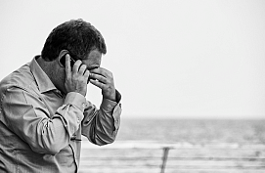
Lack of security
If an entrepreneur has a regular job, and they decide to leave that job to open their own business this is a huge risk;
They may have a mortgage, a car and other bills to pay
Also there may be insecurity of sales with falling consumer incomes

Slide 31
Definition: Uncertainty
Uncertainty is when businesses are unable to predict external shocks or future events
Uncertainty (unlike risk) is not objective and does not assume knowledge of alternatives

Slide 32
Uncertainty and Tsunami
Toyota has made changes to its production system after the 2011 quake exposed the vulnerability of the "just in time" system, which allows companies to operate without big and costly inventories and instead receive small quantities of parts from suppliers only when needed.
All the parts were made in Japan and shipped to the UK plants where they were assembled into cars

Slide 33
Uncertainty and health scares
A health scare is a widely reported story about the danger of something, usually a consumer good or medical product
In 1988 Health Minister Edwina Currie said most of Britain’s eggs were infected with salmonella, as a result sales of eggs dropped dramatically by 60% and farmers were forced to slaughter 4 million hens and destroy 400 million unwanted eggs
Notes:
http://www.independent.co.uk/life-style/health-and-families/health-news/the-big-question-was-edwina-currie-right-about-salmonella-in-eggs-after-all-424625.html

Slide 34
Uncertainty and commodity price shocks
Commodity means: a raw material or primary agricultural product that can be bought and sold, such as copper or coffee
If a business relies on commodities as raw materials then price shocks could mean significant impact on profit
Have a look at the FT.com commodity prices data – can you build up a list of commodities? Do the prices fluctuate much?

Slide 35
Uncertainty and changes in exchange rates
An exchange rates is the value of one currency valued in terms of another
UK exporters benefit from a fall in the value of sterling. However British firms importing raw materials, components or foreign-made goods face higher costs and must either put up their prices or reduce their profit margin
Key factors that influence exchange rates:
Economic uncertainty
Political stability and performance
Inflation
Interest rates
Notes:
Adapted from: http://www.bbc.co.uk/schools/gcsebitesize/business/environment/stateofeconomyrev4.shtml

Slide 36
Uncertainty and changes in interest rates
The UK Interest rate is the cost of borrowing to consumers
If interest rates go up then consumers are less likely to borrow for cars, houses, furniture, holidays etc.
If consumers stop spending and start to save then the economy may start to enter recession
Have a look at the chart on the right. What information does this chart give you? What happened 2008 / 2009?
Notes:
Recession

Slide 37
Uncertainty and the horse meat scandal
The 2013 horse meat scandal was a scandal in Europe in which foods advertised as containing beef were found to contain undeclared or improperly declared horse meat – as much as 100% of the meat content in some cases
It was revealed by the Food Standards Agency that the Findus beef lasagne range in the UK, France and Sweden and the shepherd's pie and moussaka ranges in France contained horse meat

Slide 38
Suggested activity – Brexit and uncertainty
Carry out some research to answer these 3 questions:
How is Brexit causing uncertainty in business?
What kinds of impacts is this uncertainty having on business?
How are businesses responding to the uncertainty?
Can you make an infographic to show your research? Free infographic maker here. (Canva)
Remember to quote the sources of your research

Slide 39
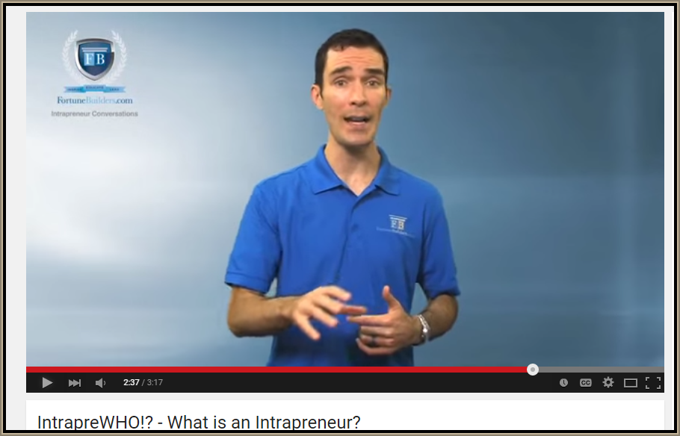
Revision Video

Slide 40
Bonus video

Slide 41
Sample Edexcel A2 questions
Notes:
No suitable A2 question for this topic so I have borrowed an Edexcel sample AS question for practice

Slide 42
Case study for question 1

Slide 43
Sample question 1
Knowledge 2
Application 2
Analysis
2
Evaluation
2

Slide 44
Answer sample question 1

Slide 45
Answer sample question 1 continued

Slide 46
How to level sample question 1

Slide 47
Case study for question 2

Slide 48
Sample question 2
[12]
Knowledge 2
Application 2
Analysis
4
Evaluation
4

Slide 49
Answer sample question 2

Slide 50
Answer sample question 2 continued

Slide 51
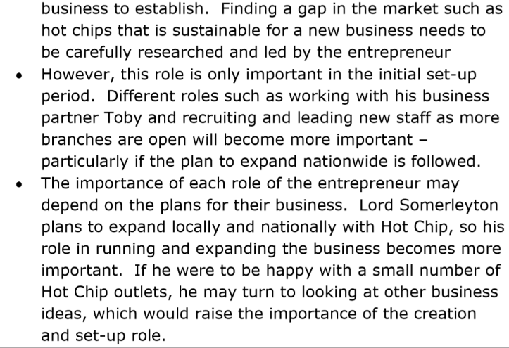
Answer sample question 2 continued

Slide 52
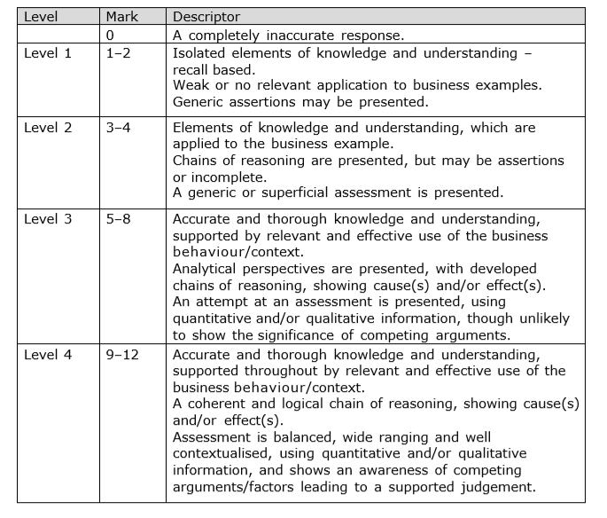
How to level sample question 2

Slide 53
Glossary
Intrapreneur; an employee who works for a large business but thinks like an entrepreneur
Innovation; an invention taken to market and sold
Risk; The possibility of financial loss
Uncertainty; something in the future which is not known, for example a world recession

