Slide 1
Edexcel A2 Business
4.2.3. Assessment of a country as a production location
Revisionstation

Slide 2
Worksheet

Slide 3
From Edexcel
a) Factors to consider:
costs of production
skills and availability of labour force
infrastructure
location in trade bloc
government incentives
ease of doing business
political stability
natural resources
likely return on investment

Slide 4
Starter – discussion of this photo
Where do you think this is?
What do you think is happening in this photo?
Does this photo encourage or discourage you from starting production in that country?
Notes:
1 Its Brazil
2 Teachers protesting clash with the police
3 Hopefully discourage

Slide 5
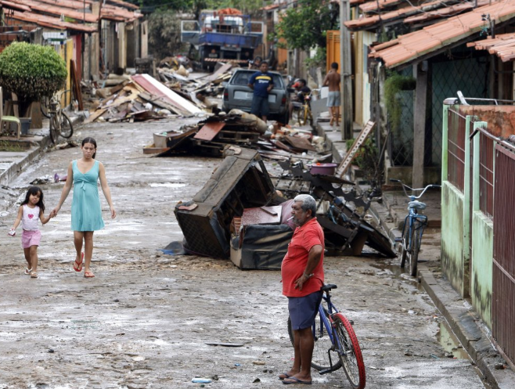
More photos of Brazil – will this be a good production location? Average wage is $288 a month

Slide 6
Assessment of a country as a production location
You should be able to recognise the factors which makes one country more attractive than another as a production location
In a previous topic you have looked at possible sales markets – this unit is all about the production so keep that in mind

Slide 7
Factor | UK | South Korea | Singapore
Costs of production
Skills and availability of labour force
Infrastructure
Location in trade bloc
Government incentives
Ease of doing business
Political stability
Natural resources
Likely return on investment
Rank the countries 1-3 3 being worst and work out which country would be best to move production to

Slide 8
Costs of production

Slide 9
Costs of production – UK is expensive
Producing goods in the UK is expensive
We have to import a great deal of the raw materials that do not naturally occur in this country e.g. Cocoa
We have a high standard of living and a high national minimum wage in comparison to other countries
Businesses that want to compete will need to move their production to another country but may keep the design or head office in the UK. This is offshoring

Slide 10
Cost of production – wages around the world
Main cost of production is the wages of employees
It stands to reason that a country which pays lower wages would be more attractive as a production location
Click the graphic to see how the UK compares – all amounts are in $US dollars which is the accepted method to compare countries

Slide 11
Skills and availability of labour force

Slide 12
Unemployment rates mean available labour
The UK has low unemployment compared to other countries (4.o5%)*
A large unemployed population means a large pool of candidates for every position
This will depend on what skills the business needs to succeed.
If it is following a differentiation strategy then it may need more skilled staff than a low cost strategy
Notes:
* At time of writing may need to be updated

Slide 13
Global school rankings
A business may need a skilled labour force and one of the ways to assess if a country has this is to look at the global school rankings
Click the graphic and see how the UK compares with the other countries

Slide 14
Skills of workforce
Comparative advantage is the idea that some countries can make products better than others.
This may be down to a range of factors such as skills of the locals, availability of raw materials etc.
Canada exports maple syrup to the USA as they have a history and tradition of making the product, this gives them a comparative advantage over other nations

Slide 15
Infrastructure

Slide 16
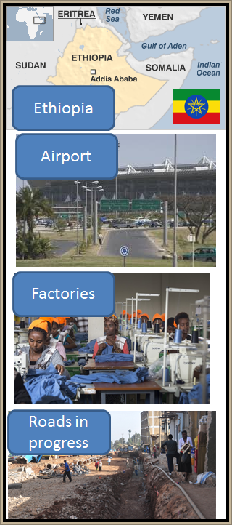
Infrastructure
One factor to consider when deciding where to locate production is the infrastructure of a country
A business will need to assess if the country have adequate road, rail, sea and air transport systems so goods can be exported and imported easily
The business will also need to know if the country have suitable buildings and premises where the goods could be manufactured
The country have a reliable power system e.g. in Ethiopia power cuts are a daily occurrence

Slide 17
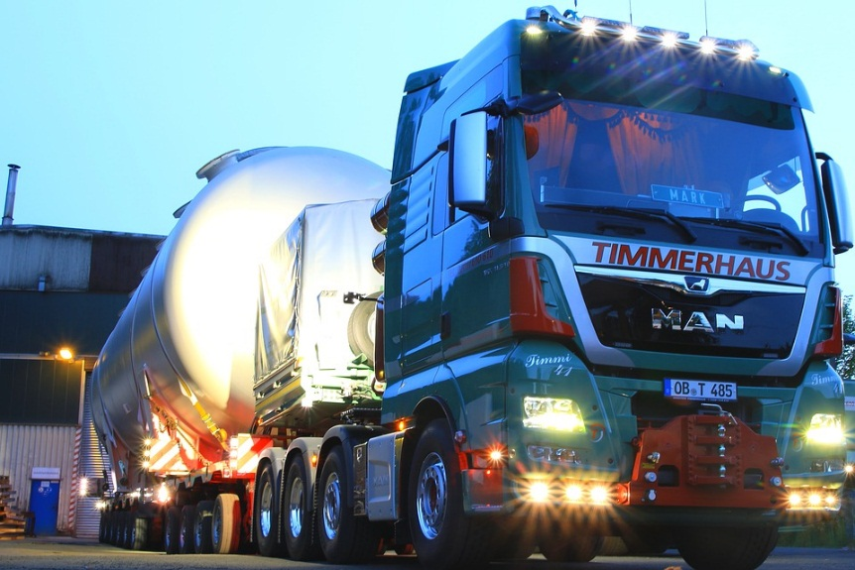
Infrastructure rankings
Have a look at the global trade logistics rankings and compare the UK to the other countries

Slide 18
Location in a trade bloc

Slide 19
Location in trade bloc
Some businesses may start production in a country as a way into a trade bloc.
For example Honda, Nissan and Toyota all have manufacturing plants in the UK to gain access to the lucrative rich and developed EU market for cars
EU is the world’s largest trading bloc, which accounts for some 20% of global GDP and approximately 500 million people.
Trading Blocs
NAFTA
SAARC
ASEAN
OPEC
EU
CEFTA
EEA

Slide 20
Government incentives

Slide 21
Government incentives
The government of a country may offer incentives for businesses to set up there
Tax incentives are given to companies in the hope that foreign investors will bring in capital to support economic development and create local employment
Africa is losing $2 billion a year in tax breaks for foreign businesses

Slide 22
Ease of doing business

Slide 23
Ease of doing business
The Ease of doing business (EODB) is an index published by the World Bank
This is a mixture of 11 indicators such as; labour regulations, construction permits, land availability and time taken to build a warehouse
The EODB looks at 190 countries worldwide and aims to encourage countries lower down the rankings to reform their business practices
Short Video HERE from the World Bank
Look up your countries here

Slide 24
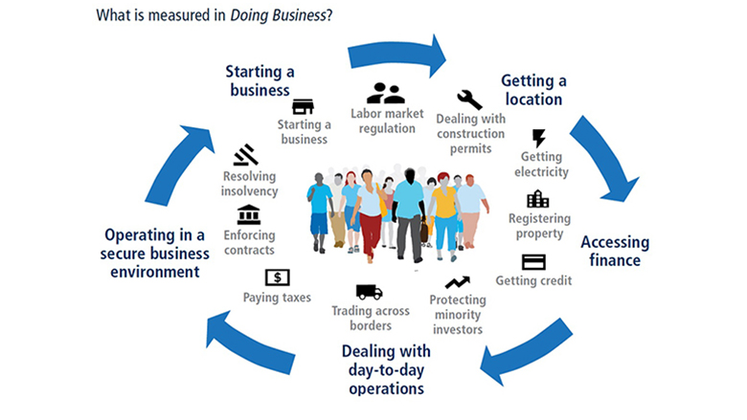
World Bank – EODB graphic

Slide 25
Importance of EODB when deciding where to manufacture
EODB rank will help a business to find out the time period required to start a business and the number of paperwork obstacles to be overcome
EODB higher rank implies that the business could start quickly reducing start-up costs and this may be a good reason to choose a location
Other factors may be important too such as labour costs, skills an availability of labour and infrastructure
Location may however depend on access to raw materials
The business may require high skills and good infrastructure rather than cheap labour which may effect the decision of where to produce

Slide 26
Political stability

Slide 27
Would a country, which is in political crisis, be a good place to start manufacturing products?

Slide 28
Syria – could you set up production here?

Slide 29
Natural resources

Slide 30
Natural Resources – list of countries
Take a look at this list of countries and the natural resources on the right
Remember you are trying to decide where to locate.
You may need raw materials from that country
If you don’t locate there you may have to import which could be expensive
This will push up the costs of your production
This will reduce your profits

Slide 31
Natural resources – China rare earth metals
Some countries have an advantage that they have natural resources that are not found elsewhere
For example China has a monopoly on rare earth metals – to watch this video you will need to use Internet Explorer.

Slide 32
Natural resources – African diamonds
You may need to set up production in another country because the raw materials that you need do not naturally occur in the UK
The business could decide to import cocoa beans, coffee beans, rice or pineapples, but perhaps it will be cheaper to move the production location to the country of origin

Slide 33
Likely return on investment

Slide 34
Likely return on investment
If a business sets up production in another country this is expensive
Moving factory
Setting up new production
Buying machinery
Hiring staff
Moving operations such as HR
Hiring key staff such as managers with local knowledge (language)
Investors will need to know that these expenses will be returned with profits

Slide 35
Sample Edexcel A2 questions

Slide 36
Case study for question 1

Slide 37
Sample question 1
[6]
Knowledge 2
Application 2
Analysis
2
Notes:
Another 6 mark legacy question

Slide 38
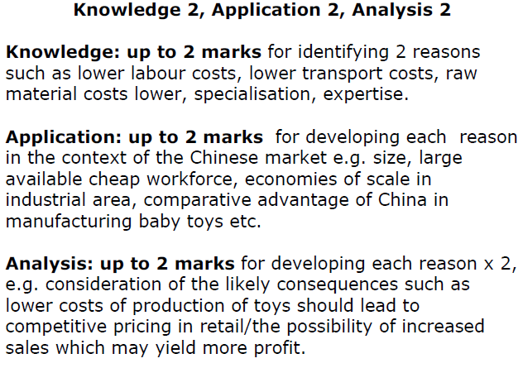
Answer sample question 1

Slide 39
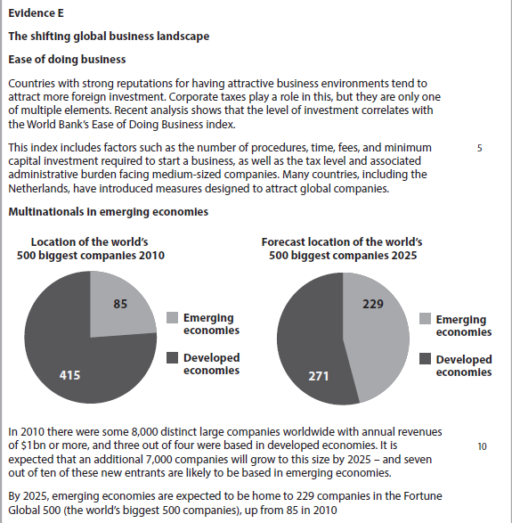
Case study for question 2

Slide 40
Sample question 2
[10]
Knowledge 2
Application 2
Analysis
3
Evaluation
3

Slide 41
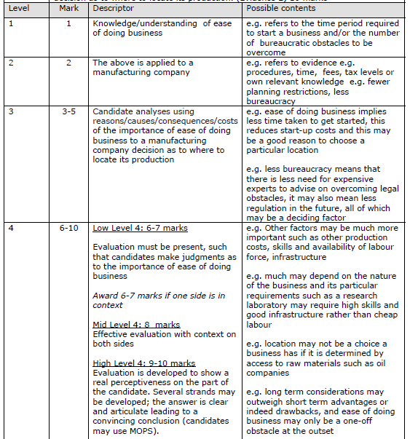
Answer sample question 2

Slide 42
Case study for question 3

Slide 43
Sample question 3
[6]
Knowledge 2
Application 2
Analysis
2
Notes:
6 mark legacy question

Slide 44
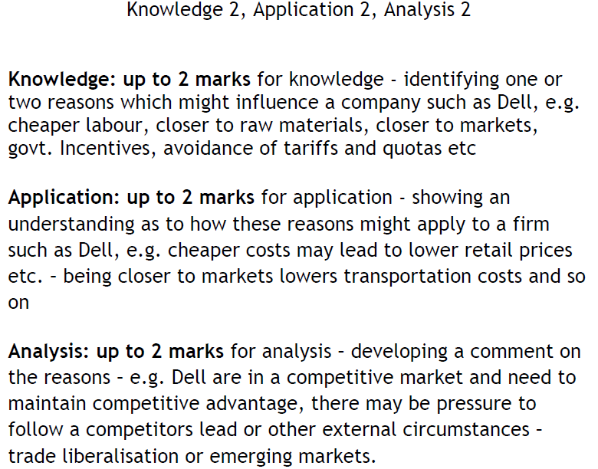
Answer sample question 3

Slide 45
Case study for question 4

Slide 46
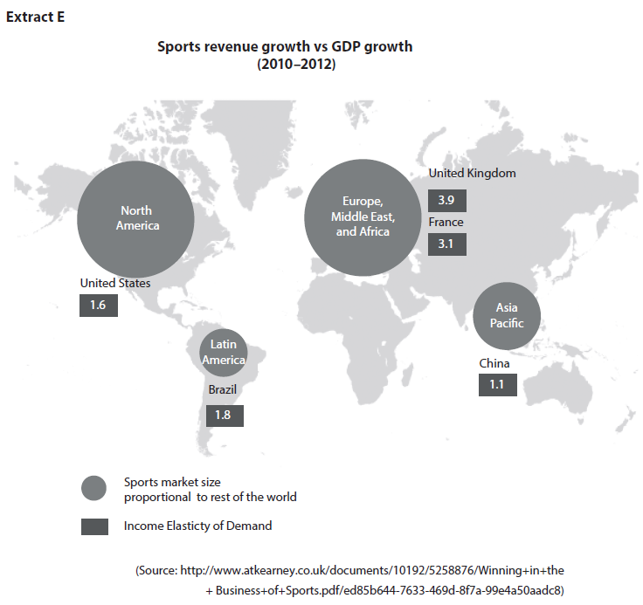

Slide 47
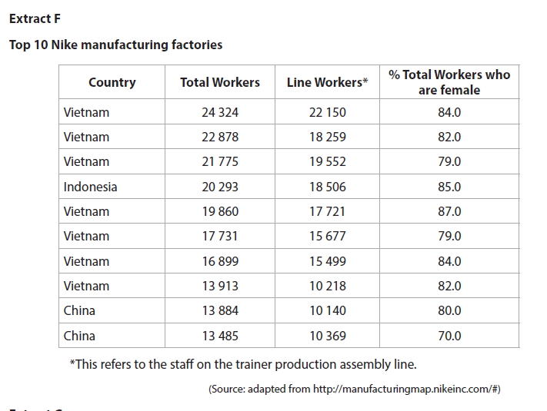

Slide 48
Sample question 4
Knowledge 4
Application 4
Analysis
6
Evaluation
6

Slide 49
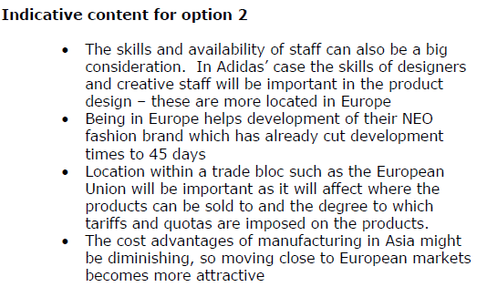
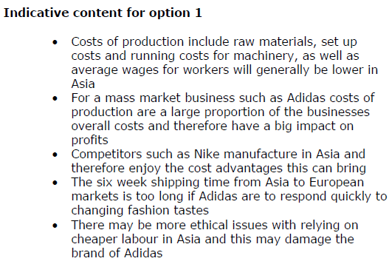
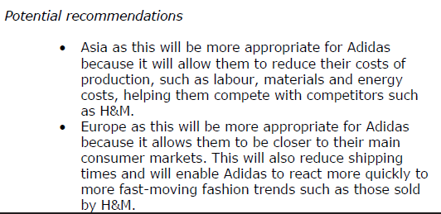
Answer sample question 1

Slide 50
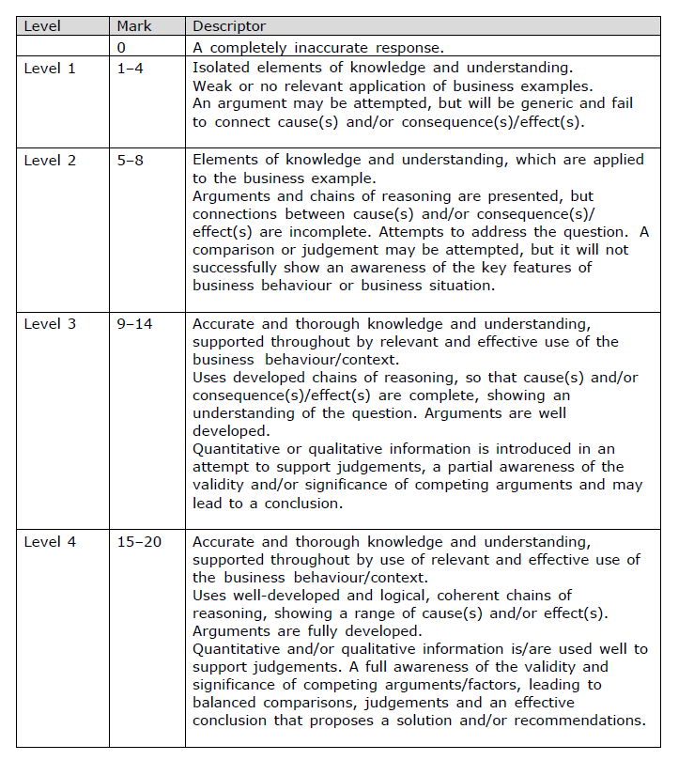
How to level question 4

Slide 51
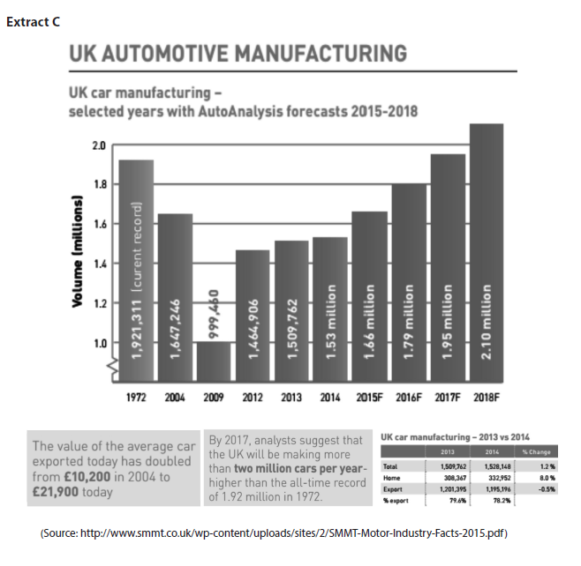
Case study for question 5

Slide 52
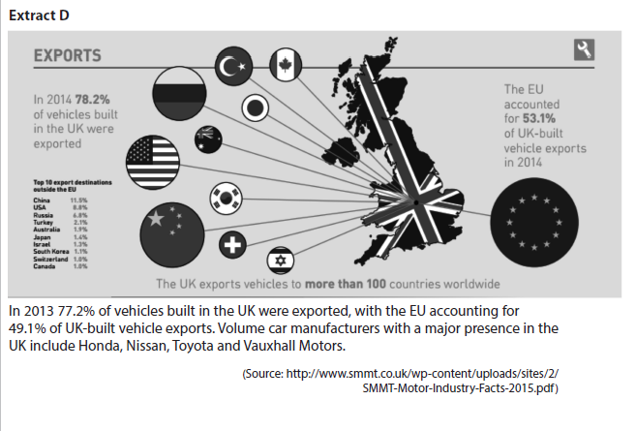

Slide 53
Sample question 5
Knowledge 4
Application 4
Analysis
6
Evaluation
6

Slide 54
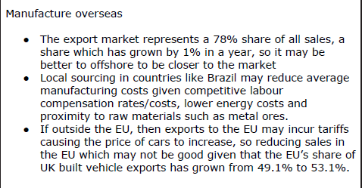
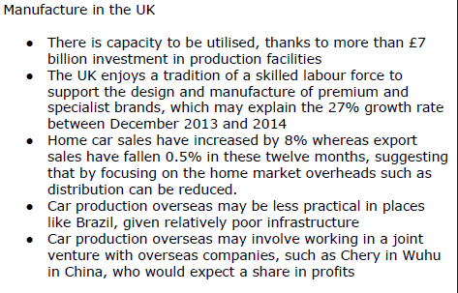
Answer sample question 5

Slide 55
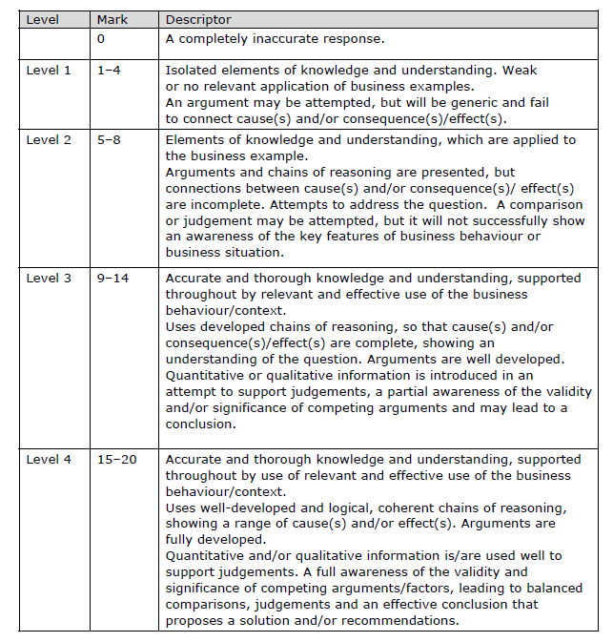
How to level sample question 5

Slide 56
Glossary
Infrastructure; the framework of features in a country that makes trade possible e.g. roads, rail, factories and power
Ease of Doing Business; A ranking of nations designed by the Wold Bank to be the “World Cup” of doing business. Can be used by a company to decide where to locate a manufacturing base.
Government Incentives; This is money that is given to a company by a government, in order to attract them to manufacture in that country. For example in 2009 Dell was paid 52 million Euros by the Polish government to move their manufacturing base from Ireland to Lodz in Poland.

