Slide 1
Edexcel A2 Business
1.2.1 Demand
Revisionstation

Slide 2
Worksheet

Slide 3
From Edexcel
a) Factors leading to a change in demand:
changes in the prices of substitutes and complementary goods
changes in consumer incomes
fashions, tastes and preferences
advertising and branding
demographics
external shocks
seasonality

Slide 4
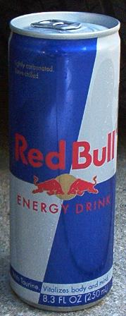
Starter
If this drink was £5 a can would you buy it?
If this drink was 10p a can would you buy more of it?

Slide 5
Definition: Demand
Demand is the amount of a good that consumers are willing and able to buy at a given price

Slide 6
Kickstarter video

Slide 7
Factors leading to a change in demand - price

Slide 8
What determines demand?

Slide 9
Price determines levels of demand
Price and demand are related – here is an example
As the price increases on a product or service, normally, the demand will decrease as less customers are willing (or able) to pay the price
As the price decreases – what might happen to demand?
Notes:
Demand rises as the price falls

Slide 10
Factors leading to a change in demand non-price

Slide 11
Non-price determinates of demand
Price of substitutes
Alternative brands
Price of compliments
Changes in consumer income
Trends in fashion and tastes
Marketing, advertising and branding
Population structure / demographics
Time of year
Weather and climate
External shocks
Get ready to make some notes on these 10 area
Non-price factors that can affect demand for a product or service
Is there anything missing from this list?
Notes:
Availability of competitors products

Slide 12
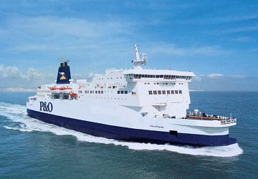
#1 Price of substitutes
A substitute product is an alternative
For example if a customer cannot afford to fly to a destination they may consider going via ferry and train which would be cheaper
Another example is if coffee is too expensive a consumer may consider buying tea instead

Slide 13
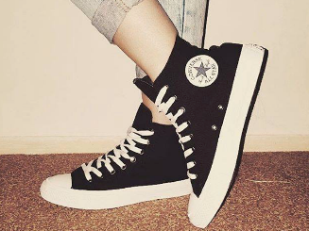
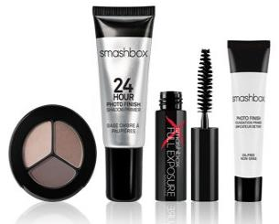
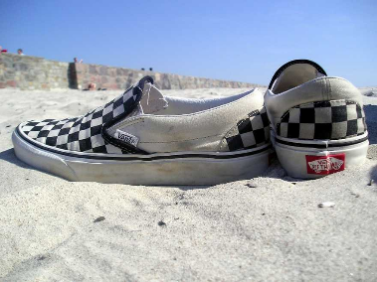
#2 Alternative brands
If an alternative brand is available and the product is not available then this will affect demand
If customers are able to buy a similar product, with a similar brand profile then demand may be affected
Do you own any “alternative brands”?

Slide 14
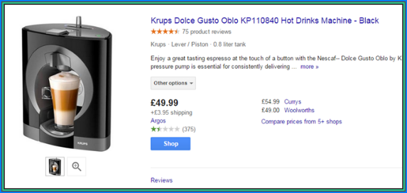
#3 Price of compliments
A complementary product is one that needs to be used with another product
Another example is buying capsules for a coffee machine
As the prices of these complimentary goods rise then demand for the main product falls
Can you name one more product that has complimentary products?
Notes:
Printer and ink

Slide 15
#4 Changes in consumer income
As consumer incomes rise then demand for some products falls e.g. microwave meals – consumers may buy fresh food or eat out instead
Equally as consumer incomes rise then they have more disposable income to spend on luxuries like; holidays, prestige cars etc.
Lottery winners – will the type of products that they demand change now they have won?

Slide 16
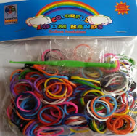
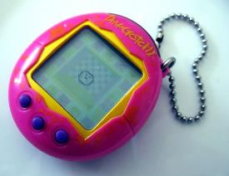
#5 Trends and fads in fashion and tastes
As trends in goods and services rise then demand for these products rise
Trends tend to be a change in consumer preference over time e.g. Smartphones
Fads are short lived e.g. fidget spinners. Do you still have one? Did you ever have one?

Slide 17
# 5Trends and fads graph

Slide 18
#5 Trends and fads graph
Fashion
Fad
Trend
Sales
Time

Slide 19
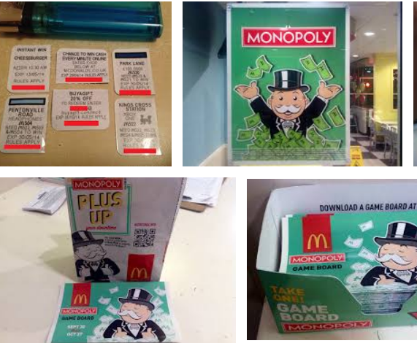
#6 Marketing
Marketing can also stimulate demand e.g. promotions can help to encourage sales
McDonald’s run the monopoly promotion every year
The marketing mix can help a business to drive traffic to a website – through a sale or an offer
Some websites like Groupon and Vouchercloud help to increase demand
Have you got any voucher apps?

Slide 20
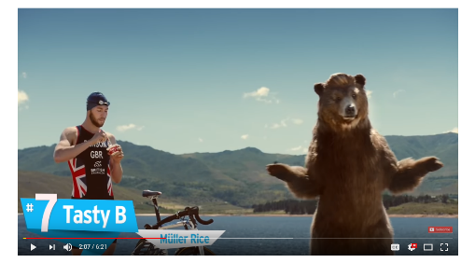
#6 Advertising
Advertising can stimulate demand and increase sales
Advertising can call the public’s attention to a product or service
It can also be used to launch new products, remind customers about how good established products are and build the image of the brand
Watch these 10 adverts and vote on which is the most annoying

Slide 21
#6 Advertising and branding
As products are heavily advertised they may experience an increase in demand. If this did not occur then businesses would not invest in advertising at all.
Products in adverts are associated with other things we already have a positive feeling about (see video)
Heavy branding on goods will help to increase or keep demand stable

Slide 22
#7 Population structure and demographics
The UK population is getting older, this means that different products and services will be in higher demand
Weddings are also going out of fashion which may mean that demand for wedding cakes will fall
The UK is also experiencing a baby boom – what kinds of products may experience higher demand as a result?

Slide 23
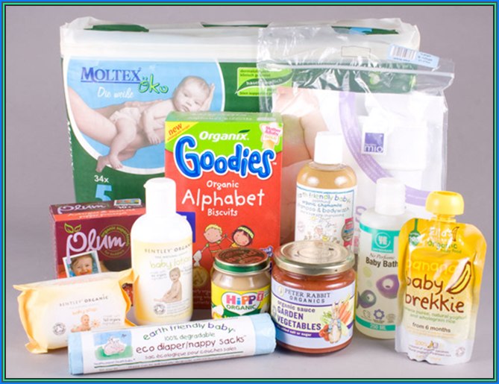
Baby Boom means an increase in demand for baby products – can you think of 6 products?

Slide 24
Baby Boom = increase in demand for baby products
Nappies
Baby food
Prams
Baby bath products
Baby clothes
Cot blankets

Slide 25
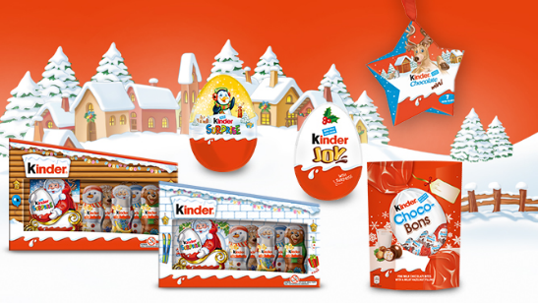
#8 Time of year
Some products reach peak demand at certain times of the year in the UK:
Christmas trees
Easter eggs
Pumpkins at Halloween
Can you think of other examples?
Notes:
Strawberries during Wimbledon season

Slide 26
#9 Weather and climate
Some products have a seasonality factor and may be affected by the weather and the climate
One example is an ice cream van’s Mr Whippy 99 ice creams
Can you think of other examples of products that sell better if the weather is better?
Notes:
Garden furniture, flipflops, beach towels, BBQs

Slide 27
#10 External shocks
External shocks such as; terrorism, war, disease and health scares can change demand
For example after terror attacks in Tunisia travel agents have found it hard to sell holidays there
30 British tourists were killed on the beach
Can you think of other examples of countries where attacks have had an impact on tourism?

Slide 28
Sample Edexcel A2 questions

Slide 29
Case study for question 1

Slide 30
Sample question 1
Knowledge 2
Application 2
Analysis
3
Evaluation
3

Slide 31
Answer sample question 1

Slide 32
How to level sample question 1

Slide 33
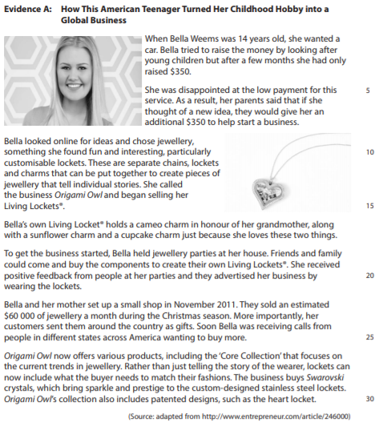
Case study for question 2

Slide 34
Sample question 2
Level 1
1-2
Level 2
3-4
Level 3
5-7
Level 4
8-12

Slide 35
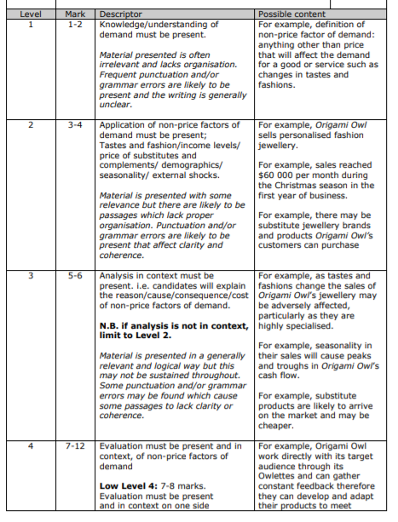
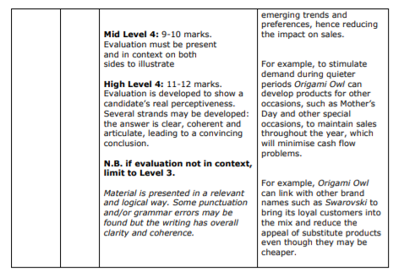
Answer sample question 2

Slide 36
Glossary
Substitute goods; Where one type of product could be replaced with another e.g. bus for a taxi, margarine for butter
Complementary goods; Where one product is used at the same time with another product e.g. Coffee pods in a coffee machine, ink in a printer
Demographics; This means anything to do with the structure of the population e.g. we are all living longer
External shocks; This is an event which causes significant change e.g. war, terrorism, disease outbreak e.g. Ebola in Liberia
Seasonality; Any predictable change or pattern in a time series that recurs or repeats over a one-year period can be said to be seasonal

