Slide 1
STARTER ACTIVITY RECAP
RECAP: What is PED?
Perfectly Elastic PED
-Diagram
-Value
Relatively Inelastic PED
-Diagram
-Value
Relatively Elastic PED
-Diagram
-Value
Perfectly Inelastic PED
-Diagram
-Value

Slide 2
Price Elasticity of Demand
RECAP: What is PED?
PED = A measure of the degree of responsiveness of demand after a given change in price for a particular product or service. Products can be either: ELASTIC INELASTIC

Slide 3
YED Lesson 1

Slide 4
LEARNING OBJECTIVES
Lo1: Be able to define the term “income elasticity of demand” (YED).
Lo2: Be able to calculate YED and explain the different degrees of YED.
Lo3: Analyse how the nature of the product/service effects the degree of YED.

Slide 5
Specification
1.2.3 Price, income and cross elasticities of demand
a) Understanding of price, income and cross elasticities of demand
b) Use formulae to calculate price, income and cross elasticities of demand
c) Interpret numerical values of:
price elasticity of demand: unitary elastic, perfectly and relatively elastic, and perfectly and relatively inelastic
income elasticity of demand: inferior, normal and luxury goods; relatively elastic and relatively inelastic
cross elasticity of demand: substitutes, complementary and unrelated goods
d) The factors influencing elasticities of demand
e) The significance of elasticities of demand to firms and government in terms of:
changes in real income
changes in the prices of substitute and complementary goods

Slide 6
We know that elasticities measure the response of a change in one variable as a result of a change in another variable… - Define price elasticity of demand… - What do you think income elasticity of demand measures?
YED measures how a change in income can affect a change in quantity demanded for a given product or service in a market.

Slide 7
What is the formula for PED? % change in quantity demanded % change in price
Finding the income elasticity of demand is similar, you merely replace price with income!
% change in quantity demanded
% change in income
Or the formula could look like this...
YED = %ΔQd
%ΔY

Slide 8
Positive or Negative
Unlike PED, the positive/negative aspect of the YED figure is important.
Negative YED: A rise in income will lead to a FALL in the quantity sold. Vice versa.
Positive YED: A rise in income will lead to an INCREASE in the quantity sold. Vice versa.

Slide 9
Demonstrate a demand curve with a positive YED relationship.
Income
Positive YED: A rise in income will lead to an INCREASE in the quantity sold.
What kind of products/services would have a positive YED relationship?
0
Quantity

Slide 10
Demonstrate a demand curve with a positive YED relationship.
Income
+YED
Y2
What kind of products/services would have a positive YED relationship?
Y1
Positive YED: A rise in income will lead to an INCREASE in the quantity sold.
0
Q1
Q2
Quantity

Slide 11
Demonstrate a demand curve with a negative YED relationship.
Income
Negative YED: A rise in income will lead to a FALL in the quantity sold.
0
Quantity

Slide 12
Demonstrate a demand curve with a negative YED relationship.
Income
What kind of products/services would have a negative YED relationship?
Y2
Negative YED: A rise in income will lead to a FALL in the quantity sold.
Y1
YED
0
Q2
Q1
Quantity

Slide 13
If a good or service is YED elastic this means: changes in income will lead to a proportionately GREATER change in demand. (Greater than 1.)
DEGREES OF YED ELASTICITY
If a good or service is YED inelastic this means: changes in income will lead to a proportionately SMALLER change in demand. (Less than 1.)

Slide 14
YED Elastic (positive)
Income (Y)
YED is the demand for a good or service… This diagram demonstrates a small change in income (Y) leads to a proportionately larger change in quantity demanded.
+YED
Y2
Y1
0
Q1
Q2
Quantity
Quantity

Slide 15
YED Inelastic (positive)
Income (Y)
+YED
This diagram demonstrates change in income (Y) leads to a proportionately smaller change in quantity demanded.
Y2
Y1
0
Q1
Q2
Quantity

Slide 16
Inferior goods are of a lower quality. For example: Tesco’s own brand. (-Negative YED.)
Normal goods are demanded more when incomes increase. Most goods adhere to this law of demand. (+Positive YED.)
Necessities (type of normal good) are goods/services that are essential. For example: Petrol. (+Inelastic)
Luxury goods (type of normal good) are of more extravagant standard. For example: caviar. (+Elastic)

Slide 17
Is the YED positive or negative?
Positive
Negative
NORMAL GOOD
INFERIOR GOOD
We don’t need to analyse any further than this for inferior goods.
Greater than 1
Less than 1
LUXURY GOOD
NECESSITY

Slide 18
Consumer incomes increase from an average of 30,000 per year to 33,000 per year. During the same year, the demand for cheese increased from 2.8bn to 2.856bn. What was the YED for cheese during this particular year? What kind of good was cheese during this particular year?
2%/10% = +0.2 YED, therefore cheese is a necessity.
As it is positive but less than 1.
Consumer incomes increase from an average of 25,000 per year to 30,000 per year. During the same year, the demand for smartphones increased by 40%. What is the YED for smartphones during this particular year? What type of good was the smartphone during this particular year?
+40%/+20% = +2 YED, therefore smartphones are a luxury good.
As it is positive and greater than 1.
Consumer incomes increase by 10%. During the same year, the demand for coach travel decreased by 3%. What is the YED for coach travel during this particular year? What type of good was coach travel during this particular year?
-3%/+10% = -0.3 YED, therefore coach travel is an inferior good.
As it has a negative YED coefficient.

Slide 19
TABLE ACTIVITY
Complete the table with regards to the following goods:
Toothpaste
Caviar
Poundland Cheese
Internet

Slide 20
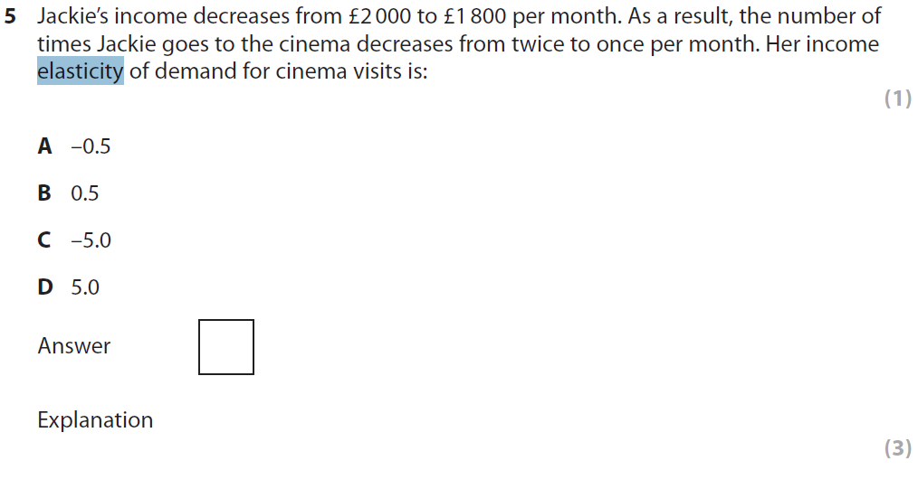
Notes:
Jan 2011 Q5

Slide 22
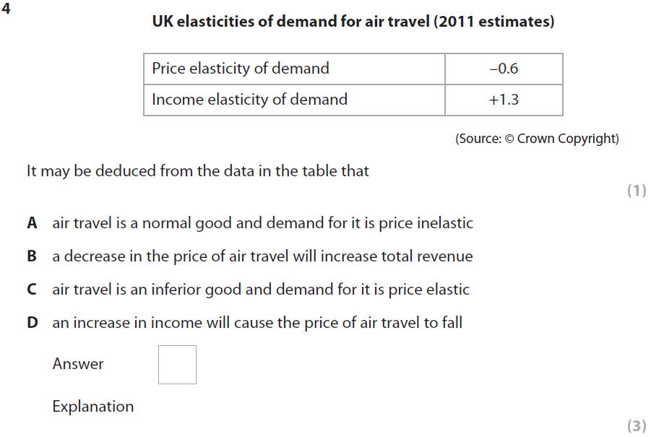
Notes:
Q4 January 2013

Slide 24
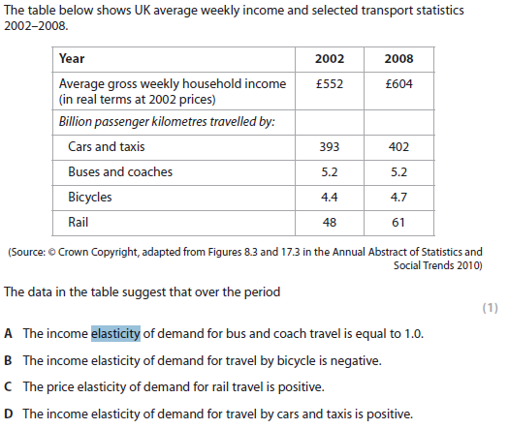
Notes:
Q4 January 2012

Slide 26
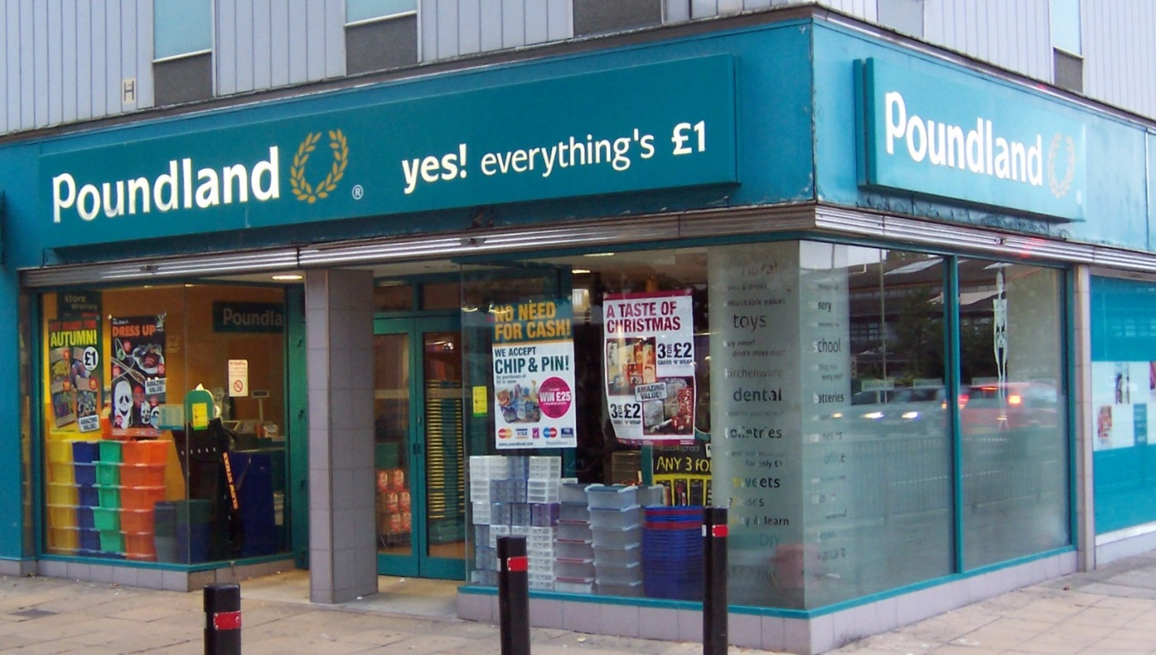
Poundland ARTICLE
Read the article about Poundland.
How do Poundland maintain their profit margins, despite not being able to change the price.
What type of goods (in terms of YED) do you think Poundland generally sells?
Positive/Negative?
Inelastic/Elastic?

