Slide 1
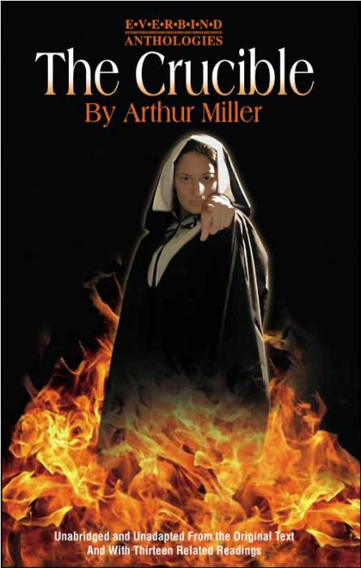
The Crucible by Arthur Miller
Leaning Objective: To explore the background of the play ‘The Crucible’.

Slide 2
Learning Outcomes
By the end of the lesson you should be able to…
Recall the life of Arthur Miller and what he experienced.
Describe the differences between the real and the fake story.
Explain how it feels to live in Puritan times.

Slide 3
Our Understanding
What is a witch?
Perfect Partners………

Slide 4
Background
The Crucible is a play about witch trials in Salem village in the American state of Massachusetts in 1692
It is based on real events and real people but it is a fictional account of what happened.

Slide 5
What really happened!!
In February 1692, several girls in Salem started having fits and accused other villages of bewitching them.
Over the next 8 months, over 150 people were arrested for witchcraft. Nineteen of them were hanged.

Slide 6
The 1950’s ‘Witch Hunt’
In the 1950’s the House Un-American Activities Committee (HUAC), a body set up to investigate radical political groups, accused thousands of people of being communists. These people were aggressively questioned, lost their jobs and imprisoned.
Miller wrote The Crucible to highlight the dangers of modern day ‘witch hunts’ !!!

Slide 7
Arthur Miller
1915: Born in New York
1936: Wrote 1st play ‘The Villain’
1952: Millers friend was accused by the HUAC and it inspired him to write ‘The Crucible’.
1953: The Crucible on Broadway.
1956: Married Marlin Monroe.
1957: Accused by HUAC, prison for 30 days, not allowed passport, black listed.
1958: Conviction overturned.
2005: Died aged 89.

Slide 8
Superstition.
“A belief or action that is not based on reason or evidence”.

Slide 9
Puritan life
Learn passages of the bible by heart, Obey the laws of the church, Attend church every Sunday, Read the bible aloud at mealtimes, Must sleep soundly with a pure and clean mind, Children do not enter the woods.
5 letters or less
Who is the witch?

Slide 10
Puritan life
In groups of 4/5 create a still image that shows some form of Puritan life. This does not have t be about witches… remember some of the rules…
God fearing, church, working hard, man is in charge, punished for misbehaving. Women inferior.

Slide 11
Evaluation…
Can you Recall the life of Arthur Miller and what he experienced?
Can you Describe the differences between the real and the fake story?
Can you Explain how it feels to live in Puritan times?

Slide 12
Independent Learning
For next lesson…
Copy up your drama diary/ progress books.
This Power Point is on Moodle.
What progress have you made….
Set your own target for next lesson….
What techniques have you used….
How could you use the information from today.

