Slide 1
Edexcel A2 Business
2.4.1 Production productivity
and efficiency
Revisionstation

Slide 2
You will need a ruler and selection of colours

Slide 3
Worksheet

Slide 4
From Edexcel
a) Methods of production:
job
batch
flow
cell
b) Productivity:
output per unit of input per time period:
factors influencing productivity
link between productivity and competitiveness
c) Efficiency:
production at minimum average cost:
factors influencing efficiency
distinction between labour and capital intensive production

Slide 5
Starter
How productive are you?
A) on a Monday morning first lesson
B) on a Wednesday afternoon last lesson
C) on a Friday lunch time?
Notes:
My students just said “not very£ to all of them which prompted my question – what is productivity then?, as they were able to answer they must have understood the term

Slide 6
Productivity defined
Productivity is the output per input (person or machine) per hour
Production is the total amount of output that is produced in a time period
You need to learn BOTH and make sure you don’t get them mixed up

Slide 7
Methods of production

Slide 8
Methods of production
There are various methods of producing goods for sale. Each method will be suitable for certain goods, you will need to know the advantages and disadvantages of each of the methods and when they would be appropriate.
These are the four methods that your exam board would like you to be able to discuss:
Job
Batch
Flow
Cell

Slide 9
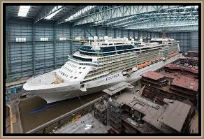
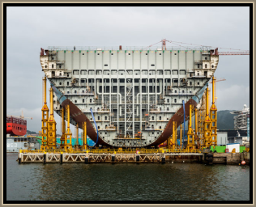
#1 job production
Job production is where one single product is made at a time
Products are made for a specific client or customer
Products made are high quality, which means higher prices can be charged
However, the production process can be slow and labour intensive

Slide 10
#1 Job production
A key feature of job production: goods are made by skilled craftspeople who will be well motivated

Slide 11
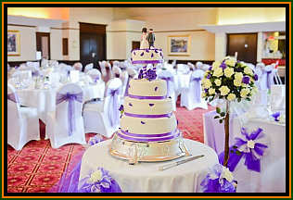
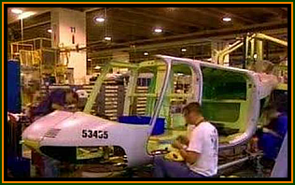
#1 Examples of job production

Slide 12
#1 When to choose job production
Job production
Correct production process to choose when one product needs to be produced at a time:
Building a ship
Hand knitting a jumper
Building a bridge over a river
Writing a book

Slide 13
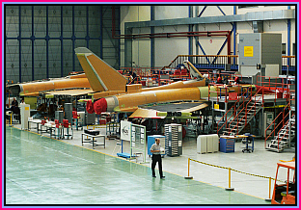
#1 Job production
Disadvantages
Skilled labour and craftsmen are expensive
Wide range of tools may be required
Hard to speed up if demand increases
Advantages
Bespoke, unique, one off, to customers measurements or specifications e.g. a kitchen
Very motivated workers who can see one item made from start to finish
Motivated workers are normally more productive and have lower rates of absenteeism
Higher prices can be charged to the customers – how does this impact on the profitability of a business?

Slide 14
#2 batch production
This is the production method used when a business wants to make more than one item at a time
Goods are made in batches, and can be switched over to make something different on the same production line
Bread factory also makes crumpets and tortillas
Furniture makers may produce a run of one design of chair before switching to make something else
Watch the video, why is Denby pottery an example of batch production?
Notes:
Clue is in the screenshot, lots of different designs

Slide 15
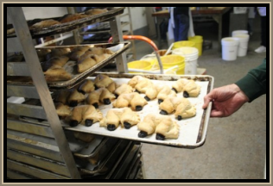
#2 Batch production
Disadvantages
Small batches carry higher average unit costs (EOS)
Workers may be less motivated with repetitive work
Idle time between batches needs to be managed as this is wastage
Advantages
Production can be changed to meet customer needs or fluctuations in demand
Standard production of items means it can be mechanised less labour involved than job production
Employees specialise so become good at their job
Lower skilled workforce means lower wages can be paid

Slide 16
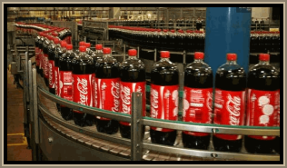
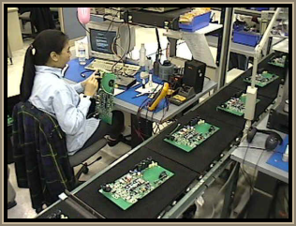
#3 flow production
Flow production uses production lines with continuous movements of items through the process
Many mass produced products are made this way such as; cola, cars and toothpaste
The factory would be laid out in assembly lines
Why is this a very capital intensive process?
Notes:
Capital intensive lots of machines highly automated

Slide 17
#3 When to choose flow production
Flow production
Correct production process to choose when standardised products need to be mass produced in huge volumes in a continuous process:
Toothpaste
Cola
Crisps
Chocolate bars

Slide 18
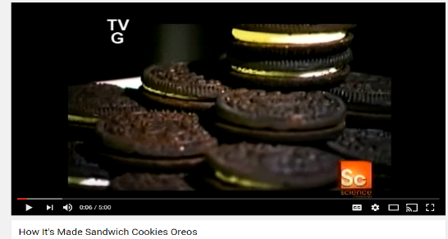
#3 Flow production
Disadvantages
High costs to buy the factory and machinery
Low motivation of staff due to repetitive tasks
Break downs and lost production can be costly
Very inflexible, hard to change the factory machinery to make different products, the production process will be set up to make just one item e.g. bottled cola
Advantages
A business can make larger quantities which means they can bulk buy raw materials and save money (economies of scale)
Automated and computerised production means improved quality and more complex designs can be made in shorter times
As production is continuous stocks of parts and raw materials don’t need to be held this means a business can use the JIT (just-in-time) system

Slide 19
#4 cell production
Cell production is dividing up production into separate self contained areas that are each responsible for a section of work
In the DR Martens video you can see that cutting the leather is one section, then sewing is another etc.
Each cell will have a team leader and a team of multi-skilled workers

Slide 20
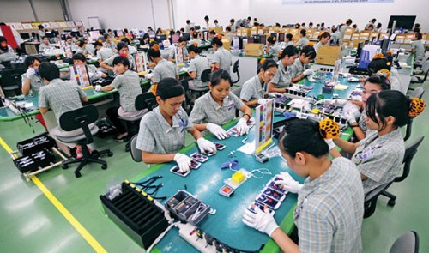
#4 Cell production
Disadvantages
Any breakdown of machinery will stop the production
Needs more staff to supervise than a continuous flow
Expanding can be hard as space may be limited or restricted by tasks
Advantages
Wastage through movement of materials is reduced
Time waiting for stock to arrive is reduced
Bottlenecks in the production process are reduced (where everything builds up waiting to go to the next stage)
Cell production can mean increased worker commitment and motivation and therefore increased productivity

Slide 21
Productivity

Slide 22
Productivity
Productivity is how a business can measure how hard a person or a machine is working
This helps in planning, scheduling, monitoring, budgeting and running the business
We talk about productivity in terms of “efficiency” if it is good or “inefficiency” if it is bad

Slide 23
Ways to improve productivity
If a business can increase their productivity while keeping costs to a minimum then will increase their efficiency. There are lots of ways to do this, the main ones that you exam board would like you to know are:
Productivity bonus
Productivity deal
Staff training
Investment in new machinery and equipment
Get ready to make some notes on these ways, over the next few slides.

Slide 24
#1 Productivity bonus
A business may decide to boost their productivity levels by offering their employees a productivity bonus
So for example, the employees if they increase production by 5% may be entitled to with a lump sum bonus e.g. £500 or a percentage on their wages
This will increase the costs of the business so may not maximise efficiency

Slide 25
#2 productivity deal
The union in a business may negotiate a productivity deal for all staff
This should motivate everyone in the organisation to work harder and more efficiently
Again this is a financial method of motivation and as such there is a cost

Slide 26
#3 staff training
If staff are better trained they can be more productive
Imagine a factory, its your first day, you have no idea what to do, until you are shown what to do all you can do is stand around – which is very inefficient
Once you are fully trained you will be able to work hard at your job
Training can be expensive because it means that two people (at least) are away from their job while the employee is being trained, so there is also lost productivity while that happens

Slide 27
#4 investment in new machinery and equipment
The business may decide to invest in new machinery to make it more efficient and produce more goods per hour – which will boost productivity
Machinery / capital investment is expensive and may take years to recoup the costs so is a very long-term strategy to improve productivity

Slide 28
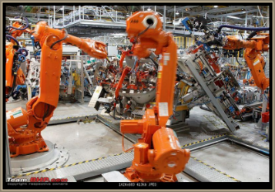
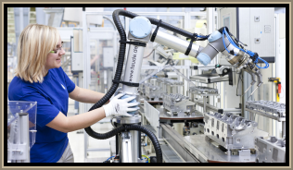
Factors influencing productivity
Quality of inputs in the production process – faulty parts in an assembly line can stop the line
Labour shift organisation of workers, having the right number of staff on at peak times will increase productivity overall, as stretched staff are demotivated by being overloaded
Investment in new technology, robots can work 24/7 without rest breaks and so will increase productivity levels

Slide 29
Link between productivity and competitiveness
In essence if a business is more productive then it can produce goods more economically efficiently and therefore is in a position to charge more competitive prices
For example a business that introduces s new machine perhaps to bottle beer or wrap crisps and can now produce double the amount in half the time
The business will enjoy economies of scale and can therefore charge a competitive price

Slide 30
Efficiency

Slide 31
Production at minimum average cost
Efficiency is maximised when goods are produced at the minimum unit or average production cost
Production will aim to operate at the minimum average cost per unit so that they can take advantage of economies of scale
Average cost formula:
TC / output
Where TC = FC + VC
Costs and revenues
Minimum average cost
output

Slide 32
Productivity and efficiency
Firms that have a higher output per employee are more efficient
This can lead to competitive advantage as prices per item made are lower than competition
Can become market leader through low prices or
Enjoy high profits due to lower production costs
Quality may suffer as a result of trying to produce items too quickly

Slide 33
Labour costs and the impact on production choice – suggested activity
Carry out some online research
Fine out the average hourly wage rate for:
China
India
UK (Over 25)
Convert all 3 into dollars
Which country has the highest wage rate?
How will this impact on the cost of production?
Notes:
* Correct at time of writing

Slide 34
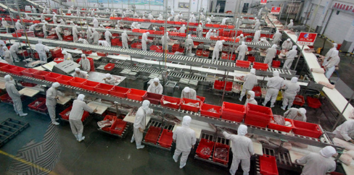
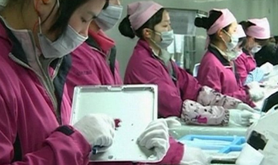
Look at the photos, can you explain what labour intensive might mean? What will the main costs of a production line like this be? Can the UK afford to produce goods in this way?

Slide 35
Labour intensive production
Labour intensive production makes products using mostly human effort (or labour)
China and India both have access to cheap labour so favour these production methods
The nature of the product will determine if it is suitable for labour intensive production e.g. can make cars by hand but to produce in volume requires machines

Slide 36
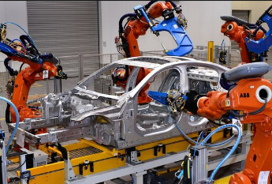
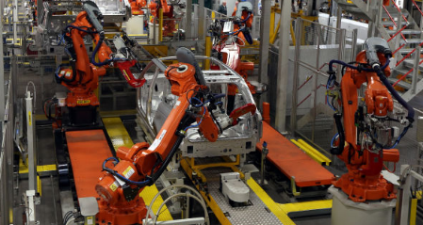
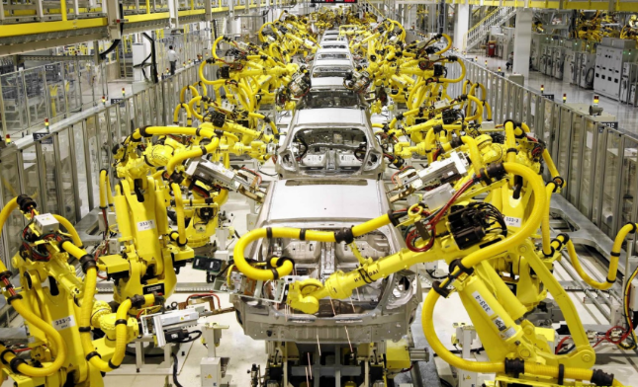
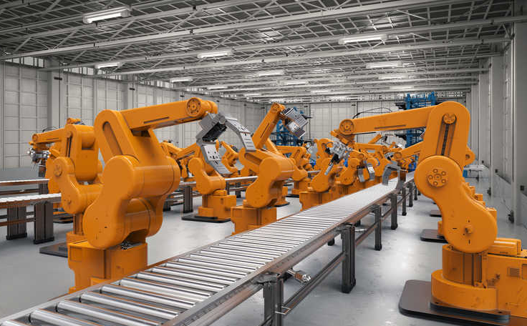
Look at the photos, can you explain what capital intensive might mean? What will the main costs of a production line like this be? Can the UK afford to produce goods in this way?

Slide 37
Capital intensive production
In some industries only capital intensive production is possible
In capital intensive production goods are produced using mainly machines and equipment
UK has high labour costs so favours capital intensive production
This allows the business to produce goods at the minimum average price (bottom of the cost curve)
Machines often break, need to be maintained and are expensive to buy

Slide 38
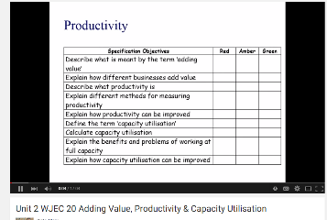
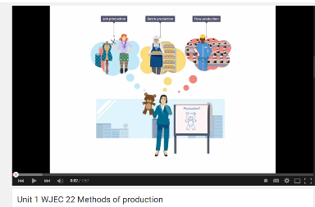
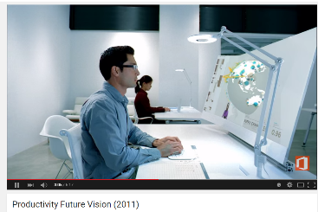
Revision Videos

Slide 39
Sample Edexcel A2 questions

Slide 40
Case study for question 1

Slide 41
Sample question 1
Knowledge 2
Application 2
Analysis
4
Evaluation
4

Slide 42
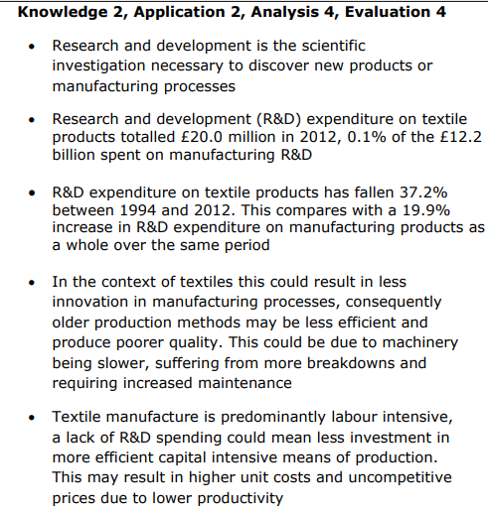
Answer sample question 1

Slide 43
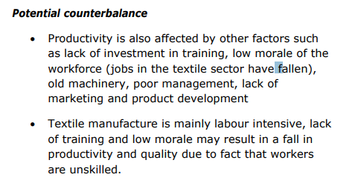
Answer sample question 1

Slide 44
Answer sample question 1
or

Slide 45
Case study for question 2

Slide 46
Sample question 2
Knowledge 4
Application 4
Analysis
6
Evaluation
6

Slide 47
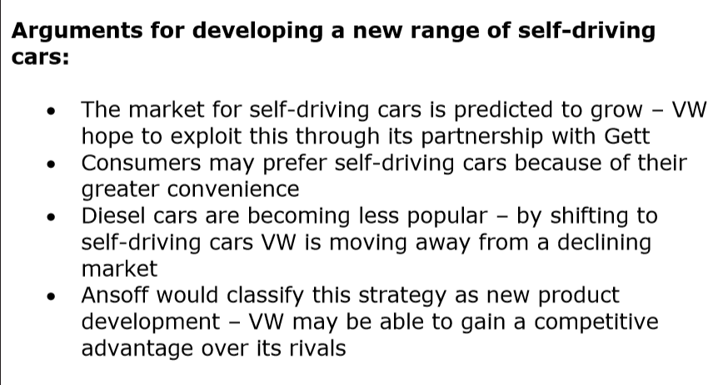
Answer sample question 2

Slide 48
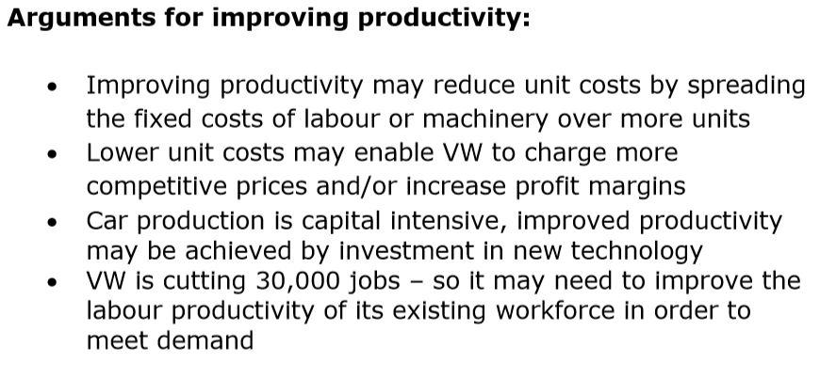
Answer sample question 2

Slide 49
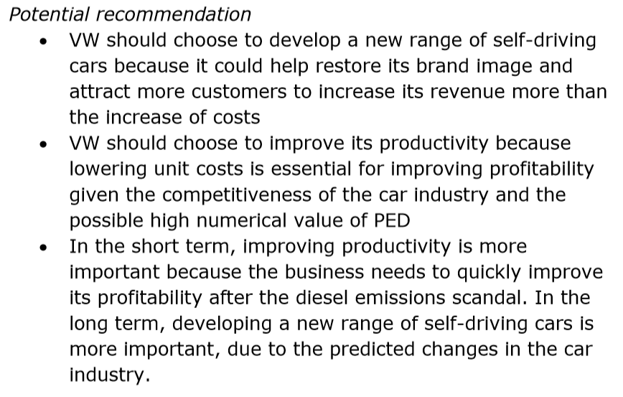
Answer sample question 2

Slide 50
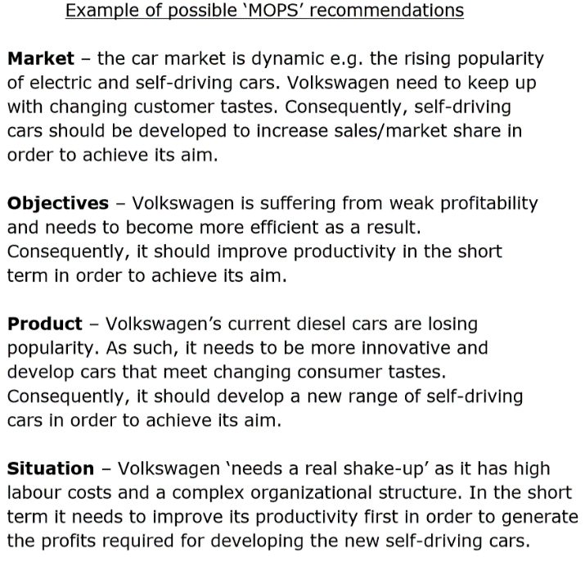
Answer sample question 2

Slide 51
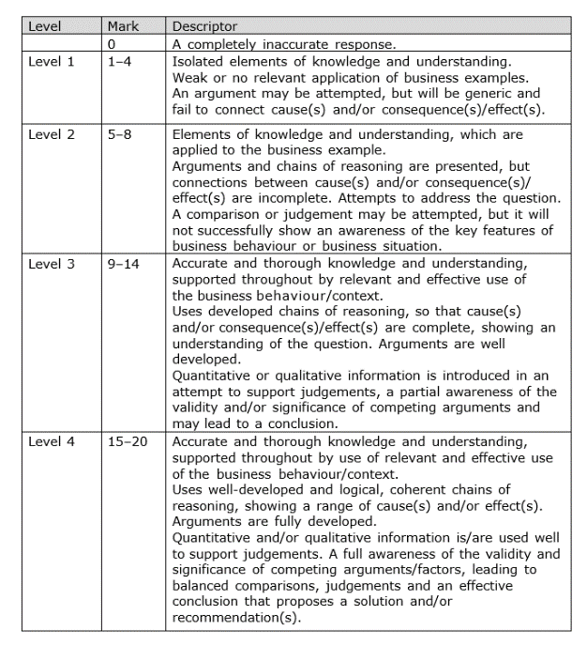
How to level question 2

Slide 52
Glossary
Productivity; output per unit of input - per time period
Job production; production of one item at a time
Batch production; Production of a few items at a time
Flow production; Continuous production of many items at a time
Cell production; Reorganisation of production into smaller work areas
Labour intensive; Many workers used in production
Capital intensive; Many machines used in production

