Slide 1
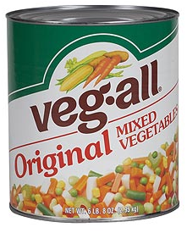
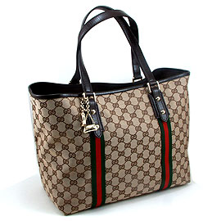
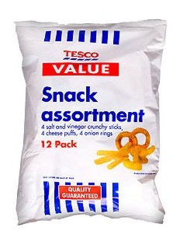
STARTER – YEDs and TYPE OF GOOD?
RECAP: What is PED?

Slide 2
ED

Slide 3
LEARNING OBJECTIVES
Lo1: Define and state the formula for cross elasticity of demand
Lo2: Calculate and analyse different degrees of XED
Lo3: Analyse and comment on XED calculations and assumptions

Slide 4
Specification
1.2.3 Price, income and cross elasticities of demand
a) Understanding of price, income and cross elasticities of demand
b) Use formulae to calculate price, income and cross elasticities of demand
c) Interpret numerical values of:
price elasticity of demand: unitary elastic, perfectly and relatively elastic, and perfectly and relatively inelastic
income elasticity of demand: inferior, normal and luxury goods; relatively elastic and relatively inelastic
cross elasticity of demand: substitutes, complementary and unrelated goods
d) The factors influencing elasticities of demand
e) The significance of elasticities of demand to firms and government in terms of:
changes in real income
changes in the prices of substitute and complementary goods

Slide 5
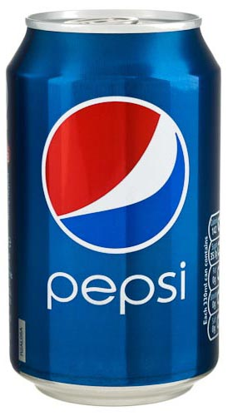
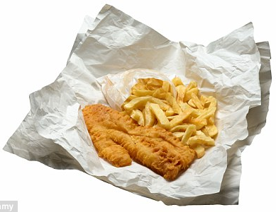
So far we have looked at PED and YED.... Now we will be moving onto XED. What do you think this focuses on?

Slide 6
Learning outcome 1
The price of Xbox One has increased....
What is likely to happen to the demand for Xbox controllers?
What do we call products that are consumed together?
COMPLEMENTS!

Slide 7
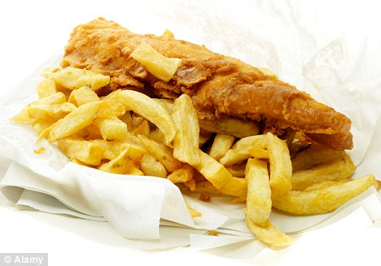
COMPLIMENT AND COMPLEMENT
THIS is a COMPLEMENT….
THIS is a COMPLIMENT….
Don’t get the spelling wrong… you’ll look silly. You’re not silly.

Slide 8
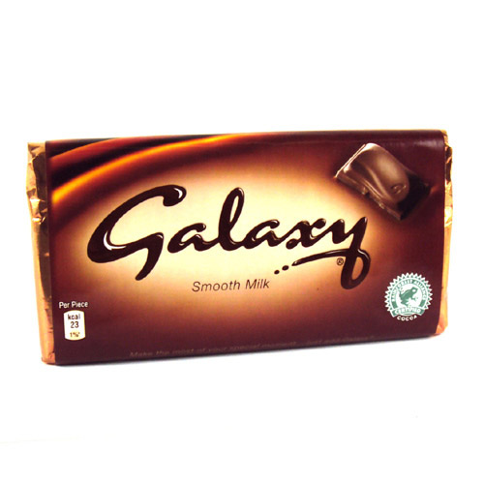
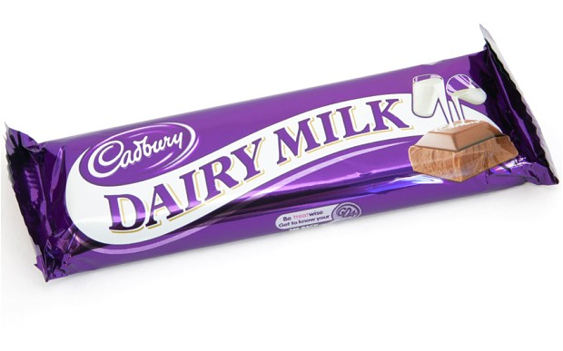
Why might a change in the price of one good effect the demand for another?
Learning outcome 1
vs.
What do we call products that can be used to replace existing ones?
SUBSTITUTES!

Slide 9
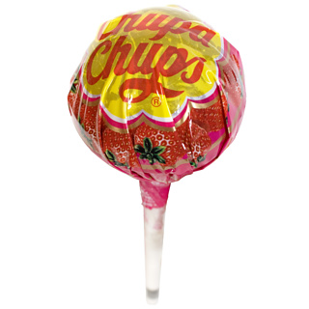
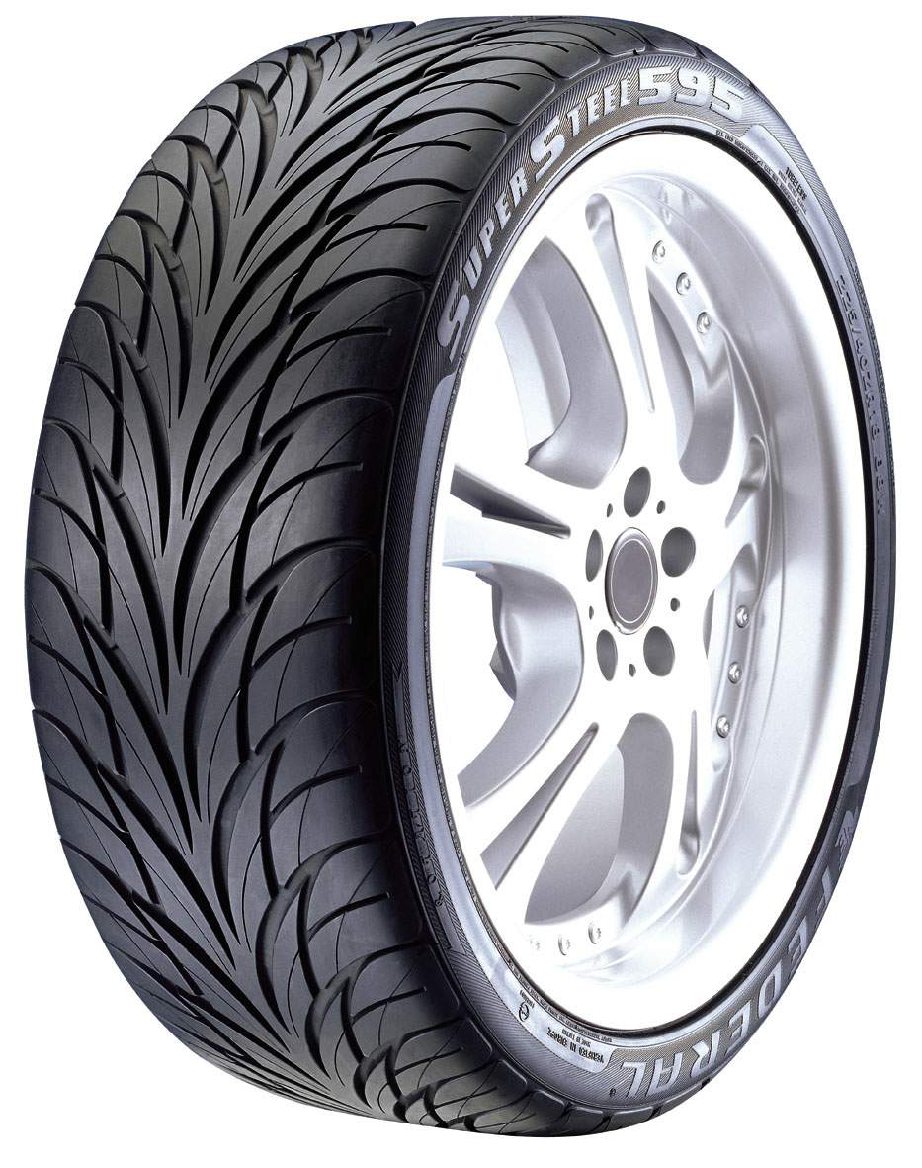
Learning outcome 1
What might happen to demand for tyres, if the price of lollipops increased?
Nothing! Not all products have a relationship or will provoke a response in consumer behaviour!
The specification refers to these as “unrelated”.

Slide 10
What is Cross Elasticity of Demand (XED)?
Learning outcome 1
Define in your own words!
What might the formula be?

Slide 11
Measures the degree of responsiveness of demand for a given product after a change in price for another product.
What does XED mean?
In other words... Measures the change in demand for product X after the price of product Y has changed.

Slide 12
If PED is calculated:
% change in quantity demanded
% change in price
And if YED is calculated:
% change in quantity demanded
& change in income
How do we calculate XED?
% change in quantity demanded for product X
% change in price of product Y

Slide 13
What do you think the results mean?
Using the formula, think about the following…
Can you work out what the different XED coefficients might be for:
Substitutes
Complements
Unrelated
What might the inelastic and elastic element imply?

Slide 14
Is the XED positive or negative?
Positive
Negative
ZERO
Substitute
Complementary
Unrelated
Inelastic
Elastic
Inelastic
Elastic
Weak Substitute
Strong Substitute
Weak Complement
Strong Complement

Slide 15
Learning outcome 2
+
What is Positive XED?
Substitutes have a positive XED, demand for substitute products increase when the price for another product increases.
If the result of the calculation is positive, it has a positive XED!

Slide 16
Price of Good X
Close Substitute
Price of Good X
+XED
Weak Substitute
+XED
P1
P1
P2
P2
Q2
Q1
Demand for Good Y
Q2
Demand for Good Y
Q1
Small change in price of Good X causes large change in demand for Good Y.
Large change in price of Good X Causes small change in demand for Good Y.

Slide 17
_
Learning outcome 2
What is Negative XED?
Complements have a negative XED, this is when demand for a product decreases as a result of a price increase of another product.
If the result from the calculation is negative it has a negative XED!

Slide 18
Price of Good X
Price of Good X
Close Complement
Weak Complement
P1
P1
P2
P2
-XED
-XED
Q1
Q2
Demand for Good Y
Q1
Q2
Demand for Good Y
Small change in price of Good X causes large change in demand for Good Y.
Large change in price of Good X Causes small change in demand for Good Y.

Slide 19
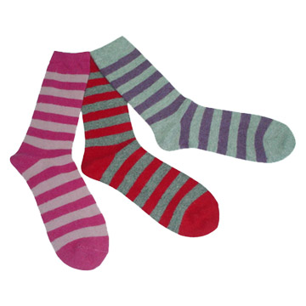
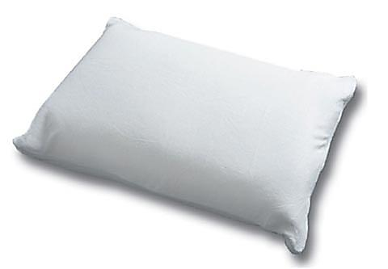
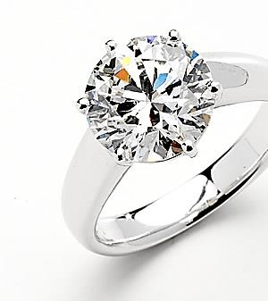
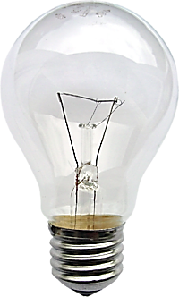
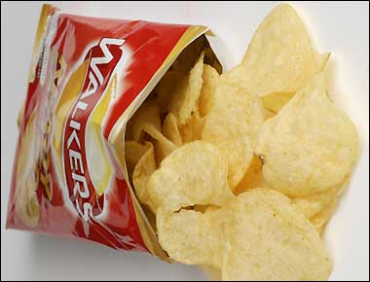
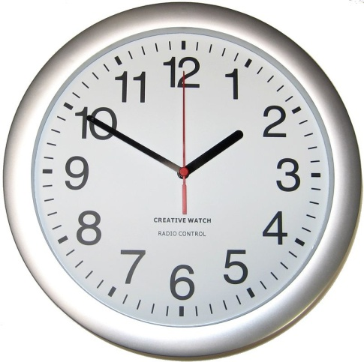
If the result of the calculation is 0 this means....
Unrelated to each other… a change in price will not impact a change in the quantity demanded for the other product.

Slide 20
Unrelated
Price change of Good Y causes zero change in Qd of Good X
Price of Good Y
XED
P2
P1
0
Q1
Quantity of Good X

Slide 21
XED QUESTIONS...
Complete the next page and a half of questions on your own.
Draw diagrams for each XED result.
Requires you to explain what the results mean.

Slide 22
XED QUESTIONS – Q1
If the price of Coca Cola increases from 50p to 60p per can, and the demand for Pepsi Cola increases from 1m to 2m per year, the XED between the two products is:
+100/+20 = (+) 5
The positive sign means that the two goods are substitutes, and because the value is greater than one (elastic), they are regarded as close substitutes.

Slide 23
XED QUESTIONS – Q2
If the price of Cinema Tickets increases from £5.00 to £7.50, and the demand for Popcorn decreases from 1000 tubs to 700, the XED between the two products will be:
-30/+50 = (-) 0.6
The negative sign means that the two goods are complements, and the value is less than one (inelastic), indicating that they are not close complements.

Slide 24
Good/Service | Substitute Goods | Complementary Goods
Bread
Pizza
Laptop
University Education
Xbox One
Private Healthcare
Car

Slide 25
PAST PAPER XED QUESTIONS

Slide 26
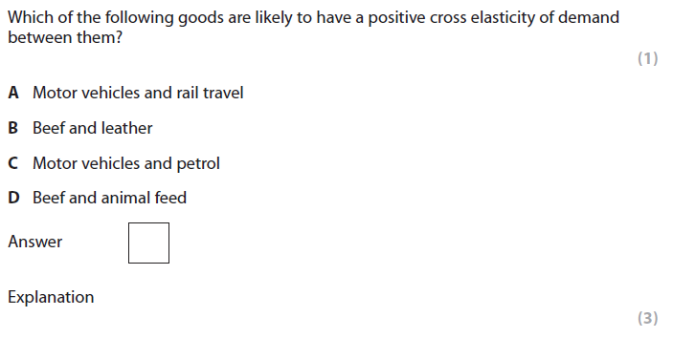
Notes:
Q6 June 2009

Slide 28
Notes:
D

Slide 29
Answer: D

Slide 30
Notes:
Q4 June 2014 Junit 1 R

Slide 32
http://qualifications.pearson.com/content/dam/pdf/A%20Level/Economics/2013/Exam%20materials/6EC01_01_msc_20120307.pdf
Page 13 Q9b

Slide 33
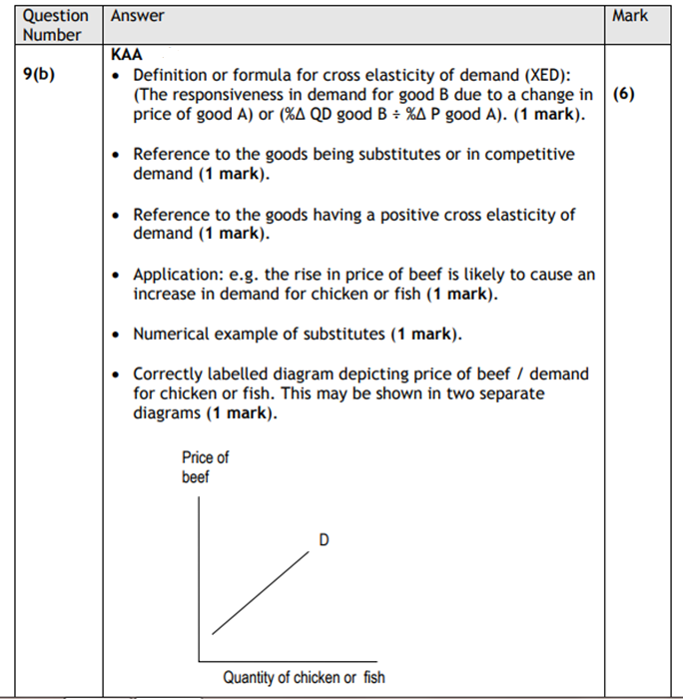
KAA 6 marks
EV 2 marks
6 marks

Slide 34
2 marks
KAA 6 marks
EV 2 marks

Slide 36
Are the following positive, negative or zero XED?
List the numbers 1 to 10 down your page!
You will have 30 seconds to highlight the following XED elasticity!

Slide 37
Are the following positive, negative or zero XED?
1. Petrol and public transport
2. Strawberries and sugar
3. Bread and butter
4. Coffee and red bull
5. Ipod and headphones
6. Xbox and PS3
7. Tea and milk
8. Iphone and Blackberry
9. Oyster card and bicycles
10. Louis Vuitton and Gucci
30 seconds!

Slide 38
Are the following positive, negative or zero XED?
1. Petrol and public transport: Positive
2. Strawberries and sugar:
3. Bread and butter:
4. Coffee and red bull:
5. Ipod and headphones:
6. Xbox and PS3:
7. Tea and milk:
8. Iphone and Blackberry:
9. Oyster card and bicycles:
10. Louis Vuitton and Gucci:

Slide 39
Are the following positive, negative or zero XED?
1. Petrol and public transport: Positive
2. Strawberries and sugar: 0
3. Bread and butter:
4. Coffee and red bull:
5. Ipod and headphones:
6. Xbox and PS3:
7. Tea and milk:
8. Iphone and Blackberry:
9. Oyster card and bicycles:
10. Louis Vuitton and Gucci:

Slide 40
Are the following positive, negative or zero XED?
1. Petrol and public transport: Positive
2. Strawberries and sugar: 0
3. Bread and butter: Negative
4. Coffee and red bull:
5. Ipod and headphones:
6. Xbox and PS3:
7. Tea and milk:
8. Iphone and Blackberry:
9. Oyster card and bicycles:
10. Louis Vuitton and Gucci:

Slide 41
Are the following positive, negative or zero XED?
1. Petrol and public transport: Positive
2. Strawberries and sugar: 0
3. Bread and butter: Negative
4. Coffee and red bull: Positive/ 0
5. Ipod and headphones:
6. Xbox and PS3:
7. Tea and milk:
8. Iphone and Blackberry:
9. Oyster card and bicycles:
10. Louis Vuitton and Gucci:

Slide 42
Are the following positive, negative or zero XED?
1. Petrol and public transport: Positive
2. Strawberries and sugar: 0
3. Bread and butter: Negative
4. Coffee and red bull: Positive/ 0
5. Ipod and headphones: Negative
6. Xbox and PS3:
7. Tea and milk:
8. Iphone and Blackberry:
9. Oyster card and bicycles:
10. Louis Vuitton and Gucci:

Slide 43
Are the following positive, negative or zero XED?
1. Petrol and public transport: Positive
2. Strawberries and sugar: 0
3. Bread and butter: Negative
4. Coffee and red bull: Positive/ 0
5. Ipod and headphones: Negative
6. Xbox and PS3: Positive
7. Tea and milk:
8. Iphone and Blackberry:
9. Oyster card and bicycles:
10. Louis Vuitton and Gucci:

Slide 44
Are the following positive, negative or zero XED?
1. Petrol and public transport: Positive
2. Strawberries and sugar: 0
3. Bread and butter: Negative
4. Coffee and red bull: Positive/ 0
5. Ipod and headphones: Negative
6. Xbox and PS3: Positive
7. Tea and milk: Negative
8. Iphone and Blackberry:
9. Oyster card and bicycles:
10. Louis Vuitton and Gucci:

Slide 45
Are the following positive, negative or zero XED?
1. Petrol and public transport: Positive
2. Strawberries and sugar: 0
3. Bread and butter: Negative
4. Coffee and red bull: Positive/ 0
5. od and headphones: Negative
6. Xbox and PS3: Positive
7. Tea and milk: Negative
8. Iphone and Blackberry: Positive
9. Oyster card and bicycles:
10. Louis Vuitton and Gucci:

Slide 46
Are the following positive, negative or zero XED?
1. Petrol and public transport: Positive
2. Strawberries and sugar: 0
3. Bread and butter: Negative
4. Coffee and red bull: Positive/ 0
5. Ipod and headphones: Negative
6. Xbox and PS3: Positive
7. Tea and milk: Negative
8. Iphone and Blackberry: Positive
9. Oyster card and bicycles: Positive
10. Louis Vuitton and Gucci:

Slide 47
Are the following positive, negative or zero XED?
1. Petrol and public transport: Positive
2. Strawberries and sugar: 0
3. Bread and butter: Negative
4. Coffee and red bull: Positive/ 0
5. Ipod and headphones: Negative
6. Xbox and PS3: Positive
7. Tea and milk: Negative
8. Iphone and Blackberry: Positive
9. Oyster card and bicycles: Positive
10. Louis Vuitton and Gucci: Positive or 0!

