Slide 1
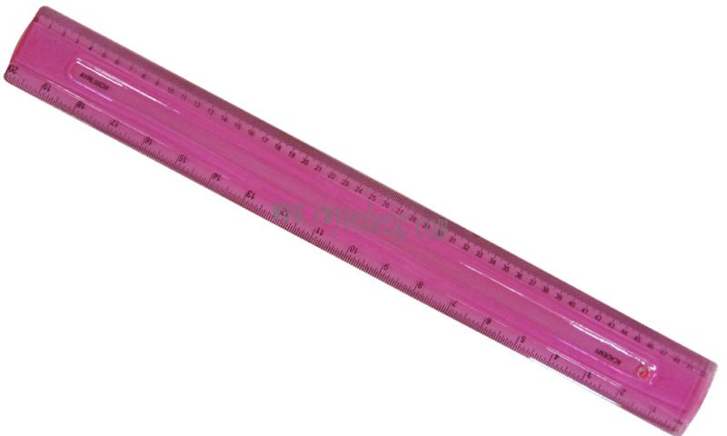
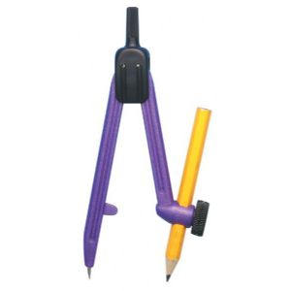
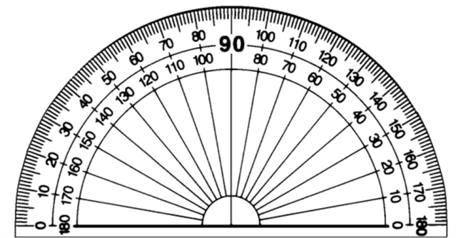
Maths Command Words
Estimate
Don’t work out exactly! Round the numbers to one significant figure first.
Simplify
Work out
Collect like terms together
Explain
A written or mental calculation is needed.
Simplify e + 7e
Answer: 8e
Estimate 4.7 x 6.2
Answer: 5 x 6 = 30
You must state why.
Work out 6²
Answer: 6 x 6 = 36
Give your answer in its simplest form
Calculate
You must show your working
Expand
You will need to do a sum either with or without your calculator.
Multiply out the brackets
If you don’t show your working you won’t get ALL the marks!
Cancelling of a fraction or ratio is needed.
Expand 4(3x – 2)
Answer: 12x – 8
12 : 15
simplified is 4 : 5
Solve
Factorise
Describe fully
Find the value of the variable in the question.
Usually with transformations:
Translation by a vector (2 marks)
Enlargement of a scale factor about a point (3 marks)
Reflection in a mirror line (2 marks)
Rotation through an angle about a point (3 marks)
To find factors and put brackets in.
Solve: 3x = 12
Answer: x = 4
Factorise 6x + 10x²
Answer: 2x(3 + 5x)
Measure
Use a ruler or protractor to accurately measure lines or angles.
Sketch
Construct, using ruler and compasses
An accurate drawing is not needed; freehand will do!
Diagram NOT accurately drawn
Use your ruler and pair of compasses to make an accurate drawing.
Don’t measure angles or sides.

Slide 2
Keywords
Estimate → This means work out roughly by rounding the numbers to one significant figure.
Explain → Tell the examiner how you got your answer or how you know your answer is correct.
Construct → This is another way of saying ‘draw accurately’ using mathematical equipment.

Slide 3
Keywords
Calculate → This does not mean use a calculator, it means ‘work out’ (and show your working!).
Complete → This usually means to fill in a data table or to fill in gaps.

Slide 4
Keywords
Expand
4(d - 3) = 4d – 12
Factorise
Solve → this means to work out the value of something; usually a variable in an algebraic equation.
Simplify → This is the process of making something simpler, eg. algebra or a fraction.

Slide 5
Rounding
Make sure you read whether you need to round to decimal places or significant figures.
For example: 0.0453682
0.05 2 decimal places
0.045 2 significant figures
For example: 85762
85800 3 significant figures

Slide 6
Time Management
You have 90 minutes for 80 marks.
1 mark = 1 minute
Some time left over at the end to check.
If you are spending 3 minutes on a 1 mark question, there will be an easier method.
Likewise, if you spend 1 minute on a 6-marker, you’ve probably missed something.

Slide 7
Underline key words and information
Wordy questions can be daunting.
Underline key information to help you pick out the things you need.
Cross out any red herrings – for example, information in a table that you’re not going to need.
Tick each piece of information off as you use it so you don’t miss anything out.

Slide 8
Write Neatly
The easier you make it for the examiner to read your answers, the more marks you could obtain.
Lay out each step of your working clearly and include units where necessary.

Slide 9
Units and Conversions
Check: are the units the same throughout the question?
Check: are there units given on the answer line?
Remember:
5 miles = 8 km
12 inches = 1 foot = 30 cm
60 minutes = 1 hour
30 minutes = 0.5 hours, NOT 0.3

Slide 10
Units and Conversions
1 cm
1 m
10 mm
100 cm
1 cm
1 m
10 mm
100 cm
1 cm
10 mm
1 m² = 10 000 cm²
1 cm³ = 1000 mm³

Slide 11
“Give reasons for your answer”
Is it plural or singular? Use the marks available to interpret how many reasons to give.
This does not mean write an essay!
The examiner will be looking for keywords in your answer.
It might help to plan your answer briefly first to make sure you leave enough space for your reasons.

Slide 12
“Diagram not drawn accurately”
Rulers and protractors will be of no use here.
You will need to use angle reasoning, area and volume formulae, trigonometry or circle theorems to help you answer these questions.

Slide 13
Don’t cross out your working!
…Unless you’ve got something better to replace it with.
Crossed out working cannot be marked. You are better off leaving incorrect working there and gaining one or two marks than gaining none.

Slide 14
Answer Everything
Again, you are better off leaving incorrect working there and gaining one or two marks than gaining none.
Why not have a go at that really hard question at the back? I bet you know some maths you can use for it.

Slide 15
Check Your Working!
If you finish early…
Check your working.
Don’t just sit looking at the wall.
This doesn’t mean just look at your answers, go over every step of your working to make sure you haven’t made any silly mistakes with times tables or negatives.

Slide 16
AO2 and AO3
AO2 – Select and apply mathematical methods in a range of contexts
AO3 – Interpret and analyse problems and generate strategies to solve them
These are those problem solving questions you think you’ve done way to many of. Don’t forget the skills you need to apply to them!

Slide 17
Old Exam
Work out 29 x 52
New Exam
A local football club have just reached the county cup final. They want to bring 29 coaches to the final. Each coach has 52 seats. How many supporters are going to the final?
The mathematical skills haven’t changed, YOU have to decide when is the right time to use them.
We all have a Mathematical Toolbox full skills that we have built up over the years. All we have to do is decide what is the correct tool to use for the job.

Slide 18
Organise information in a table
Draw a bar model
Estimate first, then check
Work backwards
Strategies/tools you could use
Highlight key information
Write down useful formulae
If it’s tricky, draw a piccy!
Make an equation

Slide 19
Step 1
Read the question highlighting key information.
Step 2
Plan and structure how you are going to answer it.
Step 3
Answer it showing all your mathematical working out.

Slide 20
Don’t Panic
Do your best – it is all you can do ☺

