Slide 1
Edexcel A2 Business
4.3.1 Marketing
Revisionstation

Slide 2
Worksheet

Slide 3
From Edexcel
a) Global marketing strategy and global localisation (glocalisation)
b) Different marketing approaches:
domestic/ethnocentric
mixed/geocentric
international/polycentric
c) Application and adaptation of the marketing mix (4Ps) and Ansoff’s Matrix to global markets

Slide 4
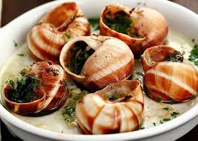
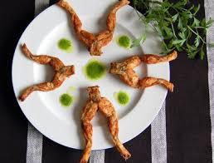
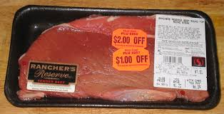
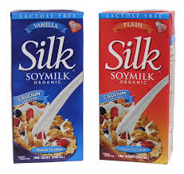
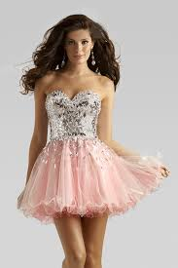
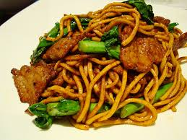
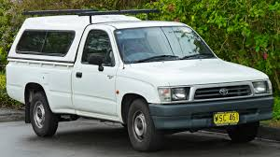
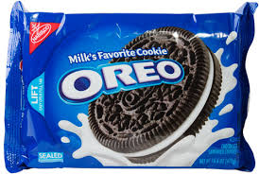
Starter Global products
How many of these products would you say were global – could be sold to anyone in the world?
Notes:
Soy milk, snails, frogs legs, pork noodles, raw beef, short dress, diamond ring, Toyota Hilux. Obvious issues with pork and beef and the short dress. Less obvious is frogs legs and snails – hard to sell outside of France. Soy milk is global as is the ring and the Hilux. The answer to which is the most global is the Oreo – sold in 100 countries world wide – see video on next slide.

Slide 5
OREOS the global product

Slide 6
Global marketing strategy

Slide 7
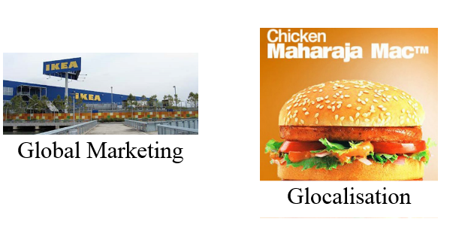
Global marketing vs Glocalisation
The first theory is that there are two approaches to marketing (4Ps) in a global marketplace. These are:

Slide 8
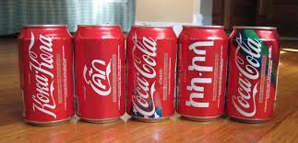
Global marketing strategy
A global marketing strategy means that a business doesn’t differentiate its products or marketing between countries.
The same product is sold in many countries with some fine tuning of the product price, promotion etc.

Slide 9
Global brands
A global brand views the world as a global marketplace and creates products that will suit a world audience
Microsoft is the ideal global product, all it needs to do is adapt the languages, adjust the cost for the region and fine tune the marketing to suit the area

Slide 10
Global marketing decisions
In global marketing the promotional message may be the same all over the world leading to reduced average marketing costs, economies of scale
The only differences might be that sales incentives may vary in different countries

Slide 11
Global marketing brand - Disney
Disney will concentrate on selling their films to cinemas in countries where there is an existing film distribution and similar media infrastructure.
They may be able to use the same promotional message for their film in each country reducing the average cost of marketing.

Slide 12
Global marketing
Advantages
Disadvantages

Slide 13
Advantages to global marketing
Economies of scale can be achieved in both production and distribution
This will mean lower than average marketing costs
Power in the market as the brand is known
Consistency in brand image
Ability to leverage good ideas quickly and efficiently
Uniformity of marketing practices

Slide 14
Disadvantages to global marketing
Differences in consumer needs, wants and usage patterns for products
Differences in consumer response to marketing mix elements.
Differences in brand and product development and the competitive environment
Differences in the legal environment, some of which may conflict with those of the market

Slide 15
Glocalisation

Slide 16
Glocalisation defined
Glocalisation is a combination of the words 'globalisation' and 'localisation' and is used to describe products and services that are both developed and sold to global customers but designed so that they suit the needs of local markets.
A business needs to think global but act local if they are following this strategy – see McD video HERE

Slide 17
Glocalisation and the local market
Glocalisation businesses are aware of the importance of combining relevant, transferrable products with the heritage and authenticity of local identities
Products or services are designed to benefit a local market while at the same time being developed and distributed on a global level.

Slide 18
Different marketing approaches

Slide 19
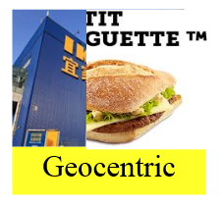
The three approach theory to global marketing or PEG

Slide 20
The PEG approach
The decision whether products sold in a new international market should be adapted or standardised.
To what extent can a MNC design and market a truly global product.
Polycentric – adapt to each market to appeal to local customers to maximise revenue
Ethnocentric – standardise the product for all markets to keep costs low
Geocentric – a mixture of the two

Slide 21
Polycentric
The international approach is the polycentric model – adapting the marketing mix to maximise sales in different countries
Each host country is unique
Each subsidiary business in each country should develop its own marketing strategy

Slide 22
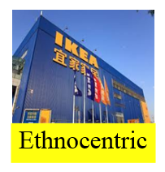
Ethnocentric
A business which believes that a success story in one country can translate to all other countries in which it operates
Foreign operations are subordinate to domestic markets
Products sold without adaptation
Ethnocentrism is the belief of superiority is one's personal ethnic group

Slide 23
Geocentric
Business can have some of the advantages of a standardised global approach to get economies of scale but cater for needs of individual markets to maximise sales
Branding may be done on a global basis
The businesses has a world wide approach to marketing and its operations become global
A global MNC will have manufacturing and processing facilities around the world to serve the various regional and national markets through a complicated but well co-ordinated system of distribution networks
Watch the video of this concept car – how many features would work in the UK, and how many would need to be changed for other countries?
Notes:
Language
Right hand drive
Doors (kerbs on other side of road) etc

Slide 24
Adaptation of 4Ps to global markets

Slide 25
Product
Standardised
Adapted
Travel, media and the Internet, world is getting smaller easier to market a product that is known globally
International standardisation has its own advantages. As people travel the World, they can be assured that wherever they go the product that they buy from the business will be same and that it will have the same, standard benefits. Levis Read here
Coca-Cola makes its products sweeter for some markets to take account of local tastes
In Canada it has taken the decision to make it less sweet to bring it in line with other countries, see an article and video here

Slide 26
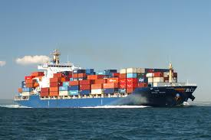
Place
Standardised
Adapted
Distribution in national markets such as the United Kingdom will probably involve goods being moved in a chain from the manufacturer to wholesalers and onto retailers for consumers to buy from.
In an overseas market there will be more parties involved because the goods need to be moved around a foreign market where business practices will be different to national markets.
For example agents might be used to sell products in other countries

Slide 27
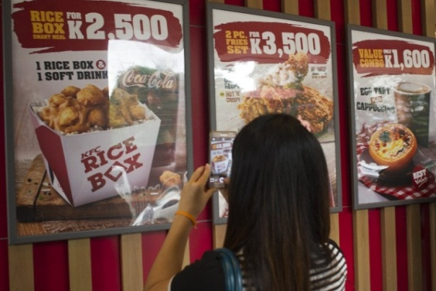
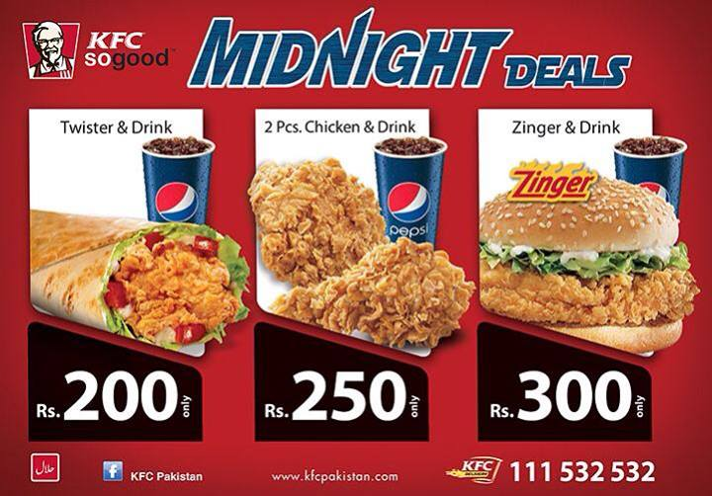
Price
Standardised
Adapted
Setting international prices is very complex
It is unlikely that a MNC will attempt to gain the same price in Mexico or Brazil as it does in Germany or France due to the disposable income of the population
Business needs to consider factors such as;
the cost of transport tariffs or
import duties
exchange rate fluctuations,
personal disposal incomes of the target market
the currency they want to be paid in
the general economic situation of the country and how this will influence pricing

Slide 28
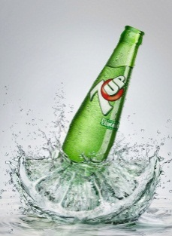
Promotion
Standardised
Adapted
Standardised marketing can be used internationally
This type of marketing strategy conforms to work across different cultures and countries to promote a product
This reduces costs and ensures the brand is known world wide
Advertising messages in countries may have to be adapted because of language, political climate, cultural attitudes and religious practices.
What works in one country could cause offence in another country.
For example a business cannot promote white bridal wear in India as it is worn as a colour by mourners

Slide 29
Ansoff’s and global markets

Slide 30
Application and adaptation of Ansoff’s matrix to global markets
Ansoff’s Matrix is a management tool that helps business leaders to decide how to grow their business.
Ansoff suggested that there were only 4 real strategies that a business would follow
He then put all of this into a table format which is why it is called a Matrix (Americanism for table)
It also helps business managers to assess the risk of these strategies
See next slide
Market penetration strategy – current products and current markets
Product development strategy – new products and current markets
Market development strategy – current products and new markets
Diversification – new products and new markets

Slide 31
Ansoff’s Matrix
 | Existing Product or Service | New Product or Service
Existing market | 1 Market Penetration (Low risk) Increase sales to the existing market, or penetrate it more deeply | 2 Product or Service Development (moderate risk) New product or service developed for existing market
New Market | 3 Market Development (moderate risk) Existing product or service sold to new market | 4 Diversification (high risk) New product or service sold in new markets (new to the company):

Slide 32
#1 Market penetration
Market penetration on a global basis means selling more products to existing customers
Marketing teams may look to see if frequency of use or purchase can be increased
This is a very low risk strategy as the customers are already very loyal
Promotions play a large part in this e.g. MCd Happy meals / Monopoly games / holiday and festival promotions such as Halloween

Slide 33
#2 product or service development
New product development in marketing can be critical to keep customers buying more – think about your IPhone is it an IPhone 4? No???
This strategy may be used to replace the normal product with a better one, or to develop and sell a complementary product that needs to be sold along side the main one (coffee pods for coffee machines) http://www.differentiateyourbusiness.co.uk/ansoff-growth-matrix-four-ways-to-grow-a-business

Slide 34
#3 market development
Market development means taking products that already exist and finding new global markets for them
This may mean moving into countries that have had trade liberalisation
This may also mean the business has to find suitable alternative markets for the products
India takes advantage as China has announced liberalisation of pharmaceutical imports.

Slide 35
#4 diversification
Diversification is the most risky of the four strategies as it means providing new products for new markets
A business will do this in an attempt to move away from shrinking markets and into new more attractive markets
A business may look at other markets where it can use its core competencies e.g. Swatch made plastic watches – so then came up with the plastics for the smart car
Believe it or not, it was the man behind the Swatch wristwatch who originally came up with the concept of what would go on to be the Smart car. In the end its all plastics (core competencies)

Slide 36
Plenary word wall (Can you define these terms?)
ethnocentric
global identity
consumer
domestic
geocentric
strategies
market
integrated
polycentric
platform
multinational
responsibility
standardised
globally
foreign
brand

Slide 37
Sample Edexcel A2 questions

Slide 38
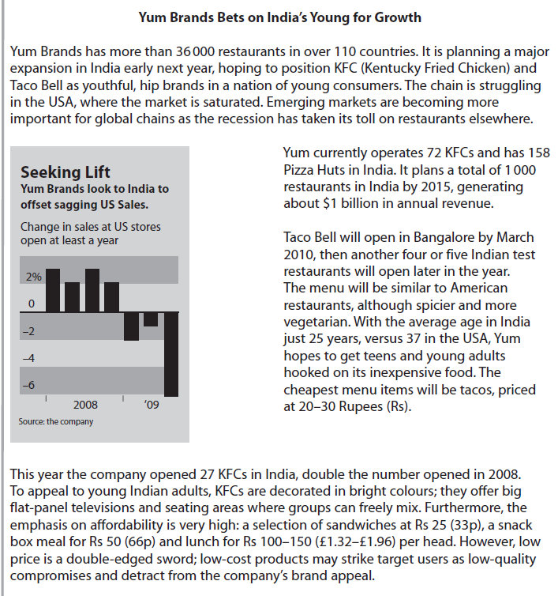
Case study for question 1

Slide 40
Sample question 1
Knowledge 3
Application 3
Analysis
3
Evaluation
6
Notes:
Legacy question – no 15 mark questions on the new papers
Levels are a guess

Slide 41
Answer sample question 1
e.g. defines or identifies elements of a global marketing strategy –where a business doesn’t differentiate its products or marketing between countries.
e.g. McDonalds’ distinctive yellow and red packaging is recognisable the world over, Yum uses the same brands worldwide such as KFC, Pizza Hut.
e.g. The golden arches are one of the most recognised logos internationally. Similar layouts/decor and standardisation of ingredients/quality of product. Similar arguments could be used for Yum and its brands. This is desirable because of economies of scale, standardised procedures etc.
e.g. whilst the use of Mc..., and The Big Mac are ubiquitous, there are clearly many local exceptions such as Maharajah Mac.
e.g. cultural requirements (e.g. beef) and how they impact on different promotional messages, pricing strategies, distribution channels and supply chains. There is an awareness of the trade off between the advantages of a true global strategy and the gains from localisation.

Slide 42
Case study for question 2

Slide 43
Sample question 2
[6]
Knowledge 2
Application 2
Analysis
2
Notes:
No 6 mark questions on the paper this is from an ec/bus legacy paper

Slide 44
Answer sample question 2

Slide 45
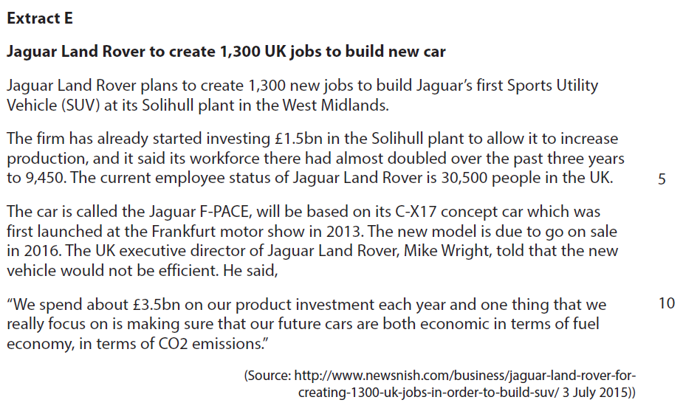
Case study for question 3

Slide 46
Sample question 3
Knowledge 2
Application 2
Analysis
2
Evaluation
2

Slide 47
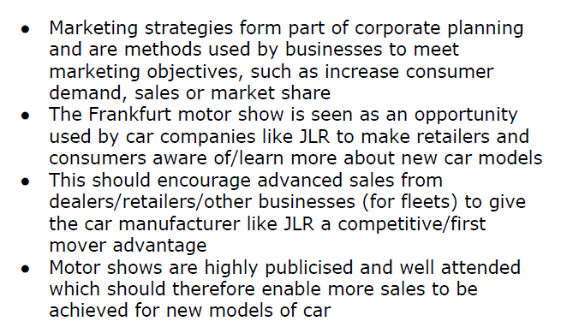
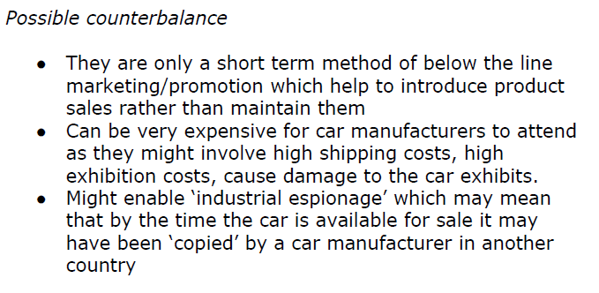
Answer sample question 3

Slide 48
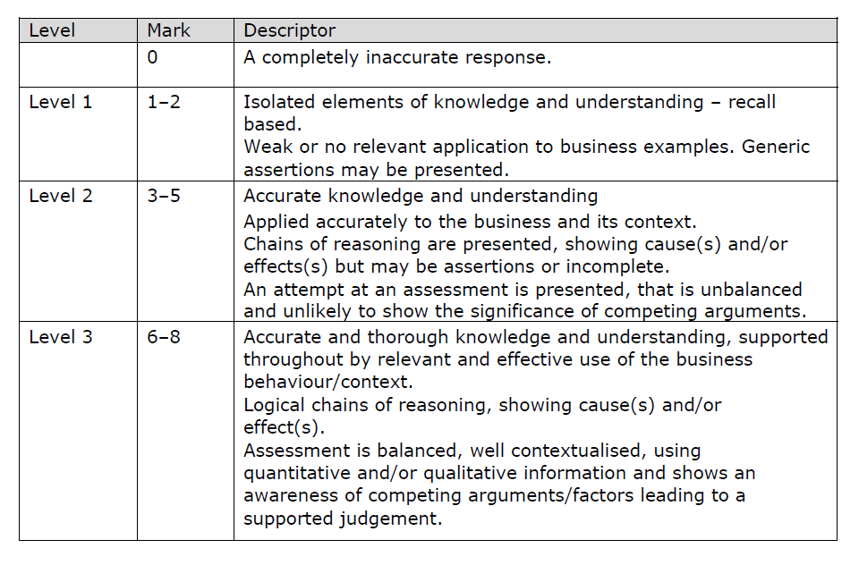
How to level sample question 3

Slide 49
Glossary
Polycentric; (PEG) All marketing is carried out in a standardised global way, with a global product etc. E.g. Evian water
Ethnocentric; (PEG) All marketing is adapted to suit the local country, their culture and social systems, lifestyles and beliefs e.g. Maharaja Mac
Geocentric; (PEG) Geocentric approach is the best of both worlds in that it has some aspects of its marketing in a global way and others in a localised way, depending on the country and the circumstance
Global marketing; This means that the marketing is produced and communicated globally in a standard way e.g. IKEA is the same all over the world
Glocalisation (also Glocalization); Think global, act local. This means that the marketing strategy is adapted for the country where the product or service is sold

