Slide 1
The BIG Idea
Investment appraisal
Today we will:
Starter:
Why do firms invest ?
What is the purpose of an appraisal?
Notes:
Students identify key words to underline

Slide 2
The BIG Idea
Investment appraisal
Today we will:
alternative investment options using quantitative techniques
The time value of money concept
The merits and limitations of quantitative methods
Notes:
Students identify key words to underline

Slide 3
Starter
You have been promised £100 in two years time, in settlement of a debt.
How much would you accept in settlement today?
Names?
What would influence your decision?

Slide 4
The Use of Money In Business
There are 3 ways in which a business will spend money:
Paying Overheads
Fixed or indirect costs that need to be paid to keep the business running
Invest In Assets
Buying Raw Materials
Investment in fixed assets, such as machinery, will allow the business to do more
Called working capital – these are resources used up as part of production

Slide 5
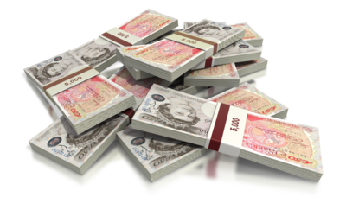
Investment
“Investment” can be defined as:
Effectively a business is spending money in the short-term in the hope that it will enable them to increase profits in the long-term
This means that firms invest whenever they buy fixed assets
“Expenditure on capital goods, i.e. goods that are used to make other products in the production process”

Slide 6
Investment Appraisal
All investment decisions involve an element of risk
Since they deal with the future
A firm’s decision to invest will depend upon:
Whether the investment worthwhile
Whether the firm is optimistic about the future
There are a range of investment appraisal techniques that can be used to help select investment options:
Payback
The Accounting Rate of Return
Discounted Cash Flow

Slide 7
The Payback Method
This measures how quickly the initial cost of an investment can be recovered:
i.e. how soon the expected returns cover the cost of the investment
Invest in June 2011
Payback by July 2015
If there is more than one possible project, the one with the shortest payback period will be selected
If the payback period is acceptable the project will be undertaken

Slide 8
An Example of Payback
A company is considering the investment projects outlined in the table below:
However:
They can only afford one project
Which should they choose, according to payback?
Year | Project A | Project B
0 | -£40,000 (initial cost) | -£40,000 (initial cost)
1 | £40,000 | £20,000
2 | £30,000 | £30,000
3 | £20,000 | £40,000

Slide 9
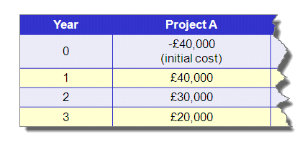
Payback for Project A
In order to calculate the payback period for project A the following calculation would be necessary:
Project A
Initial Cost = £40,000
After Year 1:
£40k - £40k = £0 still to cover
This means that the project has paid
for itself by the end of Year 1
So the payback period is 1 year

Slide 10
Payback for Project B
In order to calculate the payback period for project B the following calculation would be necessary:
Project B
Initial Cost = £40,000
After Year 1:
£40k - £20k = £20k still to cover
After Year 2:
£20k- £30k = -£10k still to cover
So payback occurs during year 2.
But when exactly?
£20k of the £30k received in Year 2 is needed to payback the initial cost:
£20k/£30k = 0.67
0.67 x 12 months = 8 months
So payback takes 1 year 8 months

Slide 11
Making The Decision
So given the two calculations that have been carried out:
Given that the payback period for project A is sooner project A would be chosen
Note that the income is assumed to be spread equally over the 12 month period
Year | Project A | Project B
0 | -£40,000 (initial cost) | -£40,000 (initial cost)
1 | £40,000 | £20,000
2 | £30,000 | £30,000
3 | £20,000 | £40,000
Payback | 1 Year | 1 Year 8 Months

Slide 12
Advantages & Disadvantages of Payback
Advantages
Disadvantages
It is extremely simple
Cash earned after the payback period is ignored
It is particularly useful for new technology projects, since the payback period can be defined as expected life of item
It does not take into account the effects that inflation has on the value of money over time
It helps prevent cash flow problems

Slide 13
Payback – Business Application
Age of businesses which will prioritise early payback?
Cash flow position of business which will prioritise early payback?
Economic/Market condition when early payback is prioritised?

Slide 14
How Cash is Ignored After Payback
Consider the following two projects:
 | Project A | Project B
Initial Cost | £7,000 | £7,000
Revenue in Year 1 | £5,000 | £3,500
Revenue in Year 2 | £2,000 | £3,500
Revenue in Year 3 | £1,000 | £0
Revenue in Year 4 | £500 | £0
Total Returns | £8,500 | £7,000
Profit | £1,500 | £0
In this example projects A & B both have a payback period of 2 years
Yet clearly project A is more profitable over a 4 year period

Slide 15
Challenge: Using the previous table, state the main reason for using the Payback method of investment appraisal.
Super Challenge: Describe the limitations of the Payback method.
Turbo Challenge: Explain how the economic environment can impact on your appreciation of the Payback method of investment appraisal.

Slide 16
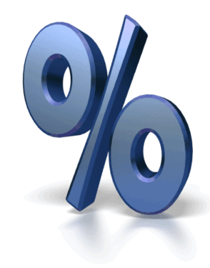
The Accounting Rate of Return (ARR)
This method measures the net return each year as a percentage of the initial cost of the investment
It is calculated using the formula:
If the ARR is acceptable then the project will be undertaken
If there is a choice of projects, the one with the highest ARR will be chosen
Net Return (Profit) Per Annum
ARR (%) =
X 100
Capital Outlay (Cost)

Slide 17
An Example of ARR
A business is considering 1 of the 2 investment projects outlined below:
Therefore project B would be chosen
Project A (£)
Project B (£)
Initial Cost
10,000
20,000
Return in Year 1
4,000
9,000
Return in Year 2
5,000
9,000
Return in Year 3
5,000
12,000
Return in Year 4
4,000
10,000
Total Return
18,000
40,000
Total Profit
8,000
20,000
Average Annual Profit
2,000
5,000
ARR (%)
20
25

Slide 18
Advantages & Disadvantages of ARR
Advantages
Disadvantages
It shows the profitability of a product clearly
It is more complex to calculate than the payback method
It allows easy comparison between different projects
It still does not take into account the effects that inflation has on the value of money over time
The opportunity cost of the investment can be taken into account

Slide 20
Student Activity 2
Complete the ARR and Payback for Project X and Y.
PROJECT X
Net Cash Flow Cumulative NCF
Year 0 (£15,000) (£15,000)
Year 1 6,000 (£9,000)
Year 2 5,000 (£4,000)
Year 3 4,000 0
Year 4 3,000 £3,000
Total Return £3,000
Payback = 3 Years
ARR = £3,000/4/£15,000 *100 = 5%

Slide 21
Student Activity 2
PROJECT Y
Net Cash Flow Cumulative NCF
Year 0 (£15,000) (£15,000)
Year 1 3,000 (£12,000)
Year 2 4,000 (£8,000)
Year 3 5,000 (£3,000)
Year 4 6,000 £3,000
Total Return £3,000
Payback = 3 Years 6 Month
ARR =
Weakness of ARR?
£3,000/4/£15,000 *100 = 5%
Do we need to bother?

Slide 22
Challenge: Using the previous table, state the main reason for using the ARR method of investment appraisal.
Super Challenge: Describe how the ARR overcomes some of the limitations of the Payback method.
Turbo Challenge: Explain how the economic environment can impact the reliability of your projected net cash flows.

Slide 23
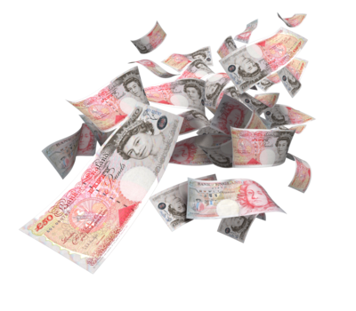
Discounted Cash Flow
This method of investment appraisal accounts for the fact that the value of money changes over time
It does so by calculating the Net Present Value
This calculation converts all monetary values into today’s value
As such comparing monetary values over different time periods is easier
Allowing easy comparison between different projects

Slide 24
Time Value of Money
1. If I offered to pay you £100 today or £100 in two years time, which would you accept?
2. Explain your answer
Compound Interest
A= P (1+r) ^{n}
Where
A = Accumulated sum
P = Principal invested
r = Interest rate
N = Number of years
Challenge - Calculate the accumulated sum if £50 is invested for 4 years at an interest rate of 3%
A=£50 (1.03)⁴
A=£50 (1.1255)
A=£56.275
Super Challenge: Describe the limitations of predicting IR’s over time.
Turbo Challenge: Explain how the economic environment can impact on your choice of IR.

Slide 25
Student Activity 3
Complete Q1 – Remember to use the figure you chose in the Starter!
You have been promised £100 in two years time, in settlement of a debt.
How much would you accept in settlement today?
Names?
What would influence your decision?

Slide 26
The BIG Idea
Investment appraisal
Today we will:
alternative investment options using quantitative techniques
The time value of money concept
The merits and limitations of quantitative methods
Notes:
Students identify key words to underline

Slide 27
Calculating The Present Value
The present value is calculated by multiplying the expected future income by a discount factor
The discount factor used will be the required rate of return that the firm wants from the investment project
For example:
If a firm wants a return of 10% the future value of £1000 would be:
Note:
Year | 0 | 1 | 2 | 3
Discount Factor of 10% | 1 | 0.909 | 0.826 | 0.751
Present Value of £1000 | £1000 | £909 | £826 | £751
The discount factor will always be less than one (since money falls in value over time)
The discount factor will be provided –you will not be expected to calculate it
This shows that to have a return of £1000 in 3 years time the firm would need to invest £751 today

Slide 28
Calculating The Net Present Value
Once the present value has been calculated the net present value can be obtained simply by subtracting the initial cost of the investment project
For example:
The net present value of a £1000 investment which yielded the following returns over 3 years, with a required return of 10% would be:
Year | Return | Discount Factor | Present Value
0 | (£1000) | 1 | (£1000)
1 | £600 | 0.909 | £545.40
2 | £400 | 0.826 | £330.40
3 | £200 | 0.751 | £150.20
Net | £200 | - | £26
This shows that the net present value of the return on this investment is just £26. However, it would still be undertaken since the positive result shows that the required 10% return has been exceeded!
ASK MATTHEW

Slide 29
Advantages & Disadvantages of NPV
Advantages
Disadvantages
It takes account of the value of money over time
It is much more complex to calculate
The value of all expected cash inflows is accounted for
It requires more time to make a decision
It’s accuracy depends on the choice of discount factor – which is usually an educated guess!
The opportunity cost of the investment can be taken into account

Slide 30
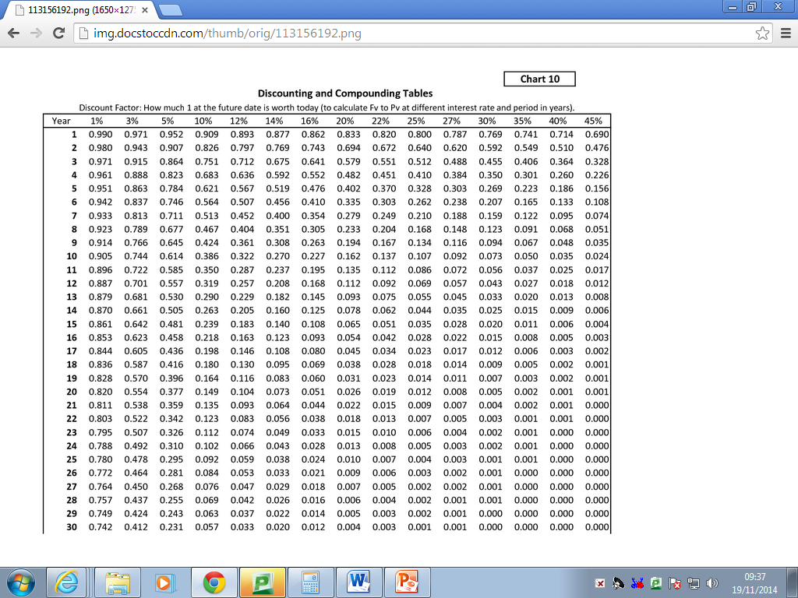
DF = A
(1+r) ^{n}

Slide 31
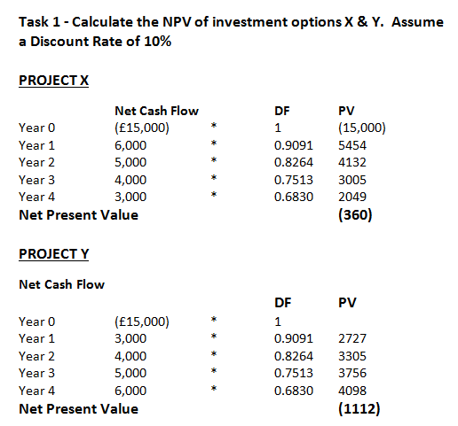

Slide 33
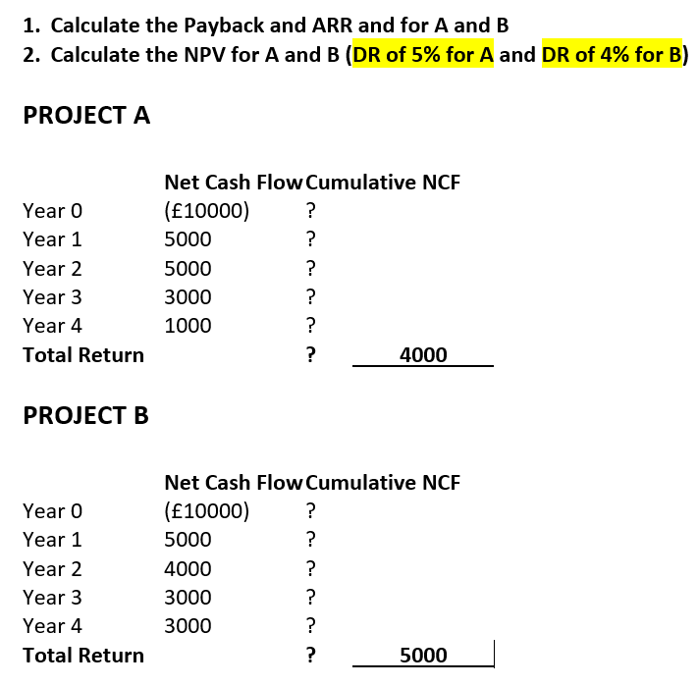
All 3 methods
3%

Slide 34
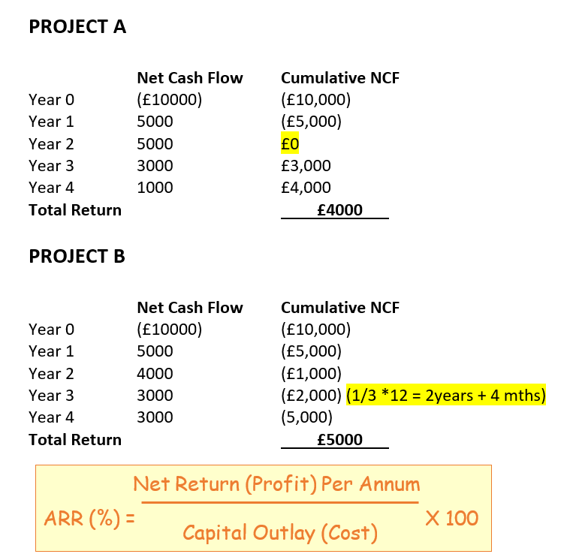

Slide 35
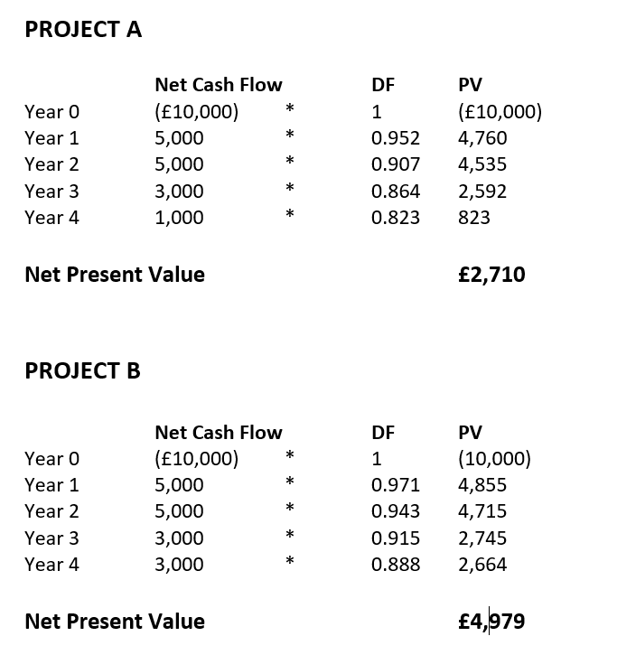

Slide 36
Challenge: Which project would you recommend and state why?
Super Challenge: Describe how the DR may have been determined for each project.
Turbo Challenge: Evaluate the extent to which investment appraisal is objective i.e. not based on qualitative factors.

Slide 37
Key terms
Criterion level: a yardstick set by directors to enable managers to judge whether investment ideas are worth pursuing (for example, ARR must be 15+ per cent or payback must be a maximum of twelve months).
Cumulative cash: the build-up of cash over several time periods (for example, if cash flow is +£20,000 for three years in a row, cumulative cash in year 3 is +£60,000).
Discounting: applying a discount factor to a money sum to take into account the opportunity cost of money over time.
Present values: the discounting of future cash flows to make them comparable with today's cash. This takes into account the opportunity cost of waiting for the cash to arrive.
Short-termism: making decisions on the basis of the immediate future and therefore ignoring the long-term future of the business.
Tactical decisions: those that are day-to-day events and therefore do not require a lengthy decision-making process.

Slide 38
Revision questions
Distinguish between quantitative and non-financial factors when carrying out an investment appraisal.
Why should forecasted cash-flow figures be treated with caution
Explain the purpose of discounting cash flows
Using only qualitative analysis, would you prefer £100 now or £105 in one year's time, at an interest rate of 10 per cent?
What qualitative issues might a firm take into account when deciding whether to invest in a new fleet of lorries?

Slide 39
Extended writing
'Financial methods of assessing investment decisions are based on no more than educated guesses about future cash flows.’
Evaluate whether that invalidates the use of these techniques.(20 marks)

Slide 40
NPV – Super turbo challenge
What happens to the NPV when the DR increases?
Where should the DR come from?
How could bias affect the decision making?

