Slide 1
Edexcel A2 Business
1.3.3 Pricing Strategies
Revisionstation

Slide 2
1.3.3 Pricing Strategies
a) Types of pricing strategy:
cost plus (calculating mark-up on unit cost)
price skimming
penetration
predatory
competitive
psychological
b) Factors that determine the most appropriate pricing strategy for a particular situation:
number of USPs/amount of differentiation
price elasticity of demand
level of competition in the business environment
strength of brand
stage in the product life cycle
costs and the need to make a profit
c) Changes in pricing to reflect social trends:
online sales
price comparison sites

Slide 3
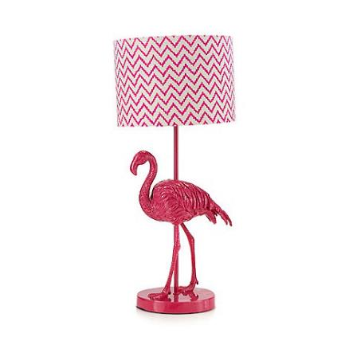
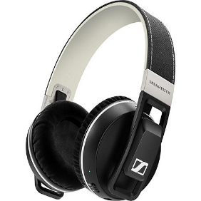
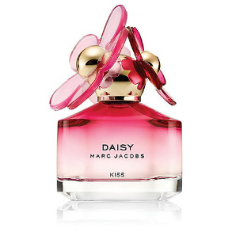
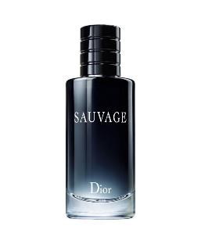
Starter
How much would you charge for these products?
Butterfly Home by Matthew Williamson Pink flamingo table lamp
Marc Jacobs 'Daisy Kiss' eau de toilette 50ml
Sennheiser Black 'Urbanite XL' over ear wireless bluetooth headphones
DIOR 'Sauvage' eau de toilette
Notes:
Product A: £60
Product B: £225
Product C: £49.50
Product D: £62.55

Slide 4
Definition: Pricing
The process of pricing is the choice of pricing strategy that a business makes when setting prices for their products or services

Slide 5
Types of pricing strategy

Slide 6
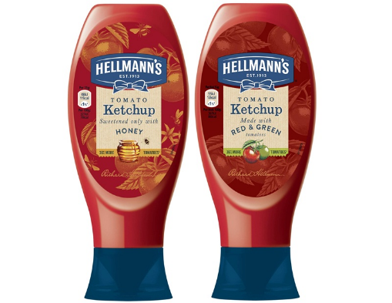
Pricing strategy introduction
Once a product has been developed, a price will then needed to be decided upon
A strategy is the medium to long term plan of the business and the pricing will need to fit with the business objectives
The pricing strategy will depend on many factors;
The product or service itself
Competitors in the market e.g. Heinz ketchup
The aims and objectives of the business
How would you price Hellman’s Ketchup?
Notes:
Suggested answer – look at competitors and price below when launching to encourage consumers to try the product then raise it later on once customer loyalty has been established.

Slide 7
Types of pricing strategy
There are lots of different types of pricing strategies, these are the six that your exam board would like you to know. Get ready to make some notes about these on the next few slides.
cost plus
price skimming
penetration
predatory
competitive
psychological

Slide 8
#1 Cost plus pricing
A cost-plus pricing strategy seeks to set a price for a product or service which covers the costs AND provides a good profit margin for the business
Cost-plus is the most logical approach to pricing because it achieves the business objective of maximising profits
Many Young Enterprise teams work out their projected profits by using cost-plus pricing

Slide 9
#1 Cost-plus benefits and drawbacks
Protects the profit margins of the business
Easiest method of pricing to apply
Easy to estimate profit levels
This method of pricing does not take into account the prices of the competition

Slide 10
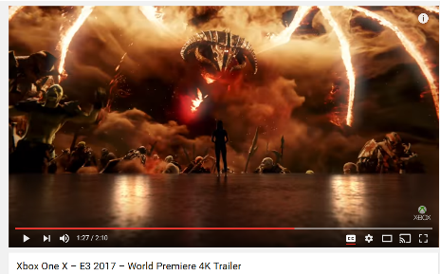
#2 Skimming pricing
A skimming price strategy is used when launching a new product
The price is set high to start, this will create high profits and may be used to pay back high Research and Development (R&D) costs
Usually used in technological or very innovative products which have few competitors
As competitors eventually enter the market the price is then reduced
How much do you think this console costs?
https://youtu.be/g98eOPnQlkk
Notes:
£450 – according to Xbox the official magazine

Slide 11
#2 Skimming benefits and drawbacks
A high starting price can establish an upmarket image
For innovative products it can be a great way to harvest high profits from early buyers who want the latest gadget / item / product and are prepared to pay a premium
Cheaper imitations of the product may appear on the market too soon and take sales away from the product
Risky strategy as customers may be put off from buying due to the high price

Slide 12
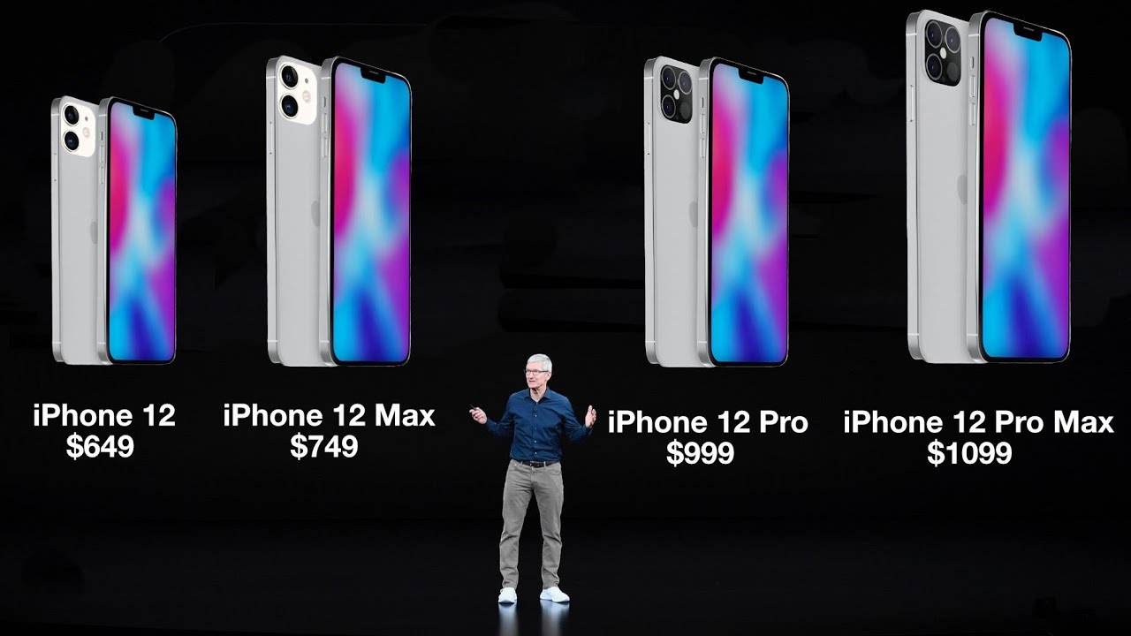
Price skimming
Assess the benefits to Apple of using price skimming for it's new iPhone 12 range?

Slide 13
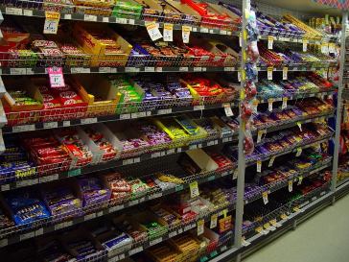
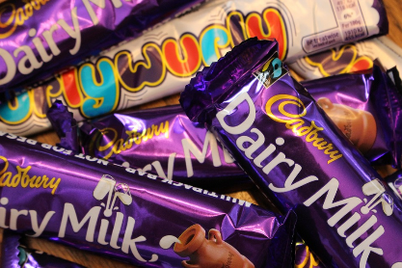
#3 Competitive pricing
Some products or services are priced in line with competitors
This means that customers will have to judge a product or service on “non-price” methods such as; quality of service or speed
Strategy usually used where products in a market are all very similar

Slide 14
#3 Competitive benefits and drawbacks
Useful in a market where one brand is dominant, the other brands would need to discount and offer lower prices encourage customers to buy
Pricing at the competitive rate may not cover all the costs of some smaller businesses which can’t get the same economies of scale as the larger ones

Slide 15
#3 Competitive pricing
Assess the benefits to supermarkets of using competitive pricing? What other examples of competitive pricing can you think of?
https://youtu.be/_QPok_HeL2w
https://youtu.be/t9OtAbXR9PM

Slide 16
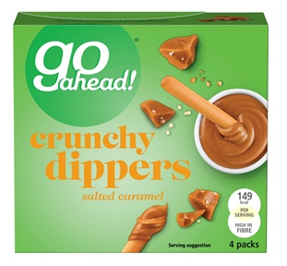
#4 Penetration pricing
This means setting prices really low on a new product to encourage sales and to persuade customers to try the product. Then when they like the product and have to keep buying it the business raises the price
Low prices should gain the business more market share (market penetration)
Mass market – repeat purchases e.g. tea bags, biscuits which are called Fast Moving Consumer Goods (FMCG).
New product on the market, prices will start at £1.99 and may rise later on

Slide 17
#4 Penetration benefits and drawbacks
Works best with new products being launched to encourage consumers to try the product
Consumers may have bought anyway, even without the low start price
Expensive as it eats into profits by reducing sales revenue

Slide 18
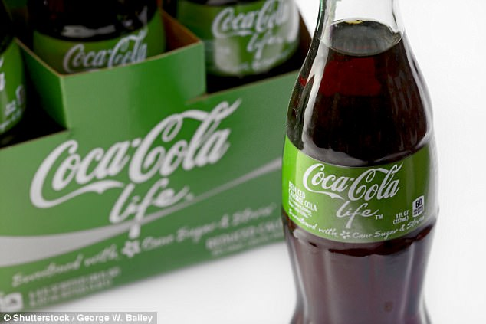
#4 Penetration pricing
Assess the impact of coca cola using penetration pricing for a new product such as coke life?

Slide 19
#5 Predatory Pricing
In oligopolies (markets with just a few large businesses e.g. budget airlines) existing businesses may hold off the threat of a new entrant to the market by lowering their prices so that any competitor cannot make a profit.
This is when aggressive price cutting is used to deter competitors or push them out of the market
Depends on the strength of the brand, will consumers switch or stay loyal?
Depends on the financial strength of the firm can they afford to cut prices?

Slide 20
#5 Predatory pricing benefits and drawbacks
The intention with predatory pricing is to drive competitors out of the market place or set a barrier to entry to discourage new entrants to the market
Depends on the price elasticity of the product, if it is low then a lower price won’t make much difference to customer demand

Slide 21
#5 Predatory Pricing
https://youtu.be/a-Me7j5c0a8
Dumping occurs when governments subsidise domestic producers. This allows them to achieve economies of scale. It can often lead to retaliatory action.
Murdoch guilty in `Times' price war | The Independent | The Independent
What motivated the actions of Murdoch.
Why is predatory pricing illegal? Do you agree with this? Justify your answer.

Slide 22
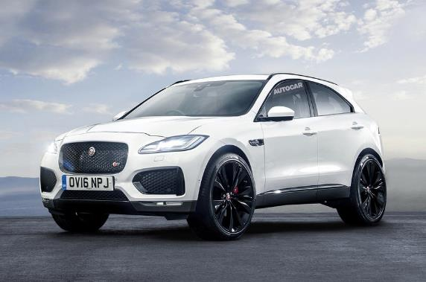
#6 Psychological pricing
This means pricing a product at £1.99 rather than £2.00 to appear cheaper
Some businesses consider pricing carefully as it is often an indicator of quality
High value or status items like luxury cars avoid pricing just below but instead may price higher to match their customers’ expectations
Build your own e-pace here: LINK
New Jaguar E-Pace The E-Pace is priced around £28,000 for entry-level models. Range-topping models could set you back around £40,000 while any high-performance version could cost more than £60,000

Slide 23
#6 Psychological benefits and drawbacks
Ideal for products which want to project a premium image – the price might be part of the appeal
Psychological pricing strategy can be high risk, if comparable products are available for a lower price consumers could be tempted away

Slide 24
#Loss Leader
The use of loss leaders is a method of sales promotion. A loss leader is a product priced below cost-price in order to attract consumers into a shop or online store. The purpose of making a product a loss leader is to encourage customers to make further purchases of profitable goods while they are in the shop.

Slide 25
#Loss Leader – does it work?
If a business undercuts its competitors on price, new customers may be attracted and existing customers may become more loyal. So, using a loss leader can help drive customer loyalty.
One risk of using a loss leader is that customers may take the opportunity to "bulk-buy". If the price discount is sufficiently deep, then it makes sense for customers to buy as much as they can (assuming the product is not perishable).
Using a loss leader is essentially a short-term pricing tactic for any one product. Customers will soon get used to the tactic, so it makes sense to change the loss leader or its merchandising every so often.

Slide 26
#Loss Leader
Assess the importance of loss leader pricing to a business such as Walmart?
https://youtu.be/XduHK6XRxSo

Slide 27
Pricing Strategies - Quiz
Pricing Decisions | tutor2u

Slide 28
Factors that determine the most appropriate pricing strategy for a particular situation
number of USPs/amount of differentiation
price elasticity of demand
level of competition in the business environment
strength of brand
stage in the product life cycle
costs and the need to make a profit

Slide 29
Factors that determine a pricing strategy
There are lots of factors which may help a business to determine the pricing strategy that it should use, these are the six that the exam board would like you to be able to discuss and apply to case studies – get ready to make some notes on these on the next few slides.
number of USPs/amount of differentiation
price elasticity of demand
level of competition in the business environment
strength of brand
stage in the product life cycle
costs and the need to make a profit

Slide 30
#1Number of USPs/amount of differentiation
A USP is a unique selling point – it is the unique details or features of the product that differentiates it from its rivals
For example: In a chocolate bar it may be the % of cocoa, or extra ingredients
In a washing machine it may be how quiet it is, or the load capacity or its eco settings

Slide 31
#1Number of USPs/amount of differentiation
USP/Differentiation: Assess the importance of differentiation in the pricing strategies of luxury hotels
https://youtu.be/Viwfx0DtjHE

Slide 32
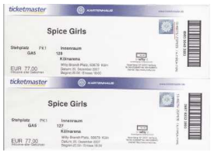
#2Price elasticity of demand
Elastic demand
Homogenous products which have lots of substitutes will have to price close to competitors
Too high and consumers will switch to alternatives
Too low and consumers may perceive the product as inferior to comparable
Inelastic demand
Unique products which have few alternatives will be able to command premium prices as consumers will be unable to switch and therefore willing to pay the price
Why might Spice Girls concert tickets have inelastic demand?
Notes:
Fans will pay whatever the price is for the tickets, so a small increase in price will not affect demand

Slide 33
#3 Level of competition in the business environment
No business works in isolation so a change in the price of one business may result in the change of all the others
The availability of substitute products will affect business pricing decisions
If a business wants to establish and maintain loyal customers it will need to match or have similar prices to its competitors
Some stores offer a price match e.g. John Lewis “never knowingly undersold”

Slide 34
#3 Level of competition in the business environment
Level of competition: How would the level of competition in the super market industry effect the pricing strategy of businesses in this industry?
https://youtu.be/etr7ldjlNb0

Slide 35
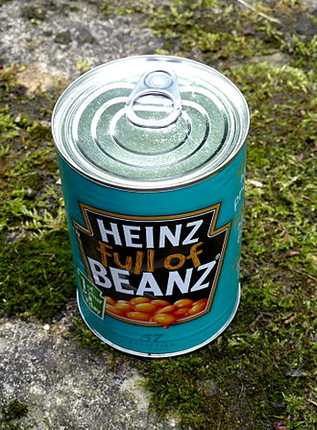
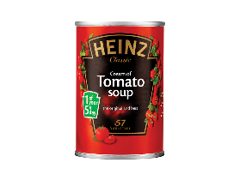
#4 Strength of brand
A brand helps to define a business in the eyes of a consumer
A strong brand can charge higher prices because consumers will pay the higher price for the strong brands
In 84%* of sales brand is the largest influence on price
Notes:
*Source: http://www.wpp.com/wpp/marketing/reportsstudies/whatpriceastrongbrand/

Slide 36
#4 Strength of brand
Strength of brand: Assess the importance of a strong brand to Apple's pricing strategy?
https://youtu.be/nbVaTapB_YI

Slide 37
#5 Stage in the product life cycle

Slide 38
#5 Stage in the product life cycle

Slide 39
#5 Stage in the product life cycle
Products in the launch phase may use skimming if the if the product is unique and the business wants to claw back the R&D costs
Products in the maturity or decline phase may be priced lower to clear stocks before a new product is introduced.
Products in growth or maturity phase may decide to price closer to competitors – after new imitations enter the market place

Slide 40
#6 Costs and the need to make a profit
The costs of a product all need to be taken into account when its price is decided:
Raw materials
Promotion and advertising
Product development and design
A business will want to break-even and make a profit, break-even is the point where total costs equal total revenue

Slide 41
#6 Costs and the need to make a profit
https://youtu.be/NsS2Y8VRsrg
Costs: How would costs effect the pricing strategy of a company like Ferrari?

Slide 42
Changes in pricing to reflect social trends
online sales
price comparison sites

Slide 43
Online sales
Websites can offer low prices than the bricks and mortar shops because they don’t have the overheads, rent and costs of running a store.
Many customers look at the goods in a store and then buy online at a cheaper price
This means many online retailers need to have dynamic pricing which is constantly checking and updating based on competitors prices
40 tips to slash the cost of online shopping

Slide 44
How has online shopping impacted pricing strategies?
https://youtu.be/qWptB4GMs8g
https://youtu.be/ASYzHI1hajw

Slide 45
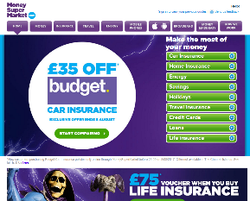
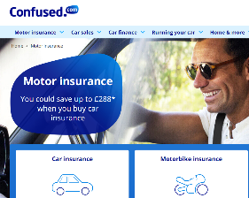
Changes in prices to reflect social trends
Price comparison sites
Customers are now able to shop around and using these sites compare prices of insurance, where previously they would have had to phone a few companies to get quotes, this was time consuming and an expensive phone bill
They work by heavily advertising and the companies pay to be featured in a list
Go compare
Money supermarket
Article on BBC on problems with price comparison sites
https://uk.camelcamelcamel.com/

Slide 46
Changes in prices to reflect social trends
How have price comparison websites impacted pricing strategies?
https://youtu.be/Dn4CFhqYN28
https://youtu.be/6Hthl4RrI0M

Slide 47
Suggested activity - discussion
What kinds of products or services might be found cheaper online than in a shop?
Can you make a mindmap, diagram or doodle to display this information?

Slide 48
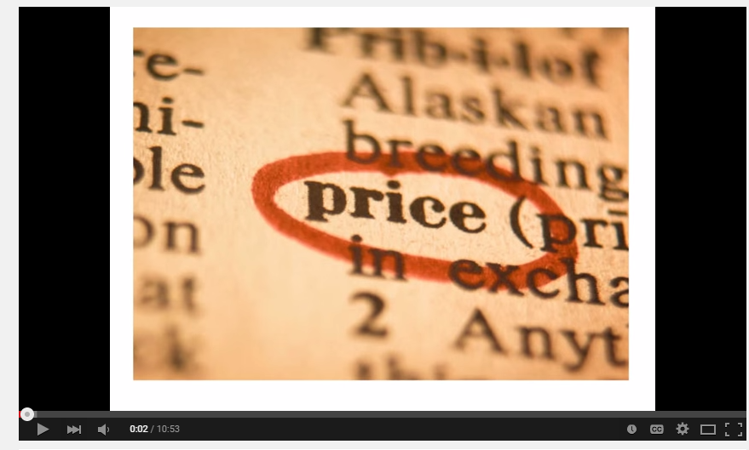
Revision Video

Slide 49
Sample Edexcel A2 questions
Notes:
No suitable A2 question for this topic so I have borrowed an Edexcel sample AS question for practice

Slide 50
Case study for question 1 – from 2017 paper

Slide 51
Sample question 1
Knowledge 2
Application 2
Analysis
3
Evaluation
3

Slide 52
Case study for question 2

Slide 53
Sample question 2
Knowledge 1
Application 2
Analysis
1

Slide 54
Review Questions
1 Explain why price is fundamental to a firm's revenues. (3)
3 Explain how the actions of Nike could affect the footwear prices set by Adidas. (3)
5 Explain the difference between pricing strategy and pricing tactics. (2)
6 For each of the following, decide whether the pricing strategy should be skimming or penetration. Briefly explain your reasoning.
a) Richard Branson's Virgin group launches the world's first space tourism service (you are launched in a rocket, spend time weightless in space, watch the world go round, then come back to earth). (4)
b) Kellogg's launches a new range of sliced breads for families who are in a hurry. (4)
c) The first robotic washing machine is launched. It washes, dries and irons the clothes - and places them in neat piles. (4)
7 Is a price-elastic product likely to be priced competitively or on a cost-plus basis? Explain your reasoning. (3)
8 Outline two circumstances in which a business may decide to use predatory pricing. (4)

Slide 55
Glossary
Cost-plus; To set the price of a product or service by calculating the cost then adding a set amount or % to it
Competitive pricing; To charge a similar amount for goods as are charged elsewhere
Mark-up; The amount above cost added to a product before it is placed for sale
Homogenous; Products which are all the same or alike

