Slide 1
Edexcel A2 Business
3.5.2 Ratio Analysis
Revisionstation

Slide 2
Worksheet

Slide 3
Calculators will be needed for this topic

Slide 4
From Edexcel
a) Calculate:
Gearing ratio
Return on capital employed (ROCE)
b) Interpret ratios to make business decisions
c) The limitations of ratio analysis

Slide 5
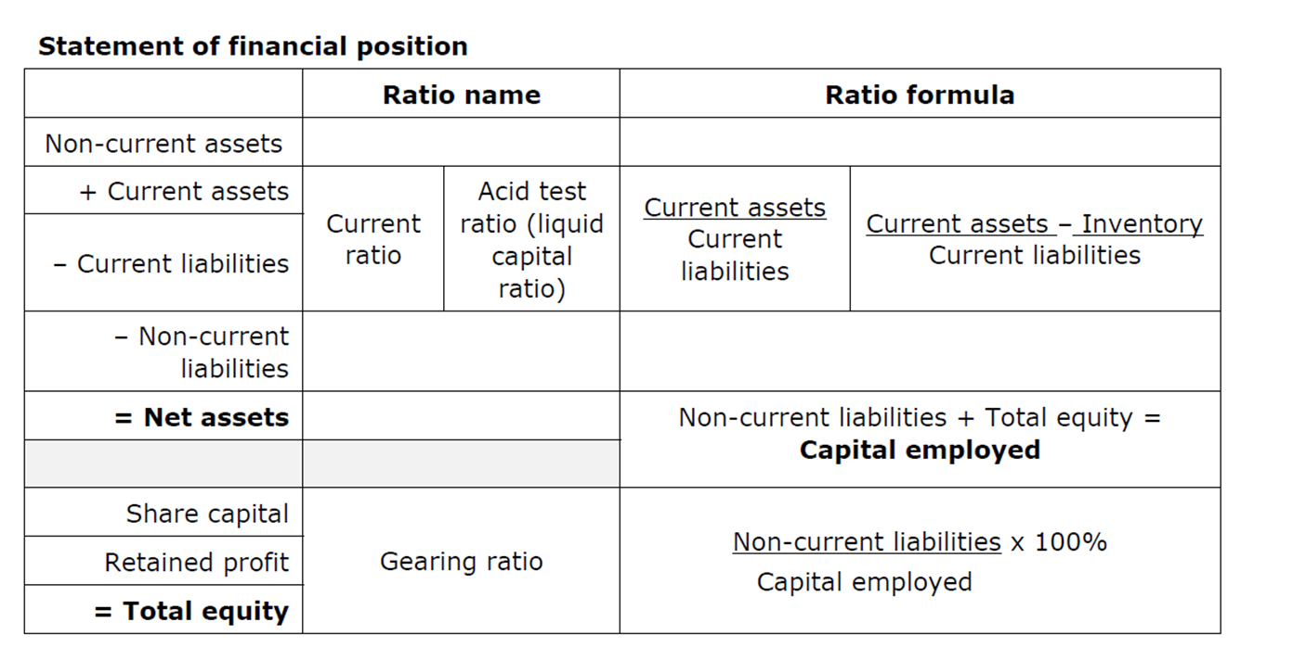
Starter (online timer here)
You have 5 mins to learn as much of these as possible (Go!)
Notes:
Blank om next slide

Slide 6
Can you now fill in the grid? How much did you remember?
Notes:
This took me ages to do – so I hope its correct – print a few out for the starter or get them to come up to the board and fill in. Take as long as you need to with this activity as they need to learn these ratios.

Slide 7
Ratios defined
A ratio measures a company's ability to meet financial obligations.
Notes:
* Taken from : http://articles.bplans.co.uk/growing-a-business/business-ratios/284

Slide 8
Calculations and interpretation

Slide 9
Current Ratio formula
Current Assets
__________________________________
Current Liabilities
Notes
Current Assets and Current Liabilities are both found on the statement of financial position (balance sheet)
The answer should be expressed as a ratio to 1, so for example 3:1

Slide 10
Current Ratio explained
This is also known as the working capital ratio
The ideal is around 1.5:1 and 2:1
Below 1.5:1 the business might not have enough working capital to cover all their bills
They may be over borrowing or over trading and will have cash flow problems
Above 2:1 and the money in the business is tied up and not being used efficiently

Slide 11
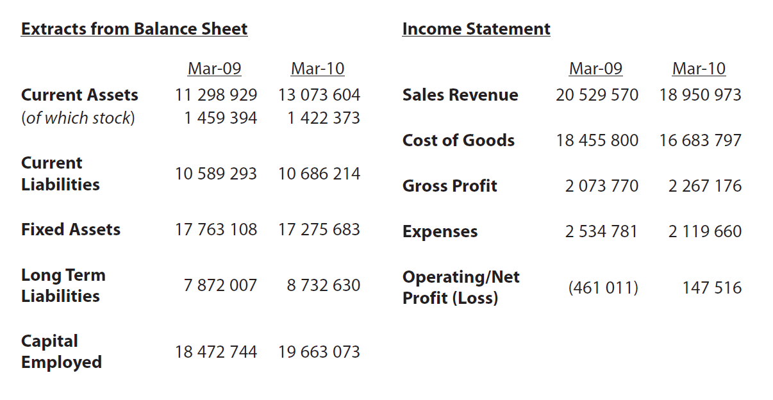
Current Ratio – calculate from this data

Slide 12
Current Ratio answer
 | 2009 | 2010
Current Assets | 11 298 929 | 13 073 604
Current Liabilities | 10 589 293 | 10 686 214
Current Ratio | 1.06:1 | 1.22:1
Move shape to reveal answer
Move shape to reveal answer

Slide 13
Acid test ratio formula
Current Assets - Inventory
__________________________________
Current Liabilities
Notes
Inventory is also known as stock and will be found on the statement of financial position (balance sheet)
This is also expressed as a ratio to 1 e.g. 4:1

Slide 14
Acid test ratio explained
The acid test ratio is also known as the quick ratio and is the most commonly used ratio to judge the financial health of a business
Stock is excluded because it may perish or be obsolete or not worth the stated value
A result of less than 1:1 means that the current assets do not meet their current liabilities and they will struggle to pay their bills

Slide 15
Acid test ratio – calculate from this data

Slide 16
Acid test ratio answer
 | 2009 | 2010
Current Assets | 11 298 929 | 13 073 604
Current Liabilities | 10 589 293 | 10 686 214
Stock | 1 459 394 | 1 422 373
Acid test Ratio | 0.92:1 | 1.09:1
Move shape to reveal answer
Move shape to reveal answer

Slide 17
Gearing ratio formula
Non-current Liabilities
__________________________________
X 100
Capital Employed
Notes
Non-current liabilities are also known as long-term liabilities and are found with capital employed on the statement of financial position (balance sheet)
The answer should be expressed as a percentage %

Slide 18
Gearing ratio explained
The gearing ratio looks at the long-term finance of the business and where it comes from
A result of over 50% means the business is highly geared, most of the money comes from loans, this is very risky for a potential investor
A result of less than 50% means the business is low geared and most of the money comes from the owners, a better risk for an investment

Slide 19
Gearing ratio – calculate from this data

Slide 20
Gearing ratio answer
 | 2009 | 2010
Long Term Liabilities | 7 872 007 | 8 732 630
Capital Employed | 18 472 744 | 19 663 073
Gearing Ratio | 42.66% | 44.4%
Move shape to reveal answer
Move shape to reveal answer

Slide 21
ROCE ratio formula
Operating Profit
__________________________________
X 100
Capital Employed
Notes
ROCE means return on capital employed
Operating profit figure comes from the statement of comprehensive income (profit and loss)
Capital employed figure comes from the statement of financial position (balance sheet) it can be found by adding non-current liabilities and total equity figures together
X100 means the answer must be expressed as a percentage with a % sign

Slide 22
ROCE ratio explained
Return on Capital employed is a measure of the profitability of the business
If you were considering investing in a business you might calculate the ROCE % and then compare this against a bank savings plan (less risky) of 5%
The higher the ROCE figure the better
Demonstrates how hard the business made the money invested work

Slide 23
ROCE ratio – calculate from this data

Slide 24
ROCE ratio answer
 | 2009 | 2010
Operating Profit or loss | (461 011) | 147 516
Capital Employed | 18 472 744 | 19 663 073
ROCE ratio | -2.5% | 0.75%
Move shape to reveal answer
Move shape to reveal answer

Slide 25
Ratio limitations

Slide 26
Ratio limitations
The balance sheet is just a snapshot of the business on one day, if the ratios are based on this figure, then it’s a ratio of just one day in the business and as markets are dynamic figures could change
The ratios are only as good as the information provided in the balance sheet and the profit and loss
The ratios need comparison like a pair of shoes you need two to be comfortable. For example 45% on its own means nothing but a rise from 45% to 87% means something

Slide 27
Ratio limitations continued
Ratios must be seen in an industry context. In some supermarkets the current ratio is very low as the stock is sold so fast , so a low current ratio or acid ratio would not be a worry
Keep in context – were poor ratios in a time of world recession e.g. 2008?
During a recession, for example, it may be useful to compare the business performance with a competitor

Slide 28
Sample Edexcel A2 questions

Slide 29
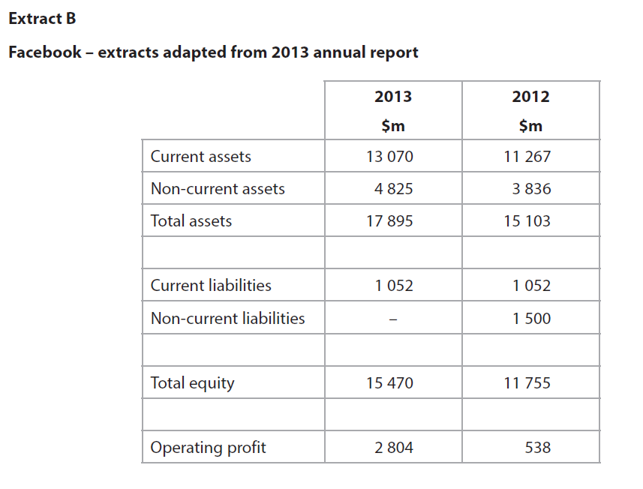
Case study for question 1

Slide 30
Sample question 1
Knowledge 1
Application 3

Slide 31
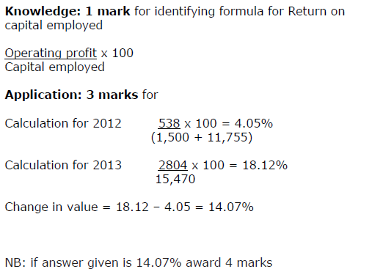
Answer sample question 1

Slide 32
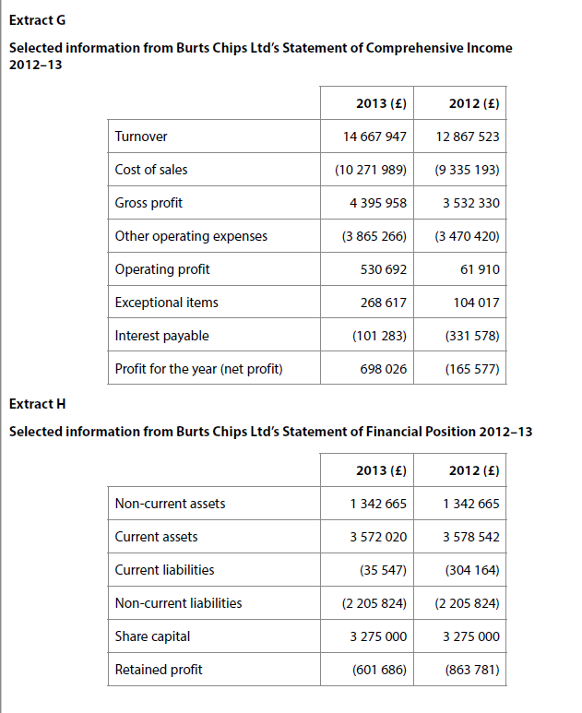
Case study for question 2

Slide 33
Sample question 2
Knowledge 4
Application 4
Application 6
Application 6

Slide 34
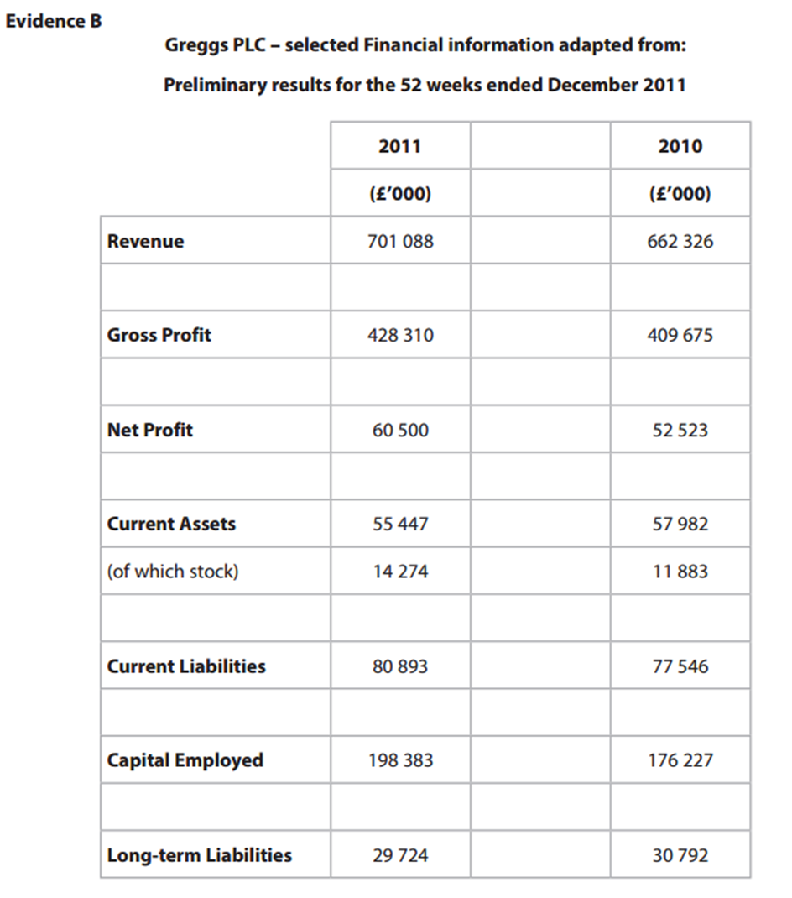
Case study for question 3

Slide 35
Sample question 3
Knowledge 2
Application 2

Slide 36
Case study for question 4

Slide 37
Sample question 4
Knowledge 2
Application 2

Slide 38
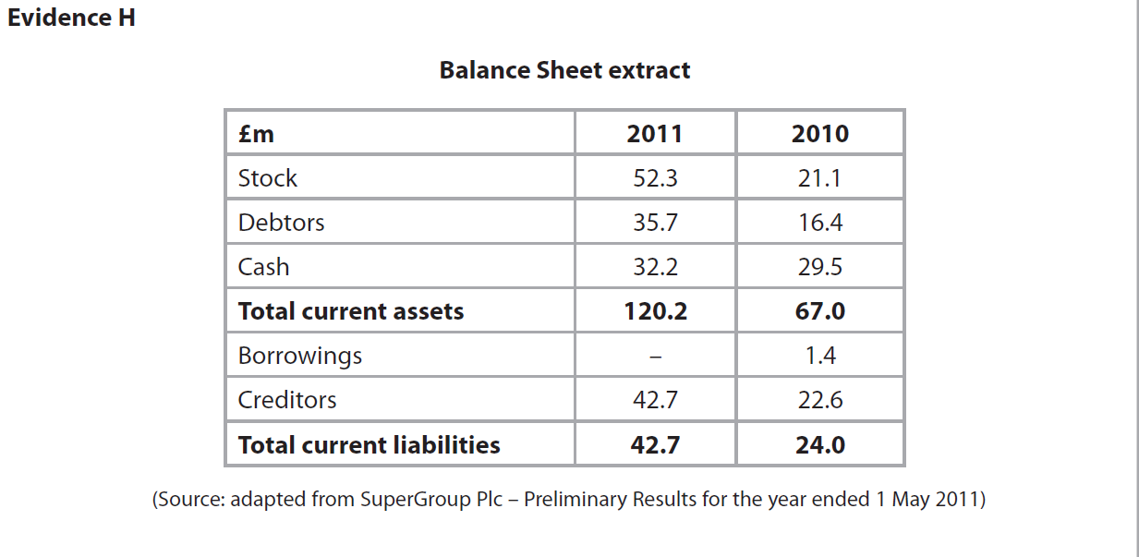
Case study for question 5 and question 6

Slide 39
Sample question 5
Knowledge 2
Application 2

Slide 40
Sample question 6
Analysis
2
Application 2

Slide 41
Glossary

