Slide 1
STARTER ACTIVITY - 5 mins

Slide 2
LEARNING OBJECTIVES
Lo1: Explain different factors which can impact PES
Lo2: Diagrammatically illustrate and apply PES.
Lo3: Evaluate the extent to which factors impact upon the PES of goods.

Slide 3
Madejski Stadium Activity
Complete the PES Madejski Stadium worksheet

Slide 4
Price
Supply is fixed in the short-term, so the curve is perfectly inelastic.
S1
S2
Expanding The Mad Stad would cause supply to shift to the right S1-S2.
P1
Demand is high and supply is fixed, leading to high ticket prices (P1).
Expanding the stadium increases supply (S2) and lowers ticket prices (P2).
P2
D1
Q1 (24,161)
Stadium Expansion
Q2 (36,900)
Quantity

Slide 5
SR/LR Economics Definitions
The idea of ‘short-run’ and ‘long-run’ in Economics is used in many other theories throughout A-Level, therefore understanding this definition is important for topics beyond price elasticity of supply:
Short-run: defined in Economics as the period of time when at least one factor of supply (land, labour and capital) is fixed and the rest are variable/changeable in terms of quantity/quality.
Long-run: defined in Economics as the period of time when all factors of supply (land, labour and capital) are variable/changeable in terms of quantity/quality.

Slide 6
Price
SLR
SSR
Supply is fixed in the short-term, so the curve is perfectly inelastic.
If we consider the supply in the long-run, all factors of supply are variable and so the likelihood of expansion increases. Therefore supply becomes more elastic over time.
Quantity

Slide 7
PES WORKSHEET
Average house prices in an area have increased from £145,000 to £170,000 and supply increases from 40,000 to 44,000. PES is:
+10 / +17 = 0.588
Housing is therefore inelastic.
Planning permission, 6-9 month build time.

Slide 8
Commodities - GROUP WORK
In small groups you will each be given a commodity from a past paper exam question.
Read the extract in order to answer the evaluative PES question.
Fill in the table – KAA points and EV points.
You will then report your findings back to the rest of the class.

Slide 9
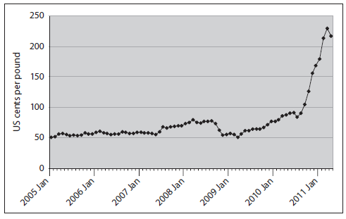
Exam Question
With reference to the information provided and your own knowledge, discuss whether the price elasticity of supply for cotton is likely to be inelastic or elastic. (10)

