Slide 1
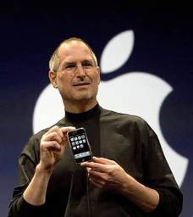
c) Limitations of market research
Market research is incapable of seeing potential in real leaps forward - Steve Jobs
If I asked customers what they wanted, they'd have asked for a horse - Henry Ford
Summarise the limitations of market research according to Steve Jobs and Henry Ford

Slide 2
Use of ICT to support market research

Slide 3
Market Research
d) Use of ICT to support market research:
websites
social networking
databases

Slide 4
Websites
Many websites automatically generate customer questionnaires. They might target everyone through the home page or the focus on a subgroup. This may look like free research, but who answers the questions raised? This can be very time consuming and it could be biased towards those with more time on their hands.

Slide 5
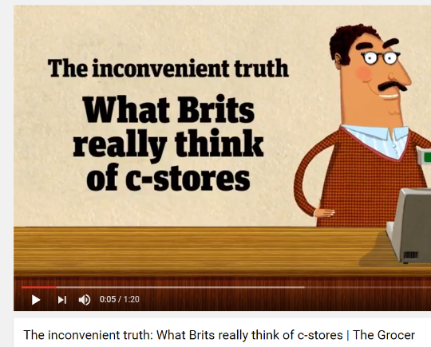
Websites
Pop-ups on websites can be used to ask customers about products they have bought or may buy
These may also be used to gather e-mail addresses so that targeted customers can be surveyed later via e-mail
Some sites (Like the Grocer, see video) have lots of useful quantitative data about the industry
Explain the limitations of using Pop-ups to gather email addresses.
Outline the role of websites such as `The Grocer`

Slide 6
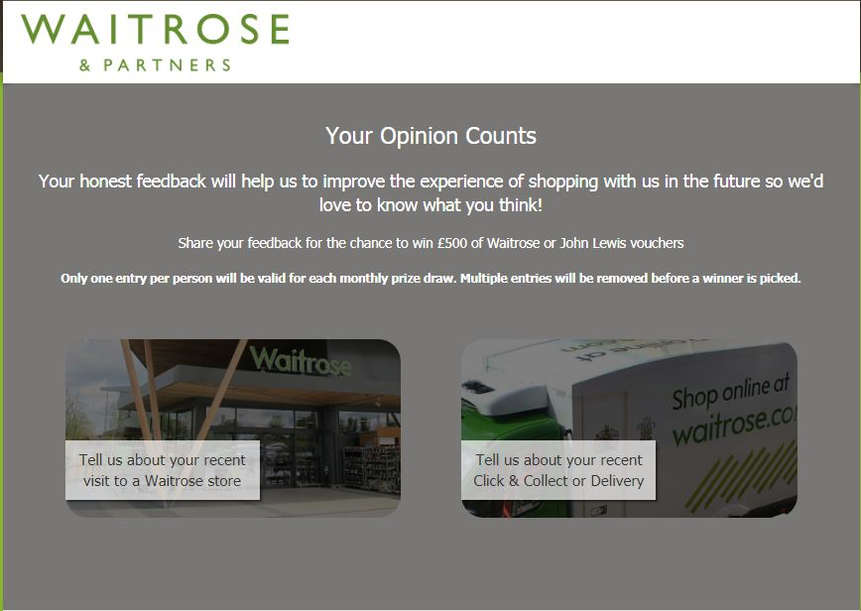
​Why might a business decide to use surveys to carry out it's market research? What are the issues with such questionnaires on websites?

Slide 7
The use of social media
Social media provide the interactivity that may help to develop a relationship between the business and its customers. Social media can provide a way to gain a fuller understanding of what customers really love about the brand and product range.

Slide 8
Social Networks - Twitter
Twitter can be used to support marketing research – by searching for trending hashtags to see emerging trends
It can also search a business name or a brand name to find out quantitative information about customer perceptions
See twitter cloud here
Click on the link above and see what is trending on Twitter (UK and Hull)
How is Twitter used by business as part of their market research?

Slide 9
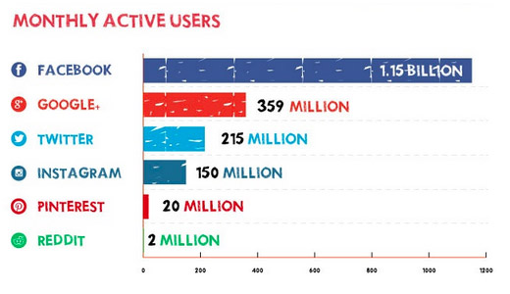
How can businesses use social media for market research?
Summaries the usefulness of each social media platform.
Why might a business choose to use this method to collect their data?

Slide 10
What might be the potential problems of using this method to collect their data?

Slide 11
Social networks – it doesn’t always work!
What went wrong with this use of social media to conduct market research?

Slide 12
Business Databases
Almost 75% of supermarket shopping was done with the use of a `Loyalty Card`. This provide a retailer with a multi-million user database, which can be interrogated to find out answers to quantitative questions, such as what percentage of purchases of Lynx are among households with boys under 12?

Slide 13
What is the Tesco club card? How is it used? What is the benefit of Tesco using this? ​Are there any potential drawbacks?

Slide 14
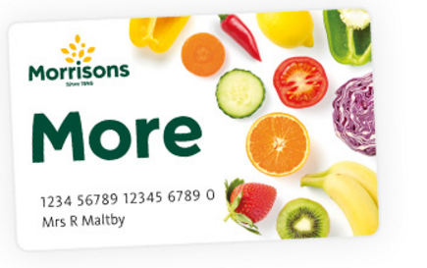
Business Databases
Large supermarkets use all the data from their loyalty schemes to build huge customer databases
This information can be used to target customers likely to buy at the store e.g. customer satisfaction with bakery products at Morrison's
Other databases such as Experian can also be a valuable source of customer information e.g. credit scores, incomes
Explain how loyalty cards are used by supermarkets to conduct market research?
Explain the role of loyalty cards assist in promotional activities.

