Slide 1
Edexcel A2 Business
3.4.4 Business Ethics
Revisionstation

Slide 2
Worksheet

Slide 3
From Edexcel
a) Ethics of strategic decisions:
trade-offs between profit and ethics
b) Pay and rewards
c) Corporate Social Responsibility (CSR)

Slide 4
Starter
What do think these 10 companies have in common:
Nestlé
Monsanto
Amazon
Shell
Tesco
Barclays
Exxon
Wal Mart
Coca Cola
Primark
Notes:
The top ten least ethical companies were: http://www.ethicalconsumer.org/aboutus/ethicalconsumerat25/thebestandworstofthelast25years.aspx

Slide 5
Ethics vs profitability
In some businesses it is not possible to be ethical and profitable
According to the Ethical Consumer website: The top ten least ethical companies were:
Nestlé
Monsanto
Amazon
Shell
Tesco
Barclays
Exxon
Wal-Mart (ASDA)
Coca Cola
Primark

Slide 6
Definition of ethics
Definitions from the Oxford English Dictionary
(ethics) Moral principles that govern a person’s behaviour or the conducting of an activity
(morals) Standards of behaviour; principles of right and wrong

Slide 7
Ethics of strategic decisions

Slide 8
Ethical decisions
Businesses want to appear to be doing “the right thing” but this is not always possible if they wish to make a profit
Often there is a trade-off between ethics and profitability (compromise)
A prime example of a pharmaceutical company’s exploitation of medicinal availability is GSK created a monopoly of HIV/AIDS medications in South Africa that resulted in drug availability to only 10 percent of the people who needed it.

Slide 9
Ethics vs profitability – Deepwater Horizon
2010 BP oil rig Deepwater Horizon caught fire
11 men lost their lives
Obama said it was “the worst environmental disaster ever”
Millions of gallons of oil spilt into the Gulf of Mexico
All due to cost cutting by BP, failure to invest in training and health and safety
Worst affected – fishermen and residents of the Gulf
Notes:
If you can persuade the kids to watch the Mark Wahlberg film

Slide 10
Nestle –profit before ethics
Nestlé has been voted the least ethical company of the last 25 years by readers of Ethical Consumer.
The Swiss food company 'won' with 15% of the vote, finishing just above Monsanto (14%) and the UK's number one tax avoider Amazon (12%).
Nestlé is currently subject to the longest ever running consumer boycott. For over 20 years Baby Milk Action has called a boycott of the company for its irresponsible marketing of baby milk formula, which infringes the International Code of Marketing of Breast-milk

Slide 11
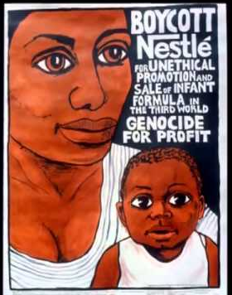
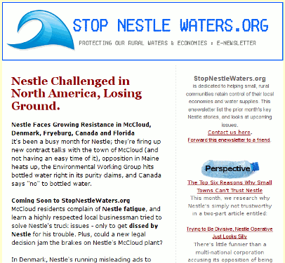
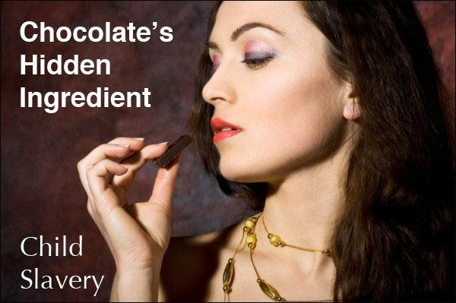
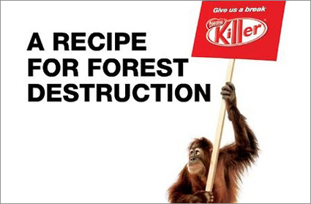
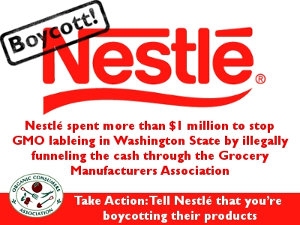
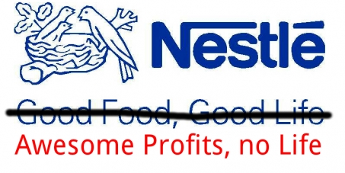

Slide 12
Ethics vs profitability - vw
VW found it was cheaper to sell “green cars”
So their marketing brag to customers was that their cars were low emissions and environmentally friendly
This was a cheat designed to sell more cars
The result was a loss of reputation for the car company

Slide 13
Ethics vs profitability - Monsanto
Monsanto started as a chemical company and went into agribusiness producing genetically modified seed for farmers
Seed only propagates once a year so farmers have to buy new seed every year
Monsanto has been labelled the “face of corporate evil” and its products called “frankenfood” and “the terminator” strong words indeed
Revenue in 2016 was $13.5 billion

Slide 14
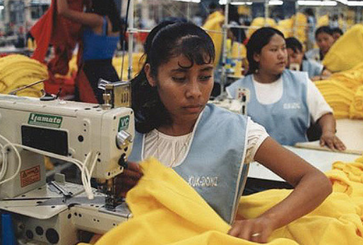
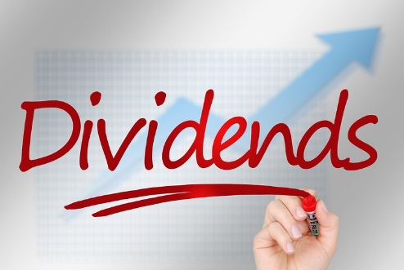
The big question
Can you describe how the ethical interests off shareholders differs from other stakeholders of a business? Use these images to help you. (Click to reveal)
Suggested answers on next slide

Slide 15
CSR shareholders / stakeholders
Shareholders
Stakeholders
Shareholders are interested in the profit performance of the business and any potential dividend payout from it
They are less concerned with costly ethical issues and may even discourage ethical initiatives on financial grounds
Stakeholders are interested in the way that suppliers of materials and components to the business are treated – for example; fair wages and good working conditions
Pressure groups are interested in the use of child labour and sweatshops in the production process

Slide 16
Pay and rewards

Slide 17
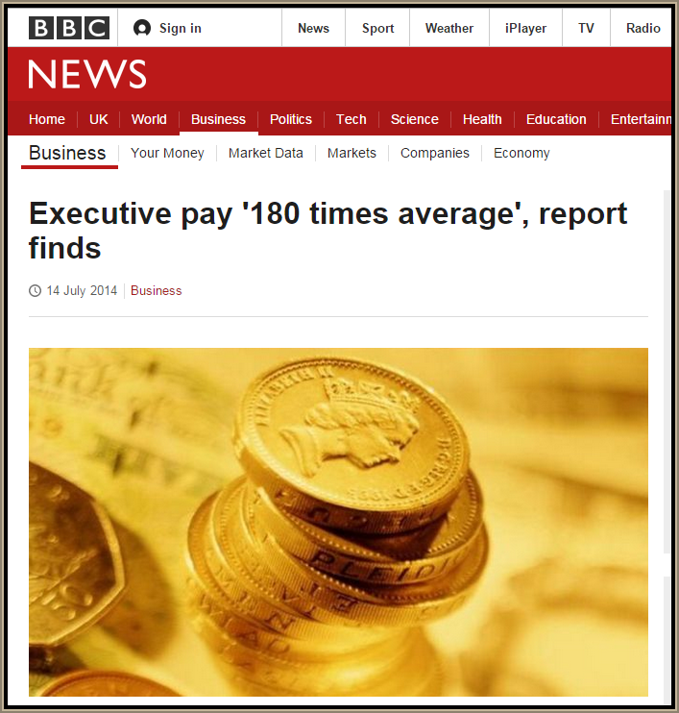
Executive pay vs employee pay
Video on income inequality here
Wealth inequality video here
“When the lion’s share of reward is going to a few at the very top of society, we are stifling spending power among the rest. That is going to hold back our economy and create large divisions in society.”*
Notes:
* High Pay Centre an independent think tank

Slide 18
Bankers bonuses
Discuss the ethics of these facts:
Bankers are set to be awarded £5billion in bonuses, including £2.2billion for staff at scandal-hit HSBC.
The vast sum is expected to be paid out to bankers at HSBC despite it being embroiled in a tax dodging row.
And Royal Bank of Scotland, bailed out by the taxpayer after the financial crash, is likely to hand its staff £500million in bonuses.
Notes:
http://www.dailymail.co.uk/news/article-2961292/Bankers-set-enjoy-5BILLION-bonuses-including-2-2bn-scandal-hit-HSBC-900m-banks-bailed-taxpayer.html

Slide 19
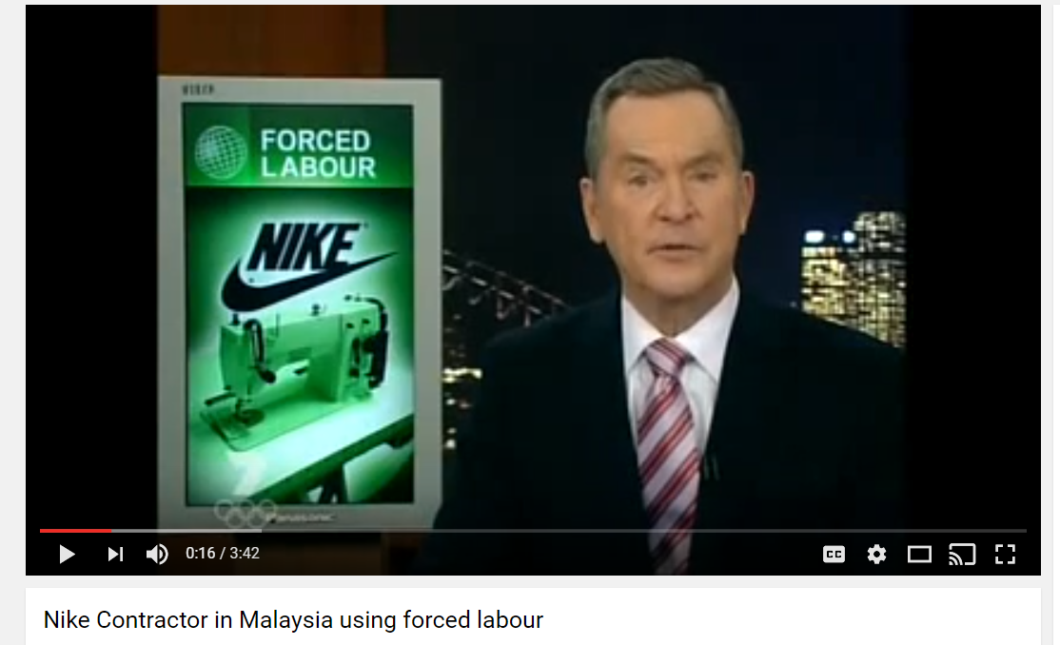
Sponsorship
Christiano Ronaldo earns $8 million a year from sponsorship by Nike alone, but his total endorsement deals add up to $21 million a year
This is on top of his $200,000 a week football salary*
Notes:
source: http://www.tsmplug.com/richlist/cristiano-ronaldo-net-worth/

Slide 20
Corporate social responsibility (CSR)

Slide 21
CSR defined
In essence a (CSR) or Corporate Social Responsibility is a business approach that contributes to sustainable development by delivering economic, social and environmental benefits for all stakeholders

Slide 22
CSR and us
CSR means that a business considers the impact that its decisions have on us as citizens
The business also considers what responsibilities they have towards society as stakeholders
It is generally accepted that CSR principals are incompatible with profit maximisation objectives
However many businesses now use their CSR credentials as a selling feature of their products, services or brands

Slide 23
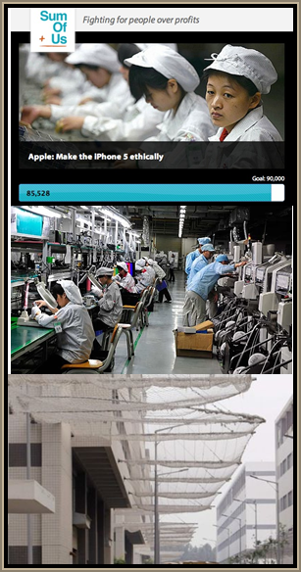
CSR approach
Some of largest MNCs struggle to achieve their own CSR objectives – as in the case of the technology giant Apple.
First watch:
Employees: BBC video on exhausted Apple workforce, ABC news video on Foxconn suicide nets at the Apple factory (see bottom picture on the right)
Now read:
Counterbalance read the Apple supplier responsibility colourful PDF here

Slide 24
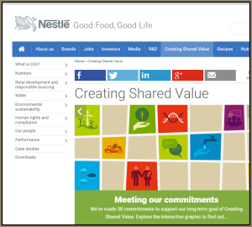
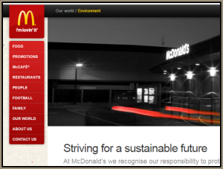
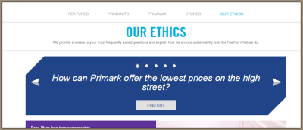
CSR example Choose one of these businesses and compare their CSR policy with their mission statement
CSR policy
Mission statement
CSR policy
Mission statement
Video from BBC
CSR policy
Values
Extra Primark case CSR here PDF
Notes:
Print the PDF before the lesson

Slide 25
Corporate social responsibility

Slide 26
Corporate social responsibility
Reduce
negative
environmental
impact
Positive regard
for Human rights
in
employment
Reduce
climate change
Positive
links
with
community
Ethical
trading
policies
Using
sustainable
resources
Notes:
This is taken from looking at about 40 different CSR diagrams – this is a concentrated version © I would ask students to add to it, to find examples of best practice, to take one and expand and explain it…

Slide 27
Advantages of a CSR approach
Happy customers; more loyal to a CSR business
Happy staff; more motivated and productive workers who are proud of the business that they work for
Happy investors; more funding and investment will become available, many investors seek CSR businesses
New products new markets; working in a CSR way will stimulate innovation (in ways to save energy for example)
Good PR; public relations which show the business in a positive light
Happy community; trusted relationships built with the local communities
Happy suppliers; who may choose a CSR business because of their ethical stance
Cost reductions; in not having to re-hire staff, in energy saving in reducing waste, in keeping loyal customers

Slide 28
Disadvantages of a CSR approach
Fad?; Many business writers speculate that CSR is the latest fad and soon consumers will tire of it and move on to something else
Motive?; Some businesses may have a CSR policy specifically for the good PR that it creates, the evidence for this is a CSR job would be working inside a PR department of a large organisation
Cost?; Is the cost larger than the benefits for a business? If the competition are not bothering with CSR that does not necessarily give completive advantage it could just make for a more expensive product
Care?; Do consumers care that the farmer that grew the coffee beans was paid a fair wage, or will they buy the coffee based on price or a nice looking jar?

Slide 29
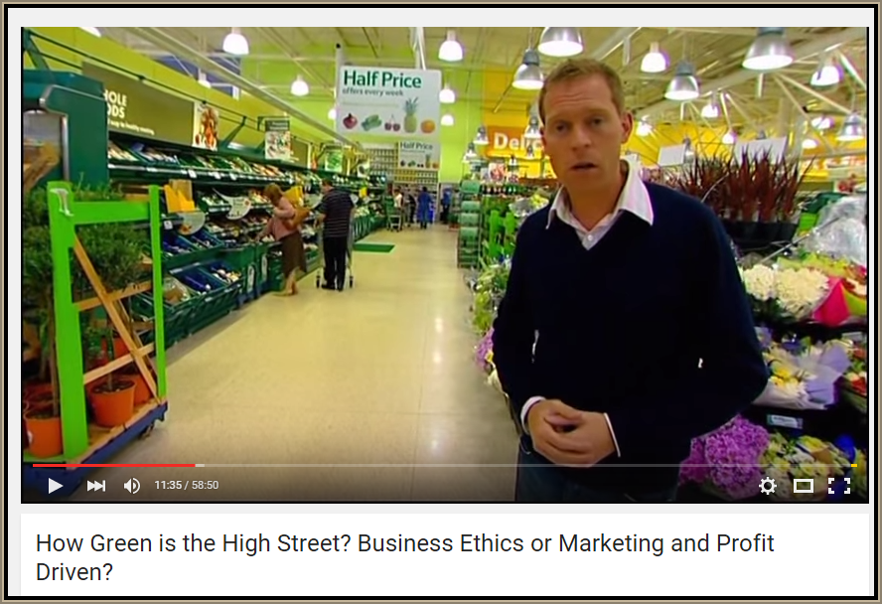
Revision Video

Slide 30
Sample Edexcel A2 questions

Slide 31
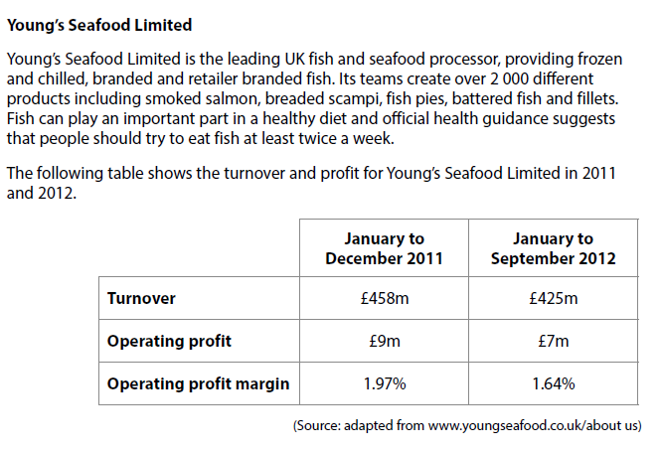
Case study for question 1

Slide 32
Sample question 1
Knowledge 4
Application 4
Analysis
6
Evaluation
6

Slide 33
Issues to cover in the answer
Which are environmental and which are ethical?
Damage to dolphins
Over-fishing
Pollution of water
Damage to whales
Disruption to local eco-systems
Cruelty from fishing
Cruelty in fish farming
Mistreatment of staff in developing countries

Slide 34
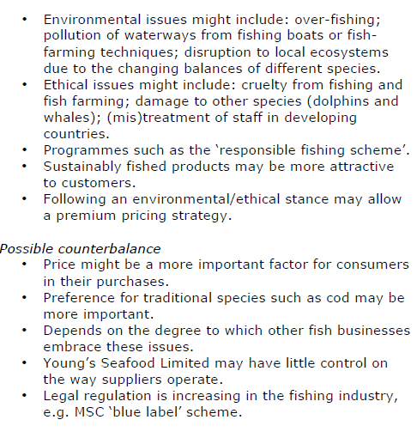
Answer sample question 1

Slide 35
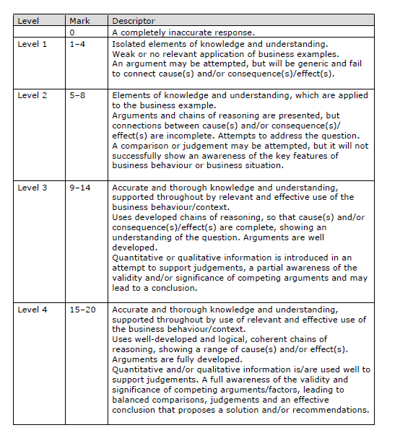
How to level sample question 1

Slide 36
Case study for question 2

Slide 37
Sample question 2
[12]
Knowledge 3
Application 3
Analysis
3
Evaluation
3

Slide 38
Answer sample question 2

Slide 39
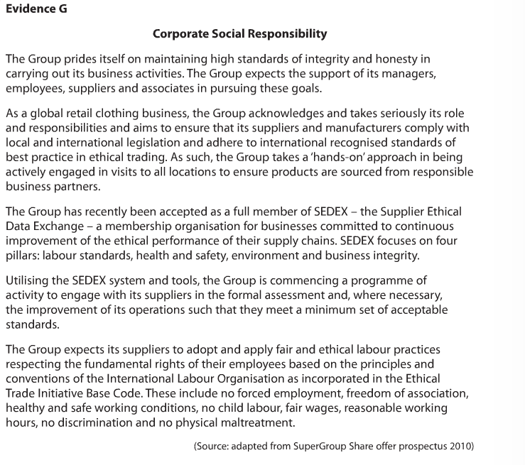
Case study for question 3

Slide 40
Sample question 3
{20}
Level 1
1-3
Level 2
4-7
Level 3
8-14
Level 4
15-20

Slide 41
Answer sample question 3
1 | 1-3 | CSR refers to the extent to which a business accepts obligations to society over and above the legal requirements • This usually refers in particular to treatment of employees, the environment and suppliers • Stakeholders are groups with a direct interest in the company’s operations
2 | 4-7 | SuperGroup has a clear CSR position as outlined in the share offer prospectus • It is a member of the Supplier Ethical Data Exchange • It has expectations about what its clothing suppliers will and will not be involved in.
3 | 8-14 | CSR is important to stakeholders such as suppliers because they want to be treated fairly and in a way that does not force them to behave unethically in order to keep the Superdry contracts • Clothing companies are particularly vulnerable to scrutiny from the media and pressure groups over issues such as child labour and sweat shops • Customers do not want to buy clothing that may be supplied by businesses who treat their employees badly • Part of Superdry’s brand appeal is its newness and the idea of breaking moulds – this would be damaged if CSR policies were broken or not followed • Celebrity endorsers are likely to desert the company if questions are raised about SuperGroup’s treatment of its stakeholders.
4 | 15-20 | SuperGroup’s success is based on design, image and price – customers are less likely to be concerned with background issues such as CSR • Shareholders are concerned about the profit performance of the newly floated business, so they are less likely to be concerned with potentially costly issues such as changing suppliers • Stakeholders such as employees in the UK are more likely to be concerned with the basic wage and working conditions they face than ‘higher-minded’ issues often covered with CSR • Superdry is not engaged in many activities that damage the environment, so it is less likely to invite scrutiny from pressure groups on this issue • However, Superdry’s focus is on growth, so shareholders are interested in how this could affect their returns. If CSR is important, it is likely to be in terms of how suppliers are treated, particularly if they are pressured into increasing supply to support Superdry’s growth.

Slide 42
Glossary
Ethics; doing business in a way that is morally right
Trade-off; a compromise reached between one thing and another
CSR; Corporate Social Responsibility is the extent to which a business accepts obligations to society over and above the legal requirements
Notes:
*Making Good Business Sense by Lord Holme and Richard Watt

