Slide 1
Edexcel A2 Business
2.3.1 Profit
Revisionstation

Slide 2
Calculators will be needed for this topic

Slide 3
Worksheet

Slide 4
From Edexcel
a) Calculation of:
gross profit
operating profit
profit for the year (net profit)
b) Statement of comprehensive income (profit and loss account):
measuring profitability:
- calculation of gross profit margin, operating profit margin, and profit for the year (net profit) margin
ways to improve profitability
c) Distinction between profit and cash

Slide 5
Definition: Profit
Profit is the financial gain of a business through trading and can be found be deducting expenditure from income; P =TR-TC where TR is total revenue and TC is total costs
Three types of profit that your exam board would like you to know about and to be able to calculate from a statement of comprehensive income:
Gross profit
Operating profit
Net profit

Slide 6
Statement of comprehensive income
PLCs and limited companies(Ltds) need to publish their accounts every year, this is UK law
As part of those accounts they need to show their profit and loss and this appears in their “statement of comprehensive income (SOCI)”
You will need to use extracts from a SOCI to make calculations
Notes:
The whole set of accounts can be found here: https://www.supergroup.co.uk/media/docs/SuperGroup-2016-Annual-Report-Accounts.pdf

Slide 7
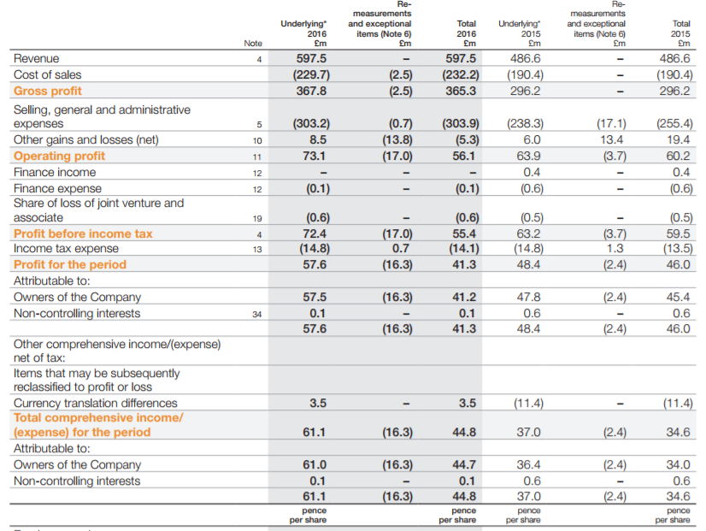
SuperGroup Plc. statement of comprehensive income 2016
Notes:
Your students need this to answer all the questions on this slide show
Point out that it also has data for the 2015 year as well for comparison

Slide 8
Calculations

Slide 9
Gross profit formula
GP = SR – Cost of sales
Where:
GP is Gross Profit
SR is Sales Revenue
Cost of Sales are costs that vary with output or level of sales, and may include stock

Slide 10
What is the Gross Profit for SuperGroup Plc?
Use the Statement of Comprehensive income for SuperGroup plc to read their GP figure for 2016 and 2015
Use the total figures
2015
2016

Slide 11
What is the Gross Profit for SuperGroup Plc?
2015 | £296.2m
2016 | £365.3m
What conclusions can you make from these two profit figures?

Slide 12
Conclusions from the Gross Profit figures
The statement of comprehensive income for SuperGroup plc shows that between 2015 and 2016 the gross profit increased by £69.1 million (Can you calculate this as a percentage increase?)
At first glance this is excellent financial progress but we would need more information plus ratio analysis to make an informed judgment about their suitability as a company to invest in
Notes:
% increase formula is change / original x 100
69.1 / 296.2 x 100 = 23.33% (rounded up)

Slide 13
Operating Profit formula
OP = GP - expenses
Where:
OP is operating profit
GP is Gross Profit
Expenses are other costs to the business aside from stock e.g. admin, an ad campaign etc.

Slide 14
What is the Operating Profit for SuperGroup Plc?
Use the Statement of Comprehensive income for SuperGroup plc to read their operating profit figure for 2016 and 2015
Use the total figures
2015
2016

Slide 15
What is the Operating Profit for SuperGroup Plc?
2015 | £60.2m
2016 | £56.1m
What conclusions can you make from these two profit figures?

Slide 16
Conclusions from the Operating Profit figures
The statement of comprehensive income for SuperGroup plc shows that between 2015 and 2016 the operating profit figure decreased by £4.1 million (what is this as a percentage decrease?)
How does this compare with gross profit figure? What might be causing this?
Notes:
Change / original x 100
4.1 / 60.2 = 6.81%
High expenses an ad campaign perhaps. Selling expenses were £17.1 million in 2015 which is a huge figure so an ad campaign would make sense. The full accounts probably explains why.

Slide 17
Net profit formula
NP = OP - interest
Where:
NP is net profit
OP is operating profit
Interest are payments due on loans or debts

Slide 18
What is the Net Profit for SuperGroup Plc?
Read the SuperGroup statement of comprehensive income and find the net profit figure. It is NOT called net profit on the statement – it is called Total comprehensive income / (Expense ) for the period
2015
2016

Slide 19
What is the Net Profit for SuperGroup Plc?
2015 | £34.6m
2016 | £44.8m
Looking at these two figures, if you were considering investing in SuperGroup plc – what would this information tell you?

Slide 20
Conclusions from the Net Profit figures
The statement of comprehensive income for SuperGroup plc shows that between 2015 and 2016 the net profit increased by £10.2 million
Can you calculate the percentage increase?
What can you do with the net profit data?
Notes:
% increase is change / original x 100
10.2 / 34.6 = 29.48%
Use net profit to calculate the net profit margin which is the most accurate measure of a business’s profitability.

Slide 21
Statement of comprehensive income

Slide 22
How the statement of comprehensive income helps to measure profitability
A business that is profitable will be able to reward its investors with a return on their investment e.g. dividends paid on shares
A business that is not profitable will not last long unless drastic changes are made
The statement of comprehensive income helps managers, owners and investors to know how the business is doing by measuring the profitability

Slide 23
Gross profit margin formula %
GP margin = Gross Profit
_____________ x 100
Sales Revenue
Express your answer as a %

Slide 24
What is the gross profit margin % for SuperGroup plc?
Use the GP figure from earlier PLUS use the total revenue figure from the statement
Don’t forget to multiply your result by 100 to get a %
Show your answer to 2 decimal places
2015
2016

Slide 25
Answers
2015 | 60.87%
2016 | 61.14%
Looking at these two figures, what conclusions can you make about the profitability of the business?

Slide 26
Conclusions
Calculation of gross profit margins for the SuperGroup plc from the statement of comprehensive income indicate that the gross profit margin has increased from 2015 to 2016.
How much has it increased by?
Notes:
It has increased by 0.27

Slide 27
Operating profit margin formula %
OP margin = Operating Profit
________________ x100
Sales Revenue
Express your answer as a %

Slide 28
What is the operating profit margin % for SuperGroup plc?
Use your OP calculation from earlier and the sales revenue total from the statement
Express your answer as a % to two decimal places
2015
2016

Slide 29
Answer
2015 | 12.37%
2016 | 9.39%
Looking at these two figures, what conclusions can you make about the profitability of the business?

Slide 30
Conclusions
Calculation of gross profit margins for the SuperGroup plc from the statement of comprehensive income indicate that the operating profit margin has increased from 2015 to 2016.
How much has it increased by?
Notes:
Changed by 2.98%

Slide 31
Net profit margin formula %
NP margin = Net Profit
________________x100
Sales Revenue
Express your answer as a %

Slide 32
What is the net profit margin % for SuperGroup plc?
Use your NP calculation from earlier and the sales revenue totals from the statement to make your calculation
Express your answer as a % to two decimal places
2015
2016

Slide 33
Answer
2015 | 7.11%
2016 | 7.50%
If you were looking to invest in this business, what conclusions about profitability could you make from these figures?

Slide 34
Conclusions
Calculation of gross profit margins for the SuperGroup plc from the statement of comprehensive income indicate that the net profit margin has increased from 2015 to 2016.
How much has it increased by?
Notes:
Net profit margin has increased by 0.39%

Slide 35
Ways to improve profitability – increase revenue
If profit is TR-TC then it makes sense to say that one of the ways to improve profitability is to increase revenue
This can be done in a number of ways;
Have a sale, reduce the prices
Advertise more e.g. Yorkshire tea – see the advert on the right and the other advert HERE
Promote the products more

Slide 36
Ways to improve profitability – reduce costs
If profit is TR-TC then the other way to improve profitability is the other side of the equation and reduce costs in the business
This could be done through a number of ways, here are two suggestions:
Restructuring, delayering and redundancies
Automating production

Slide 37
Distinction between profit and cash

Slide 38
Profit vs cash
Profit
Cash
Profit is recorded straight away
A business can trade for many years without profit
To improve profitability a business must either increase their revenue or reduce their costs as:
P = TR- TC
Cash will not be recorded until it is paid out or received which could be in a different trading year
A profitable business may go bust of it runs out of cash to pay a supplier or wages of staff
If owners introduce cash via savings or a loan this will not affect the profit figure

Slide 39
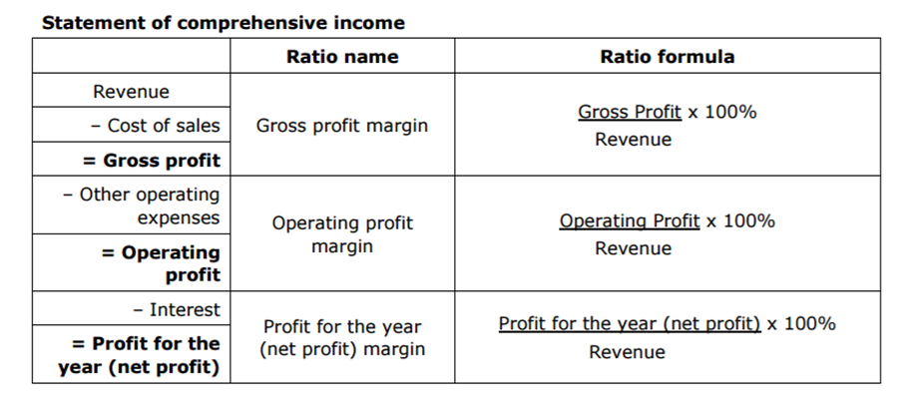

Slide 40
Sample Edexcel A2 questions

Slide 41
Case study for question 1 – from 2017 paper
Notes:
Borrowed an AS question

Slide 42
Sample question 1
[4]
Knowledge 2
Application 1
Analysis
1

Slide 43
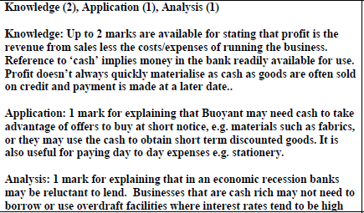
Answer sample question 1

Slide 44
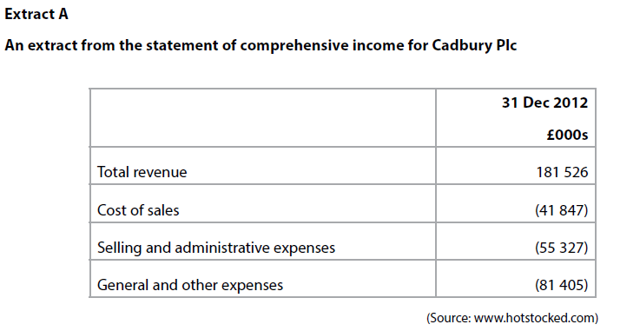
Case study for question 2

Slide 45
Sample question 2
Knowledge 1
Application 3

Slide 46
Answer sample question 2

Slide 47
Glossary
Basic profit formula; P = TR-TC
Gross profit formula; GP = TR-COS
Operating profit formula; OP= GP - expenses
Net profit formula; NP = OP – interest
Gross profit margin formula; GP / SR x100
Operating profit margin formula; OP / SR x 100
Net profit margin formula; NP / SR x 100

