Slide 1
Edexcel A2 Business
1.5.5 Business Choices
Revisionstation

Slide 2
Worksheet

Slide 3
From Edexcel
a) Opportunity cost
b) Choices and potential trade-offs

Slide 4
Starter
James is an entrepreneur. He sells hats at festivals on a stall. He now wants to grow his business.
He has a decision to make:
OPTION A: he can rent another stall
OPTION B: he could sell his hats, on another stall through another trader, who will charge him commission for every hat sold
He cannot do both – which should he choose?
Justify your decision

Slide 5
Possible answer to starter
OPTION A – If James opens another stall he will have the cost of the rent and the cost of paying a member of staff to work the stall (he cannot be on both stalls at once). However he can offset this with the extra revenue that he will bring in and the profit that he could make could double.
OPTION B James could pay another trader commission to sell his stock, he won’t have the cost of the staff or the stall and it’s a lower risk as he will only pay out on what the trader sells. However he will get lower revenue and lower profits.
Opportunity cost of OPTION A is the loss of revenue and profit made by taking OPTION B
Opportunity cost of making OPTION B is the loss of revenue and profit made by taking OPTION A

Slide 6
Opportunity cost

Slide 7
Definition: Opportunity cost
Opportunity cost can be measured as the cost of foregoing the next best alternative
In other words, if there is another alternative, then if this is not chosen this is also cost to the business – an opportunity cost

Slide 8
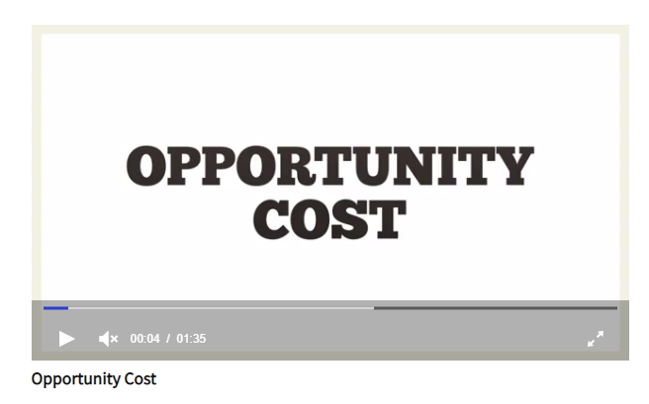
Opportunity cost
The problem:
Land, labour, capital and enterprise are limited resources
However our wants are unlimited
This causes scarcity
As business people we need to decide how best to use those scarce resources, we make choices
When making important decisions in business, the cost of not selecting an alternative is an opportunity cost
Watch the video can you explain opportunity cost now?

Slide 9
Choices and potential trade-offs

Slide 10
Definition: Trade-off
A trade-off is when less of one is exchanged for more of another. It is also known as a compromise.

Slide 11
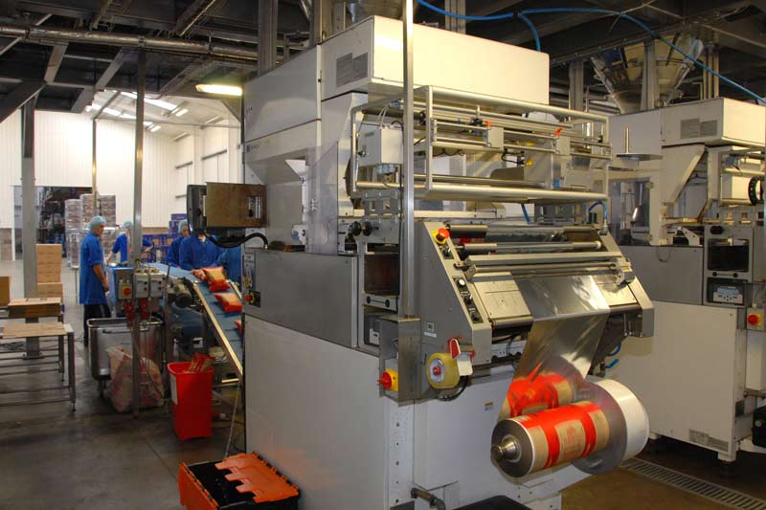
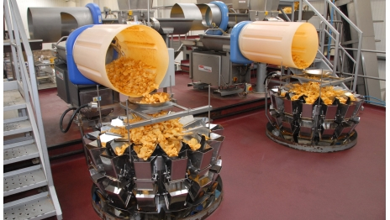
Trade-off defined
In business to achieve two things may not be possible, as there is only so much capital and only so much of other resources.
It may mean that the business has to complete less of one thing e.g. marketing in order to do more of something else e.g. new machinery for production
When there are choices, a compromise must be made and in business this is called a trade-off

Slide 12
Trade-off example scarves
Imagine you want to start a shop selling beautiful scarves imported from Ethiopia, made by disabled workers, but then find the import tariffs into the UK are too high. This would increase your costs and push up your prices for silk scarves.
However, you have found an alternative supplier in Europe the prices are cheaper and you will make more profit, but the quality is not as good as the Ethiopian scarves
What do you do? What choice do you make?
What is a possible trade-off and what are the potential opportunity costs in this business scenario?
Notes:
Trade-off sell less Ethiopian silk scarves and more European scarves.
Opportunity costs is the lost ethical benefit of selling the Ethiopian scarves, which could be a USP and help lots of disabled workers in Ethiopia.

Slide 13
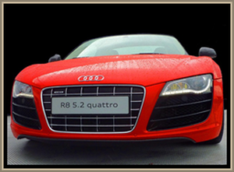
Trade-off example cars vs vans
One factory can produce either cars or vans, or some of each with the limited resources available to it
To increase car production, resources must be shifted away from van production, and vice versa
Can you explain the opportunity cost and trade-off in this trade-off example?
Notes:
This is obviously an example from industry.
You could add an example from the home. For example, the kids want cake and cookies, and parents must set up to produce. How many cakes and how many cookies?
Or an example from government. WWII gives us a good one: rationing consumer goods to boost production of military goods.

Slide 14
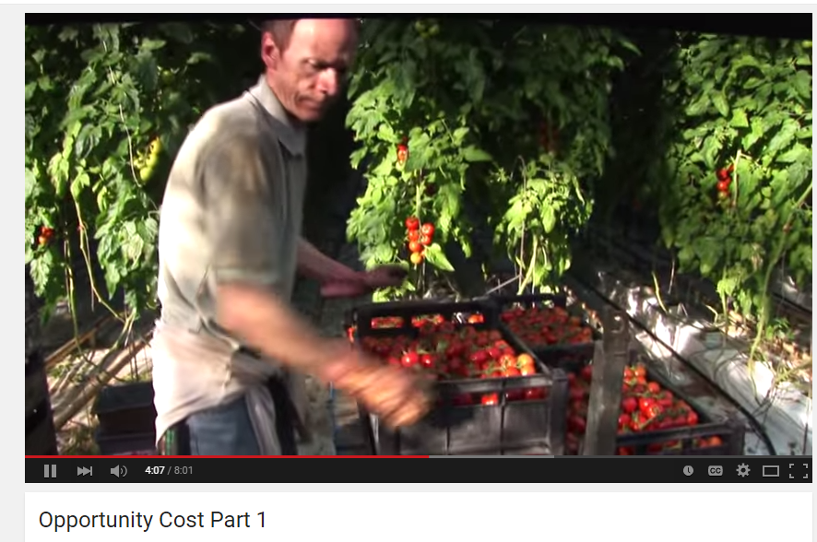
Opportunity cost video part 1

Slide 15
Opportunity cost video part 2

Slide 16
Opportunity cost part 3

Slide 17
Sample Edexcel A2 questions

Slide 18
Case study for question 1 – from 2017 paper

Slide 19
Sample question 1
Knowledge 2
Application 2
Analysis
2
Evaluation
2

Slide 20
Answer sample question 1

Slide 21
Answer sample question 1

Slide 22
How to level sample question 1
Notes:
Hi – the MMA crossed out the text on this levelling matrix not me.

Slide 23
Glossary
Opportunity cost; the cost of the loss of the item not chosen, or the profit from the goods not produced, the cost of foregoing the next best alternative
Trade-off; a compromise

