Slide 1
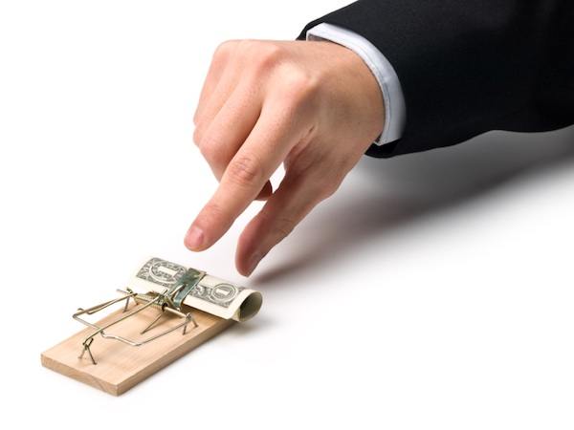
Risk & Reward

Slide 2
Risk & Reward
Roulette simulator

Slide 3
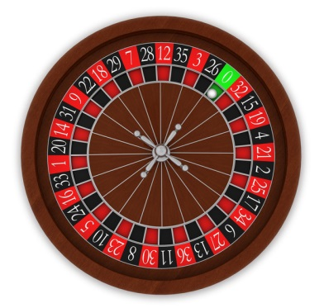
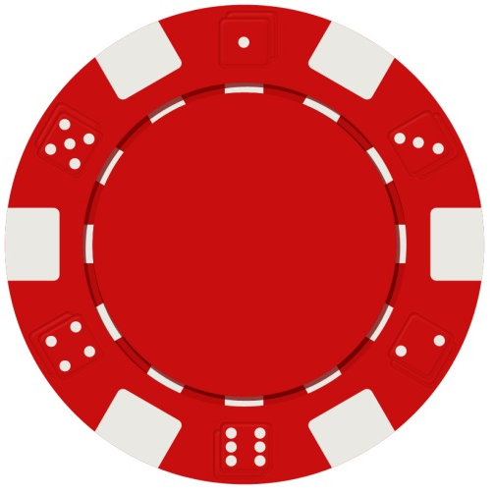
Place you bets….
There will be 3 spins of the wheel.
You can place 3 bets of any amount, anywhere on the table.
The odds are as follows:
Individual numbers: 36/1
1st, 2nd 3rd 12: 3/1
Red/black/odd/even: 2/1
Total
Loses or Winnings
1
Amount:______
Position:______
Win or Lose
2
Amount:______
Position:______
Win or Lose
3
Amount:______
Position:______
Win or Lose

Slide 4
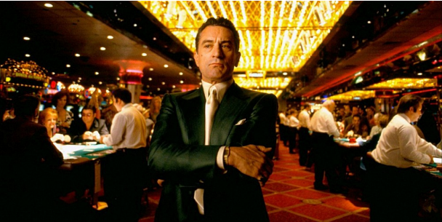
My prediction is: most of you lost!
In the casino, the house always wins. The odds are stacked in our favour!
Look at the examples below, what can you do to reduce the risk of failure?

Slide 5
Setting up a new business
Ways to reduce risk
1.
2.
3.
4.
5.
Low Risk
High Risk

Slide 6
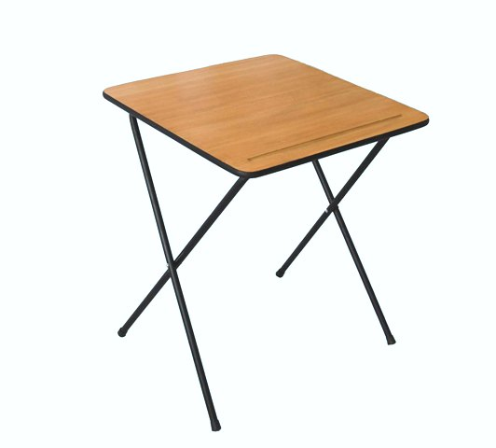
Succeeding in your exams
Ways to reduce risk of failure
1.
2.
3.
4.
5.
Low Risk
High Risk

Slide 7
Expanding a business
Ways to reduce risk of failure
1.
2.
3.
4.
5.
Low Risk
High Risk

Slide 8
Entering an international market
Ways to reduce risk
1.
2.
3.
4.
5.
Low Risk
High Risk

Slide 9
Employees becoming demotivated
Ways to reduce risk
1.
2.
3.
4.
5.
Low Risk
High Risk

