Slide 1
The BIG Idea
2.5.3 The competitive environment
Today we will:
Competition and market size
Definition - A competitive environment involves measuring the directness and toughness of the competition within a market or sector within a market
Notes:
Students identify key words to underline

Slide 2
What is a competitive market?
There is a presumption that a competitive market:
- is good for consumers, innovation and the economy
will be more intense with more competitors
However, a market with 50 businesses may not be very competitive if one of them has 60% market share
Businesses do not like fierce competition and may use predatory pricing, USP and entry barriers to entry keep competition to a minimum

Slide 3
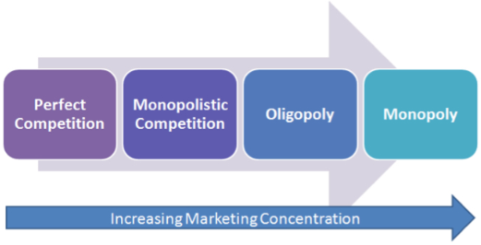
The degree of competition
Very few, if any, businesses operate without facing competition. It is not enough to understand what customers value. A business has to be able to deliver customer value better than the competition.
The ability to do this is heavily influenced by the structure of the market in which a business operates. The more competitive a market is – the harder the task becomes.
In economics, there are four main categories of market structure:

Slide 4
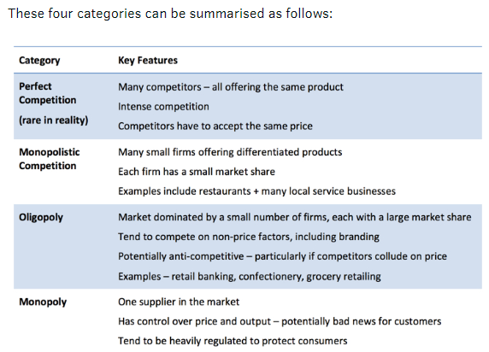

Slide 5
A monopoly in its purest form is when one business dominates the whole market – it has 100% concentration. In reality, the CMA describe a monopoly as any firm with more than 25% of the industry's sales.
Oligopoly collusion - When a few large firms dominate a market there is always the potential for businesses to seek to reduce uncertainty and engage in some form of collusive behaviour

Slide 6
Responses of businesses to a changing competitive environment
Price cutting - may help to maintain market share but at potentially lower profit margins. Refer to PED as well.
Increase product differentiation – Increase the extent to which customers perceive your product to be different and insulate the business from having to compete head on with its rivals
Design – eye catching design can add value to a product
Unique product features – MPG, distance travelled on one charge
Collusion – work together in order to avoid damaging consequences of fierce competition. This is common, but can lead to significant legal penalties.

Slide 7
Introduction
You look at the nature of competition and business strategy in detail later in your studies. This topic provides a brief introduction to some key concepts.
What is Competitiveness?
Competitiveness is the ability of a business to deliver better value to customers than competitors.

Slide 8
What is Competitiveness?
Competitiveness is the ability of a business to deliver better value to customers than competitors.
If a business is able to be more competitive than the rest of the market or industry over a sustained period, it is said to have competitive advantage:
The ability of a business to add more value for its customers than its rivals and attain a position of relative advantage
A situation where a business has an advantage over its competitors by being able to offer better value, quality and/or service

Slide 9
Competition and Market Structure
The nature of competition in a market is determined by a variety of factors, including:
• The extent of current competition
• The potential for new businesses to enter the market
• The extent to which a business produces a similar product (indistinct from rivals) or a differentiated product (distinct from rivals)

Slide 10
Threat of new entrants
The threat of new businesses entering a market is a particularly important factor influencing the extent of competitive rivalry:
High profits will tempt newcomers to enter a market and this will drive down prices and profits
Therefore the maintenance of market power depends upon erecting and maintaining barriers to market entry

Slide 11
Barriers to Market Entry
What can existing competitors in a market do to dissuade new businesses from trying to enter a market?
Product differentiation (including brands)
– Will act to increase customer loyalty making it difficult for newcomers to gain market share
Control access to raw materials and distribution channels
– A lack of access will make it difficult for newcomers to enter the market
Retaliation by established products
– E.g. the threat of price war
– Will act to discourage newcomers

Slide 12
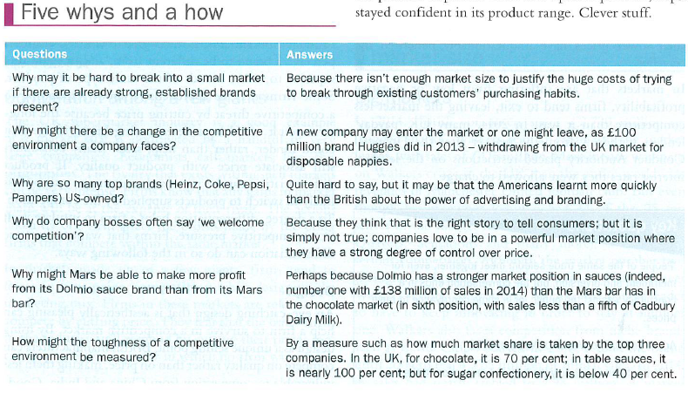

Slide 13
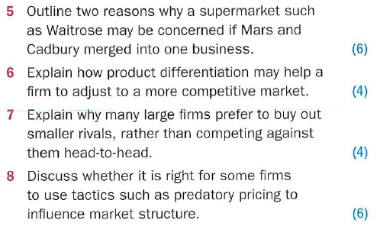

Slide 14
