Slide 1
Who is telling the truth?
In groups of 4/5 create a short scene that uses at least 3 dramatic strategies. You should focus on the following.
Creating a character that is not yourself…
Voice: P, P, P, P, P
Movement
Facial Expressions
Where you are on stage..
Levels
Other characters
The Audience.

Slide 2
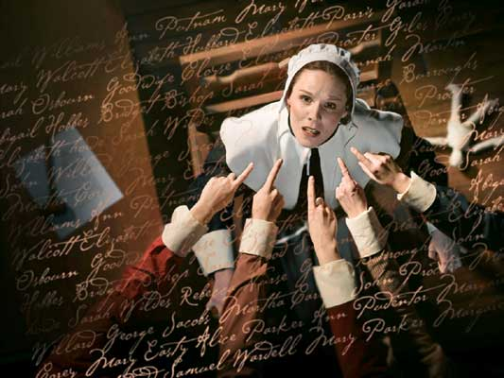
Who is telling the truth?

