Slide 1
Edexcel A2 Business
2.3.2 Liquidity
Revisionstation

Slide 2
Calculators will be needed for this topic

Slide 3
Worksheet

Slide 4
From Edexcel
a) Statement of financial position (balance sheet):
measuring liquidity:
calculating current ratio and acid test ratio
ways to improve liquidity
b) Working capital and its management: the importance of cash

Slide 5
Starter
You owe some people money, this is your financial liability
Which one item that you own do you think would be the quickest to sell if you needed to raise cash in a hurry?
This is your most liquid item; it is an asset to you
You can turn your assets into cash to pay your liabilities
Notes:
Most students may say phone or xbox possibly a posh watch, cars take too long to sell

Slide 6
Definition: Liquidity
The ability of a business to turn its assets into cash to pay its current liabilities

Slide 7
Liquidity – turning assets into cash
The ability of a business to turn its assets into cash
The least liquid assets are listed at the top of the statement of financial position (balance sheet) – premises and specialist machinery for example may take a while to sell, while stock is easy to sell on
Cash is the most liquid asset of all

Slide 8
Statement of financial position

Slide 9
Definiton: Statement of financial position (balance sheet)
A PLC (Public Limited Company) or a LTD (Private Limited Company) business have to publish their accounts by UK law
One of these accounts is the statement of financial position. In older text books and on the Internet you may also see it called the balance sheet
In the exam you will NOT need to write one, but you will need to be able look at an extract from one and make some calculations

Slide 10
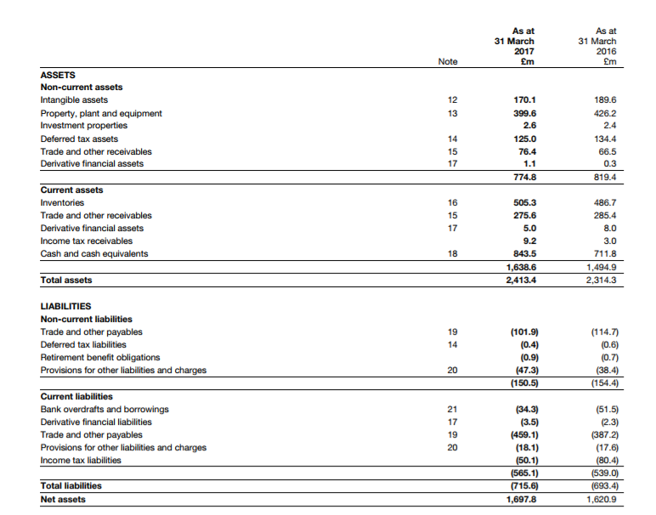
This is the statement of financial position for Burberry for 2016 and 2017
Why do the liabilities figures appear in brackets?
Notes:
Students will need this to carry out the calculations in this slideshow

Slide 11
Statement of financial position - the exam version
In the exam you are given a much simpler version to work with. This is an example from the 2017 paper 3.

Slide 12
Measuring liquidity
A business owner and their investors can use liquidity as a measure of how healthy the business is, this it doesn’t have too many debts and that it can easily pay its bills
So we measure liquidity to find this out
The tools to measure liquidity (ability to pay bills) is the statement of financial position and two key ratios
Current ratio
Acid test ratio

Slide 13
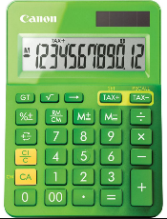
Current ratio formula
Current assets
______________
Current liabilities
Write down this formula and get out your calculator
and prepare to try some examples

Slide 14
Current ratio calculation
Use the statement of financial position to calculate the current ratio for Burberry for 2016 and 2017
Careful to only use the current asset and current liability figures and not the totals
Express your answer as a ratio to 1
2016 | :1
2017 | :1

Slide 15
Current ratio answer
2016 | 2.77:1
2017 | 2.90:1
What conclusions can you make from these ratios?
Some answers on the next slide

Slide 16
Current ratio analysis
Burberry has a current ratio of 2.9:1
This means that for every £1 of debts they have £2.90 of assets that they can quickly turn into cash
The Ideal ratio is 1.5:1, lower than this and there is not enough money to pay bills
Higher than this and there is too much money tied up in stock – but with Burberry being a high end retailer the current ratio looks about right for holding high value of stock

Slide 17
Acid test ratio formula
Current assets - inventory
_______________
Current liabilities
Write down this formula and get out your calculator
and prepare to try some examples

Slide 18
Acid test ratio calculation
Use the statement of financial position to calculate the acid test ratio for Burberry for 2016 and 2017
Careful to only use the current asset and current liability figures and not the totals
Express your answer as a ratio to 1
2016
2017

Slide 19
Answer
2016 | 1.87:1
2017 | 2.01:1
Now that the inventory or stock has been removed – what conclusions can you make about the ability of Burberry to meet their day-to-day bills?

Slide 20
Acid test conclusions
This is also known as the quick ratio and is a harsher test of liquidity because you cannot guarantee to sell all of the stock. Stock can also spoil, become obsolete or just go out of fashion.
If a business has an acid test ratio of less than 1:1 then its current assets (minus stocks) do not cover its current liabilities.
This could mean a problem for the business
Again some retailers with strong cash flow and fast moving stocks may have an acid test of 0.4:1 and be fine, it depends on the industry

Slide 21
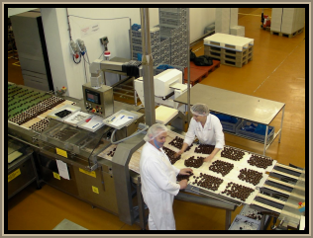
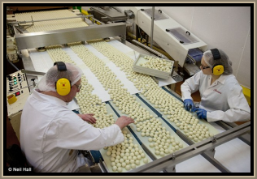
Ways that liquidity can be improved
A business could reduce the amount of stocks that it holds, so finished goods need to be dispatched faster to customers
A business could reduce the credit period offered to customers, for example insist that customers pay in 30 days not 90
A business could also pay suppliers later on agreed credit terms
Increase borrowing long term and clear the short term debts

Slide 22
Working capital and its management: the importance of cash

Slide 23
Definition: Working capital
Working capital means the day-to-day finance needed in a business and can be calculated by CA-CL

Slide 24
Working capital cycle

Slide 25
Working capital cycle
The longer this cycle takes, the longer the cash is tied up in stock or owed by debtors
How can a business improve their working capital cycle?
Cash
Cash paid by debtors for goods or services bought
(current asset)
Sales
Stock purchased from suppliers on credit
(current liability)
Notes:
They can pay their suppliers later or demand earlier payment from their customers

Slide 26
Revision Video

Slide 27
Sample Edexcel A2 questions

Slide 28
Case study for question 1
Notes:
Borrowed an AS question

Slide 29
Sample question 1
Knowledge 1
Application 3

Slide 30
Answer sample question 1

Slide 31
Case study for question 2
Notes:
Borrowed an AS question

Slide 32
Sample question 2
Knowledge 1
Application 3

Slide 33
Answer sample question 2

Slide 34
Glossary
Liquidity; The ability of a business to turn its assets into cash to pay its current liabilities
Balance sheet; a snapshot valuation of the business, what it owes, what it owns and owner equity
Current assets (CA); items the business owns that will become cash within one year e.g. stock or debtors
Current liabilities (CL);items the business owes to others that must be paid within one year e.g. credit from suppliers
Current ratio; CA / CL
Acid test ratio; CA – stock / CL
Working capital; day-to-day money needed by a business to pay its bills on time

Slide 35
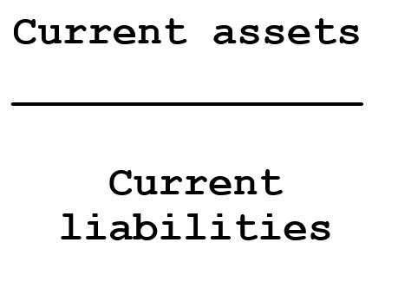
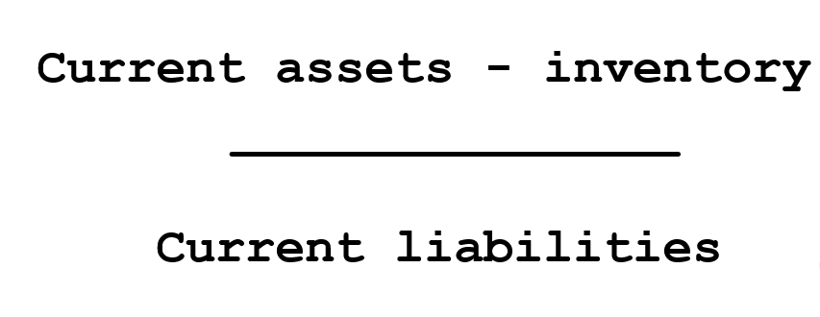
These are the ratios you need to learn for this unit
Which is the formula for the current ratio and which is the formula for the acid test ratio?

