Slide 1
Edexcel A2 Business
4.1.4 Protectionism
Revisionstation

Slide 2
Worksheet

Slide 3
From Edexcel
a) Tariffs
b) Import quotas
c) Other trade barriers:
government legislation
domestic subsidies

Slide 4
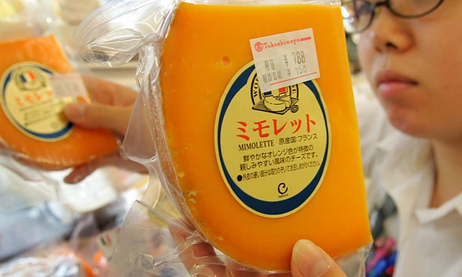
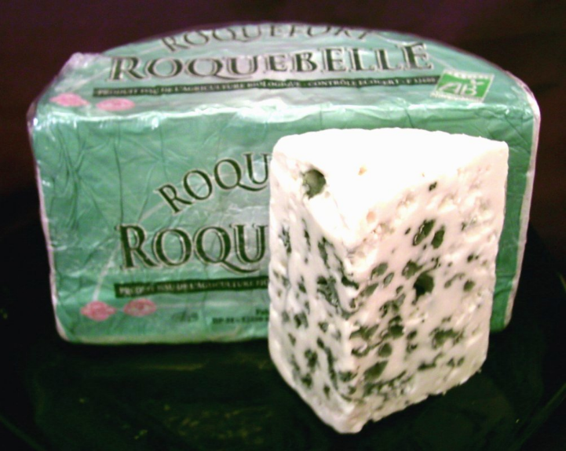
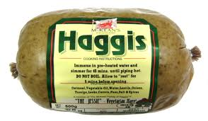
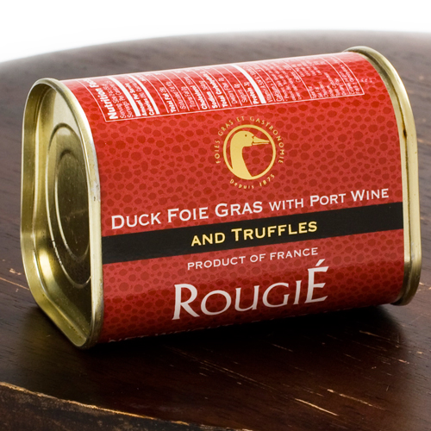
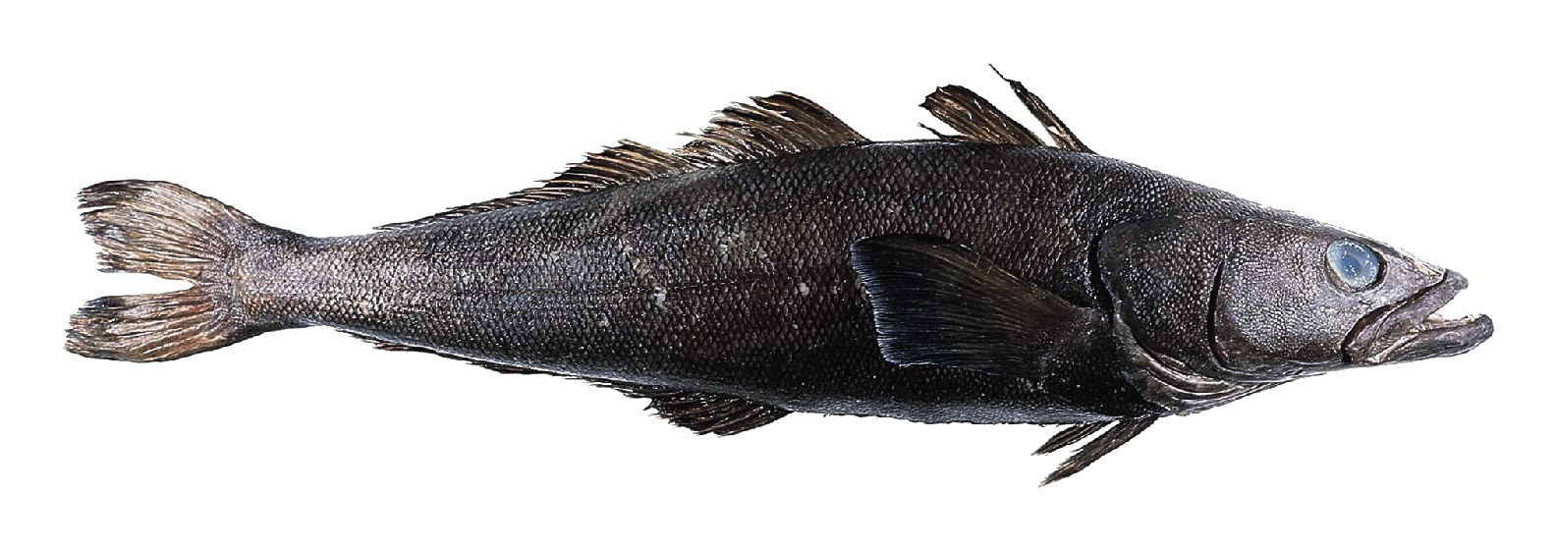
Starter – imports banned or not banned?
A
B
C
F
E
D
Notes:
Answer is they are all banned somewhere – legal restrictions is to reduce trade in these items in other countries
A Mimolette cheese from France, Banned in the USA – made from mites
B French Roquefort cheese is banned in New Zealand
C Haggis is banned in the USA – made from a sheep’s stomach
D Foie Gras banned in USA as it involves force feeding fat to ducks
E flick knife – banned from being imported into the UK
F Artic toothfish is banned in New Zealand: http://www.customs.govt.nz/features/prohibited/imports/Pages/default.aspx

Slide 5
Protectionism defined
Protectionism is the theory or practice of shielding (or protecting) a country's domestic industries from foreign competition by taxing imports, imposing quotas or passing laws

Slide 6
Reasons for protectionism

Slide 7
Reasons for protectionism
It is human nature to want to protect what is ours
Protectionism is a government‘s actions to protect the businesses and interests of their own nation
Government is looking to protect what is theirs

Slide 8
Protection for domestic industries
The main reason that a government will seek to put in place protectionist policies is to protect their domestic industries
For example the French government will seek to protect French industries so may place tariffs and quotas on imports of wine and cheese
This stops the French markets being flooded with cheap imports, which will affect the sales of the domestic businesses

Slide 9
Tariffs

Slide 10
What is a tariff?
A tariff is a tax placed on an import to increase its price and decrease its demand
Tax can be imposed by governments to raise revenue and to restrict imports
A tariff is likely to raise the final price to the consumer – therefore a fall in demand for the goods
Consumers will switch consumption to domestic goods

Slide 11
Tariffs – impact on business
Imposing a tariff will help a country to:
Protect their fledgling (new) domestic industries from foreign competition
Protect their aging and inefficient industries from foreign competition
However:
If a business faces having to pay stiff tariffs they may have to reduce production and this can mean job losses

Slide 12
Tariffs – 3 reasons they are imposed
#1 To raise tax revenue
Poorer countries may impose heavy tariffs on imports to raise much needed funds for healthcare and education
#2 For environmental reasons
Tariffs are sometimes only placed on goods that have negative externalities e.g. cigarettes (sin tax)
#3 Protectionism – see the video

Slide 13
Advantages of tariffs
Domestic produced goods do not incur the tariff and so are likely to be cheaper
Tariff protection allows domestic businesses to sell more because they gain a price advantage compared to imports
Domestic producers gain price advantage
It can ensure better job security
It can raise important tax revenue for government which can be spent possibly on infrastructure

Slide 14
Disadvantages of tariffs
Some products, even with tariff cost added, do not put off potential customers willing to pay for unique or unusual imported products
Tariffs may just increase the costs to consumers
Other countries may retaliate by imposing their own tariffs on imports

Slide 15
Import quotas

Slide 16
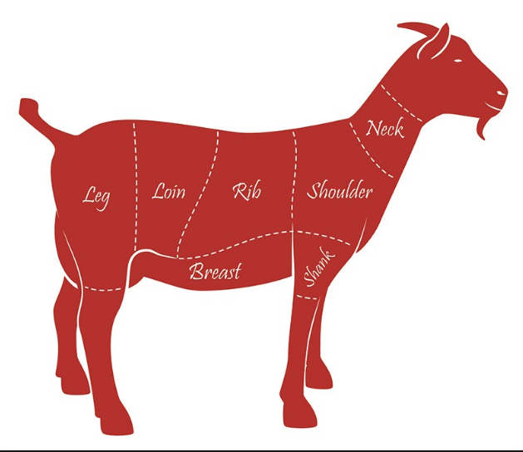
What is an import quota?
A quota is a physical limit on the quantity of goods imported or exported for example only 10,000 units a year
Imposing a limit on the quantity of goods that are imported will increase the share of the market available for domestic products (made in the home country)
New Zealand is allowed to import up to 230,000 tons of sheep and goat meat a year to the EU

Slide 17
Why are quotas imposed?
When an import quota is set, it allows a country to be sure of the amount of the good imported from the foreign country
When there is a tariff, if the supply curve of the foreign country is unknown, the quantity of the good imported may not be predictable, quotas are predictable because the actual amount is known

Slide 18
Uses of import quotas
Import quotas are imposed to protect jobs of domestic producers
Import Quotas are also imposed as a bargaining chip to be used in negotiations on trade
Other uses for quotas are to protect strategic industries such as defence and agriculture. In market environments where imports are on the rise, quotas are more protective than tariffs.

Slide 19
Advantages of import quotas
#1 protects domestic industries e.g. USA calling for quotas on steel imports
#2 safeguards jobs in domestic industries
#3 Benefit to the customers, the price of imported goods rise so domestic goods appear cheaper and better value in comparison

Slide 20
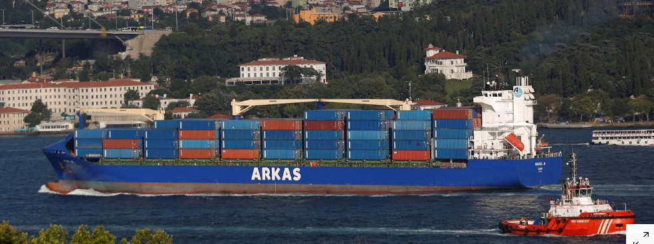
Disadvantages of quotas
When one country uses quotas, its trading partners do the same and the end result is less exporting opportunity for all producers and higher prices for all consumers.
Quotas are also complex for the country using them. They require a lot of paperwork indicating exact amounts of products for each country facing a quota.
It is also difficult to measure the precise degree of protection quotas offer.

Slide 21
Other trade barriers

Slide 22
Government legislation
Sometimes a country will not be able to set tariffs or quotas because of trade agreements or membership of a trade bloc, this means they need to come up with other ways of protecting their domestic industries from floods of cheap imports
They can do this through legislation e.g. No fakes, safety of toys etc.

Slide 23
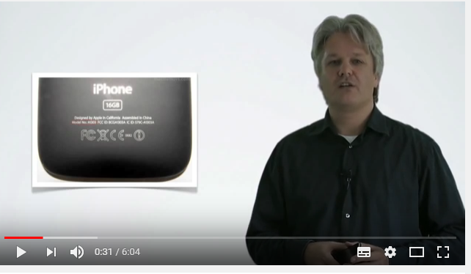
Advantages of government legislation
Government legislation can be a very powerful tool in preventing fake imports into countries
For example any toys imported into the UK must have a CE mark
This indicates that the product conforms to EU safety regulations
The added benefit is it means customers can trust the products that they are buying are genuine

Slide 24
Disadvantages of government legislation
Every import into the UK cannot be checked 2% are fake (according to the OECD) so no matter how many laws a country has it cannot prevent ALL fakes from arriving on their shores
The profits go to organised crime and can be in any sectors including medicine, machinery and clothing

Slide 25
Domestic subsidies
Subsidy is a way of a government protecting their domestic markets
Money is given to local producers to make their goods cheaper on the domestic market
This artificially raises the price of foreign goods relative to domestic goods therefore reducing demand for them

Slide 26
Subsidy example - CAP
Europe has a system of agricultural subsidies. This is called the common agriculture policy or CAP.
“Agriculture is at the heart of our daily life, vital to the economy and society. And farming cannot exist without farmers. They produce high quality, safe food for more than 500 million EU citizens. They also help tackle climate change and preserve the diversity of agriculture”*
Notes:
Source: http://ec.europa.eu/agriculture/cap-for-our-roots/cap-for-schools/index_en.htm

Slide 27
Advantages of domestic subsidies
Encourages businesses to increase their production, this can lead to more jobs being created and tax paid back to the government
Can give domestic producers first mover advantage when exporting to emerging markets (BRICS, MINT)
Can help domestic businesses to gain economies of scale from extra production

Slide 28
Disadvantages of domestic subsidies
Domestic subsidies are a form of protectionism and so is open to retaliation from other nations in return. This may mean higher tariffs or quotas on our exports.
Subsidies essentially encourage business activity which would be unprofitable and inefficient without the government financial hand out in the form of the subsidy

Slide 29
Sample Edexcel A2 questions

Slide 30
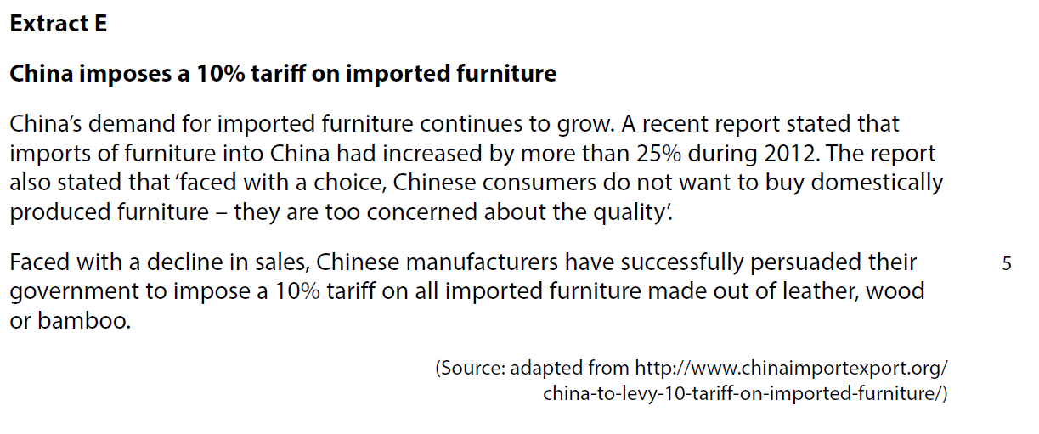
Case study for question 1

Slide 31
Sample question 1
Knowledge 2
Application 2
Analysis
3
Evaluation
3

Slide 32
Answer sample question 1

Slide 33
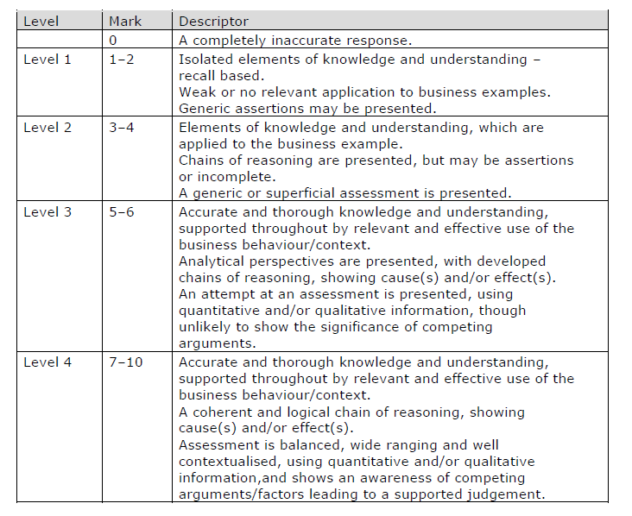
How to level sample question 1

Slide 34
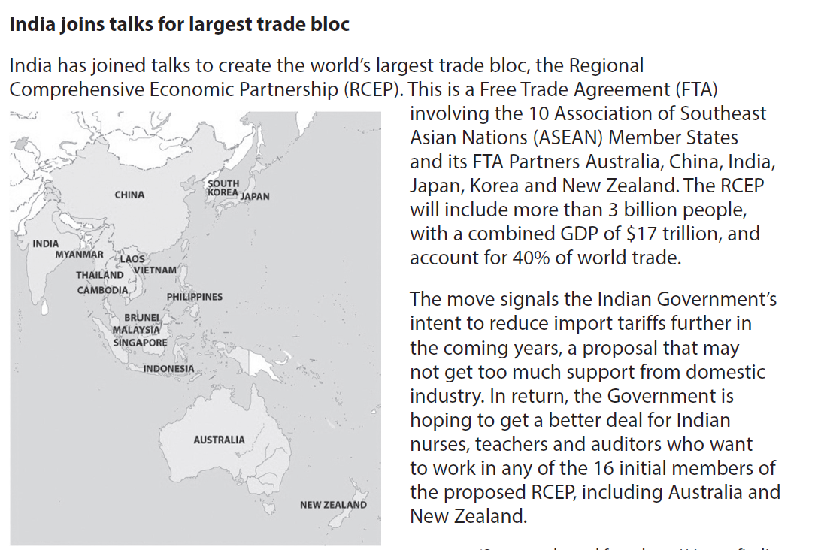
Case study for question 2

Slide 35
Sample question 2
[6]
Knowledge 2
Application 2
Analysis
2
Notes:
Legacy paper which is why it’s a 6 mark question - no 6 mark questions on the new qualification

Slide 36
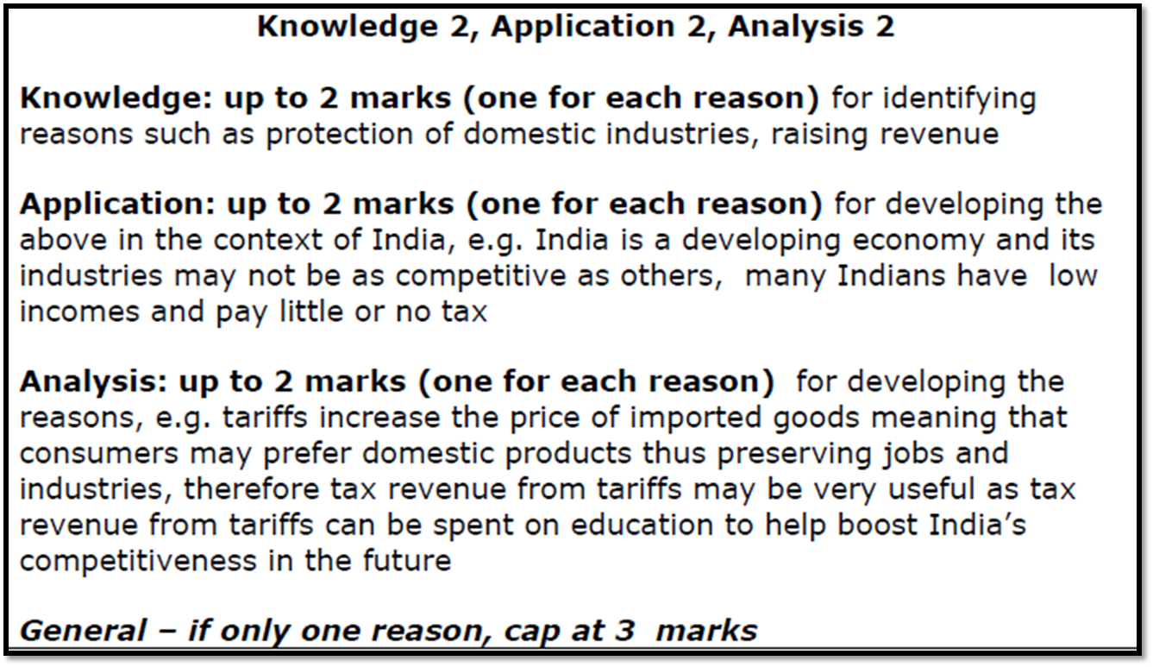
Answer sample question 2

Slide 37
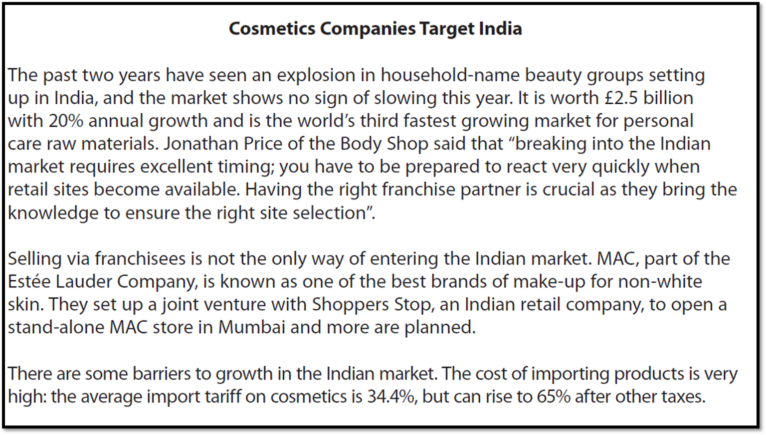
Case study for question 3

Slide 38
Sample question 3
[6]
Knowledge 2
Application 2
Analysis
2
Notes:
Another legacy 6 mark question

Slide 39
Answer sample question 3

Slide 40
Glossary
Tariff; A tariff is a tax on imports or exports
Quota; a limited quantity of a particular product which under official controls can be produced, exported, or imported.
Trade barrier; These are measures that governments or public authorities introduce to make imported goods or services less competitive than locally produced goods and services.
Protectionism; This is the economic policy of restraining trade between states (countries) through methods such as tariffs on imported goods, restrictive quotas, and a variety of other government regulations designed to allow fair competition between imports and goods and services produced

