Slide 1
Edexcel A2 Business
4.1.3 Factors contributing to increased globalisation
Revisionstation

Slide 2
Worksheet

Slide 3
From Edexcel
a) Reduction of international trade barriers/trade liberalisation
b) Political change
c) Reduced cost of transport and communication
d) Increased significance of global (transnational) companies
e) Increased investment flows (FDI)
f) Migration (within and between economies)
g) Growth of the global labour force
h) Structural change

Slide 4
Starter
Which of these factors have not influenced globalisation?
Communication systems
Fishing
Television
Internet
Smartphones
Notes:
2 fishing

Slide 5
Globalisation defined
Globalisation is the process by which the world is becoming increasingly interconnected as a result of massively increased trade and cultural exchange.
The biggest companies are no longer national firms but multinational corporations (MNCs) with subsidiaries in many countries.
Global markets are international markets created by firms exporting, importing or offshoring. (Edexcel)
Notes:
*bbc bitesize

Slide 6
Reduction of international trade barriers/trade
liberalisation

Slide 7
Trade liberalisation defined
Trade liberalisation is the process by which international trade is made easier through relaxation of tariffs and barriers

Slide 8
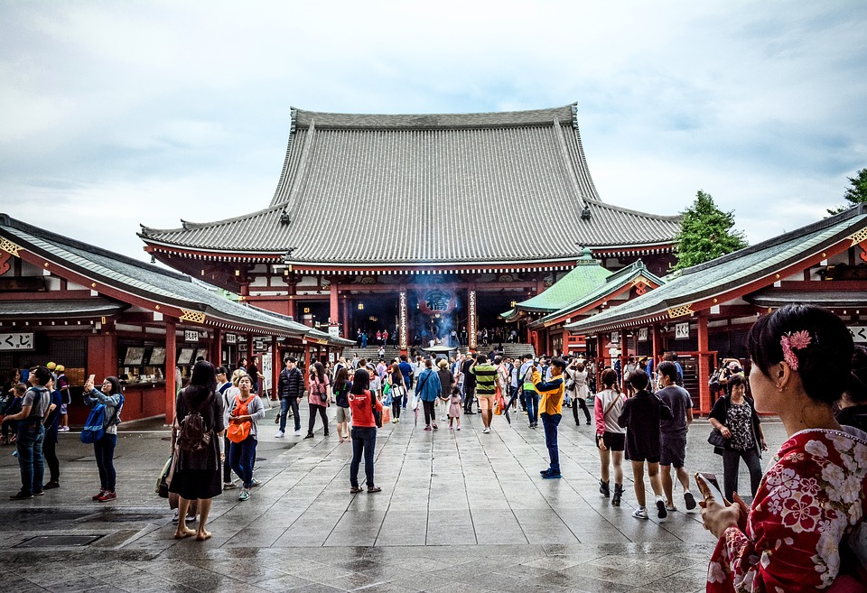
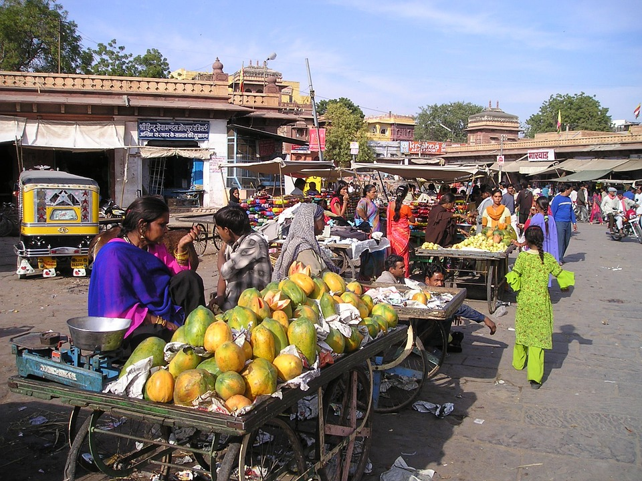
Trade liberalisation a quick history lesson
In 1947 General Agreement on Tariffs and Trade (GATT) was created
The world felt the benefits of many rounds of multilateral trade liberalisation
It raised living standards around the world as it allowed developing nations to export their goods to more industrialised ones, without having to pay huge tariffs
China and India experienced rapid growth through GATT

Slide 9
Benefits of GATT
GATT meant new jobs for unskilled workers
Countries enjoyed trade benefits of between $250 and $680 billion dollars income a year *
Labour intensive production manufacturers in developing nations, enjoyed comparative advantage because of low labour costs
Garment industry in India was very successful
Notes:
Source IMF

Slide 10
World trade organisation (WTO)
WTO was created by GATT in 1994 and exists to reduce barriers to trade and to ensure that countries keep to the agreements they have made
The organisation also deals with complaints between members, organising negotiations and, if necessary, making judgements against a country
It encourages trade liberalisation by operating a system of trade rules and by providing a forum for the negotiation of trade disputes

Slide 11
Trade liberalisation – why tariffs are imposed
Governments want to protect their domestic businesses so they use; tariffs, quotas and legal regulations to slow the rate of imports coming into a country
They might want to stop imports which will compete with state monopolies
Tariffs also generate important sources of income for poorer countries
Liberalisation is the easing or dropping of these measures

Slide 12
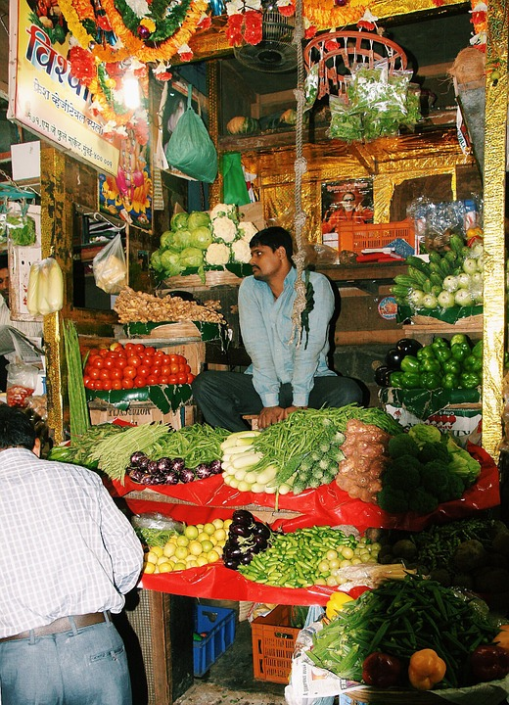
Benefits of trade liberalisation
Trade liberalisation is the process of taking down the barriers to trade between nations, removing quotas and tariffs
Consumers ultimately benefit because liberalised trade can help to lower prices and broaden the range of quality goods and services available – because they are now allowed to buy imported goods
India, Vietnam and Uganda have opened their economy in recent years

Slide 13
Benefits to business of trade liberalisation
Companies can benefit because liberalised trade diversifies risks and channels resources to where returns on investment are highest
Trade openness also means; competition, investment and increases in productivity
The main industries in Uganda that have benefitted: Sugar , beverages, tobacco , cotton textiles, cement and steel production
Since GATT Uganda has been able to export their coffee all over the world

Slide 14
Drawbacks of trade liberalisation
Competition can intensify between businesses, between nations and profit margins can end up being squeezed
Employment that has been created by lower trade barriers, may only be temporary or menial
Increased trade can mean pollution or over-cultivation of land to keep up with new demand
Developing nations can become economically dependent on industrialised ones

Slide 15
Political change

Slide 16
How political change has led to increased globalisation of markets
Politics used to be only carried out by individual governments who wanted to protect the interests of their country.
Politics now happens on a global scale with regular meetings between heads of state, summits, where power devolved to governments in trading blocs such as the EU and organisations such as the WTO.
This has led to less protectionist policies (tariffs quotas etc) and more open trade between nations. The planet is now one market.
WTO: The World Trade Organization (WTO) is the only global international organisation dealing with the rules of trade between nations. At its heart are the WTO agreements, negotiated and signed by the bulk of the world’s trading nations and ratified in their parliaments.

Slide 17
Who are the G7 countries?
The Group of 7 (G7) is a group consisting of Canada, France, Germany, Italy, Japan, the United Kingdom and the United States.
These countries are the seven major advanced economies as reported by the International Monetary Fund: the G7 countries represent more than 64% of the net global wealth ($263 trillion).
A very high net national wealth and a very high Human Development Index (HDI) are the main requirements to be a member of this group.
Every year there is a “summit” or meeting of all 7 nation’s leaders to discuss polices, including trade

Slide 18
Reduced cost of transport and communication

Slide 19
Globalisation caused by – reduced cost of transport
Video from BBC on globalisation HERE
Cost of transporting goods long distances between countries has been reduced by cargo containers
Can gain a business EOS as they can ship huge quantities at once
There are also cheaper air flights for business people needing to attend meetings in other countries

Slide 20
Globalisation caused by – reduced cost of communication
Communication and trade via the Internet has meant an explosion in globalisation and has been a huge catalyst for change
Messages can be sent instantly and for free via telecommunications systems such as e-mail or Skype
Far flung countries are no longer isolated from the global marketplace

Slide 21
Increased significance of global companies

Slide 22
Globalisation caused by – increased significance of MNCs
Globalisation has been caused by some large companies setting up or buying existing businesses in other countries
These businesses that operate in other countries are called MNCs and are from the developed countries (G7)
E.g. Starbucks, Coca Cola
Starbucks in Egypt

Slide 23
Revenue of the big 4* Task - match the revenue to the company
Revenue $215 billion
Revenue $30 billion
Revenue $46 billion
Revenue $24 billion
Notes:
*Correct at time of writing, taken from the Wikis
They are in the correct order

Slide 24
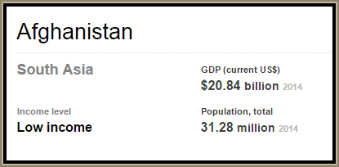
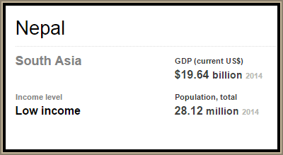
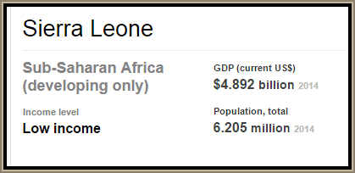
GDP of poorer nations
How do these GDP figures compare with the revenue figures of the MNCs?
Notes:
World bank data

Slide 25
Increased investment flows

Slide 26
Globalisation caused by - FDI
Businesses outside of important market trading blocs will invest in a business or set up production inside the trading bloc to get round tariffs, e.g. Honda, Nissan and Toyota manufacturing in the UK.
This has lead to globalisation, more companies in more countries.
Can give a country income generation, jobs, GDP growth, skills transfer, and the local businesses will experience the multiplier effect etc.

Slide 27
Migration

Slide 28
Globalisation caused by - migration
Many countries maintain extensive legal barriers to prevent foreigners seeking work or residency from entering their national borders.
But in the EU there is free movement of people between nations to work (at the moment, may change after Brexit)
Immigration provides a source of low income, able bodied workers

Slide 29
Growth of the global labour force

Slide 30
Globalisation caused by – Global labour force
First watch the video to understand what a labour market is
A global labour force is one that is free to seek better jobs in other countries
This can cause resentment from host nations, where citizens feel that their jobs are being taken by immigrants
See the UK job shortage occupation list HERE

Slide 31
Structural change

Slide 32
What is structural change?
Structural change is an economic condition that occurs when an industry changes the way it operates
As a country develops it moves away from primary sector business and employment (agriculture) to manufacture as it becomes industrialised
It can further develop into a knowledge economy – such as the UK – which specialises in tertiary businesses such as; banking, IT services and insurance

Slide 33
Globalisation caused by – structural change
The countries that are able to pull themselves out of poverty are those that move away from primary sector business (agriculture)
The economy grows as there is more productivity in the secondary sector – manufacturing increases and net incomes rise

Slide 34
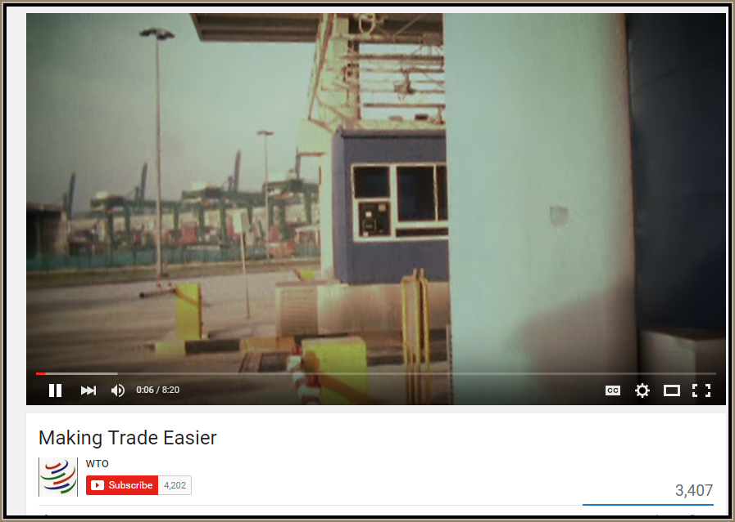
Revision Video

Slide 35
Sample Edexcel A2 questions

Slide 36
Case study for question 1

Slide 37
Sample question 1
Knowledge 2
Application 2
Analysis
3
Evaluation
3

Slide 38
Answer sample question 1

Slide 39
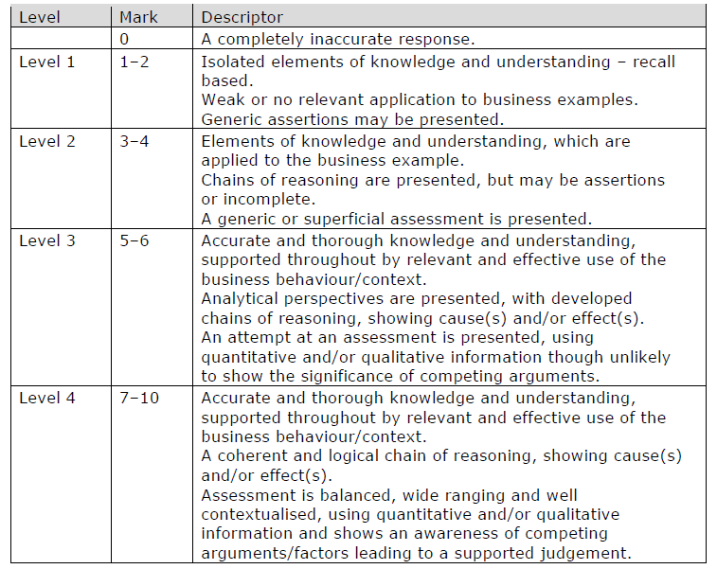
How to level sample question 1

Slide 40
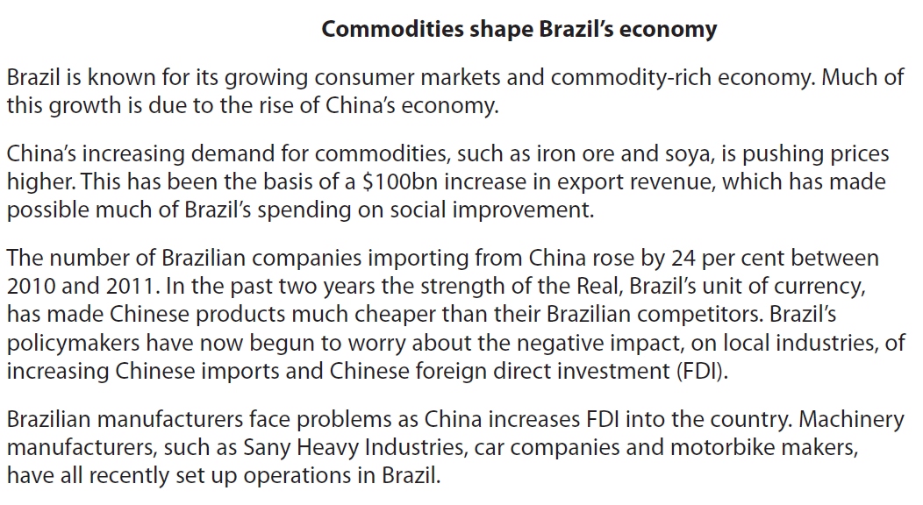
Case study for question 2

Slide 41
Sample question 2
[12]
Knowledge 3
Application 3
Analysis
3
Evaluation
3

Slide 42
Answer sample question 2
e.g. impact on economy such as consumer choice/prices, jobs, Brazilian businesses and government taxes
e.g. 2000 jobs created, income generation leading to economic growth.
e.g. Technology and skills transfer from ZTE may lead to improved domestic businesses and economic growth in Brazil.
e.g. damaging effect on domestic producers, competition and possible loss of production for domestic rivals, loss of control over key industrial sectors.
e.g. employment created may be only temporary or of menial variety,
profits repatriated, limited technology and skills transfer.
May depend if the FDI is short or long term and how extensive it is

Slide 43
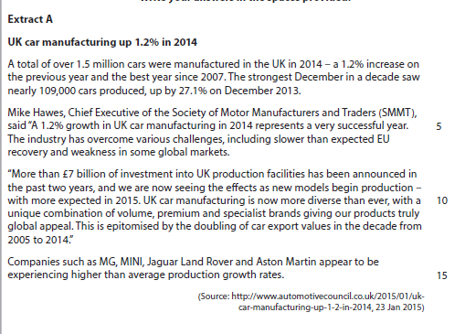
Case study for question 3

Slide 44
Sample question 3
Knowledge 2
Application 2
Analysis
2
Evaluation
2

Slide 45
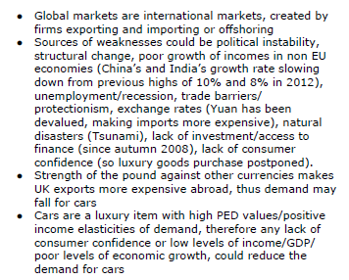
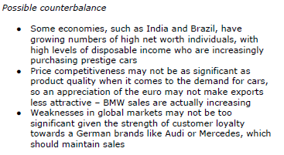
Answer sample question 3

Slide 46
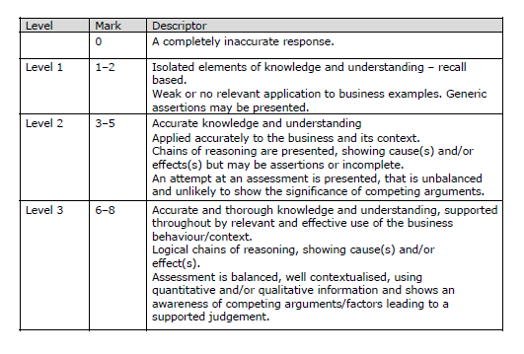
How to level sample question 3

Slide 47
Glossary
Liberalisation; The removal or reduction of restrictions or barriers on the free exchange of goods between nations. This includes the removal or reduction of both tariff (duties and surcharges) and non-tariff obstacles (like licensing rules, quotas and other requirements).
Transnational; A multinational company that works across national boundaries
FDI; Foreign Direct Investment is a controlling ownership in a business enterprise in one country by an organisation or business based in another country.
Migration; Human migration is the movement by people from one place to another with the intention of settling temporarily or permanently in the new location.
Structural change; refers to a long-term shift in the fundamental structure of an economy, which is often linked to growth and economic development. For example a primary sector nation (farming, fishing etc.) moves into becoming a secondary sector nation through manufacturing.

