Slide 1
Edexcel A2 Business
3.1.2 Theories of corporate strategy
Revisionstation

Slide 2
Worksheet

Slide 3
From Edexcel
a) Development of corporate strategy:
Ansoff’s Matrix
Porter’s Strategic Matrix
b) Aim of portfolio analysis
c) Achieving competitive advantage through distinctive capabilities
d) Effect of strategic and tactical decisions on human, physical, and financial resources

Slide 4
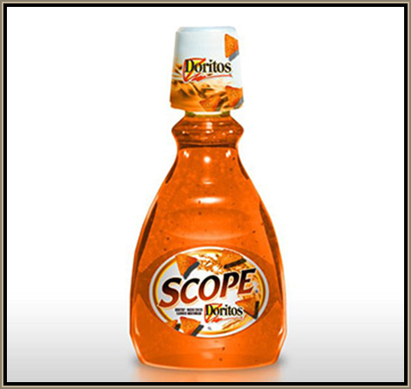
Starter
This is cheese flavoured mouthwash from Doritos – any thoughts on this product?

Slide 5
Corporate strategy defined
The overall scope and direction of a business and the way in which its various business operations work together to achieve particular goals

Slide 6
Ansoff’s Matrix

Slide 7
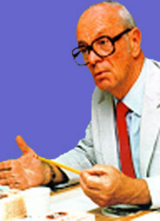
Who was Igor Ansoff?
Igor Ansoff was a business professor, who back in the 1950’s, had a theory relating to how a company looking for growth can choose their marketing strategy – all of which can be expressed in a diagram.
In an exam you have not got time to draw the diagram (in a more general question) but you can refer to it and you may be asked to discuss a given matrix in relation to the case study.
Use it as a tool for analysis, like a spanner or a wrench, a marketing question when analysed using the matrix will score you valuable marks so it’s worth learning and being able to apply to different companies.

Slide 8
Ansoff’s Matrix
 | Existing Product or Service | New Product or Service
Existing market
New Market

Slide 9
Ansoff’s Matrix
 | Existing Product or Service | New Product or Service
Existing market | Market Penetration (Low risk) Increase sales to the existing market, or penetrate it more deeply - sell more to the same customers – encourage them to order more often – loyalty schemes e.g. Boots Advantage card | Product or Service Development (moderate risk) New product or service developed for existing market: means R&D of new products to sell to your existing customers e.g. Herbal essences new shampoo
New Market | Market Development (moderate risk) Existing product or service sold to new market e.g. Colouring books sold to adults (see next slide) | Diversification (high risk) New product or service sold in new markets (new to the company): Tata Group consists of 116 diverse companies including; Jaguar, Land Rover, Tata Steel, Tetley Tea and Ginger Hotels.

Slide 10
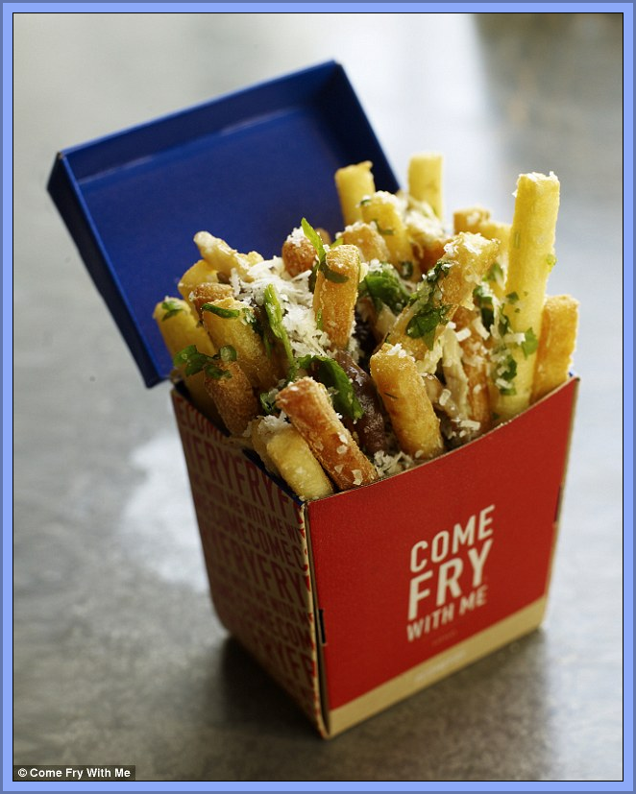
Ansoff’s Matrix examples
Daily Mail article on just chips restaurant here
Daily Mail article – on colouring books for adults here
Notes:
Old products new markets

Slide 11
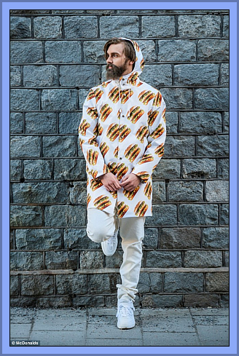
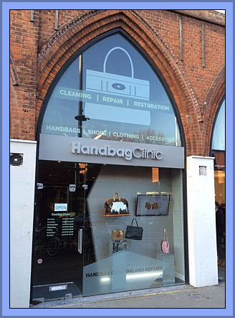
Ansoff’s Matrix examples
MacDonald’s launch clothing line see the article here
Handbag clinic, spa days for handbags launched here

Slide 12
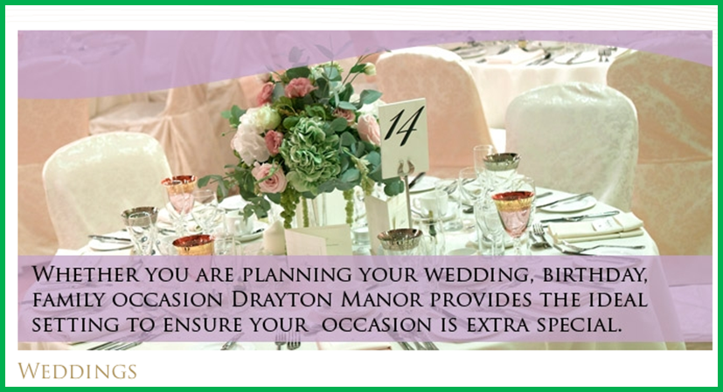
Uses of Ansoff’s Matrix – identify new markets
A business can identify all their current products or services and their markets, then consider their future options for expansion using the matrix shown, considering opportunities, associated costs, benefits and risks
Ansoff’s matrix helps to identify potential new markets or marketing strategies for a business
Drayton Manor has branched out into weddings

Slide 13
Limitations of Ansoff’s Matrix
The Ansoff’s matrix has some limitations;
It only shows part of the picture
It oversimplifies the market
Large MNCs may need thousands of sub options and strategies
Any organisation using Ansoff’s matrix as an analysis tool to help decide on a company strategy should also conduct a SWOT and a PESTLE analysis to get a better idea of the whole picture, to see the issues from more than one angle
Snapchat’s video-recording sunglasses

Slide 14
Porter’s Strategic Matrix

Slide 15
Porter’s Generic Strategies

Slide 16
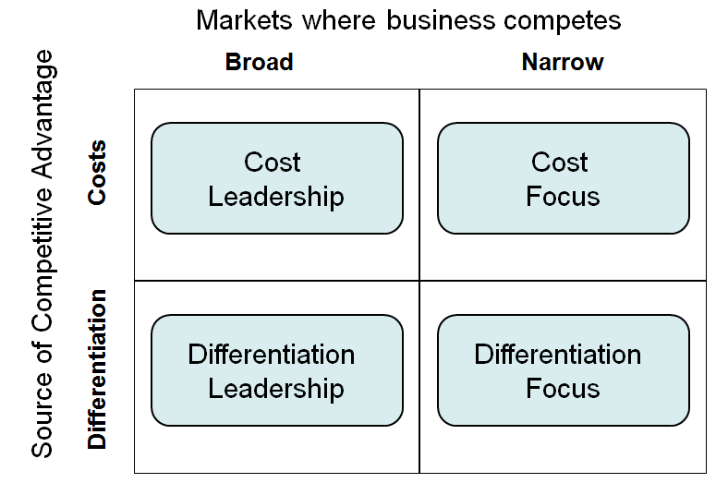
Porter’s Generic Strategies
Low Cost
Differentiation

Slide 17
Porter’s Strategic matrix
Competitive advantage
Lower cost
Differentiation
Broad
Target
Competitive scope
Stuck in
the
middle
Narrow
Target

Slide 18
Porter’s Strategic matrix
Competitive advantage
Lower cost
Differentiation
Cost
leadership
Differentiation
Broad
Target
Competitive scope
Stuck in
the
middle
Cost
focus
Differentiation focus
Narrow
Target

Slide 19
Porter’s strategic matrix
1979 Michael Porter suggested that there were 3 generic business strategies that would get competitive advantage. These were:
Cost leadership; making products at the lowest cost, may include outsourcing, lean management, standard no frills low cost products
Differentiation; the product or service is unique and the USP adds value to the product
Focus; the product or service will serve a very small specific niche, high costs are passed on to customers, no close substitutes (Divided into cost focus and differentiation focus)
He also said that if a business failed to select one of these strategies that they would be in danger and “stuck in the middle”

Slide 20
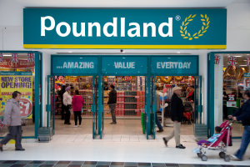
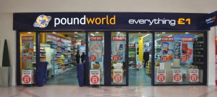
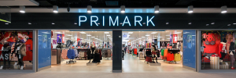
Cost leadership
Useful in highly competitive markets where there are homogenous products
Customers may frequently switch supplier to gain best value
New entrants to the market will use low process to build a customer base

Slide 21
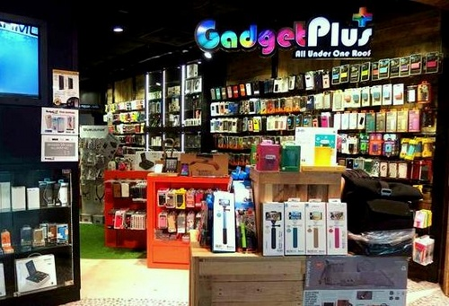
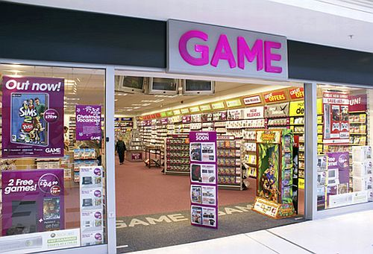
Differentiation
Useful strategy in highly technological markets where there are rapidly changing and evolving features of products and services
Where customers needs are very diverse
Where the competitors in the market are all following a similar differentiation strategy

Slide 22
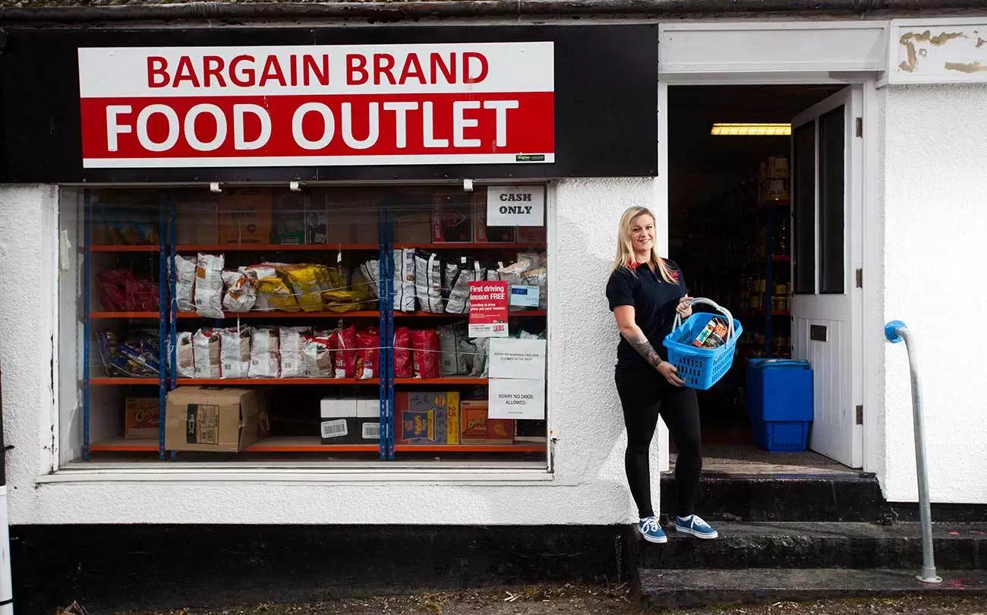
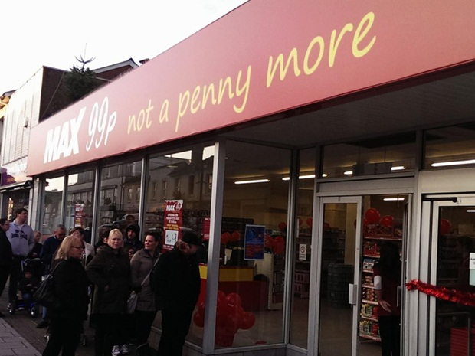
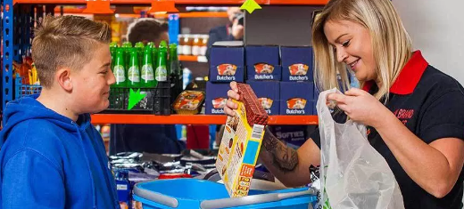
Cost focus
Useful strategy when the business wants to offer very low prices to a small market segment
Niche marketing but at very low cost
Story here

Slide 23
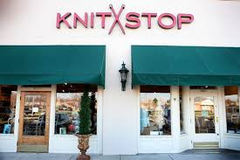
Differentiation focus
Useful strategy when the business wants to offer products and services to a small market segment
Products or services will be differentiated and aimed at a niche market

Slide 24
Uses of Porter’s Strategic matrix
Those in support of Porter’s Strategic matrix (generic strategies) say that it establishes a clear direction for the business to go in
Identifies when a business may be in trouble e.g. Woolworths and BHS both got “stuck in the middle”

Slide 25
Limitations of Porter’s Strategic Matrix
This is only a tool for a business to look at their strategy and as such has some limitations;
Not as relevant in very dynamic markets
May not be useful in a crisis situation
Over simplifies the market structure
Can be possible for a store or business to offer a range of products to a range of customers and not get stuck in the middle e.g. Debenhams

Slide 26
Boston Matrix

Slide 27
The Boston Matrix or Boston Box
Market share
High market share
Low market share
High
Market
Growth
Market
Growth
Low
Market
Growth
Notes:
© S Hilton for revisionstation this is repeated from unit 135

Slide 28
Market share
High market share
Low market share
High
Market
Growth
Market
Growth
Low
Market
Growth
The Boston Matrix or Boston Box
Notes:
© S Hilton for revisionstation this is repeated from unit 135

Slide 29
Star: A product in this quarter will have high market share and high market growth This product may be in the growth phase of the product life cycle Production of this product should remain consistent while profits are harvested | Question mark: Also known in some books as a problem child A product in this quarter enjoys high market growth but low market share This product may have just been launched on the market and is building its customer loyalty Products should be invested in while their market share builds
Cash cow: Products in this quarter are reaching the maturity of their product life cycle but still have customer loyalty Products should be produced until sales start to decline | Dog: Products in this quarter face declining sales in declining markets Products may be in the decline phase of their product life cycle For example video tapes or top hats These products should be removed from sale
Notes:
© S Hilton for revisionstation

Slide 30
BCG / Boston box / Matrix
The BCG is a matrix with a marketing planning tool which helps managers to plan for a balanced product portfolio
It looks at two dimensions, market share and market growth, in order to assess new and existing products in terms of their market potential
A business would place each individual product in its product portfolio (or product range) onto one of the quadrants of the Boston matrix based on the product's relative market share and the product's market growth in the industry
There are four possible results from using the Boston matrix; cash cow, star, dog and problem child (also known as question mark)

Slide 31
Boston Matrix (BCG)
Uses
Limitations

Slide 32
Uses of the BCG matrix
The BCG matrix is a good starting point when reviewing an existing product line to decide future strategy and budgets
The BCG helps businesses analyse future opportunities or problems with their product portfolios
The conclusions drawn from such an analysis are to transfer the surplus cash from cash cows to the stars and the question marks, and to close down or sell off the dogs.
In the end, question marks reveal themselves as either dogs or stars, and cash cows become so drained of finance that they inevitably turn into dogs.

Slide 33
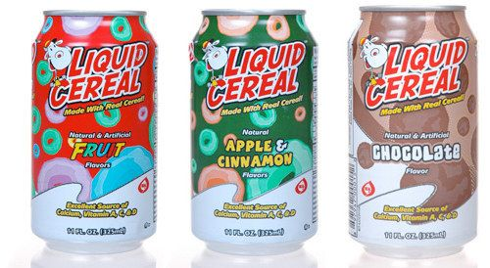
Limitations of using BCG Matrix
BCG matrix classifies businesses as low and high, but generally businesses can be medium also. So, the true nature of business may not be reflected
High market share does not always lead to high profits. There are high costs also involved with high market share.
Growth rate and relative market share are not the only indicators of profitability. This model ignores and overlooks other indicators of profitability
This approach is considered as to be too simplistic
Kay’s Distinctive Capabilities
Kay’s Distinctive Capabilities

Slide 34
From Edexcel
a) Development of corporate strategy:
Ansoff’s Matrix
Porter’s Strategic Matrix
b) Aim of portfolio analysis
c) Achieving competitive advantage through distinctive capabilities
d) Effect of strategic and tactical decisions on human, physical, and financial resources

Slide 35
Kay’s distinctive capabilities

Slide 36
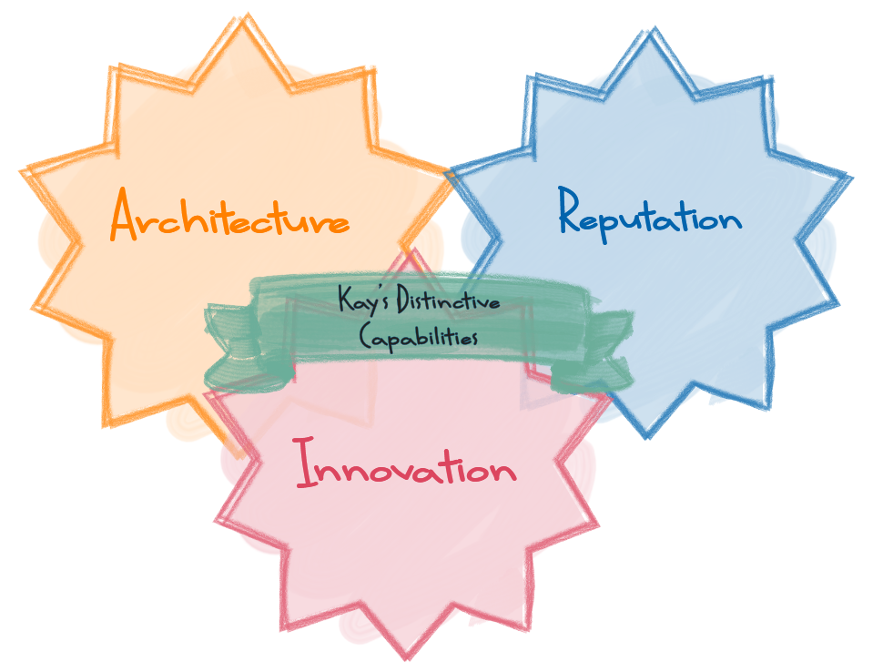

Slide 37
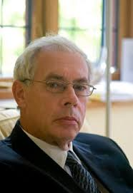
Kay’s Distinctive Capabilities
John Kay in 1993 argued that some outstanding businesses got their strength from their relationships with their employees / customers / suppliers
Key to success was the continuity and stability of relationships with these three groups
He also argued that there were 3 distinctive capabilities (DC) that could create added value and give a business competitive advantage. These were:
Architecture – relationships with employees, suppliers, customers
Reputation – through the customer experience
Innovation – bringing inventions to market

Slide 38
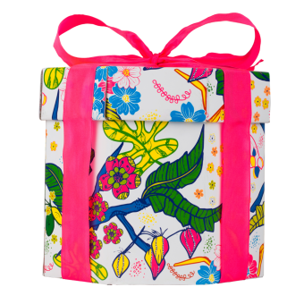
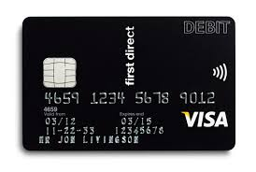
Examples of Kay’s in business
Competitive advantage that distinguishes one business from another
An asset or strength on which future growth can be built
A unique quality of the business through; reputation (Lush), innovation (Sony), architecture (First Direct) (relationships with customers, employees and suppliers)

Slide 39
Kay’s Distinct Capabilities
View each of the video links provided on slides 40-42 and explain how each business created added value and gained a competitive advantage via its distinct capabilities

Slide 40
Architecture
https://youtu.be/5g_YsLR1wZo
https://www.youtube.com/watch?v=Lx83q3mW0oo&feature=emb_rel_end
https://youtu.be/9SPpCH-oQf4

Slide 41
Reputation
https://youtu.be/Y5TvFY7xRDM
https://youtu.be/d3nQ4Y-hjZ0
https://youtu.be/JKIAOZZritk
https://youtu.be/ZcnzLN71uLg

Slide 42
Innovation
https://youtu.be/bfSFLyJqXfs

Slide 43
Strategic and tactical decisions

Slide 44
Strategic & Tactical decisions
Strategy is more long term and relates to achieving an overall goal. Tactics are shorter-term actions that help to achieve the strategy Decisions on the above will influence different aspects of the business: > Human (recruitment, training, redundancy etc.) > Physical (investment in fixed assets, location etc.) > Financial ( sources of finance, cash flow)

Slide 45
https://youtu.be/yeWT3XR_2XU
https://youtu.be/k4_XFEy64Us

Slide 46
Consider the Aldi's strategy and how it is influencing its tactics:
Aldi reports record sales but profits drop amid price war
The man driving Aldi's remarkable growth Assess the importance to Aldi of separating its strategy and tactics?

Slide 47
Strategic vs tactical decisions
Strategic | Tactical

Slide 48
Strategic vs tactical decisions
Great animation video here on strategy and tactics
Strategic | Tactical
Long term direction of the business | Short or medium term decisions
What the business will do to meet its aims and objectives | How the business will implement its strategy
Pro-active decision making | Reactive to competitor actions
Forward thinking, future planning | Present day thinking, what is happening now that needs dealing with

Slide 49
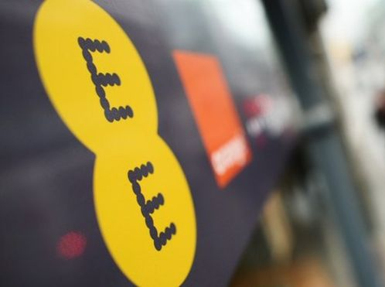
Is this strategic or tactical?
Take-over of another business
For example in Feb 2015 BT bought EE
Telecoms group BT has paid £12.5bn to buy mobile operator EE.
The takeover creates a communications giant covering fixed-line phones, broadband, mobile and TV.
Why?
BT says that within four years, the deal will be saving it £360m a year in terms of operating costs and capital investment.
It added that by combining the two businesses, it should be able to generate an extra £1.6bn a year in sales.
Full BBC article here
Notes:
Strategic – the aims and objectives of the business is to generate sales (In billions) and make cost savings

Slide 50
Is this strategic or tactical?
New Marketing strategy
For example a hairdressers – watch the video – you decide if its strategic or tactical
Notes:
Tactical - how to market a new product

Slide 51
Impact of decisions on human resources
Strategic (proactive)
Tactical (reactive)

Slide 52
Impact of decisions on human resources
Strategic (proactive)
Tactical (reactive)
Hiring new staff as part of a long term strategy to improve productivity
Training staff to achieve the business objective of long-term efficiency and growth
Having to hire a new network manager because the old one has quit
Having to train staff because a new IT system has been introduced

Slide 53
Impact of decisions on physical resources
Strategic (proactive)
Tactical (reactive)

Slide 54
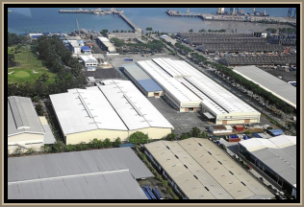
Impact of decisions on physical resources
Strategic (proactive)
Tactical (reactive)
Moving a factory location to another country to achieve the long-term objective of cost cutting and profit maximisation
Moving a factory layout around to accommodate a new product being manufactured

Slide 55
Impact of decisions on financial resources
Strategic (Proactive)
Tactical (Reactive)

Slide 56
Impact of decisions on financial resources
Strategic (Proactive)
Tactical (Reactive)
Issuing shares to raise capital to achieve a long-term objective of growth and expansion
Allocating budgets to ne R&D projects which help the business to achieve the long-term objectives of expanding the product portfolio
Agreeing an overdraft with the bank to cover a shortfall in a cash flow forecast
Arranging a bank loan to buy some office furniture to replace some that is old and broken

Slide 57
Revision Video

Slide 58
Revision video 2

Slide 59
Sample Edexcel A2 questions

Slide 60
Case study for question 1

Slide 61
Case study question 1

Slide 62
Sample question 1
Knowledge 2
Application 2
Analysis
3
Evaluation
3

Slide 63
Case study for question 2

Slide 64
Sample question 2
Knowledge 4
Application 4
Analysis
6
Evaluation
6

Slide 65
Case study for question 3

Slide 66
Sample question 3
[5]
Knowledge 2
Application 2
Analysis
1
Notes:
This is an old Edexcel Ec / Bus paper question which is why its 5 marks – good practice though

Slide 67
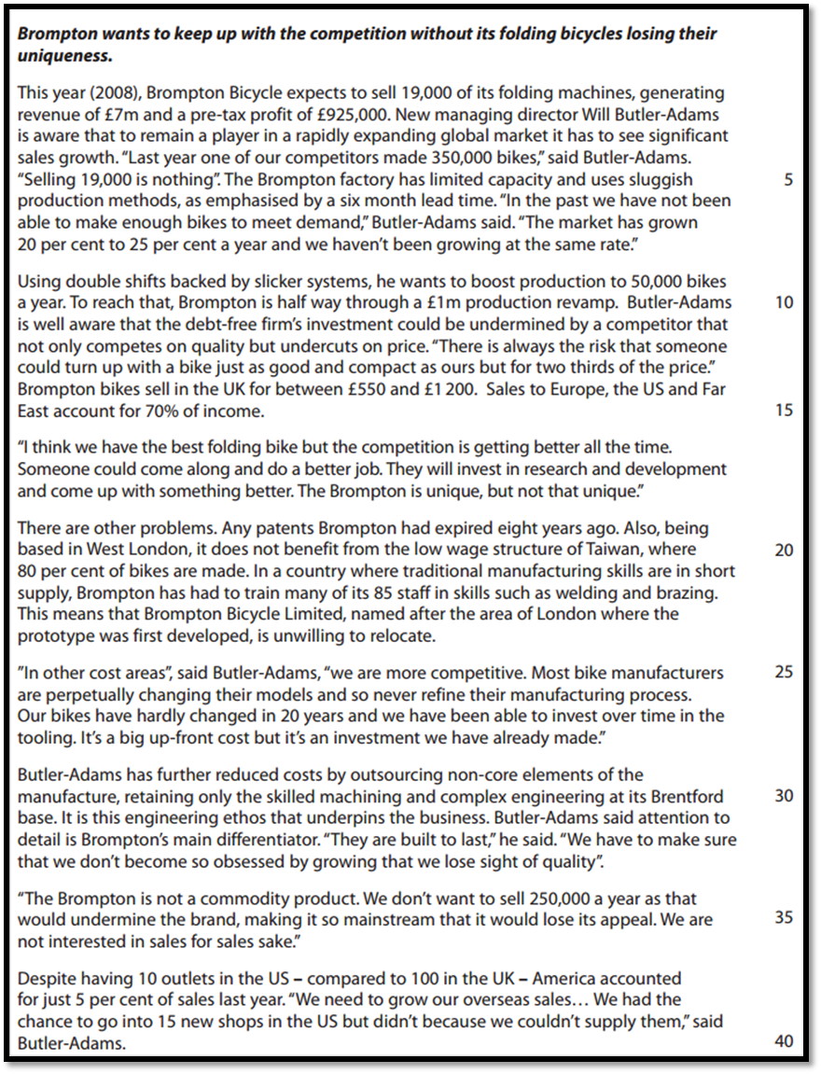
Case study for question 4

Slide 68
Sample question 4
[5]
Knowledge 2
Application 2
Analysis
1
Notes:
Another Ec/bus legacy paper question which is why its 5 marks

Slide 69
Glossary
Ansoff’s matrix; The Ansoff Matrix is a marketing planning tool which usually aids a business in determining its product and market growth by focusing on whether the products are new or existing and whether the market is new or existing
Boston Box; Created by the Boston Consulting Group, the BCG matrix aims to identify high-growth products by categorising the company's product portfolio according to growth rate and market share
Kay’s Distinctive Capabilities; This is a business strategy concept where a successful company achieves a competitive advantage over other businesses. There are 3 ways this can be achieved (3 distinctive capabilities); - Architecture, Innovation and Reputation
Product portfolio; All the products that a company produces or sells

