Slide 1
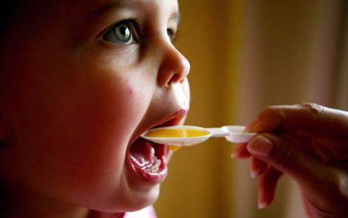
What do these products have in common?

Slide 2
ROUGHLY DRAW…
Thinking back to your lessons on demand.
Use the clues to draw what the demand curves might look like for these four scenarios:
1) When a slight percentage change in price results in a proportionately greater percentage change in the quantity demanded.
2) When a percentage change in price causes a proportionately smaller percentage change in the quantity demanded.
3) A change in price will result in infinite change in quantity demanded.
4) When a change in price causes no change at all in the quantity demanded.

Slide 3
STARTER ACTIVITY RECAP
RECAP: What is PED?
What is PED?

Slide 4
STARTER ACTIVITY RECAP
RECAP: What is PED?
PED = A measure of the degree of responsiveness of demand after a given change in price for a product. Products can be either: ELASTIC INELASTIC
Define these terms

Slide 5
PED Lesson 2

Slide 6
LEARNING OBJECTIVES
Lo1: Distinguish between PED inelastic and PED elastic.
Lo2: Represent price elasticity of demand diagrammatically.
Lo3: Calculate and interpret PED results.

Slide 7
Specification
1.2.3 Price, income and cross elasticities of demand
a) Understanding of price, income and cross elasticities of demand
b) Use formulae to calculate price, income and cross elasticities of demand
c) Interpret numerical values of:
price elasticity of demand: unitary elastic, perfectly and relatively elastic, and perfectly and relatively inelastic
income elasticity of demand: inferior, normal and luxury goods; relatively elastic and relatively inelastic
cross elasticity of demand: substitutes, complementary and unrelated goods
d) The factors influencing elasticities of demand
e) The significance of elasticities of demand to firms and government in terms of:
changes in real income
changes in the prices of substitute and complementary goods

Slide 8
PED TABLES*
Complete the table for each of the types of price elasticity of demand.

Slide 9
Relatively Elastic
PED coefficient:
>1.0
When a slight percentage change in price results in a greater percentage change in the quantity demanded.
For example: competitive markets, products or services with substitutes.

Slide 10
Relatively elastic demand curve demonstrates how a small price increase results in a proportionately greater change in quantity demanded.
When price increased slightly from P to P1, quantity demanded decreased significantly from Qd to Qd1.
Price
P2
P1
d
0
Q2
Q1
Quantity

Slide 11
Relatively Inelastic
PED coefficient:
<1.0
When a percentage change in price causes a proportionately smaller percentage change in the quantity demanded.
For example: products that are addictive such as cigarettes or necessities.

Slide 12
Price
Relatively inelastic demand curves demonstrate that when there is a significant price change there is a proportionately smaller change in quantity demanded.
When price increased from P to P1, quantity demanded only decreased from Qd to Qd1.
P2
P1
D
0
Q2
Q1
Quantity

Slide 13
Results of the formula...
Elastic – If the result is 1 or above the product is PED elastic.
This is because the percentage change in quantity demanded was greater than the change in price.
Inelastic – If the result is below 1 the product is PED inelastic.
This is because the percentage change in quantity demanded was smaller than the change in price.
We ignore the minus sign… So if the PED is -2 then this is elastic

Slide 14
Perfectly elastic
PED coefficient:
∞
When demand is perfectly elastic… a change in price will result in an infinite change in demand.
No actual examples, it is a theoretical benchmark. Demand is infinite at a fixed price.
Demonstrate a PERFECTLY ELASTIC demand curve.

Slide 15
At the price P, demand can range from Q1 to Q2.
When price is reduced the demand curve shifts downwards. The lowest price will attract all the demand in the market.
Price
P
D
0
Q2
Q1
Quantity

Slide 16
Perfectly inelastic
PED coefficient:
0
When changes in price cause no change at all in the quantity demanded.
Vital medicine… or if oxygen was bottled.
Demonstrate a PERFECTLY INELASTIC demand curve.

Slide 17
D
Price
When demand is perfectly inelastic a price change does not affect quantity demanded at all.
This graph demonstrates that when price increased from P to P1, quantity demanded remained at Qd.
P1
P
0
Q1
Quantity

Slide 18
Results of the formula...
Perfectly Elastic – The result would be infinite ∞
With a given change in price, there is an infinite response in quantity demanded
Perfectly Inelastic – The result would be zero.
With a given change in price, the response by demand is nothing – therefore no response, so zero elasticity.

Slide 19
School Uniform Price Wars*
Complete the first question as a class.
Then use the information to answer the remaining questions.

Slide 20
PED = A measure of the degree of responsiveness of demand to a given change in price for a particular product or service.
What is PED?
PED can be calculated using this formula:
percentage change in quantity demanded
Percentage change in price
What does this mean?
% Qd
% P

Slide 21
PED = A measure of the degree of responsiveness of demand to a given change in price for a particular product or service.
What is PED?
PED can be calculated using this formula:
percentage change in quantity demanded
Percentage change in price

Slide 22
%ΔQd %ΔP
Breakdown of PED formula:
Percentage change in quantity demanded
Percentage change in price
Percentage changes are calculated this way:
((New Qd – Old Qd)/Old Qd) x 100
((New P – Old P)/Old P) x 100
You can remember this as “Noo” (new, old, old)

Slide 23
PRICE WARS
((New Qd – Old Qd)/Old Qd) x 100
((New P – Old P)/Old P) x 100
Old Price £5.00 New Price £3.75 Old sales 200,000 New sales 300,000
PED > 1 So demand is elastic!
(Remember, we ignore the minus.)
((300,000-200,000)/200,000) X 100 ((3.75-5.00)/5.00) X 100
PED = -2
((100,000)/200,000) X 100 ((-1.25)/5.00) X 100
This means that a 10% change in price, causes a 20% change in quantity demanded.
So the %ΔQD is proportionately larger than the %ΔP… therefore the good is PED elastic.
50 -25
The percentage change in Qd is +50% The percentage change in P is -25%

Slide 24
PRICE WARS - Revenue
Old Price £5.00 New Price £3.75 Old sales 200,000 New sales 300,000
Revenue last year
£5.00 x 200,000 = £1,000,000
Revenue this year
£3.75 x 300,000 = £1,125,000

Slide 25
Why do we ignore the minus?
RECAP: What is PED?
Because of the relationship between price and quantity demanded.
The law of demand has a downward sloping curve.
One value (price/quantity) will always be negative, whilst the other will always be positive.
Therefore when you divide negative and positives together, the answer is always negative.

Slide 26
Results of the formula...
Unitary elasticity –
If the result is 1 exactly, then this means that any change in the price results in an equal % change in the quantity demanded. For example:
+20% Change in QD
-20% Change in Price
= -1.0
Again, ignore the minus sign… We are only interested in the figure itself.

Slide 27
x
_______________________
= -0.2
% Change in price is -20%
X = -0.2 x -20
X = +4%
Notes:
https://secure.qualifications.pearson.com/content/dam/secure/silver/all-uk-and-international/a-level/economics/2015/exam-materials/8EC0_01_rms_20160817.pdf
MARK SCHEME 5a b

Slide 28
Again, as with all 3 mark questions… one mark is always reserved for knowledge, so give a definition.

Slide 29
Qd
% Change Price
% Change Qd

Slide 31
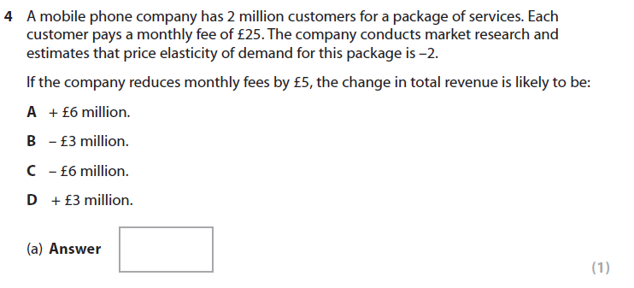
Notes:
Jan 2009 Q4

Slide 33
WORKSHEET ACTIVITY*
There are three activities, which become increasing challenging:
Activity 1
Activity 2
Activity 3
When you have finished one, mark your own answers and then move onto the next activity.

Slide 34
PED Evaluation Q*
(c) Using the information in Extract 2 and your own knowledge, discuss whether the demand for tobacco products is likely to be price inelastic or price elastic. (10)

Slide 35
Price Elasticity EXTRA*
Answer worksheets 1 and 2
Mark your own using the answers

Slide 36
Determinants of PED
Explain how the following can impact the PED of a product/service
Substitutes
Income
Luxuries
Time
Habits
Explain how the following can determine or influence PED, use examples to help explain your answers.
Feedback!
Notes:
http://www.economicsonline.co.uk/Competitive_markets/Price_elasticity_of_demand.html

Slide 37
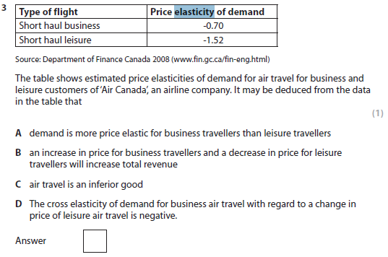
Notes:
Jan 2010 Q3.

Slide 39
MULTI-CHOICE QUIZ
In small groups, on mini-whiteboards.
http://www.economicsonline.co.uk/Competitive_markets/Price_elasticity_of_demand.html
https://play.kahoot.it/#/k/6177bf90-bcf2-4b43-9324-015805a67faa
http://www.tutor2u.net/economics/quizzes/as/ped1/quiz.html

Slide 40
MULTI-CHOICE QUIZ answers
Toothpaste
-0.33
Raise Prices
0.1% reduction in price causes a 0.3% QD increase
Close substitutes are available.
Tax revenues are less than government spending – implying taxes a low, so that people have more money to choose substitutes.
Development of sweeteners
A small percentage decrease in the QD
Relatively inelastic 25/20 = 1.25
X/10 = 1.2 so QD is 12% change.
http://www.tutor2u.net/economics/quizzes/as/ped1/quiz.html

