Slide 1
Edexcel A2 Business
3.2.4 Reasons for staying small
Revisionstation

Slide 2
Worksheet

Slide 3
From Edexcel
a) Small business survival in competitive markets:
product differentiation and USPs
flexibility in responding to customer needs
customer service
e-commerce

Slide 4
Starter
What percentage of all business in the UK is carried out by small businesses?
53%
2%
12%
57%
99%
Notes:
Answer is 5 – 99% of all UK business is through small businesses
Source: http://blog.thecompanywarehouse.co.uk/2012/07/31/what-is-an-sme/

Slide 5
Definition of small business
The usual definition of small and medium sized enterprises (SMEs) is any business with fewer than 250 employees.
There were 5.2 million SMEs in the UK in 2014, which was over 99% of all business.
Micro-businesses are business with 0-9 employees.
There were 5million micro-businesses in the UK in 2014, accounting for 96% of all businesses
Data from UK Parliament here
Notes:
For accounting purposes Companies House defines a small business as employing less than 50 people and a turnover under £6.5 million and a medium business as less than 250 employees and a turnover under £25.9 million.

Slide 6
Product differentiation and USPs

Slide 7
Differentiation strategy of small business
Creates value; highlights quality or durability of the product
Non-price competition; a differentiation strategy will focus on other ways of attracting customers such as taste and style
Brand loyalty; a differentiation strategy can gain customer loyalty
No perceived substitute; a differentiation strategy that focuses on quality and design may give the impression that there are no suitable substitutes in the market place
Lee Colourplan book makers create pattern books for businesses such as Laura Ashley – they work in a niche sector and offer high quality and satisfaction

Slide 8
USPs of small business
USP stands for unique selling point or proposition, it means what makes this product different from others on the market?
It is a way of promoting the features of the product or service of the business; quality, customer service, delivery, price, technical features or functions e.g. a feature is the reliability of the product, the benefit to the customer is less breakdowns and repairs
This small business’s USP is that they produce coffee pods which go into a range of coffee machines

Slide 9
Flexibility in responding to customer needs

Slide 10
Small business: flexibility in responding to customers’ needs
A small business can gain significant competitive advantage over larger companies if it responds quickly to customers needs
It can do this by
Carrying out research into opinions, looking at customers websites
Gaining feedback; forums, polls, users groups, online communities
Track social media discussions about the products
Collect data on customer transactions
Collaborate with customers to produce new products or services
This is Caley’s Cocoa café which responds to customers needs

Slide 11
Customer service

Slide 12
Small business survival through customer service
How else can a business differentiate themselves from their competitors? By giving excellent customer service.
Consumers appreciate businesses that give them more for their money, especially when times are tough.
Efficient service, fast delivery and flexible payment terms will help to persuade customers to spend with them rather than a competitor.
Luxury pet hotel and spa – resort style vacation for dogs

Slide 13
E-commerce

Slide 14
Small business survival through E-commerce
Small businesses can sell successfully through third party websites such as Ebay and Amazon
85% of UK consumers aged 18 or over already shop on the Internet
E-commerce will grow from 14% to 34% of all retail sales by 2020

Slide 15
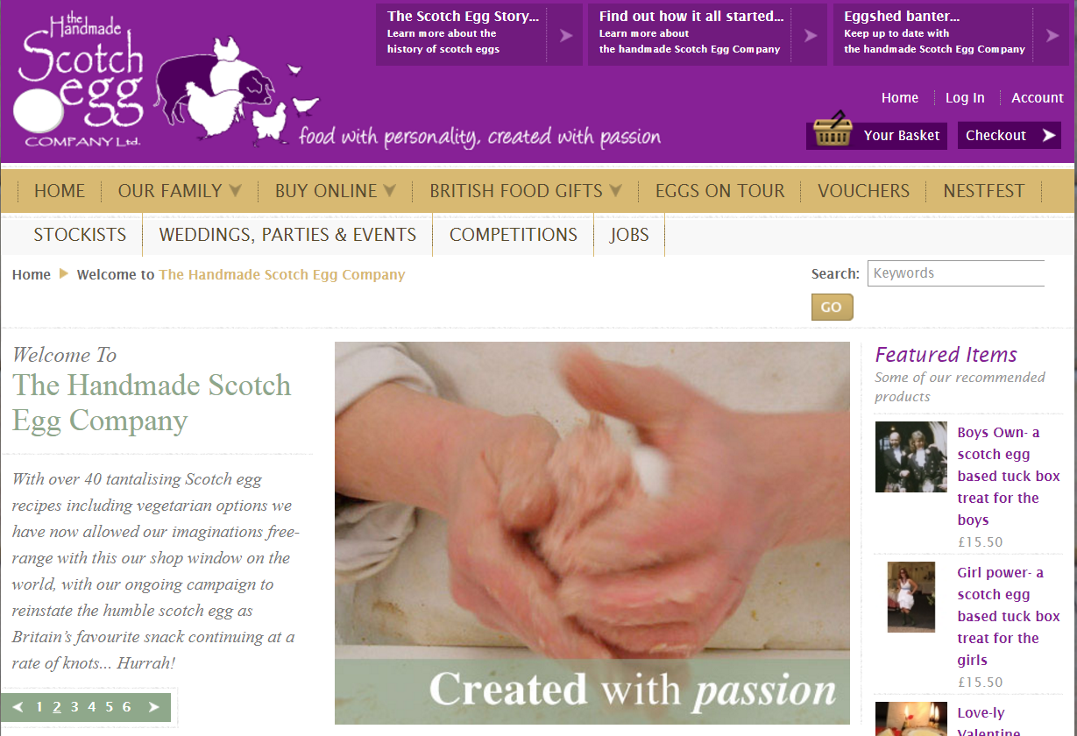
Example small business website

Slide 16
Example small business website
Handrail creations won micro business of the year 2016

Slide 17
Example small business website
Creatiques creations won UK website of the year 2016

Slide 18
eBay video

Slide 19
eBid video

Slide 20
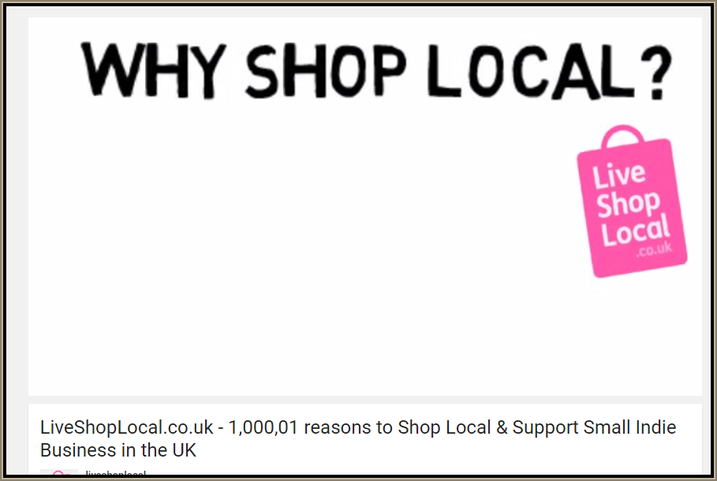
Revision Video

Slide 21
Sample Edexcel A2 questions

Slide 22
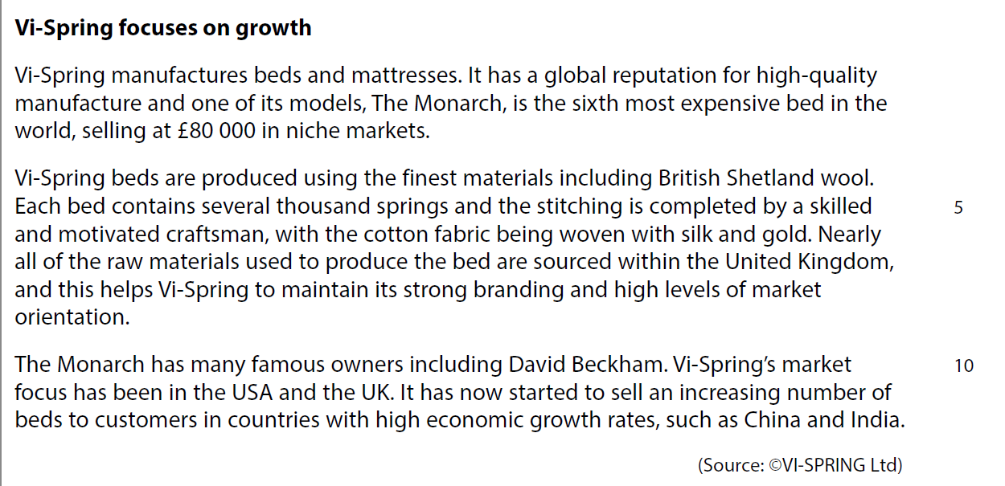
Case study for question 1

Slide 23
Sample question 1
Knowledge 1
Application 2
Analysis
1

Slide 24
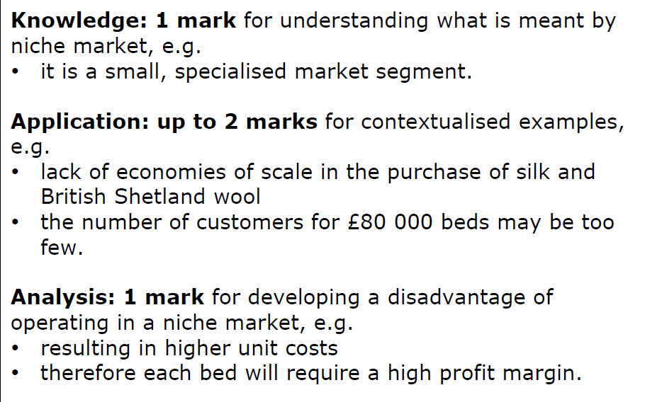
Answer sample question 1

Slide 25
Glossary
SME; Small to medium sized enterprise
USP; The feature and benefits of a product that make it unique in the market
Differentiation; a strategy where a business sets out to show that their products or services are different to other competitors
E-commerce; selling online

