Slide 1
Edexcel A2 Business
3.3.1 Quantitative sales forecasting
Revisionstation

Slide 2
Worksheet

Slide 3
From Edexcel
a) Calculation of time-series analysis:
moving averages (three period/four quarter)
b) Interpretation of scatter graphs and line of best fit – extrapolation of past data to future
c) Limitations of quantitative sales forecasting techniques

Slide 4
Starter
Which two months of the year are you likely to have the most money?
Notes:
Birthday and Christmas / other festival, but they can predict this based on historical knowledge of money given on birthdays and Christmas

Slide 5
Calculators will be needed for this topic

Slide 6
What is quantitative sales forecasting? (QSF)
QSF is a statistical technique which uses data to make predictions about the future (in terms of sales not the weather etc)
The method that your exam board would like you to know about is called “time series analysis”
In a nutshell it uses historical data, smoothed out, to make better predictions for the future

Slide 7
What can a business do with QSF information?
Once a business has carried out time series analysis they will use this information to;
Organise production
Organise resources in the business e.g. employees, premises, raw materials
Organise marketing to back up the sales predictions
Notes:
No more puppets!

Slide 8
Calculations

Slide 9
Calculate three period moving average
Step 1 – smooth the raw sales data from the table by calculating a 3 year moving average. Take the first 3 months data and calculate an average:
Date | Sales
2007 | 400
2008 | 500
2009 | 770
2010 | 900
2011 | 600
2012 | 700
2013 | 1,100
2014 | 1,500
2007 | 400
2008 | 500
2009 | 770
400 + 500 + 770
_____________
3
1,670
____
3
=
=
556.6

Slide 10
Calculate three period moving average
Step 2 – Now leave out the first year and calculate the average for the next three years
Date | Sales
2007 | 400
2008 | 500
2009 | 770
2010 | 900
2011 | 600
2012 | 700
2013 | 1,100
2014 | 1,500
2008 | 500
2009 | 770
2010 | 900
500 + 770 + 900
_____________
3
2,170
____
3
=
=
723.3

Slide 11
Calculate three period moving average
Step 3 – Now add all your calculated averages to the table:
Date | Sales | 3 year moving average
2007 | 400
2008 | 500 | 556.6
2009 | 770 | 723.3
2010 | 900 | 756.6
2011 | 600 | 733.3
2012 | 700 | 800
2013 | 1,100 | 1,100
2014 | 1,500
The new calculation goes next to the middle year

Slide 12
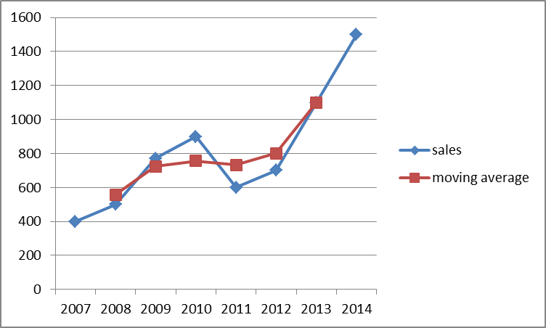
Plot a graph from your 3 period moving average
Date | Sales | 3 year moving average
2007 | 400
2008 | 500 | 556.6
2009 | 770 | 723.3
2010 | 900 | 756.6
2011 | 600 | 733.3
2012 | 700 | 800
2013 | 1,100 | 1,100
2014 | 1,500
Notice that the data is now “smooth” and so you can see trends occurring
This will help you to make more accurate sales forecasts for your business as it
smooths out any large fluctuations in data which may be down to weather or recession etc.

Slide 13
4 quarter moving average
As a business manger or owner you may need to look at your sales data in terms of the 4 seasons in the year
As your sales may fluctuate widely but you still need to schedule your production on a month by month basis you would use this technique

Slide 14
4 quarter moving average
2015 Quarter 1 sales were 600
2015 Quarter 2 sales were 700
2015 Quarter 3 sales were 850
2015 Quarter 4 sales were 350
To smooth this data to identify a trend overall we calculate a 4 point moving average
600+700+850+350
_______________________
4
2500
_____
4
= 625

Slide 15
Calculate a four quarter moving average
Date | Sales | Average
2015 1st Q | 600 | 625
2015 2nd Q | 700 |  | 650
2015 3rd Q | 850
2015 4th Q | 350
2016 1st Q | 700
2016 2nd Q | 800
2016 3rd Q | 950
2016 4th Q | 450
Notes:
600+ 700+ 850+ 350 = 625

Slide 16
Calculate a four quarter moving average
Date | Sales | Average
2015 1st Q | 600 | 625
2015 2nd Q | 700 |  | 650
 |  |  |  | 675
2015 3rd Q | 850
2015 4th Q | 350 |  |  |  | 700
2016 1st Q | 700
 |  |  |  |  |  | 725
2016 2nd Q | 800
2016 3rd Q | 950
2016 4th Q | 450
Now try and plot this on a graph
Notes:
600+ 700+ 850+ 350 = 625

Slide 17
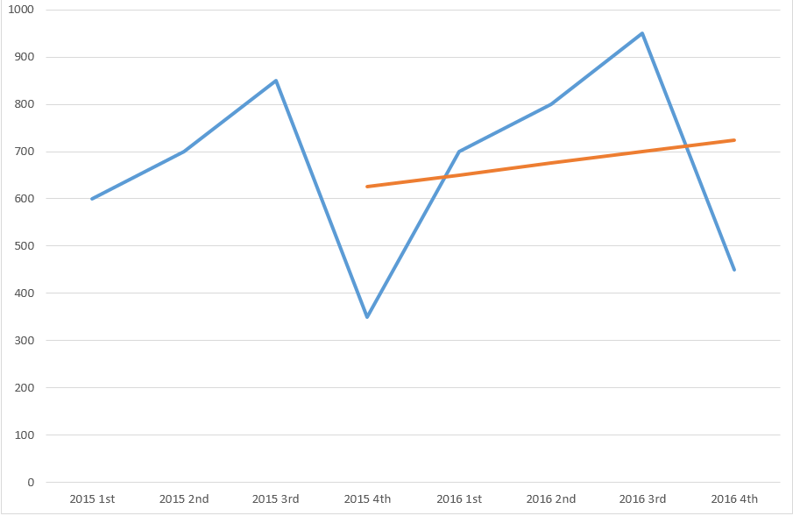
4 quarter moving average
Sales
Look how the process smoothes out the line so predictions can be made and production scheduled correctly
Dates

Slide 18
Interpretation

Slide 19
Scatter graphs
Interpretation of scatter graphs As a business director you need to find out if you need to put up the budget in a marketing department.
Does more advertising guarantee more sales? If it does we call that correlation.
Have a look at the examples on the next slides

Slide 20
Some examples of scatter graphs
Sales
Sales
Spend on advertising
Spend on advertising
Sales
Sales
Spend on advertising
Spend on advertising

Slide 21
Interpretation of scatter graphs The correlation depends on the angle of the data points and how close together they are
Sales
Sales
Negative correlation
No budget increase!
Strong positive correlation
Raise the marketing budget
Spend on advertising
Spend on advertising
No correlation
More research needed
Sales
Sales
Weak positive correlation
Keep budget same as last year
Spend on advertising
Spend on advertising

Slide 22
Interpretation of scatter graphs Lines of best fit can be drawn through the scattered data points, these show general trends over time
Sales
Sales
Spend on advertising
Spend on advertising
Sales
Sales
Spend on advertising
Spend on advertising

Slide 23
Interpretation of scatter graphs We can extrapolate (stretch) lines of best fit to see what will happen in the future
Sales
Sales
Spend on advertising
Spend on advertising
Sales
Sales
Spend on advertising
Spend on advertising

Slide 24
Limitations

Slide 25
Limitations of quantitative sales forecasting techniques
Past performance is no guarantee of the future
Businesses need to appreciate the SWOT and PESTLE factors that may affect future predictions, for example;
Weather
Trends
Competitor activity
Terrorist activity
The British government wants to build more houses. Unfortunately, there are not enough bricks
Story here

Slide 26
More limitations
Relies on what has happened in the past continuing to happen, and historical data is not always a good indication of what might happen in the future
In high technology markets change happens rapidly and products have a short product life cycle, therefore extrapolation can be misleading
It is time-consuming and complex and is only as reliable as the data put in
Use of moving averages doesn’t take into account how recent the data is
Doesn’t link with corporate objectives

Slide 27
Revision Video

Slide 28
Sample Edexcel A2 questions

Slide 29
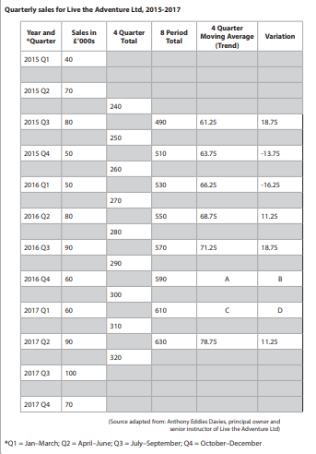
Case study for question 1

Slide 30
Sample question 1
Level 1
1-4
Level 2
5-8
Level 3
9-14
Level 4
15-20

Slide 31
Glossary
Time series analysis; a management tool to make predictions from past data
Scattergraph; a graph which shows the performance of one variable (sales) against another (spend on marketing)
Cyclical; Changes in the data due to large changes such as a recession
Correlation; a relationship between two sets of variables
Line of best fit; a line that can be drawn through a series of data to look for a trend
Extrapolation; When data is stretched out over a line of best fit to predict what will happen in the future

