Slide 1
STARTER ACTIVTIY
“There’s no such thing as a free lunch.”
Milton Friedman
What does this mean? What wider points are being made? Is this true?
Discuss.
Notes:
Get students to write onto pieces of paper, screw up and pick at random. Encourages students to be open, honest.

Slide 2
LEARNING OBJECTIVES
Lo1: Define the term ‘opportunity cost’.
Lo2: Apply the theory of opportunity cost to scenarios and the benefits/costs of economic decisions.
Lo3: Analyse how opportunity cost impacts consumers, producers and government

Slide 3
SPECIFICATION
1.1.3 The economic problem
a) The problem of scarcity – where there are unlimited wants and finite resources
b) The distinction between renewable and non-renewable resources
c) The importance of opportunity costs to economic agents (consumers, producers and government)
Covers next few lessons and activities.

Slide 4
SECRETARY OF STATE FOR HEALTH
Congratulations!
Jeremy Hunt, The Secretary of State for Health, has just resigned.
You have been appointed in his place.
First of all you need to match up the procedures with how much you think they cost the NHS.

Slide 5
SECRETARY OF STATE FOR HEALTH
£1,800
£2,300
£2,400
£5,000
£6,000
£8,900
£9,700
£15,000
£17,000
£43,000
£70,000
£70,000

Slide 6
SECRETARY OF STATE FOR HEALTH
Natural birth in NHS hospital £1,800
Abdominal hernia repairs £2,300
Planned caesarean-section in NHS hospital £2,400
Gastric (stomach) by-pass £5,000
One round of IVF treatment £6,000
Hip replacement £8,900
Plasma exchanges (20 or more) £9,700
Kidney transplant from heart-beating donor £15,000
Cochlear Implant £17,000
Heart transplant £43,000
Liver transplant £70,000
Bone marrow transplant £70,000

Slide 7
SECRETARY OF STATE FOR HEALTH
Congratulations!
Jeremy Hunt, The Secretary of State for Health, has just resigned.
You have been appointed in his place.
First of all you need to match up the procedures with how much you think they cost the NHS
Secondly, austerity means that you have been allocated a budget of only £100,000… which procedures will you choose with this budget? Justify.

Slide 8
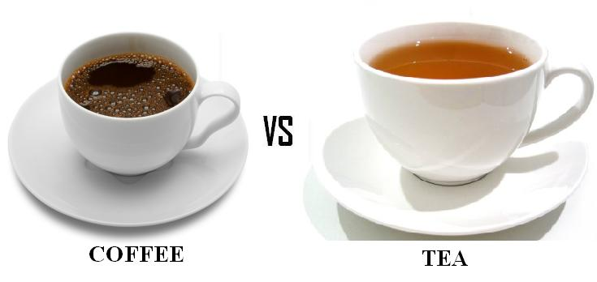
Opportunity cost measures the cost of any choice in terms of the next best alternative foregone.
…or in other words, what have you given up as a result of your decision?
Do you think we are always rational in terms of our decision-making?

Slide 9
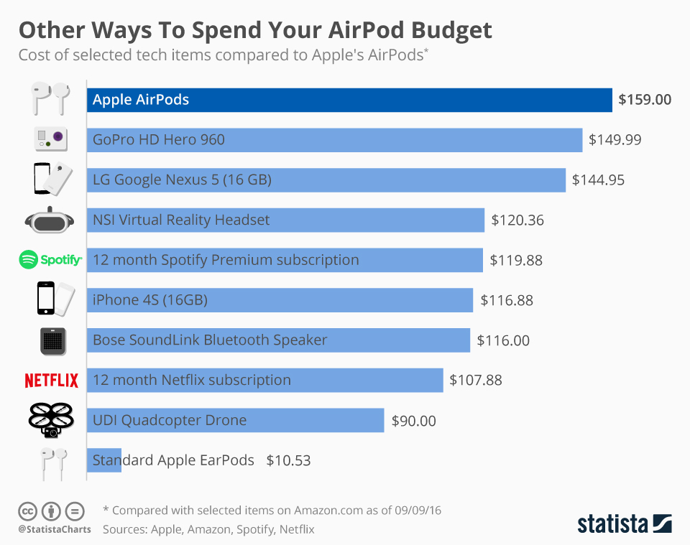

Slide 10
KEY TERM: OPPORTUNITY COST
“The loss of alternatives when one alternative is chosen...
...it is the "cost" incurred by not enjoying the benefit that would be had by taking the next best choice available.”
https://www.youtube.com/watch?v=6fGOEKkO0iI 8:02

Slide 11
Opportunity Cost SCENARIOS
Discuss the importance of opportunity cost in these scenarios:
a) Tesco deciding whether to carry on expanding their new chain of American ‘Fresh ‘n Easy’ stores during late 2008/early 2009.
b) The Board of Reading FC deciding whether or not to build a new, much bigger, stadium in Reading.
c) Phillip Hammond deciding whether or not to reduce taxes by £20 billion in the 2018 pre-budget report.
d) Woking Borough Council turning off street lamps at night to save £36,000 a year.

Slide 12
Scenarios | Consumers | Producers | Government
Government increases VAT by 10% on chocolate.
Producers across the UK stop selling plastic carrier bags
1 in 5 consumers aged 16-25 are now vegetarian.

Slide 13
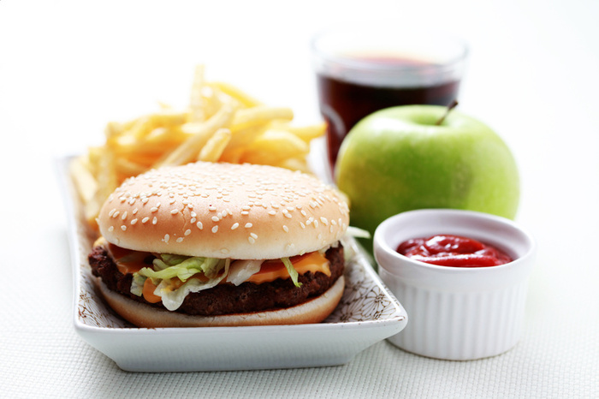
Opportunity Cost at Lunchtime
Read the article which applies the Opportunity Cost concept to everyday life.
Highlight/underline all of the occasions in which the concept occurs.

