Slide 1
Edexcel A2 Business
1.5.3 Business Objectives
Revisionstation

Slide 2
Worksheet

Slide 3
From Edexcel
a) Survival
b) Profit maximisation
c) Other objectives:
sales maximisation
market share
cost efficiency
employee welfare
customer satisfaction
social objectives

Slide 4
Starter
Do you have any of these aims?
To get a better phone for your birthday
To pass your A Level business
To get a part time job
To become a YouTube sensation
To get through the year without a detention / penalty / phone call home
To learn to play the guitar
Notes:
You could share your aim with the group – mine is to buy a new fridge

Slide 5
Definition: Business Objectives
A business objective is a goal or aim that a business wants to achieve. The best objectives are SMART and not vague, so that everyone in the business knows what direction the business is going.
SMART
Specific
Measurable
Achievable
Realistic
Timely

Slide 6
Survival

Slide 7
Survival as a business objective
Survival is a short-term objective of a business and is usually applied to a new business or start-up
Having an objectives helps the employees to focus on shared aims of the business
Different businesses have different objectives, it can depend on the product, service or industry and even on the goals of the entrepreneur starting the business

Slide 8
Survival
The business in the first year may just have survival as the objective while it builds a customer base and establishes itself in the market
The objective is to reach a sustainable level of sales that allows the business to reach its break-even point
This may involve penetration pricing of products or services at the outset to establish the business
This may not mean much profit at the start, but when the business starts to grow it will able to comfortably raise prices

Slide 9
Profit maximisation

Slide 10
Profit maximisation
Profit maximisation is when a business wants to make the most profit possible from a given amount of resources
Profit maximisation is important as an objective because it helps a business to recoup any research and development costs (R&D)
Profit maximisation is needed to help a business to maintain high levels of product development and innovation
Which stakeholder would profit maximisation be most important to?
Notes:
Shareholders

Slide 11
Profit maximisation - shrinkflation
Lots of supermarket items are getting smaller
This is known as shrinkflation – where a manufacturer keeps the price the same but makes the product smaller
The ONS says that as many as 2,529 products have shrunk over the past 5 years
Can you link this to profit maximisation?

Slide 12
Other objectives

Slide 13
Other business objectives
Aside from survival or profit maximisation, there are lots of objectives that a business may have. These are the 6 that your exam board would like you to know about. Get ready to make some notes about these from the next few slides:
sales maximisation
market share
cost efficiency
employee welfare
customer satisfaction
social objectives

Slide 14
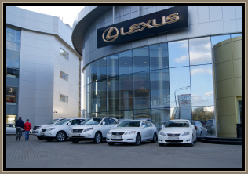
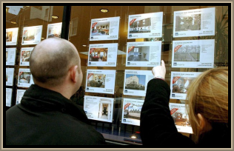
#1 sales maximisation
Some businesses may set their objective as sales maximisation
Profit figures tend to be annually so sales figures can be examined on a daily, weekly or monthly basis
Managers find sales figures more satisfying as targets as profits go to owners and salaries are often linked to sales levels
Anyone interested in investing in the business may want to see the sales data and judge it as an indicator of performance
Often found in a sales drive environment like an estate agents or a car dealership

Slide 15
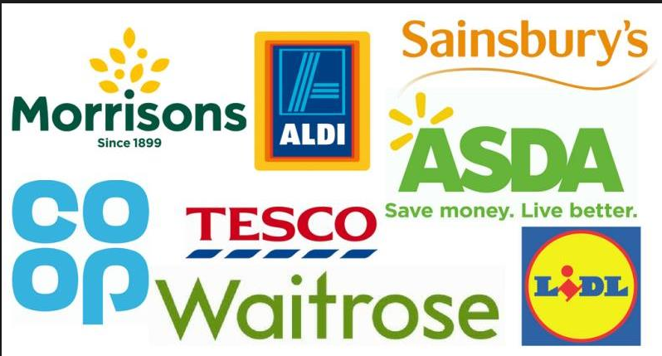
#2 market share
Market share is the % of a market that a business has, either in revenue or in units sold
This may be an objective in a very competitive market where consumers switch between suppliers (supermarkets)
Very important for investors to judge how a business is doing against competitors Loss in market share can be an indicator of long-term serious financial problems

Slide 16
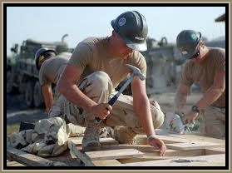
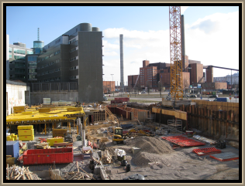
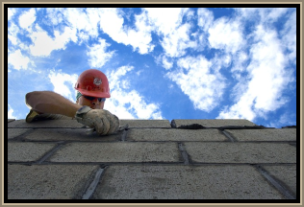
#3 cost efficiency
The most common objective in transport and construction industries where goods and services make up 70% of the cost of a project is to achieve cost efficiency
Cost efficiency can be achieved by:
Paying minimum wage to unskilled workers
Subcontracting where economically viable
Lean production or construction where material, time and process waste is eliminated to save costs
Increase the perceived value of the product through strong branding
Lower the quality and the price of the product
Lowering the average costs means economies of scale

Slide 17
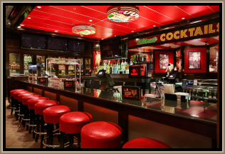
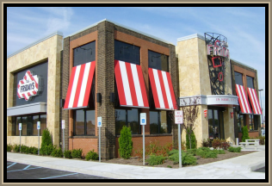
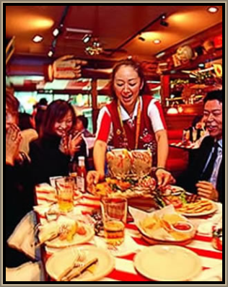
#4 employee welfare
Some businesses seek the harmonious relations with their workforce as an objective, and they aim to achieve this through employee welfare
External examples: Medical insurance, housing, education for family
Internal examples: Canteen, crèche, toilets, uniform
Employees that are satisfied are loyal and hard working, they have increased morale, motivation and productivity
The business also benefits from an enhanced public image as a good place to work – which makes recruitment easier

Slide 18
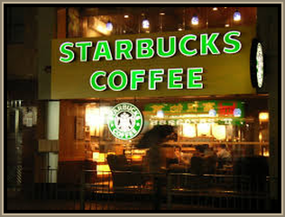
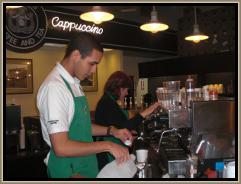
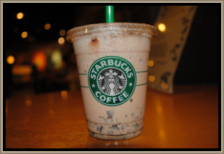
#5 customer satisfaction
This objective is common in service industry and the coffee corner shop competitive market
Businesses who follow this objective wills eek to monitor customer service levels through surveys and will focus on quality
They will attempt to identify and understand what the customer wants and then provide this
They also aim to reduce the number of complaints
A customer centred approach will:
Ensure repeat sales
Create brand loyalty to prevent customers from switching to similar brands
Satisfied customers will tell others and reputation and word of mouth are very cheap ways of highly effective marketing to improve sales

Slide 19
#6 social objectives
Social objectives are also known as corporate social responsibility or CSR objectives
This may involve:
Reducing impact on the environment
Fair wages in developing countries
Helping society
Compliance with laws to minimise externalities like operating sensible hours so not as to noise pollute the local community
Watch a cartoon here
May be the USP of the business (Body Shop) video
May be to improve corporate image (Starbucks) Video

Slide 20
Revision Video

Slide 21
Sample Edexcel A2 questions

Slide 22
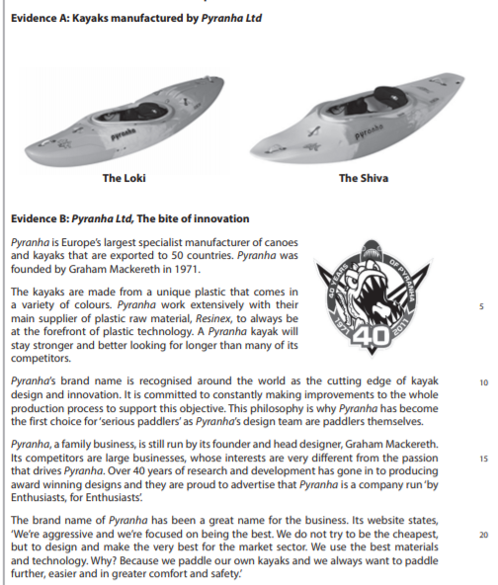
Case study for question 1 (slide 1/2)

Slide 23
Case study for question 1 Slide 2/2)

Slide 24
Sample question 1
[12]
Knowledge 2
Application 2
Analysis
4
Evaluation
4

Slide 25
Answer sample question 1

Slide 26
Glossary
Sales maximisation; This is an objective of a business, which means selling as much as possible without making a loss
Market share; The portion of a total market which is controlled by a particular product or service
Cost efficiency; This means spending as little money as possible to achieve the same objective
Employee welfare; The efforts made by a business to take care of employees whilst at the workplace. At its most basic, every employer is required by law to provide essential amenities such as toilets, sinks and clean drinking water for employees.
Customer satisfaction; This is a measure of how well the product or service meets and exceeds the needs of customer expectations
Social objectives; This is a business which has at its core the objective of helping society or the planet in some way

