Slide 1
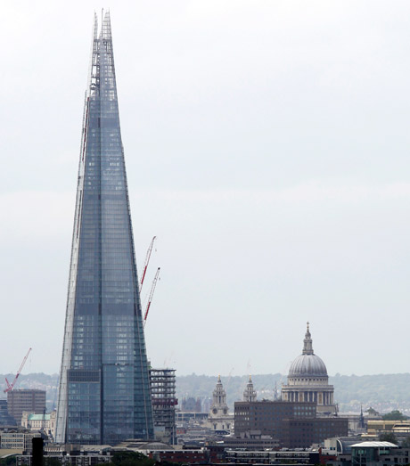
STARTER ACTIVITY
Define the key term ‘opportunity cost’.
What were the possible opportunity costs of building this?

Slide 2
STARTER ACTIVITY
You have one piece of paper left in your notebook. The dilemma is you still have 2 lessons today; 1 Economics lesson and 1 English lesson.
How will you decide on how to use the paper? What will you do? Explain how you made this choice.

Slide 3
Learning Objectives
Lo1 Draw the PPF diagram
Lo2 Distinguish between moves along and shifts in the PPF
Lo3 Illustrate opportunity cost and economic growth

Slide 4
Specification
1.1.4 Production possibility frontiers
a) The use of production possibility frontiers to depict:
opportunity cost (through marginal analysis)
economic growth or decline
efficient or inefficient allocation of resources
possible and unobtainable production
b) The distinction between movements along and shifts in production possibility curves, considering the possible causes for such changes
c) The distinction between capital and consumer goods

Slide 5
KEY TERM: OPPORTUNITY COST
“The loss of alternatives when one alternative is chosen...
...it is the "cost" incurred by not enjoying the benefit that would be had by taking the second best choice available.”
https://www.youtube.com/watch?v=6fGOEKkO0iI (part 1) 4:10 onwards PPF

Slide 6
CONGRATULATIONS!!
You have been hired as Minister of Agriculture and Manufacturing!
Agriculture
Your economy (like all economies) has scarce resources.
You are faced with an important decision:
Should you allocate your resources to Agriculture or to Manufacturing?
Can you allocate to both?
0
Manufacturing

Slide 7
CONGRATULATIONS!!
You have been hired as Minister of Agriculture and Manufacturing!
Agriculture
When more capital is invested into manufacturing, what happens to the level of investment in agriculture? Sketch on the diagram how you imagine the curve to appear.
0
Manufacturing

Slide 8
A | M
800 | 0
790 | 100
760 | 200
720 | 300
700 | 340
660 | 400
600 | 480
500 | 570
450 | 620
400 | 650
300 | 710
200 | 750
100 | 780
0 | 800
Now plot the graph to reveal the correct curve!
Agriculture
0
Manufacturing

Slide 9
What is a production possibility frontier?
Production: the action of manufacturing from components or raw materials, making a product from ‘land’ with ‘capital’ and ‘labour’.
Possibility: the chances of something happening.
Frontier: the extreme limit of understanding or achievement in a particular area.

Slide 10
This is the Production Possibility frontier
A
B
C
D
What is happening at each of these points?
E
Agriculture
F
G
0
Manufacturing

Slide 11
Potential output of two goods in an economy
Crucial: resources in this economy are fixed
A
B
100
C
Capital good is a durable good (one that does not quickly wear out) that is used to produce consumer goods.
D
Can illustrate economic growth
E
Capital Goods
Points along the curve demonstrate the maximum amount of one good that can be produced in relation to another
Consumer good: any tangible commodity produced and subsequently purchased to satisfy the current wants and perceived needs of the buyer.
F
G
0
Consumer Goods
100
Notes:
Economic growth video: http://www.bbc.co.uk/news/10613201
Capital good is a durable good (one that does not quickly wear out) that is used in the production of goods or services.
Consumer good: any tangible commodity produced and subsequently purchased to satisfy the current wants and perceived needs of the buyer.

Slide 12
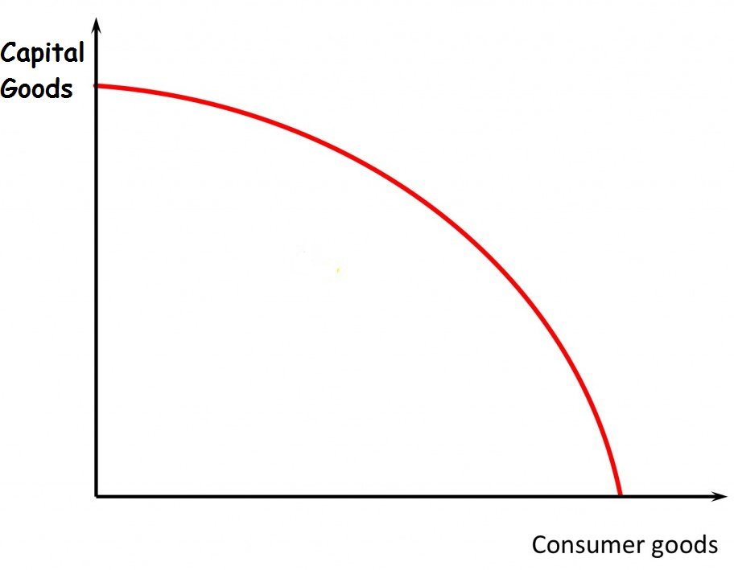
DEMONSTRATING ECONOMIC GROWTH
PPF2
If the economy gains more resources, then their production possibilities (max. could produce) increases.
PPF1
Notes:
Economies operating on the PPF curve are utilising all resources.

Slide 13
Opportunity Cost 2
Increasing opportunity cost – transferring resources from one production to the other. Shows the PPF diagram and explains (5:58)
https://www.youtube.com/watch?v=8n7tjQcMUeA

Slide 14
ACTIVITY – 20 MINS
Complete the worksheet relating to PPF scenarios.

Slide 15
Learning Objectives
REVISITED
Lo1 Draw the PPF diagram.
Lo2 Distinguish between moves along and shifts in the PPF.
Lo3 Evaluate the impact off the PPF upon economic decision-making.

Slide 17
Learning Objectives
Lo1 Identify growth and opportunity cost.
Lo2 Calculate opportunity cost.
Lo3 Evaluate the limitations of the PPF model.

Slide 18
STARTER ACTIVITY
Create a mind map (or whatever you like) of the PPF topic from last lesson.
This will be good for revision purposes!
You can also add to it through the lesson.

Slide 19
PPF SUMMARY FROM LAST LESSON
Potential output of one economy
Capital goods and consumer goods OR two alternative goods.
Assuming fixed amount of land, labour and capital.
Represents opportunity costs/ trade-offs.
A
E
B
D
C

Slide 20
COMPLETE WORKSHEET TASKS
Draw a PPF and plot the following scenarios on the diagram:
A) All resources devoted to production of capital goods.
B) All resources devoted to production of consumer goods.
C) The economy has unemployed resources
D) The economy is working at maximum capacity
E) There is a 50-50 proportion of resources devoted to the production of capital/consumer goods but only 50% of resources within the economy are being employed.
F) Scenario which is currently not possible to achieve
G) Economic growth occurs.

Slide 21
WHERE ARE THE POINTS OF PRODUCTIVE EFFICIENCY?
Can demonstrate efficient allocation of resources within an economy.
All resources are being utilised, with no wastage.
Anywhere along the curve.
Known as allocative efficiency.
A
F
(Anywhere BEYOND the curve)
C
D
(Anywhere on the curve)
(Anywhere not on the curve)
E
B
Notes:
Economies operating on the PPF curve are utilising all resources.

Slide 22
DEMONSTRATING ECONOMIC GROWTH
PPF2
Can also illustrate economic growth.
How do you think we could use the PPF to show this?
PPF1
Notes:
Economies operating on the PPF curve are utilising all resources.

Slide 23
RESERVATIONS ABOUT PPF
It’s more plausible and powerful in an manufacturing context.
In a service industry world, what’s the max capacity for a solicitors? - ie the PPF is much less clear in a service world.
The theory makes things sound like facts of life, ie the PPF is what it is – and you have to live within that constraint.
... If the Chinese had taken that view 20 years ago they would have 500 million more people in abject poverty
The PPF is a huge simplification of the real world, raising interesting questions, but not answering them.

Slide 24
PPF on GRAPH PAPER.
For the next task you will need graph paper..
Plot the PPF using the information and calculate the opportunity costs.
Butter | Guns
700 | 0
660 | 100
600 | 200
500 | 300
300 | 400
0 | 500

Slide 26
MULTI-CHOICE QUESTIONS
PPF Curves have appeared as both multi-choice questions AND data response questions.
So it is important to fully grasp this topic.

Slide 27
Notes:
June 2010

Slide 29
Notes:
January 2011

Slide 30
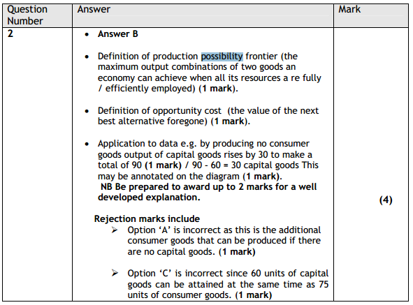

Slide 31
Notes:
January 2012

Slide 32
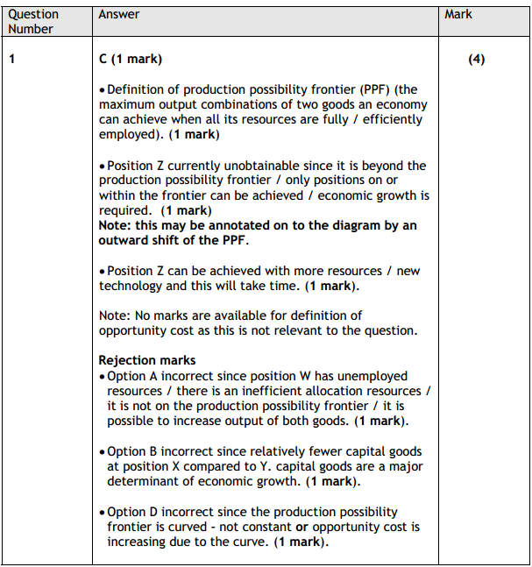

Slide 33
Notes:
Jan 2013

Slide 34
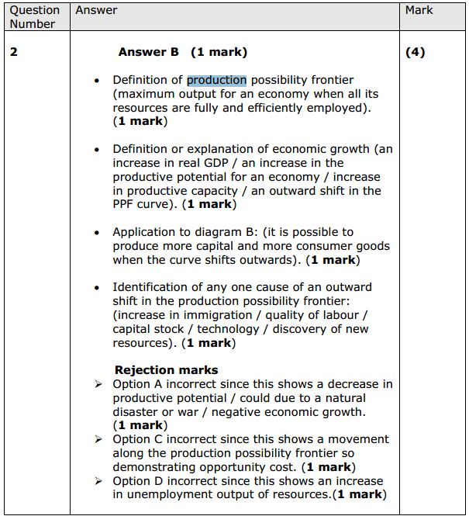

Slide 35
Notes:
June 2009

Slide 36
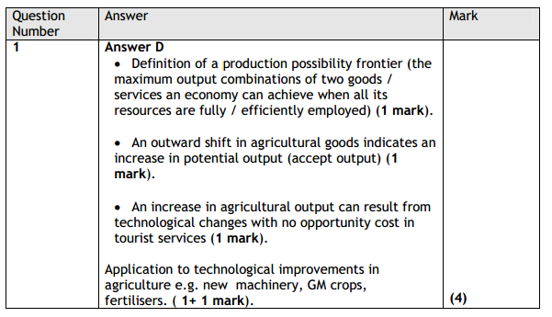

Slide 37
PPF QUESTION
Answer the past paper question on Production Possibility Frontiers.
We shall go through the answers as a class.
June 2009 – Section B (p. 12)
http://www.edexcel.com/migrationdocuments/QP%20GCE%20Curriculum%202000/January%202009/6EC01_01_que_20090116.pdf

Slide 38
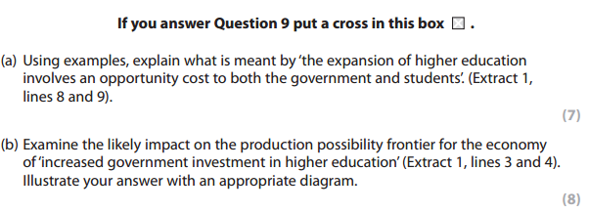

Slide 39
Land
Labour
Inputs
Output of goods/services for sale in markets
Capital
Enterprise
A firm, business or enterprise
LAND e.g. Space to construct a building, wood, water, fish, crude oil, minerals, metals, etc.
LABOUR e.g. Designers, engineers, doctors, teachers, technicians, computer operators, etc.
CAPITAL e.g. buildings, machines, furniture, computer, vehicles, etc.
ENTERPRISE e.g. Chief Executive Officer [CEO], Principal, Section Coordinator, Senior Managers, Business people, etc.

Slide 40
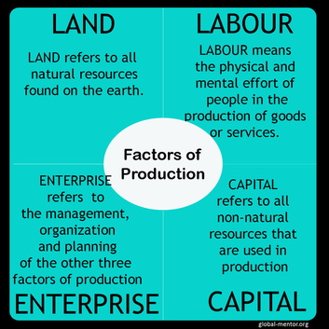

Slide 41
Notes:
Answer: B
More capital goods increasing the productive capacity/potential of the economy.

