Slide 1
Edexcel A2 Business
3.6.1 Causes and effects of change
Revisionstation

Slide 2
Worksheet
Notes:
I thought this might make nice flashcards, I am teaching this – so I may change it after I get feedback from my group!

Slide 3
3.6.1 Causes and effects of change
a) Causes of change:
changes in organisational size
poor business performance
new ownership
transformational leadership
the market and other external factors (PESTLE)
b) Possible effects on:
competitiveness
productivity
financial performance
stakeholders

Slide 4
Starter
How has your life changed in the last year?
Moved house? Changed school? New mates? Started to learn to drive? Bought a new phone?
Your life, like business, is dynamic and not static, there are changes all the time.
Who else is effected by the changes in your life?

Slide 5
Causes of change

Slide 6
Causes of change in business
There are lots of causes of change in a business, many of them are industry specific (e.g. rain in agribusiness) the main ones your exam board would like you to know about are:
changes in organisational size
poor business performance
new ownership
transformational leadership
the market and other external factors (PESTLE)

Slide 7
#1 Cause of change: changes in organisational size
The business may grow in size for example if it expands internationally
Issues the business will face as a result are
Maintaining the company culture
Motivating staff during the expansion
Increased labour costs with hiring of new staff
Training of new staff

Slide 8
#2 Cause of change: poor business performance
This may happen if the business experiences poor sales, low profits or slow expansion
Issues the business will face as a result;
The business will need new objectives and a new direction
The business will need some new strategies to compete (Ansoff’s)
The business will need to look at what is necessary to improve performance this may mean delayering or redundancies

Slide 9
#3 Cause of change: new ownership
This may happen if the business has been bought or merged with another business or there has been a management buyout
Issues the business will face as a result;
There may be significant role duplication (two marketing managers for example) so there may need to be redundancies
There may be a clash of cultures
There may be issues of communication between the two businesses as they change and merge

Slide 10
#4 Cause of change: transformational leadership
This may happen if new leadership is brought into the organisation that seeks to change it
Issues the business will face as a result;
The business will need to reinvent itself to achieve competitive advantage
A new business culture which challenges managers to develop new ways of thinking
The business encourages the development of new ideas

Slide 11
#5 Cause of change: the market and other external factors (PESTLE)
This may happen if there have been new entrants to the market (Porter’s 5 forces) or due to EU expansion, or changes in the market (e.g. energy market deregulation)
Issues the business will face as a result;
The business may need to respond by increasing their research and development budget to introduce more innovative products to their portfolio
They may need to change the corporate objectives

Slide 12
Possible effects of change

Slide 13
Possible effects of change on a business
All these changes can cause effects on a business, they depend on the type, size and industry, but the general effects your exam board would like you to know about are:
competitiveness
productivity
financial performance
stakeholders

Slide 14
#1 Effect of change on competitiveness
A business that is undergoing change may need to;
Be aware of competitors actions and be prepared to react to them
Benchmark with similar businesses to make sure they are keeping up
Invest in R&D (research and development) to keep innovating and bringing new products to market
Investigate new and emerging markets e.g. BRIC economies, (Brazil, Russia, India and China) or the expanding EU

Slide 15
#2 Effect of change on productivity
A business that is undergoing change may need to;
Invest in new equipment and machinery
Change production methods
Change quality management methods
Retrain managers so their skills meet the new technologies used

Slide 16
#3 Effect of change on financial performance
A business that is undergoing change may need to;
Compare sales estimate with available production capacity
Budget for necessary increases in staff and capacity
Produce new cash flow forecasts
Discuss how to raise any extra capital

Slide 17
#4 Effect of change on stakeholders (internal)
Stakeholders may be effected by change:
Employees may feel unsure about their future
Managers may be worried about duplicate roles and redundancies, or possibly see the change as positive with new opportunities

Slide 18
#4 Effect of change on stakeholders (External)
Stakeholders may be effected by change:
Shareholders may be reluctant to invest while there is a period of change happening, until circumstances are more settled within the business
Customers may be delighted with the new range of products and improved quality
Suppliers may see the change as an opportunity to renegotiate old contracts with more favourable terms

Slide 19
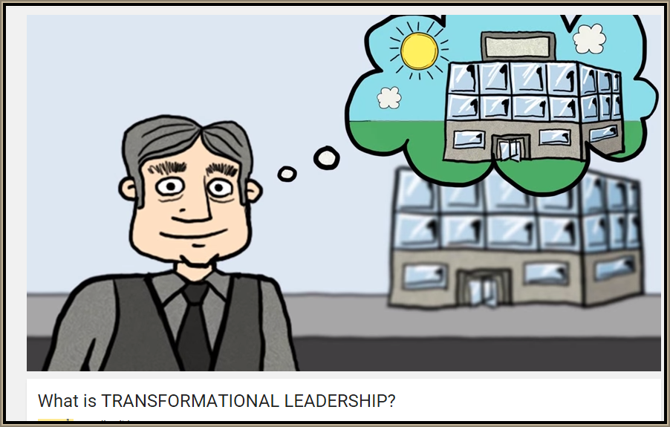
Revision Video

Slide 20
Sample Edexcel A2 questions

Slide 21
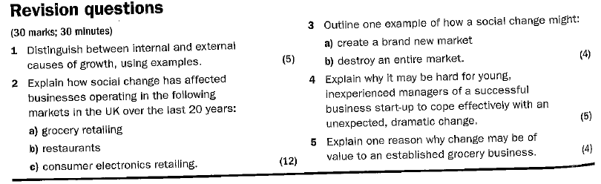

Slide 22
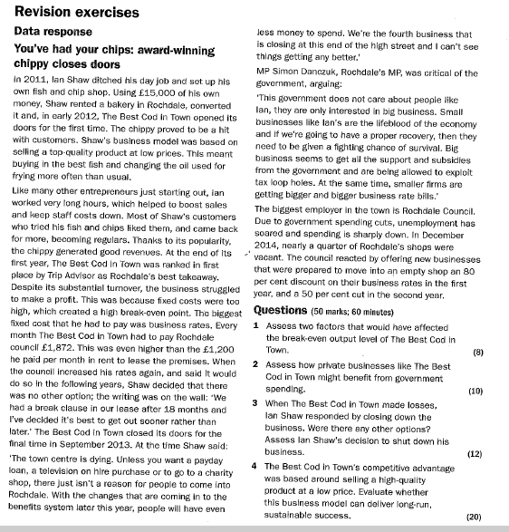

Slide 23
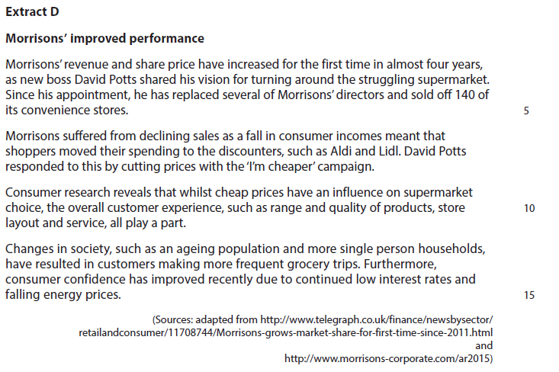
Case study for question 1

Slide 24
Sample question 1
Knowledge 2
Application 2
Analysis
4
Evaluation
4

Slide 25
Case study for question 2

Slide 26
Sample question 2
[8]
Knowledge 2
Application 2
Analysis
2
Evaluation
2

Slide 27
Glossary
Transformational leadership; A leader who transforms the business that they work for, for example Stuart Rose of Marks and Spencer
(PESTLE); Political, economic, social, technological, legal and environmental external pressures on business
Competitiveness; The ability of a business to sell goods and services in a market in relation to other businesses in the same market
Productivity; the rate of output per unit of input
Stakeholders; anyone with an interest in or who us affected by a business

