Slide 1
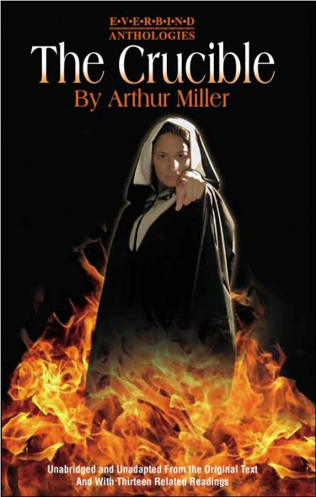
The Crucible by Arthur Miller
Leaning Objective: To explore the characters in the first scene of ‘The Crucible’.

Slide 2
Learning Outcomes
By the end of the lesson you should be able to…
Recall the main characters in the 1st scene.
Describe the relationships between the characters.
Explain how the characters should react to each other on the stage.

Slide 3
Our Understanding so far…
Split into two groups…
Write down everything you know about the crucible or Arthur Miller so far….
3 minutes

Slide 4
Scene One…
Rev. Parris is praying over his daughter, Betty Parris, who lies as if unconscious in her bed. Conversations between Rev. Parris, his niece Abigail Williams and several other girls reveal that the girls, including Abigail and Betty, were found dancing around a fire and a cooking pot in a nearby forest, apparently led by Tituba, Parris's slave from Barbados. When Parris found them Betty fainted and she has not yet come around. The townspeople do not know exactly what the girls were up to, but there are rumours of witchcraft.

Slide 5
Scene One…
John Proctor enters the room in which Betty lies in bed, Abigail is there and they are left alone. She then tries to seduce him. It does not work, but we find out that Abigail and Proctor engaged in a previous affair and that Abigail still has feelings for him.

Slide 6
Scene One…
Reverend John Hale is summoned from Beverly to look upon Betty and research the incident. He is known for detecting witchcraft and the devil and is eager to use his acquired learning. He questions Abigail, who accuses Tituba of being a witch. Tituba, afraid of being hanged and threatened with beating, she says that she is not a witch but she saw the devil and accuses Goodwives Sarah Good and Osburn of witchcraft. Betty who springs to life claims to have been bewitched and also shouts about her faith in God. Betty and Abigail sing out a list of people whom they claim to have seen with the Devil. This is all lies.

Slide 7
The Characters
Rev Parris: Pompous, unpopular and ambitious. Talks of hell in his sermon's.
Abigail Williams: a ‘victim’. Parris’ niece. Had an affair with her previous boss Proctor.
Betty Parris: Parris young daughter. Fakes being ill as to not get in trouble.
Tituba: a slave, carries out ‘spells in the woods’, admits to anything when punished.
John Proctor: the hero, very proud, everyone has a lot of respect for him… had an affair with Abi.
Rev John Hale: learned man, believes he can rid the village of evil by knowledge.

Slide 8
Your Task
Using your knowledge of the puritans and the witch hunt to create the first scene.
You know… the characters, the scene, the background…
You create the action !!!!

Slide 9
Evaluation…
Recall the main characters in the 1st scene.
Describe the relationships between the characters.
Explain how the characters should react to each other on the stage.

Slide 10
Independent Learning
For next lesson…
Copy up your drama diary/ progress books.
This Power Point is on Moodle.
What progress have you made….
Set your own target for next lesson….
What techniques have you used….
How could you use the information from today.

