Slide 1
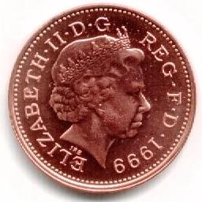
Can A Profitable Business Have No Cash?
It is important to realise that a business can be making a profit, but still have little cash
Take the following scenario as an example:
£900 cash is spent on raw materials
A manufacturer has £1000 cash
£1000 Cash
Pay £900
Make Sale
It turns the raw materials into finished products
Despite selling the products at a profit, the firm has run out of cash!
£200 Bill Due
Meanwhile a £200 gas bill payable immediately is received
Products are sold for £1,600 and the customer is given 10 days to pay
Customer Payment Due

Slide 2
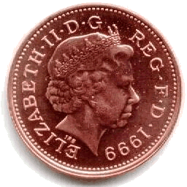
What If There Isn’t Enough Cash?
Before rushing out to borrow external finance there are a number of ways that the cash situation can be improved:
More Cash From The Owner
Adjust The Timing of Payments
The Purchase Of Fixed Assets
The owner may choose to invest more money into the business
It’s in the owners interest to ensure that the business survives
But only if it is profitable in the long-term!
It may be possible to negotiate longer credit terms with suppliers
This may allow a firm to sell the finished product and obtain payment from customers before having to pay suppliers
The acquisition of fixed assets can have a big impact on cash flow
Since it usually involves spending large sums of money
The impact may be reduced by using other ways of acquiring them
E.g. Leasing allows payments to be spread out

Slide 3
Profit Vs Cash
It is important to understand the difference between profit and cash:
Cash
Profit
This refers to the physical coins and notes that a business owns
Including what it has in the bank
Profit is calculated as:
Profit = TR - TC
Businesses need to have enough to hand to pay their bills
But holding too much cash may mean investment opportunities are being missed
It considers the costs incurred, and the revenue received from selling a product or service
However, it does not consider when the money changes hands:
It is shown in the Cash Flow Forecast
It is vital that in the short-term a business has enough cash to pay its bills
It is calculated by the Trading, Profit & Loss Account
It is vital that a profit is made for the long-term survival of the business

