Slide 1
What are the externalities associated with trees?

Slide 2
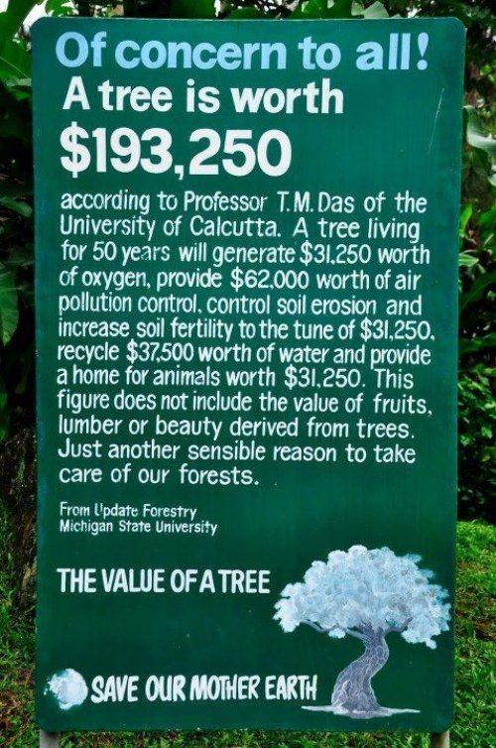

Slide 3
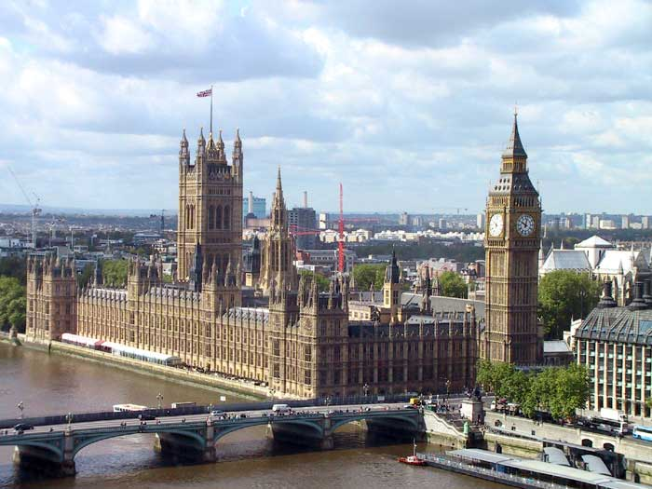
FORMS OF GOVERNMENT INTERVENTION
All intervention sets out to move the market equilibrium (Qe) closer to Q*
Indirect Taxation
Subsidies
Price Controls (SJS)
Regulation
Provision of Information
State Provision of Goods
Tradable Permits

Slide 4
LEARNING OBJECTIVES
Lo1: Explain what is meant by a ‘tradable permit’.
Lo2: Analyse their impact upon externalities.
Lo3: Evaluate their overall effectiveness.

Slide 5
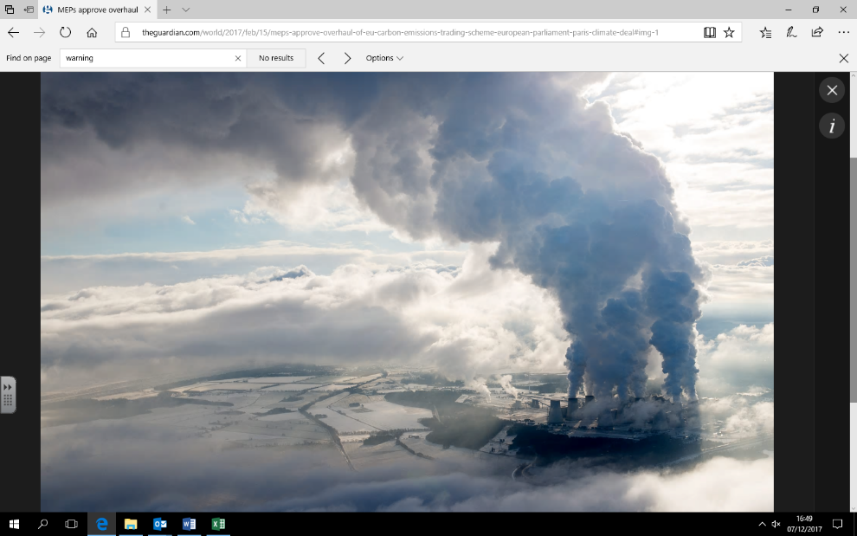

Slide 6
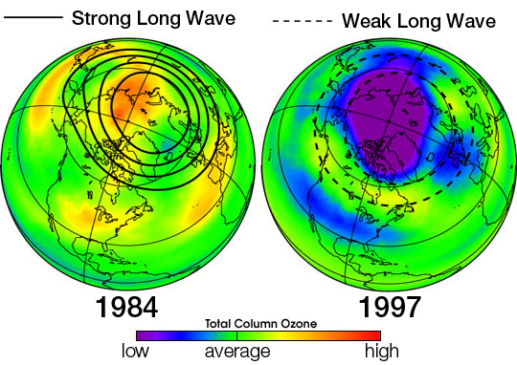
CONTEXT – SOCIAL COSTS
CO2 emissions accelerate climate change (global warming).
Rising sea levels – flooding and loss of land.
Health problems – respiratory disease, cancers.

Slide 7
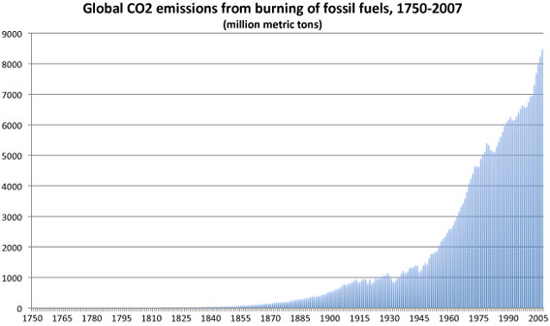

Slide 8
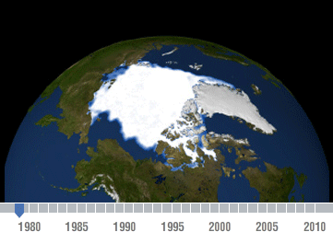

Slide 9
BIGGEST POLLUTERS?
Notes:
Which order do these polluters rank?

Slide 10
Top 4 biggest polluters (China, USA, India and Russia) account for 54% of the world’s pollution.
26%
5%
1.5%
17%
4%
1.4%
6%
2.2%
1.3%

Slide 11
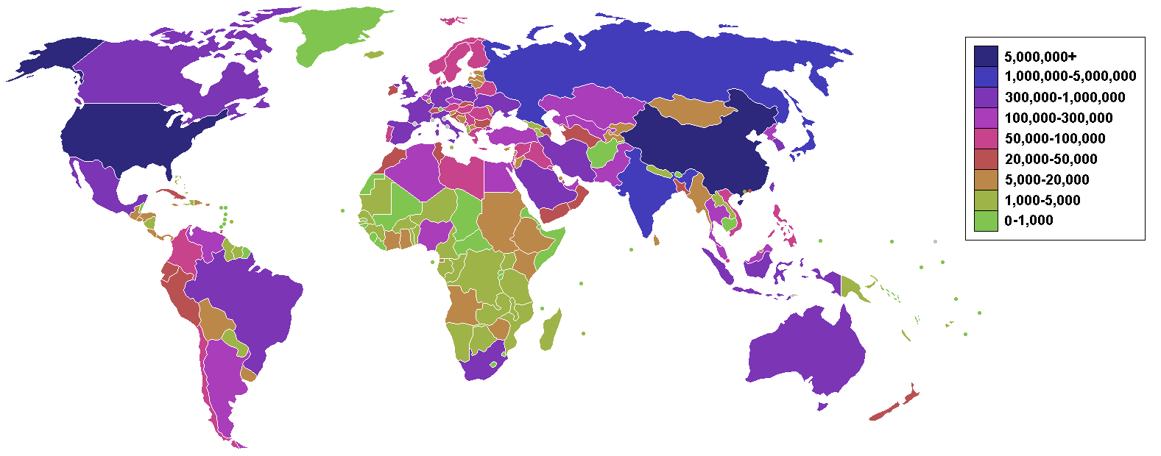
Tonnes of CO2

Slide 12
SO WHAT ARE…
Also known as carbon units… which are then traded.
Tradable Permits…?
A good or service that can be sold in another location distant from where it was produced.
Officially allow or authorise (someone) to do something.
A tradable permit gives a business the right to emit a given quantity of waste or pollution into the environment. These can then be traded.

Slide 14
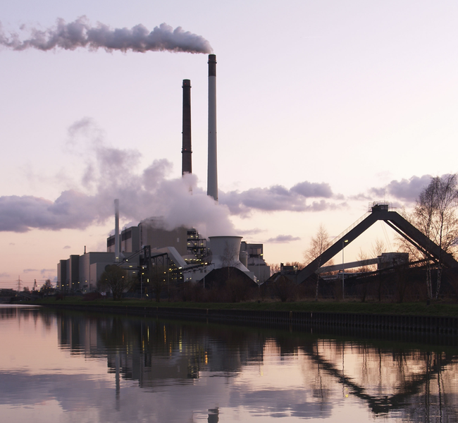
POLLUTION PERMITS
Limits/allocations of pollution are placed on firms
Firms must purchase ‘permits’ to pollute.
Also known as Carbon Credits/Carbon Trading.
Financial incentive to lower pollution
Watch the clip and answer the question sheet. http://www.youtube.com/watch?v=ReOj12UAus4
Notes:
Ask them first.

Slide 15
Q1 = Market generated level of output. MPC = MSB
Cost/Benefit
MSC
Q* = Socially optimal level of output. Best level for society. MSC = MSB
MPC
Market failure because the market gives us Q1 which is higher than the optimal.
MSC exceeds MSB so a welfare loss to society occurs.
TASK: Draw the externalities diagram for pollution. Identify the socially optimum level of output and welfare loss.
TASK 2: Now what would the diagram look like after a pollution permit scheme has been implemented?
MSB = MPB
Q*
Q1
Quantity
Notes:
Ask students to draw externalities diagram. - Is it production/consumption? - Merit or demerit?
MSC = Private costs + External costs Private costs (MPC) are costs to factory owners, like rent, wages and raw materials. Externality is the third party cost to society.
The total cost to society therefore (MSC), must include the private cost because society’s resources are being used in the production process, as well as the externality, because society’s resources are being used to clear up the mess (pollution).
MPC represents the factory’s supply curve (this is also its marginal cost curve). MSC represents the true supply curve (therefore, true marginal cost curve) for society as a whole, which takes into account the external costs to society.
**Demand curves do effectively measure the private/social benefit (here they are equal, as we’re assuming no externalities from consumption) of consuming a certain good. Ie. If 100 Mars Bars are sold at 30p, then one assumes that those 100 people felt that a Mars Bar would give them 30p of benefit.
Intervention places an additional cost upon the factory, which moves the MPC to the left. This extra cost doesn’t place any extra burden upon society, therefore MSC remains in the same position and so the welfare loss triangle becomes smaller.

Slide 16
Cost/Benefit
Q1 = Market generated level of output. MPC = MSB
MSC
MPC + Intervention*
Q* = Socially optimal level of output. Best level for society. MSC = MSB
MPC
Market failure because the market gives us Q1 which is higher than the optimal.
MSC exceeds MSB so a welfare loss triangle to society occurs.
Q3 = Intervention adds to the private costs of the polluter. Helping to correct the market failure by reducing the size of the welfare loss.
MSB = MPB
Q*
Q3
Q1
Quantity
Notes:
Counterargument… what happens if the permit isn’t enough? Draw the diagram.
This diagram is very transferable – can replace intervention with tax.
Intervention places an additional cost upon the factory, which moves the MPC to the left. This extra cost doesn’t place any extra burden upon society, therefore MSC remains in the same position and so the welfare loss triangle becomes smaller.
All the points within the welfare loss triangle are ones in which the cost of society (MSC) are greater than the benefit to society (D/MSB)… until we reach the point of equilibrium at MSB=MSC (optimum level).

Slide 17
POLLUTION PERMITS
Authorises a firm to produce 1 tonne of CO2.
One way plane journey from Oslo to Bangkok.
Cut CO2 emissions by 5% between 2008-2012 compared to their emissions in 1990.
Purchase units from factories in other countries or invest in helping other countries to reduce emissions.
Determined by D&S.
Notes:
Ask them first.

Slide 18
REDUCING THE WELFARE LOSS
In order to increase the quantity (positive externality) or reduce the quantity (negative externality).
Treat MPB as a demand curve and MPC as a supply curve.
Example: Subsidy and tax would shift MPC (supply) left/right.
Example: Government information would shift MPB (demand) left/right.
The demand curve represents marginal benefit, it shows the amount consumers are willing to pay. Willingness to pay reflects the benefit derived from each unit.
MPC (Supply)
MPC is the cost of producing an additional unit of a good/service, it is paid by those producing the commodity. The marginal private cost curve is equivalent to the firm's supply curve.
MPB (Demand)

Slide 19
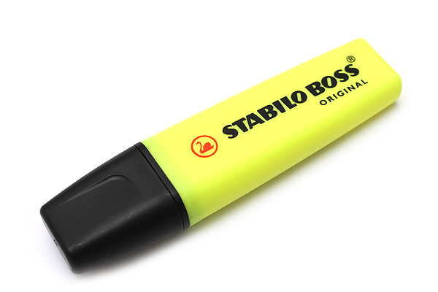
BBC ARTICLE – DRAWBACKS?
Read the BBC Article on tradable permits.
Highlight the drawbacks of pollution permits.
These are good evaluative points necessary for A/A* answers.
Notes:
Read together, then bring out the drawbacks.

Slide 20
POLLUTION PERMITS - DRAWBACKS
Does not directly compensate the third party ‘victims’.
Problem may simply be shifted to another source.
Judging the socially optimum level Q* (where MSC = MSB) and measuring externalities is difficult.
Agencies run the risk of issuing too many permits, meaning that the cost of polluting is low.
Judging the correct cap for different firms/countries is difficult.
Needs to be strictly regulated, otherwise risk of corruption. Brings about an opportunity cost.
Two largest polluters (US and China) are not part of the scheme.
Notes:
r

Slide 21
EU CARBON EMISSIONS SCHEME
The EU operates their own carbon tradable permits scheme.
Known as the ETS (Emissions Trading Scheme).
Read the article and watch the video.
KAA – Pick two points to identify how the scheme in the EU works
EV – Pick two points that refer to drawbacks or critique the scheme.
https://www.youtube.com/watch?v=vPsq47iHQSA
Carbon emissions trading in Europe | Made in Germany

Slide 22
LEARNING OBJECTIVES
Lo1: Explain what is meant by a ‘tradable permit’.
Lo2: Analyse their impact upon externalities.
Lo3: Evaluate their overall effectiveness.

Slide 23
PLENARY ACTIVITY
You will each receive a question relating to this lesson’s learning objectives.
Jot down an answer to your question and be prepared to share your question and answer with the class!
http://www.classtools.net/random-name-picker/91_D2hbhK

Slide 24
HOMEWORK
15 mark question
Due in Monday 14th December.
Notes:
Read together, then bring out the drawbacks.

Slide 25
https://www.youtube.com/watch?v=hX1hq6pJG2M
Portsmouth Professor – 6:27

