Slide 1
1.3.1 Product / Service Design
a) Design mix:
function
aesthetics
cost
b) Changes in the elements of the design mix to reflect social trends:
concern over resource depletion: designing for waste minimisation, re-use and recycling
ethical sourcing

Slide 2
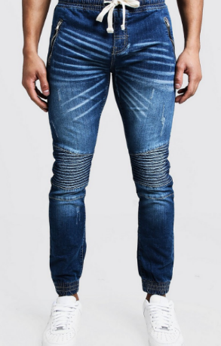
Starter
When choosing a new pair of jeans, would you buy them based on:
Design or style
How hardwearing they are
How cheaply they can be made, so how much they cost you?
Choose one
Notes:
This should lead nicely to a discussion of the design mix

Slide 3
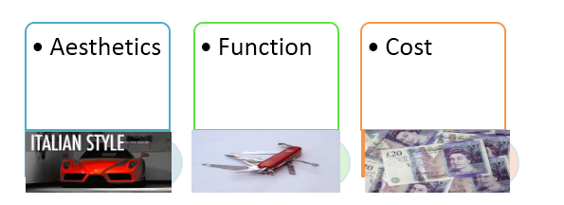
Definition: Product or service design
The combination of factors needed in designing a product
OR Aesthetics, Function, Economic Manufacture (cost)

Slide 4
Design Mix

Slide 5
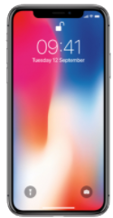
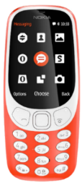
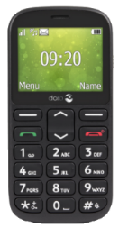
Using the Design Mix
To see how the design mix can be used to make decisions, consider the following mobile phones:
Aesthetics
Apple’s iPhone 12
A sleek, top-of-the-range phone that focuses on look and feel
Nokia’s 3310 (2017)
A basic 2G phone with a camera designed to be cheap
Doro 1360
Function
Cost
A basic phone with large buttons, which focuses on being easy-to-use

Slide 6
The design Mix – Three questions
Aesthetics – how does the product look, feel, taste?
Function – what problem does the product or service solve?
Cost – can the product be made (or service provided) for the right price, so a profit can be made?

Slide 7
a) Design Mix
https://youtu.be/Na_fSCFjxHA
Watch the above video on the theory of design mix.
What is the design mix?
What does each part of it mean?

Slide 8
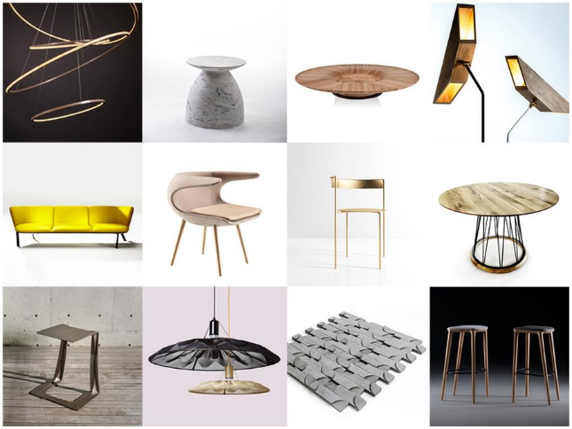
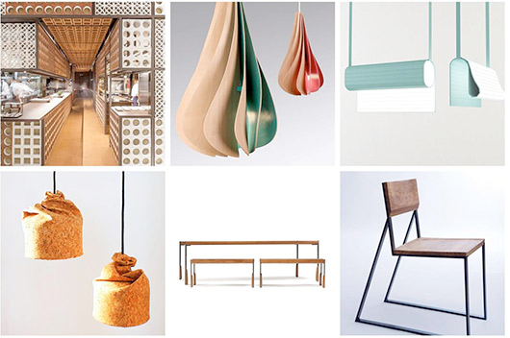
Aesthetics
Style, design, aesthetics, look, appearance, elegance, class, charm, chic, carry out some research and find some products which demonstrate aesthetics to show the rest of the group

Slide 9
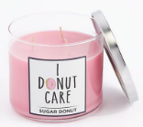
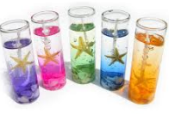
Aesthetics
Consumers are asked through marketing research about their feelings towards products: how the product looks, tastes, feels
Aesthetics can mean how the senses respond to the product e.g. the smell of a scented candle
More stylish and beautiful products tend to sell better and can charge a premium price
Aesthetics can even be the emotional attachment that the customer has with the product e.g. (watch the Budweiser puppy advert)

Slide 10
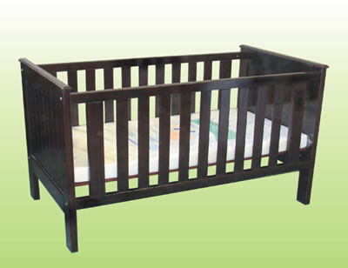
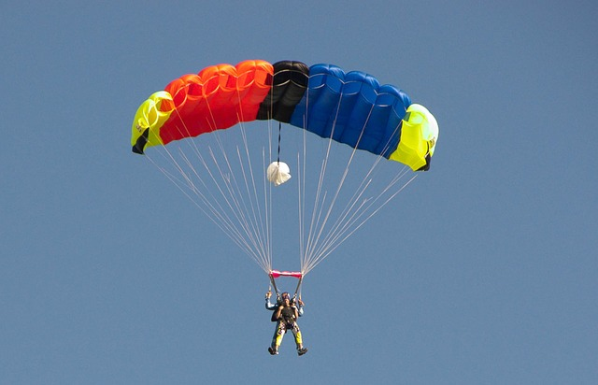
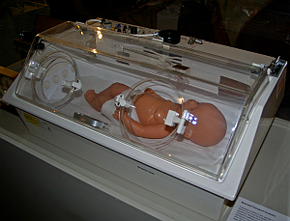
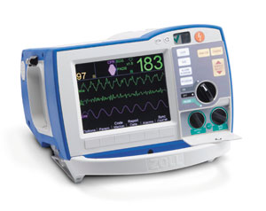
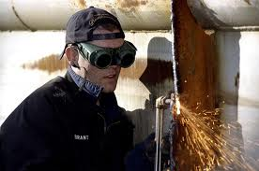
How important is it that these products have function in mind when designed? (rate 1 Not so much and 10 very)
Function
Explain why function is so important for these products.

Slide 11
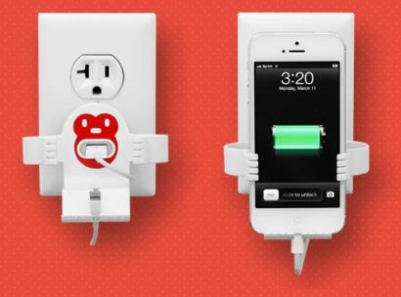
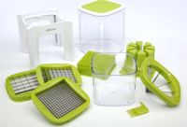
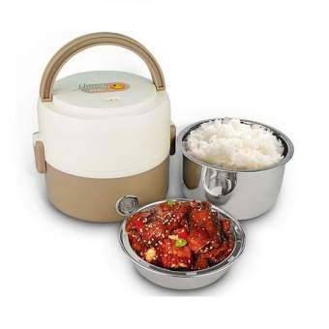
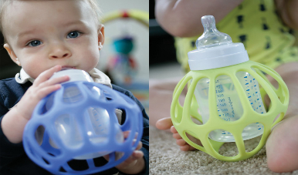
Function
Function, purpose, job, task, duty, ergonomics, usability, safety, reliability, functionality, find some products which have function as their most important aspect

Slide 12
Function
Questions that a business may need to answer about the function of a new product or service during its design:
Will the product or service be fit for purpose?
What does the product do? In a Dyson vacuum cleaner, it is designed to clean without needing a bag inside which lost suction when it got full
How well does it perform? In a car this may be its mpg (miles per gallon, the higher the number the less petrol it will need) or its top speed

Slide 13
Cost ££££££
Questions the design team might ask the production department…
What is the minimum cost that we can make this product for whilst retaining quality?
Can this product be made using productive capacity? Can it be made efficiently?
Can it be produced for a lower cost than the competitors?
For which type of products is cost the most important element in the design mix? Explain your answer.
Notes:
Links should be made that a lower cost of production will give competitive advantage…

Slide 14
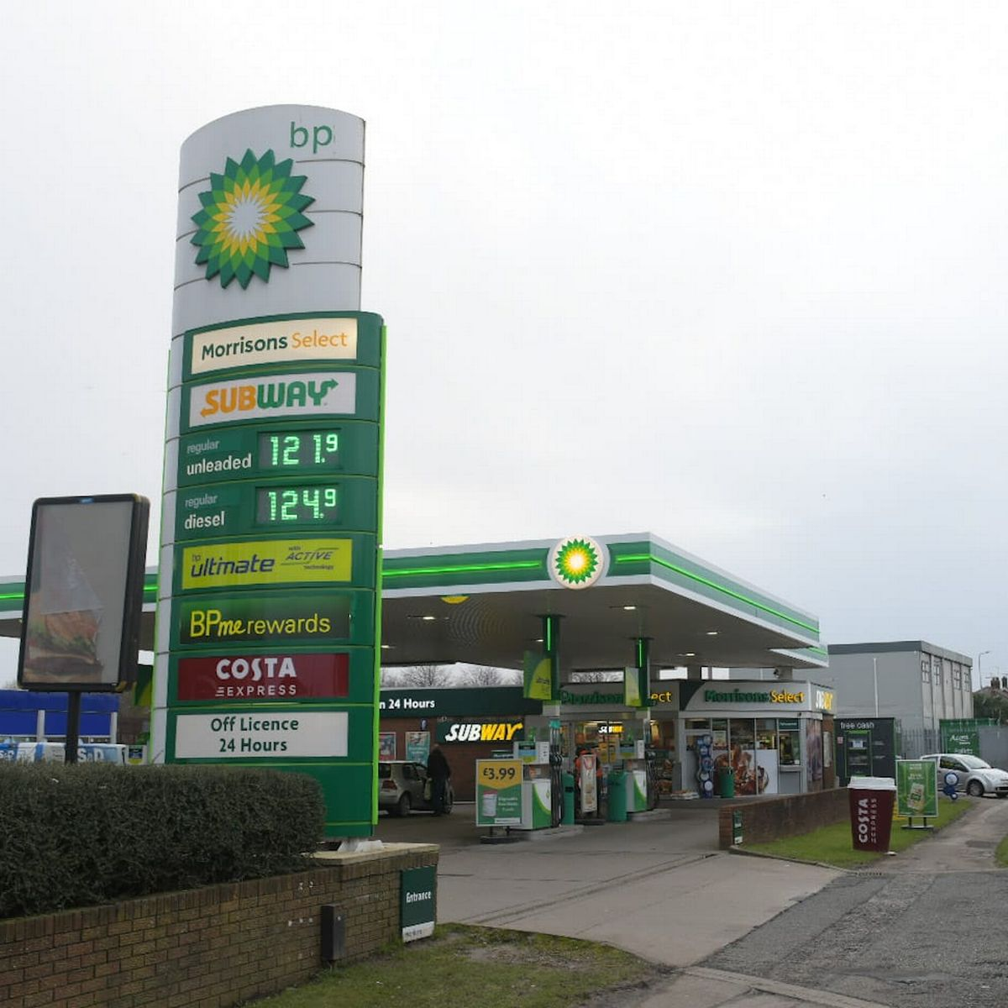
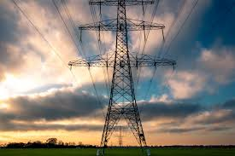
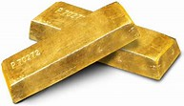
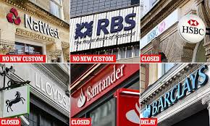
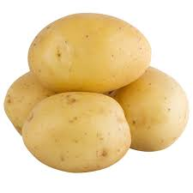
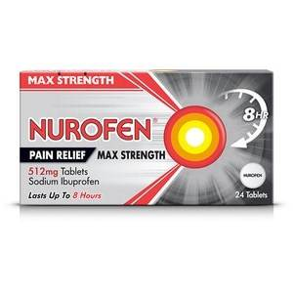
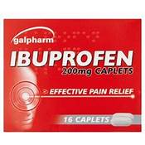
For which type of products is cost the most important element in the design mix? Explain your answer.

Slide 15
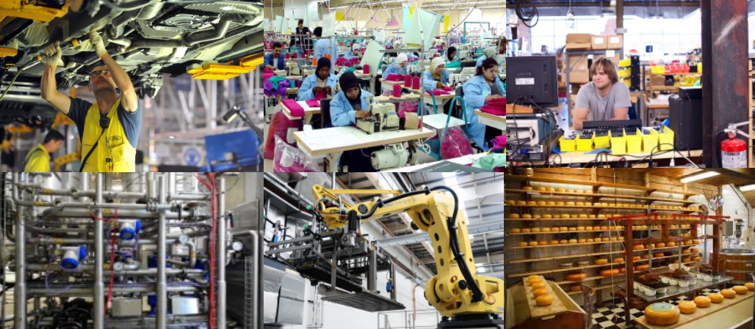
Cost (economic manufacture)

Slide 16
Cost (economic manufacture) – questions
Questions the design team might ask the production department during the design phase
What is the minimum cost that we can make this product for whilst retaining quality?
Can it be made efficiently?
Can it be produced for a lower cost than the competitors?
A lower cost of production will mean competitive advantage for the business – they can pass on lower prices to customers, making the product more appealing
Ford production line, when designing a new car what kinds of costs do you think they will need to take into consideration?

Slide 17
Watch the following videos and answer the question above each video (use this as part of your notes)
Remember: Think about linking to Porter and how the business would look to achieve a competitive advantage.
Assess the benefits to Corona of focusing on function
https://www.youtube.com/watch?v=kTMhI2Sevk4
Assess the benefits of Brompton of focusing on function
https://youtu.be/lhDoB9rGbGQ
Assess the importance to a company such as McDonalds/Burger king of focusing on aesthetics?
https://youtu.be/XrZFM2nvLXA
Assess the importance to a business such as Aldi focusing on cost?
https://youtu.be/RD8bai4hNBw

Slide 18
b) Changes in the elements of the design mix to reflect social trend
concern over resource depletion: designing for waste minimisation, re-use and recycling
ethical sourcing

Slide 19
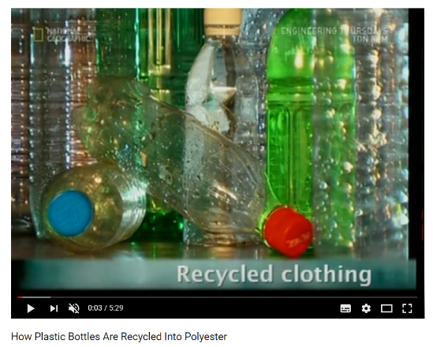
Changes in the elements of the design mix to reflect social trends
Concern over resource depletion: designing for waste minimisation, re-use and recycling
Watch the video and explain your point of view - do aesthetics have to be sacrificed when re-using?

Slide 20
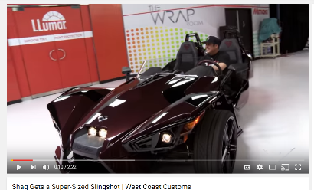
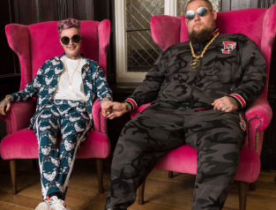
Bespoke design
Bespoke design means; custom made, custom built, tailor made to the consumer
This could be a product such as a customised car or a wedding cake
This could be a service such as a customised wedding
Watch the video and explain why this car was bespoke and which part of the design mix was most important to the customer?

Slide 21
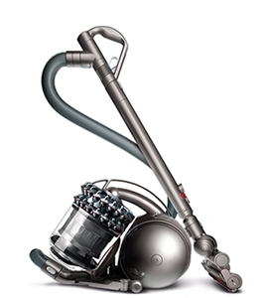
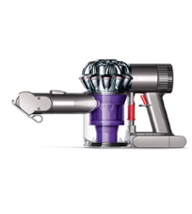
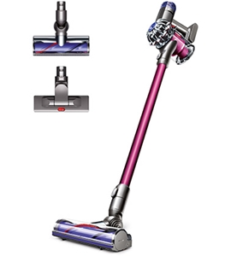
Standard design
Standard design are products or services that are sold as standard, the customer cannot add any extra features or benefits
Why are Dyson products standard and not bespoke?
Notes:
Because a customer does not have a Dyson product made to their exact specifications

Slide 22
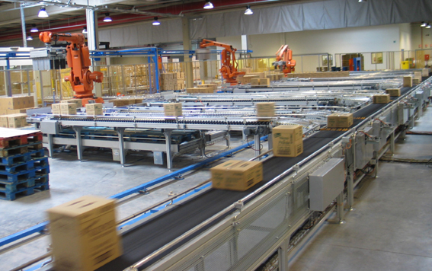
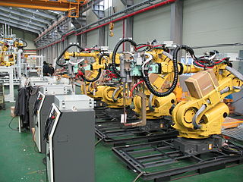
Efficiencies
Efficiencies in production can be achieved by changing the types of materials used or by updating the technology used in production

Slide 23
Concern over resource depletion: watch the video

Slide 24
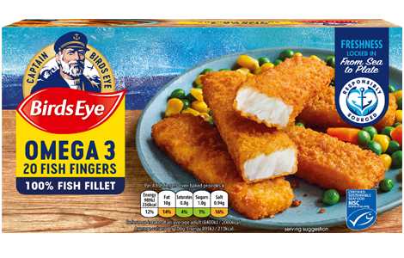
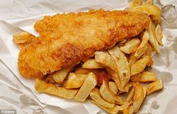
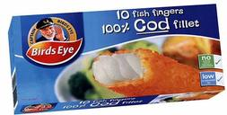
Resource Depletion
How would the depletion of cod stocks affect Birdseye?
​What would they do to overcome this?
What other social trends may effect the design mix for businesses?
https://youtu.be/iq9O41fjMmM
What is unusual about this video?

Slide 25
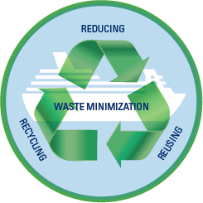
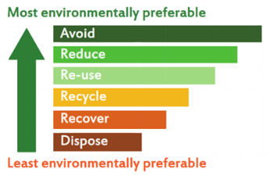
Design for waste minimisation
While waste is actually created by contractors on site, the decisions made by designers have a major influence on the type and amount of waste
Deciding what and how to build, whether to demolish or renovate, what materials to use and the design specifications for construction all impact on the waste created during a project

Slide 26
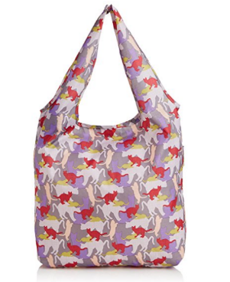
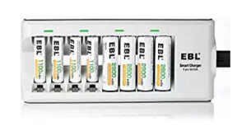
Re-use
Some products are made to be re-used, this gives consumers good value for money as they can use the product more than once
Rechargeable batteries
Reusable carrier bag
Reusable drinking straws

Slide 27
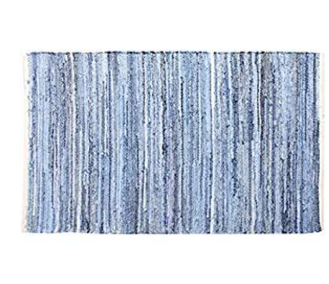
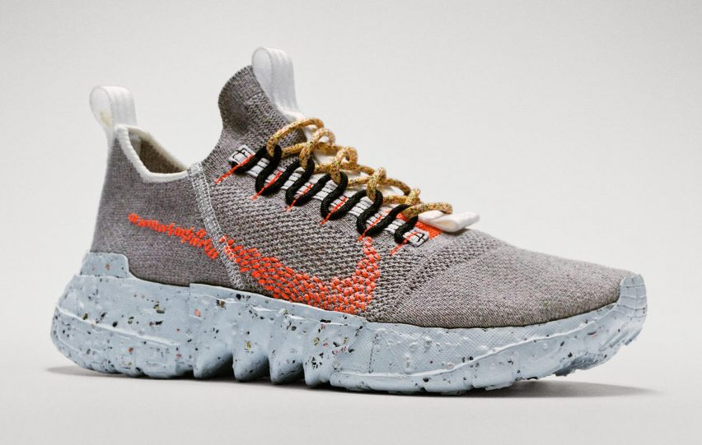
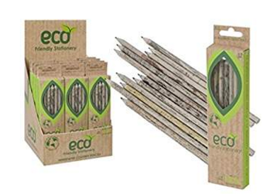
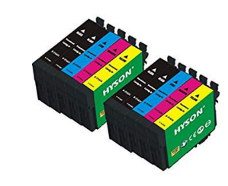
Recycling
Some products are made using recycled materials, this appeals to the green consumer and is good for the environment
Recycled trainers
Recycled pencils
Recycled jeans, made into a rug
Recycled Ink
Explain the likely costs and benefits to businesses, cuch as Nike, that provide recycling of products facilities to instore customers?
Explain the likely costs and benefits to a business of producing using recycled materials?

Slide 28
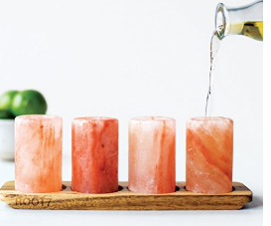
Ethical sourcing
Ethical sourcing also means 'ensuring that the products being sourced are created in safe facilities by workers who are treated well and paid fair wages to work legal hours', and it also implies 'that the supplier is respecting the environment during the production and manufacture of the products.'
Notes:
Quote taken from: https://www.icix.com/cloud-apps/sustainability/ethical-sourcing/

Slide 29
Social Trends
What social trends have affected the businesses in the following videos?
​What have they had to do to respond to such trends? How might it affect them?
Starbucks
https://youtu.be/DaG10sqw9fk
Mercedes-Benz
https://youtu.be/V2k2ospXXr8

Slide 30
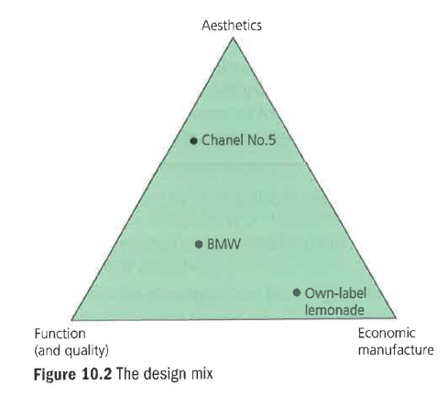
Review Questions
1 Explain how resource depletion might affect the future design of motor cars. (4)
2 Explain where you would plot the following on Figure 10.2. Give your reasoning: (9)
a) the latest Phone
b) the packaging of a Cadbury £5 Easter egg
c) a new double-decker bus for London.
3 Explain two marketing advantages that good design could bring to a business of your choice. (8)
4 How are the concepts of short-termism and design linked? (3)
5 Briefly state and explain whether ethical sourcing would be important to customers in the following circumstances:
a) the sourcing of a meat pie at Charlton FC's snack bar
b) the sourcing of a meat pie at Dundonald Primary School
c) the sourcing of a silk scarf sold at a department store. (6)

Slide 31
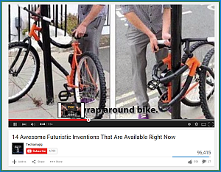
Revision Video 10 futuristic products available now

Slide 32
Sample Edexcel A2 questions

Slide 33
Case study for question 1 slide 1/2

Slide 34
Case study for question 1 slide 2/2

Slide 35
Sample question 1
Knowledge 2
Application 2
Analysis
3
Evaluation
3

Slide 36
Case study for question 2 slide 1/2

Slide 37
Case study for question 2 slide 2/2

Slide 38
Sample question 2
Knowledge 1
Application 2
Analysis
1

Slide 39
Glossary
Function; what the item is used for
Aesthetics; what the item looks like
Resource depletion; reduction in the earth’s natural resources such as precious metals
Waste minimisation; business way of making sure that there is no waste in the production process, for example making other goods from offcuts
Reuse; when a product is reused for example a bag for life
Recycled; when a product is turned into something else, a tin can becomes an airplane part
Ethical sourcing; buying from sustainable sources, for example trees from forest suppliers who replant

